Slide 1
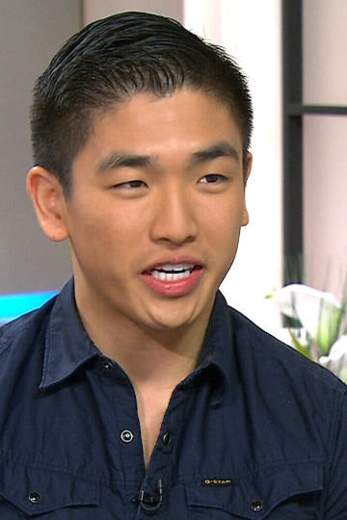
Card 1
Eric Chong
Master Chef Canada winner
Photo date: April 2014
Age 21

Slide 2
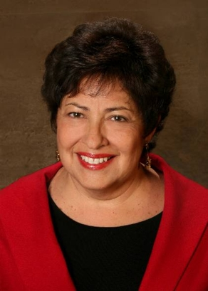
Card 2
Katherine Archuleta
Former U.S. OPM Director
Photo date: 2013
Age 64

Slide 3
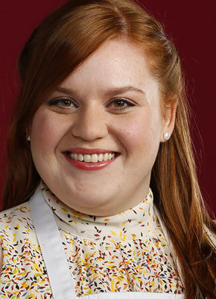
Card 3
Elise Mayfield
Chef, Actor, Baker
Photo date: 2014
Age 28

Slide 4

Card 4
Kevin Love
(then) High School Student
Photo date: June 2014
Age 14

Slide 5
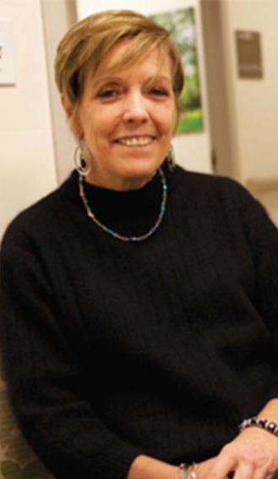
Card 5
Rosemary McGinn
Photo date: July 2013
Age 54

Slide 6
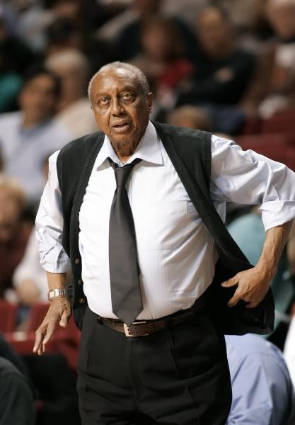
Card 6
John Chaney
Basketball Coach
Photo date: 2006
Age 74

Slide 7
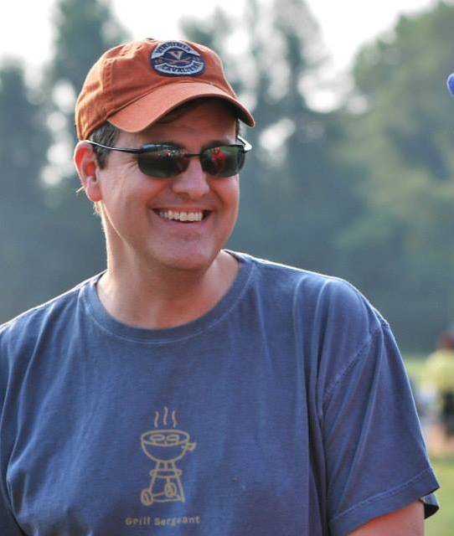
Card 7
David Storm
Photo date: August 2014
Age 44

Slide 8
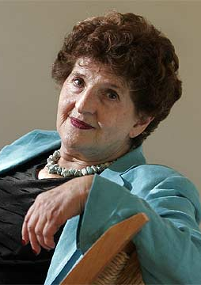
Card 8
Margo Glantz Writer
Photo date: 2013
Age 83

Slide 9
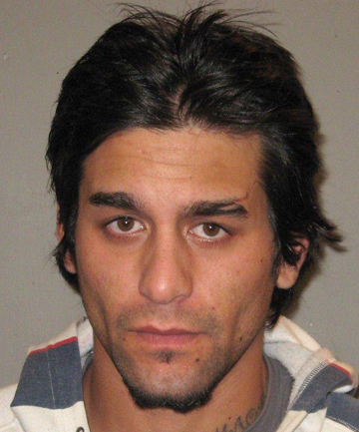
Card 9
Quade Ross Honey Fugitive
Photo date: 2012
Age 24

Slide 10
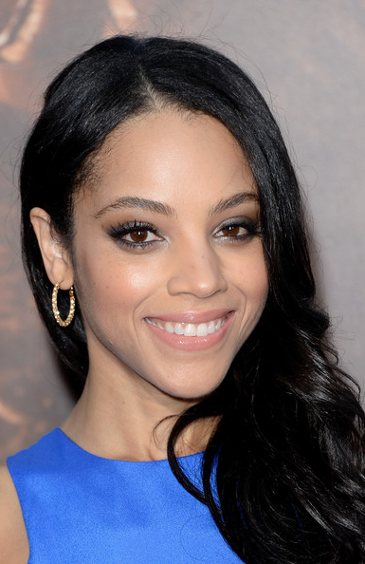
Card 10
Bianca Lawson Actress
Photo date: 2013
Age 34

Slide 11
#1 Age 21 #2 Age 64 #3 Age 28 #4 Age 14 #5 Age 54
2014-2020 Mean Guesses
25.7
52.4
27.5
14.5
54.1
68.6
47.1
74.2
34.5
27.9
#6 Age 74 #7 Age 44 #8 Age 83 #9 Age 24 #10 Age 34

Slide 12
#1 Age 21 #2 Age 64 #3 Age 28 #4 Age 14 #5 Age 54
2014-17 Errors
+4.5
-11.8
-0.7
+0.4
-0.3
-4.9
+2.7
-7.8
+10.1
-7.2
#6 Age 74 #7 Age 44 #8 Age 83 #9 Age 24 #10 Age 34

