Slide 1
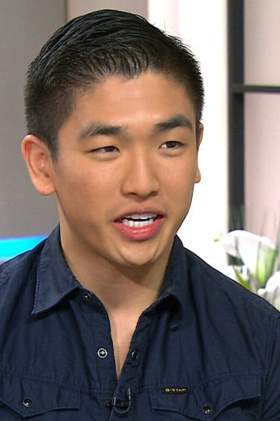
Card 1
Eric Chong
Master Chef Canada winner
Photo date: April 2014
Age 21

Slide 2
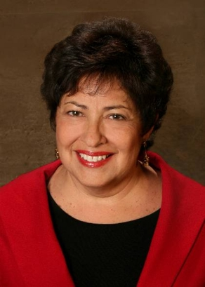
Card 2
Katherine Archuleta
Former U.S. OPM Director
Photo date: 2013
Age 64

Slide 3
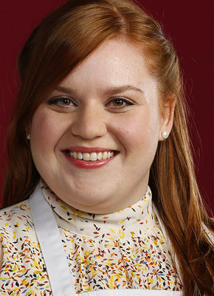
Card 3
Elise Mayfield
Chef, Actor, Baker
Photo date: 2014
Age 28

Slide 4
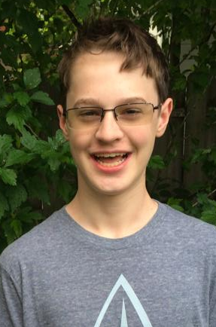
Card 4
Kevin Love
(then) High School Student
Photo date: June 2014
Age 14

Slide 5
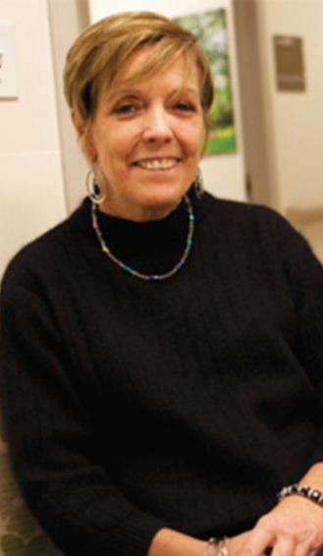
Card 5
Rosemary McGinn
Photo date: July 2013
Age 54

Slide 6
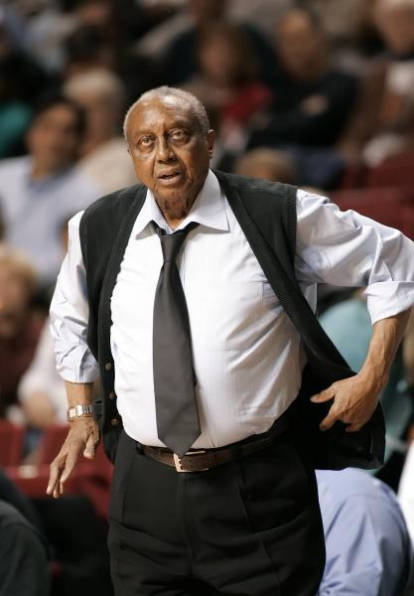
Card 6
John Chaney
Basketball Coach
Photo date: 2006
Age 74

Slide 7
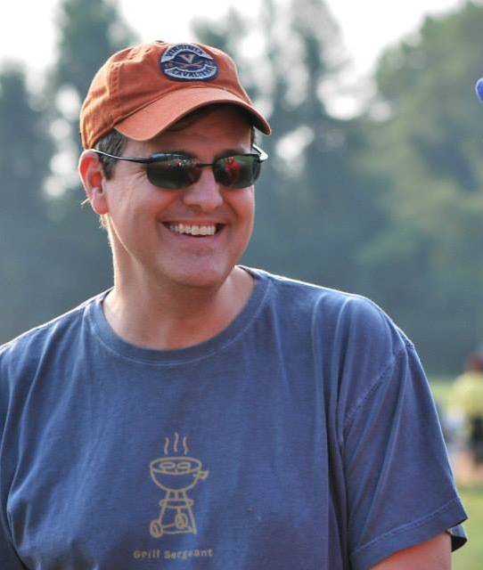
Card 7
David Storm
Photo date: August 2014
Age 44

Slide 8
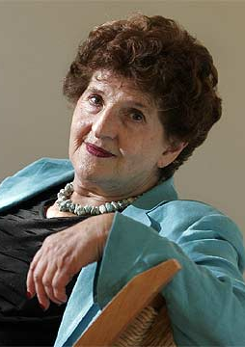
Card 8
Margo Glantz Writer
Photo date: 2013
Age 83

Slide 9
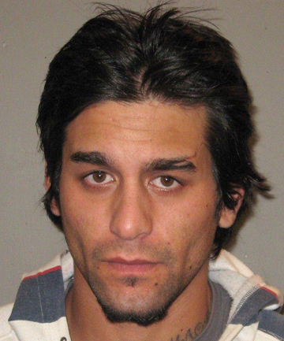
Card 9
Quade Ross Honey Fugitive
Photo date: 2012
Age 24

Slide 10
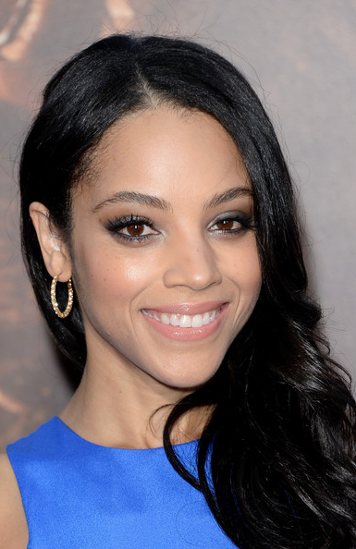
Card 10
Bianca Lawson Actress
Photo date: 2013
Age 34

Slide 11
#1 Age 21 #2 Age 64 #3 Age 28 #4 Age 14 #5 Age 54
2014-17 Errors
+4.5
-11.8
-0.7
+0.4
-0.3
-4.9
+2.7
-7.8
+10.1
-7.2
#6 Age 74 #7 Age 44 #8 Age 83 #9 Age 24 #10 Age 34

Slide 12
2022 Mean
Guesses
#1 Age 21 #2 Age 64 #3 Age 28 #4 Age 14 #5 Age 54
54.3
30.6
16.3
62.4
69.9
50.1
78.2
34.6
30.2
#6 Age 74 #7 Age 44 #8 Age 83 #9 Age 24 #10 Age 34

Slide 13
2022 Mean
Guesses
#1 Age 21 #2 Age 64 #3 Age 28 #4 Age 14 #5 Age 54
27.4
54.3
30.6
16.3
62.4
69.9
50.1
78.2
34.6
30.2
#6 Age 74 #7 Age 44 #8 Age 83 #9 Age 24 #10 Age 34

Slide 14
#1 Age 21 #2 Age 64 #3 Age 28 #4 Age 14 #5 Age 54
2 | 2446789
3 | 25
Mean: 27.4
4 | 88
5 | 03368
6 | 03
Mean: 54.3
2 | 779
3 | 012234
Mean: 30.6
1 | 44455678
2 | 4
Mean: 16.3
5 | 08
6 | 02255
7 | 00
Mean: 62.4
2022
Group Guesses

Slide 15
#6 Age 74 #7 Age 44 #8 Age 83 #9 Age 24 #10 Age 34
6 | 4458
7 | 03555
Mean: 69.9
4 | 45588
5 | 003
6 | 8
Mean: 50.1
7 | 2369
8 | 00112
Mean: 78.2
2 | 9
3 | 34555677
Mean: 34.6
2 | 2489
3 | 0115
4 | 2
Mean: 30.2
2022
Group Guesses

Slide 16
#1 Age 21 #2 Age 64 #3 Age 28 #4 Age 14 #5 Age 54
2 | 5556789
3 | 33
Mean: 27.9
4 | 9
5 | 02244556
Mean: 53.0
2 | 379
3 | 112234
Mean: 30.2
1 | 446667777
Mean: 16.0
5 | 69
6 | 0113455
Mean: 61.6
2023
Group Guesses

Slide 17
#6 Age 74 #7 Age 44 #8 Age 83 #9 Age 24 #10 Age 34
6 | 68
7 | 0124557
Mean: 72.0
4 | 2366788
5 | 33
Mean: 47.3
7 | 4589
8 | 00001
Mean: 78.6
3 | 001223558
Mean: 32.9
2 | 1577
3 | 01224
Mean: 28.8
2023
Group Guesses

Slide 18
#1 Age 21 #2 Age 64 #3 Age 28 #4 Age 14 #5 Age 54
2 | 2234
2 | 55555678
3 | 2
Mean Guess: 25.3
Mean |Error| = 4.3
AI Guess = 21
AI |Error| = 0
4 | 3
5 | 3345689
6 | 00223
Mean Guess: 56.7
Mean |Err| = 7.2
AI Guess = 49
AI |Err| = 15
2 | 778
3 | 12222223
3 | 55
Mean Guess: 31.3
Mean |Err| = 3.7
AI Guess = 27
AI |Err| = 1
1 | 24444
1 | 55556778
Mean Guess: 15.1
Mean |Err| = 1.4
AI Guess = 18
AI |Err| = 4
5 | 16
6 | 01223
6 | 7788
7 | 0
Mean Guess: 63.5
Mean |Err| = 9.9
AI Guess = 49
AI |Err| = 5
2024
Group Guesses

Slide 19
#6 Age 74 #7 Age 44 #8 Age 83 #9 Age 24 #10 Age 34
6 | 889
7 | 02233
7 | 55788
Mean Guess: 72.9
Mean |Error| = 3.1
AI Guess = 66
AI |Error| = 8
4 | 33
4 | 56677889
5 | 012
Mean Guess: 47.3
Mean |Err| = 3.6
AI Guess = 34
AI |Err| = 10
7 | 0
7 | 558
8 | 000044
8 | 557
Mean Guess: 80.2
Mean |Err| = 4.3
AI Guess = 68
AI |Err| = 15
2 | 77
3 | 002234
3 | 6789
4 | 0
Mean Guess: 33.5
Mean |Err| = 9.5
AI Guess = 30
AI |Err| = 6
2 | 66799999
3 | 1345
4 | 0
Mean Guess: 30.5
Mean |Err| = 4.5
AI Guess = 28
AI |Err| = 6
2024
Group Guesses

