Slide 1
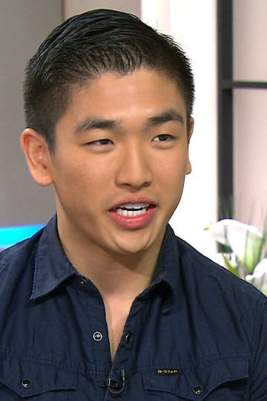
Card 1
Eric Chong
Master Chef Canada winner
Photo date: April 2014
Age 21

Slide 2
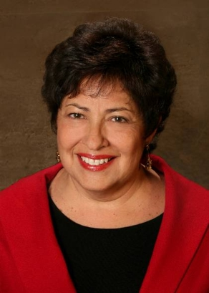
Card 2
Katherine Archuleta
Former U.S. OPM Director
Photo date: 2013
Age 64

Slide 3
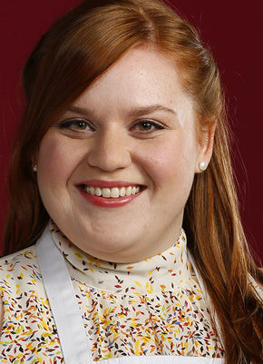
Card 3
Elise Mayfield
Chef, Actor, Baker
Photo date: 2014
Age 28

Slide 4
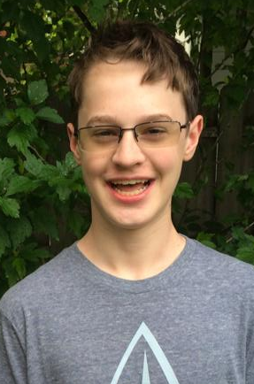
Card 4
Kevin Love
(then) High School Student
Photo date: June 2014
Age 14

Slide 5
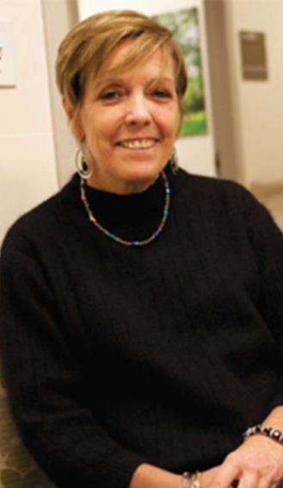
Card 5
Rosemary McGinn
Photo date: July 2013
Age 54

Slide 6
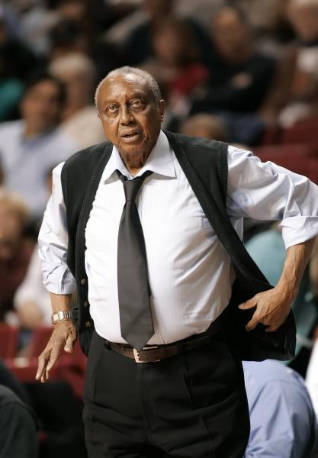
Card 6
John Chaney
Basketball Coach
Photo date: 2006
Age 74

Slide 7
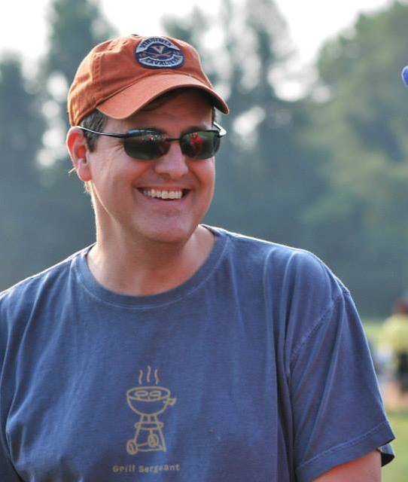
Card 7
David Storm
Photo date: August 2014
Age 44

Slide 8
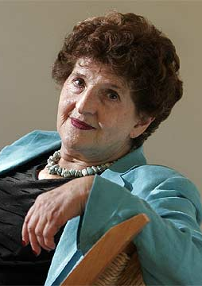
Card 8
Margo Glantz Writer
Photo date: 2013
Age 83

Slide 9
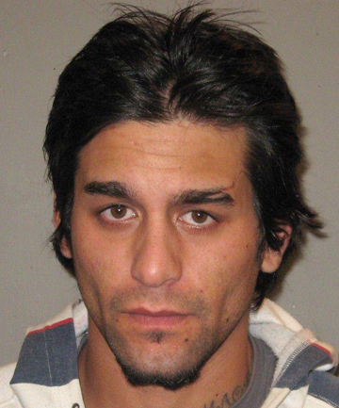
Card 9
Quade Ross Honey Fugitive
Photo date: 2012
Age 24

Slide 10
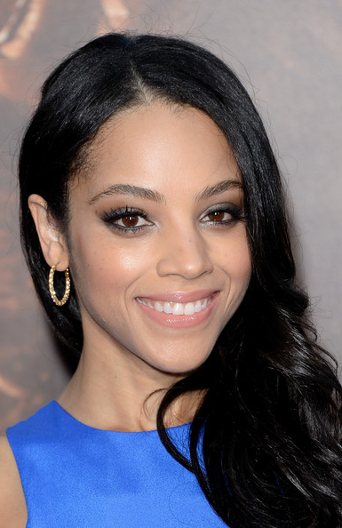
Card 10
Bianca Lawson Actress
Photo date: 2013
Age 34

Slide 11
#1 Age 21 #2 Age 64 #3 Age 28 #4 Age 14 #5 Age 54
#6 Age 74 #7 Age 44 #8 Age 83 #9 Age 24 #10 Age 34

Slide 12
2014-23 Mean
Guesses
#1 Age 21 #2 Age 64 #3 Age 28 #4 Age 14 #5 Age 54
26.1
52.7
28.2
14.9
56.4
69.3
47.4
75.4
34.3
28.5
#6 Age 74 #7 Age 44 #8 Age 83 #9 Age 24 #10 Age 34

Slide 13
#1 Age 21 #2 Age 64 #3 Age 28 #4 Age 14 #5 Age 54
2014-23 Mean Errors
+5.1
-11.3
+0.2
+0.9
+2.4
-4.7
+3.4
-7.6
+10.3
-5.5
#6 Age 74 #7 Age 44 #8 Age 83 #9 Age 24 #10 Age 34

Slide 14
2024 AI Guesses
#1 Age 21 #2 Age 64 #3 Age 28 #4 Age 14 #5 Age 54
21
49
27
18
49
66
34
68
30
28
#6 Age 74 #7 Age 44 #8 Age 83 #9 Age 24 #10 Age 34
https://howolddoyoulook.com/

Slide 15

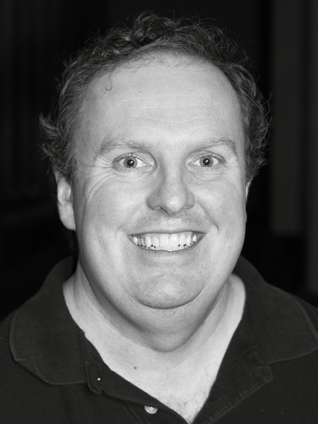
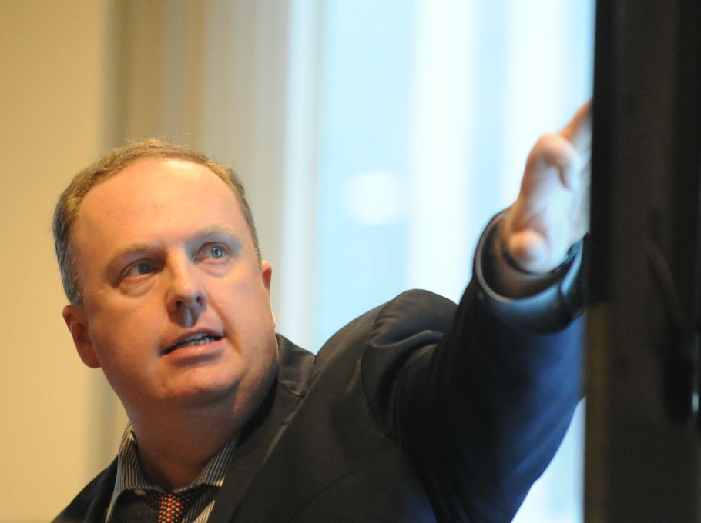
2020
2014
2018
6 years too young
12 years too young
One year too young
https://howolddoyoulook.com/
AI guesses made on 2024-08-26

