Slide 1
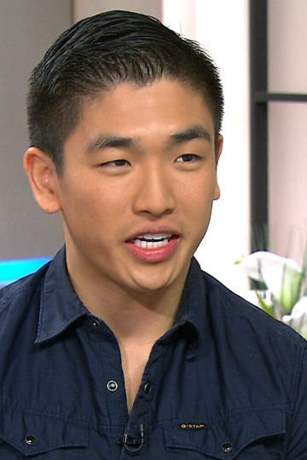
Card 1
Eric Chong
Master Chef Canada winner
Photo date: April 2014
Age 21

Slide 2
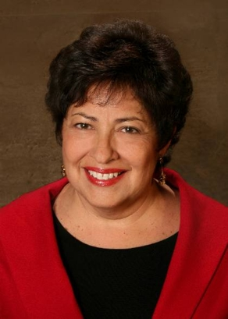
Card 2
Katherine Archuleta
Former U.S. OPM Director
Photo date: 2013
Age 64

Slide 3
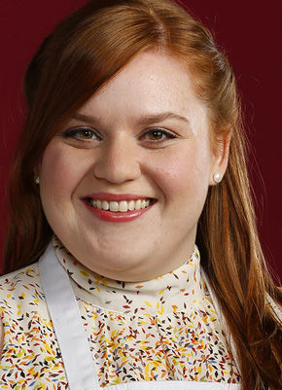
Card 3
Elise Mayfield
Chef, Actor, Baker
Photo date: 2014
Age 28

Slide 4
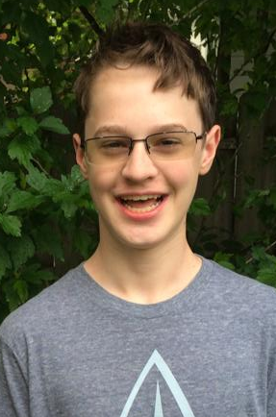
Card 4
Kevin Love
(then) High School Student
Photo date: June 2014
Age 14

Slide 5
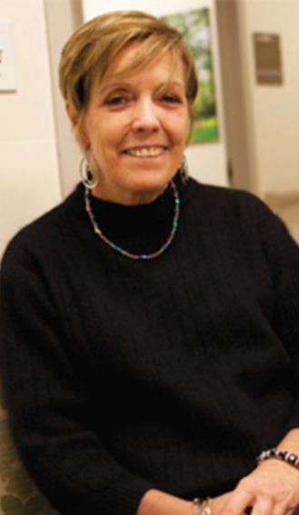
Card 5
Rosemary McGinn
Photo date: July 2013
Age 54

Slide 6
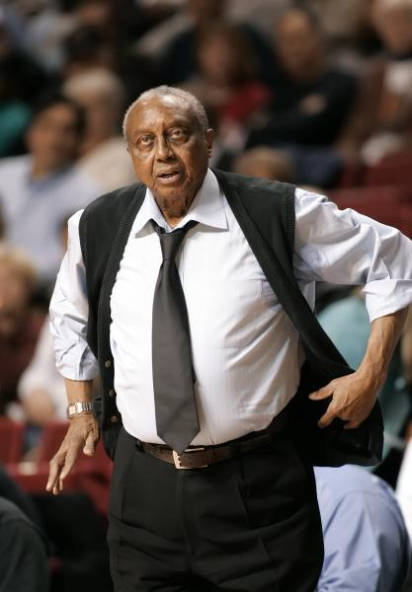
Card 6
John Chaney
Basketball Coach
Photo date: 2006
Age 74

Slide 7
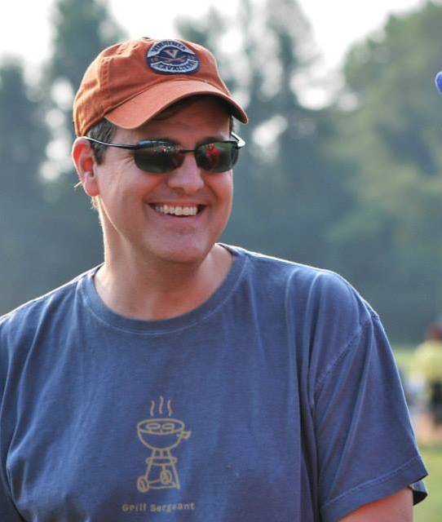
Card 7
David Storm
Photo date: August 2014
Age 44

Slide 8
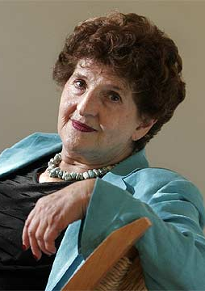
Card 8
Margo Glantz Writer
Photo date: 2013
Age 83

Slide 9
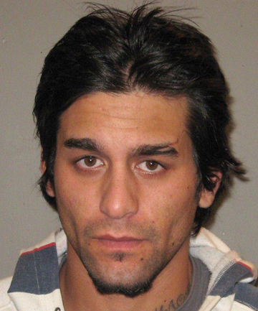
Card 9
Quade Ross Honey Fugitive
Photo date: 2012
Age 24

Slide 10
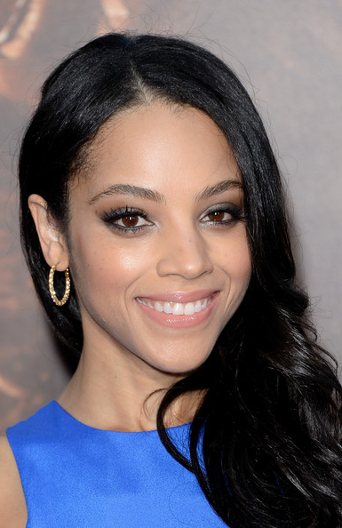
Card 10
Bianca Lawson Actress
Photo date: 2013
Age 34

Slide 11
#1 Age 21 #2 Age 64 #3 Age 28 #4 Age 14 #5 Age 54
#6 Age 74 #7 Age 44 #8 Age 83 #9 Age 24 #10 Age 34

Slide 12
2014-24 Mean
Guesses
#1 Age 21 #2 Age 64 #3 Age 28 #4 Age 14 #5 Age 54
26.0
53.1
28.5
14.9
57.0
69.6
47.4
75.8
34.2
28.7
#6 Age 74 #7 Age 44 #8 Age 83 #9 Age 24 #10 Age 34

Slide 13
#1 Age 21 #2 Age 64 #3 Age 28 #4 Age 14 #5 Age 54
2014-24 Mean Errors
+5.0
-10.9
+0.5
+0.9
+3.0
-4.4
+3.4
-7.2
+10.2
-5.3
#6 Age 74 #7 Age 44 #8 Age 83 #9 Age 24 #10 Age 34

Slide 14
2025 AI Guesses
#1 Age 21 #2 Age 64 #3 Age 28 #4 Age 14 #5 Age 54
26
55
23
21
45
62
32
69
29
26
#6 Age 74 #7 Age 44 #8 Age 83 #9 Age 24 #10 Age 34
https://howolddoyoulook.com/

Slide 15

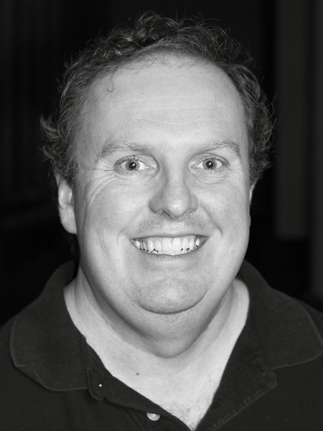
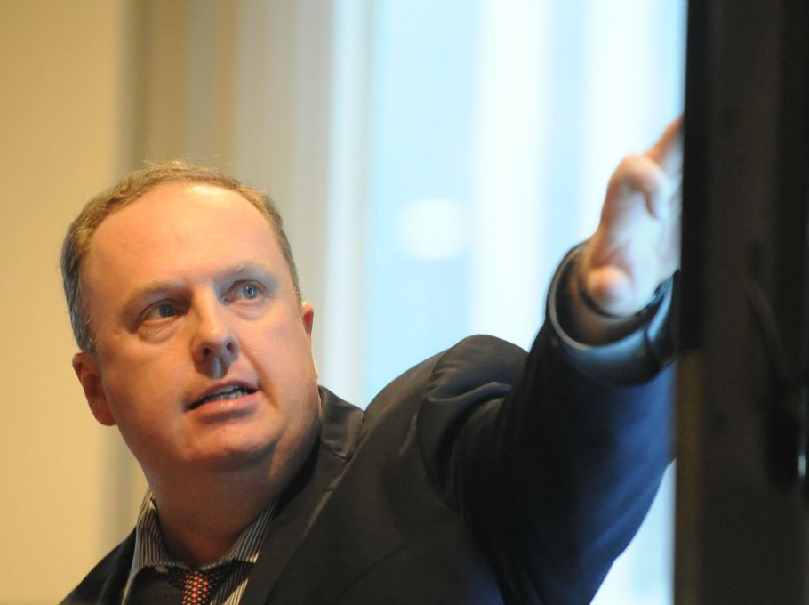
2020
2014
2018
6 years too young
12 years too young
One year too young
https://howolddoyoulook.com/
AI guesses made on 2024-08-26

