Slide 1

FRONTEND WEB DEVELOPMENT
www.techvedika.com

Slide 2
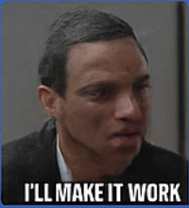
Agenda
1. Introduction to Front-End Development
2. HTML Fundamentals
3. CSS Overview
4. Bootstrap Framework
5. SCSS Preprocessor
6. Comparison on CSS vs SCSS
7. Future Trends & Conclusion

Slide 3
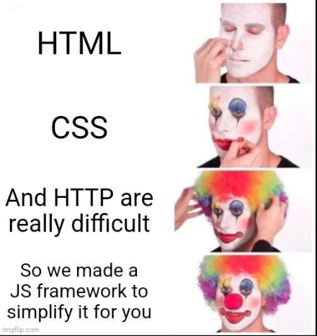
Introduction to Front-End Development
Definition: Creating visual elements of a website users interact with.
Core Goals:
Enhance User Experience
Ensure Responsiveness
Improve Accessibility
Maintain Performance

Slide 4
What is HTML?
HyperText Markup Language structures web content.
Defines headings, paragraphs, links, images, tables and forms.

Slide 5
Core HTML Concepts
HTML Tags & Attributes
Semantic Elements (<header>, <footer>, <article>)
Forms & Input Elements
Multimedia: <audio>, <video>
Linking External Resources

Slide 6
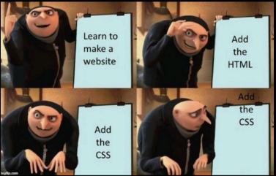
What is CSS?
CSS styles and formats web content.
Controls layout, color, typography, spacing, and animations.
Works with HTML for responsive and aesthetic designs.

Slide 7
Core CSS Concepts
Selectors, Properties, Values
Box Model: margin, border, padding, content
Positioning: relative, absolute, fixed
Flexbox & Grid Layouts
Media Queries for Responsiveness

Slide 8
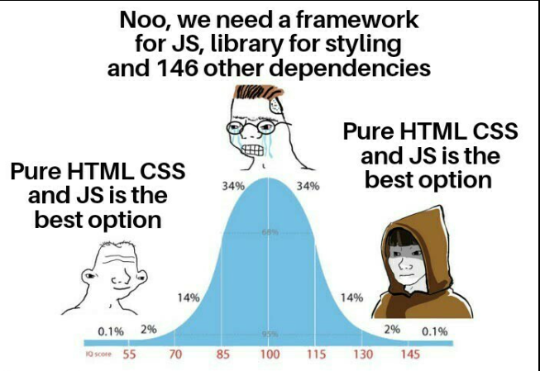
Advanced CSS Features
CSS Variables
Transitions & Animations
Pseudo-classes & Pseudo-elements
Custom Fonts (Google Fonts)
Dark Mode Styling

Slide 9
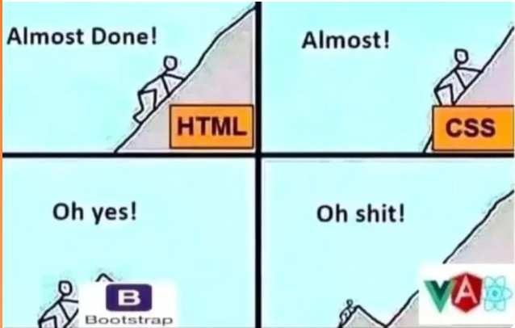
What is Bootstrap?
Open-source front-end framework.
Pre-designed components + responsive grid system.
Simplifies UI development and ensures browser consistency.

Slide 10
Key Bootstrap Components
Grid System (12-column layout)
Navbar, Cards, Buttons, Forms
Modals, Alerts, Carousels
Utility Classes: spacing, colors, typography

Slide 11
What is SCSS (SASS)?
Preprocessor scripting language extending CSS.
Adds variables, nesting, mixins, and functions.
Compiled into regular CSS.

Slide 12
SCSS Features & Advantages
Variables for consistent styling
Nesting for cleaner syntax
Partials & Imports for modular code
Mixins for reusability
Inheritance & Functions

Slide 13
CSS vs SCSS
CSS: Simple, direct, but limited structure.
SCSS: Programming-like capabilities, efficient, maintainable.

Slide 14
Conclusion & Future Trends
HTML, CSS, Bootstrap, SCSS = foundation of UI.
Future trends: CSS Grid Level 3, Container Queries, Variable Fonts, AI-driven design tools.
Quote: “Great UI is where design meets technology seamlessly.”

