Slide 1

www.techvedika.com

Slide 2
Agenda
1. Introduction to Front-End Development
2. HTML Fundamentals
3. CSS Overview
4. Bootstrap Framework
5. SCSS Preprocessor

Slide 3
Introduction to Front-End Development
Front-end development focuses on creating the visual elements of a website that users interact with directly.
Core Goals:
• Enhance user experience
• Ensure responsiveness
• Improve accessibility
• Maintain performance

Slide 4
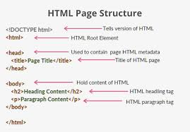
What is HTML ?
HTML structures/skeleton of the webpage
Document Structure: <!DOCTYPE html>, <html>,<head>, <body>
Defines headings, paragraphs, links, images, and other elements.
Forms the backbone of all web pages.

Slide 5
Core HTML Concepts
• HTML Tags & Attributes
• Semantic Elements (<header>, <footer>,<article>)
• Forms & Input Elements
• Multimedia: <audio>, <video>, <img>, <picture>, <a>
• Tables and Lists
• Advanced Html Concepts: Canvas, svg, geoLocation, Drag& Drop,etc...

Slide 6
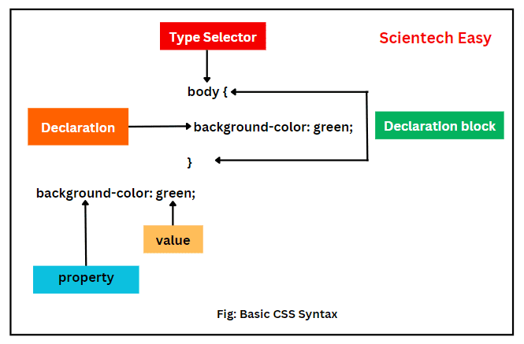
What is CSS ?
• CSS styles and formats web content.
• Controls layout, color, spacing,typography, and animations.
• Works with HTML for responsive and aesthetic designs.

Slide 7
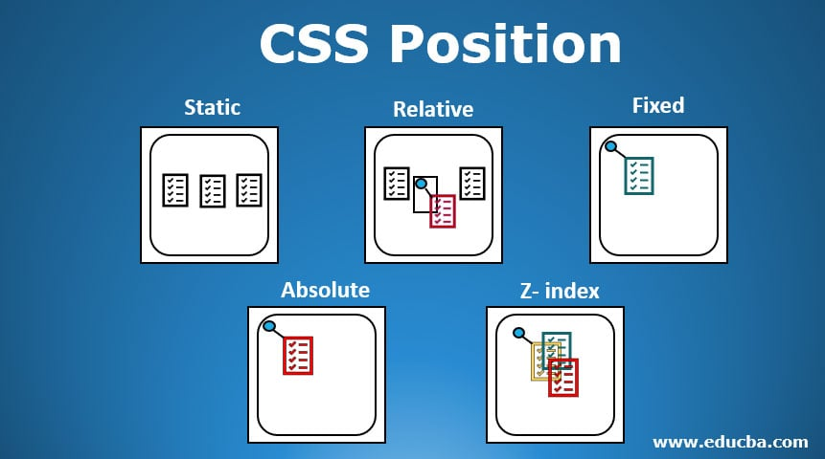
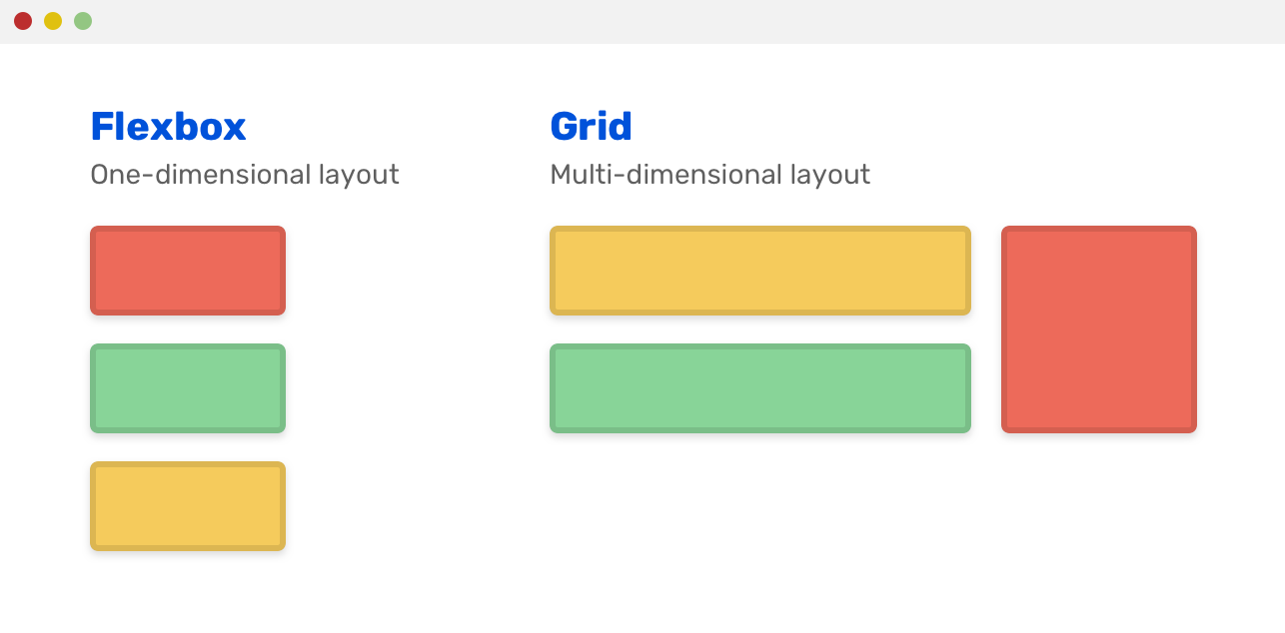
CSS Core Concepts
Selectors, Properties, Values
Box Model: margin, border, padding,content
Positioning: relative, absolute, fixed
Flexbox & Grid Layouts
Media Queries for Responsiveness

Slide 8
Advanced CSS Features
CSS Variables (property:var(--value))
Transitions & Animations
Pseudo-classes & Pseudo-elements
Custom Fonts (Google Fonts)
Dark Mode Styling

Slide 9
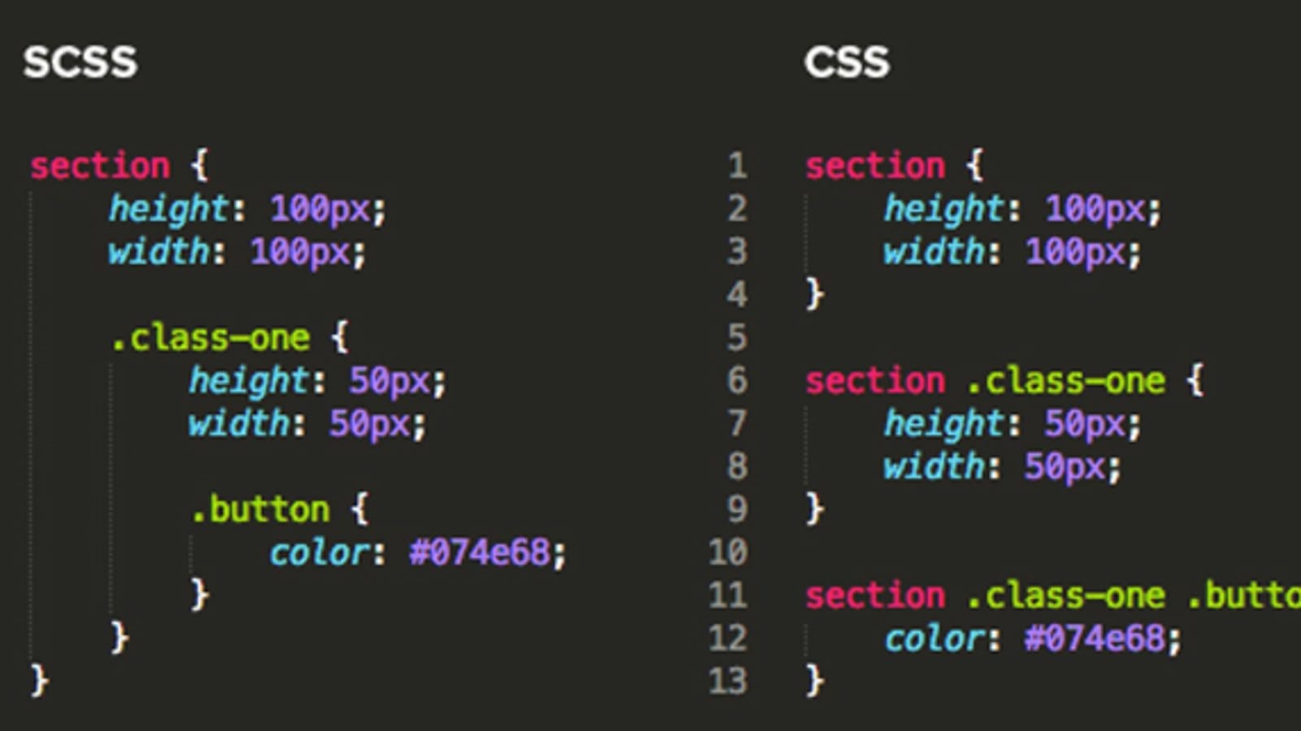
What is SCSS (SASS)?
• Preprocessor scripting language extending CSS.
• Adds variables, nesting, mixins, and functions.
• Compiled into regular CSS.

Slide 10
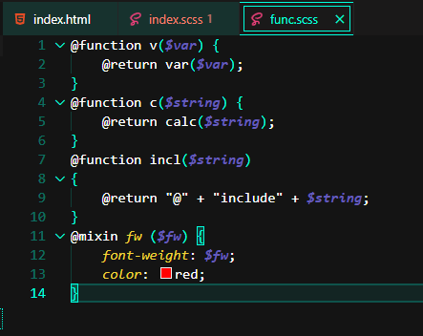
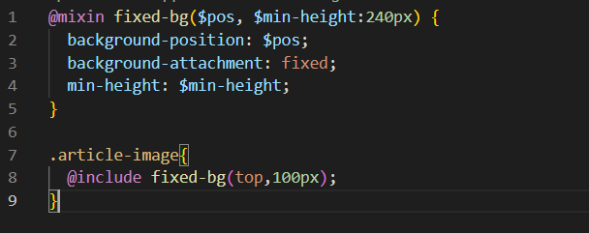
SCSS Features & Advantages
• Variables for consistent styling
• Nesting for cleaner syntax
• Partials & Imports for modular code
• Mixins for reusability
• Inheritance & Functions

Slide 11
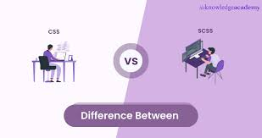
CSS vs SCSS
CSS: Simple, direct, but limited structure.
SCSS: Programming-like capabilities, efficient, maintainable.

Slide 12
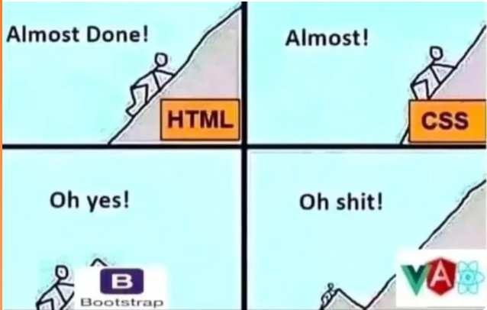
What is Bootstrap?
Open-source front-end framework.
Pre-designed components + responsive grid system.
Simplifies UI development and ensures browser consistency.

Slide 13
Key Bootstrap Components
Grid System (12-column layout)
• Navbar, Cards, Buttons, Forms
• Modals, Alerts, Carousels
• Utility Classes: spacing, colors,
typography

