Slide 1


DEPARTMENT OF COMPUTER SCIENCE AND ENGINEERING
TITLE:URBAN PULSE
Under the Guidance of
Dr. K.VINOD KUMAR
M.Tech(JNTU-A), Ph.D
Assistant Professor
T.GANESH - (R200007)
M.KOWSHIK- (R200272)
S.SOHAIL-(R200088)

Slide 2
Abstract
The UrbanPulse project is conceived as a comprehensive digital civic platform specifically designed to address the pressing challenges of fragmented municipal services in urban environments. Currently, citizens often face inconvenience and inefficiency when attempting to access various local government services due to the lack of a single, unified interface. This leads to difficulties in everything from reporting civic issues and tracking their resolution to accessing timely information about local events, government schemes, and essential public data.
UrbanPulse directly confronts these issues by proposing a singular, accessible platform that aggregates diverse municipal functions. The core objective is to build a robust digital bridge between the government administration and the citizenry, fostering enhanced communication, transparency, and participation. By providing a streamlined and intuitive user experience.
UrbanPulse aims to simplify citizen interactions with services like complaint management, event notifications, access to public data (including census reports), utility bill reminders, and information on local landmarks and government representatives.

Slide 3
Introduction
What is UrbanPulse?
UrbanPulse is presented as a digital civic platform.
Its primary function is to provide a unified experience for citizens, allowing them to access various municipal services through a single platform.
Goal:
The main objective is to improve the connection between the government and its citizens by leveraging technology.
Background and Importance:
The need for UrbanPulse arises from the challenges in existing urban systems.
Its importance lies in offering a unified and streamlined way for citizens to interact with municipal services, which were previously fragmented.

Slide 4
Challenges in Existing Urban Systems
Fragmented platforms: Municipal services are often spread across multiple, disconnected platforms.
No unified complaint redressal: Citizens lack a single point to register and track complaints across different categories like plumbing, electrical, or water issues
Lack of digital event notifications: Information about local events and festivals is not easily accessible digitally.
Difficulties in locating landmarks and facilities: Finding information and locations of important places can be hard.
Inconvenient utility bill payments: Paying bills for services like electricity, water, etc., is often a cumbersome process.
Inaccessibility of government schemes, tenders, and representatives: Information about government initiatives and who represents citizens is not readily available.
Limited access to data: Public data like census reports and statistics are not easily accessible to citizens.

Slide 5
Objectives of UrbanPulse
Easy complaint registration and tracking.
Admin-managed system for event and festival notifications.
Display of landmarks and tourism points with details and user reviews.
Unified utility bill reminders.
Access to historical and cultural insights.
Platform to publish tenders and government updates related to business.
Directory of government representatives.
Display of census and demographic insights.
System for scheduling appointments for office visits.
Feature for submitting Right to Information (RTI) requests.
Review system for public places to gather community feedback.

Slide 6
Technologies Used
Frontend: React.js for building the user interface and Tailwind CSS for styling and responsive design.
Backend: Node.js / Express.js or Firebase SDK for handling server-side logic and APIs.
Database: MongoDB / Firebase Firestore for storing and managing application data.
Map Integration: Google Maps / Leaflet.js for incorporating mapping functionalities.
Authentication: Firebase Authentication for managing user logins and security.
Notifications: Firebase Notifications / custom backend scheduler for sending alerts and updates to users.
Hosting: Vercel and OnRender Hosting for deploying the web application.

Slide 7
Key Features:
Complaint management system: Allows users to submit complaints categorized for proper routing and tracking.
Notification and alert system: Keeps users informed about events, updates, and bill reminders.
Locality map view and scrolling highlights: Provides a geographical view with highlighted points of interest.
Utility bill management and reminders: Helps users manage and remember to pay utility bills.

Slide 8
Tenders, history, census, and government updates: Centralized access to various types of public information.
Office request and RTI services: Facilitates scheduling office visits and submitting RTI requests.
Chatbot for quick support: Provides immediate assistance to users with common queries.
Community engagement via reviews and ratings: Allows users to provide feedback on public places.

Slide 9
Methodology
A systematic and phased methodology was employed.
It combined several key practices: user-centric research to understand citizen needs, agile planning for flexibility, modern development practices for efficient coding, and iterative testing throughout the process.
The development was structured into distinct phases:
Requirement analysis: Defining what the system needs to do.
Planning: Organizing the development process.
Development: Building the actual application.

Slide 10
System Architecture & Design
Multi-layered architecture (3-tier): The system is divided into three distinct layers for better organization and separation of concerns.
Presentation Layer: The user interface built with Frontend technologies (React.js).
Logic Layer: Handles the application's business logic and data processing using Backend technologies (Firebase Functions/Express.js).
Data Layer: Manages data storage and retrieval using the Database (Firestore/MongoDB).
Modular component design: The system is built using independent, reusable components.

Slide 11
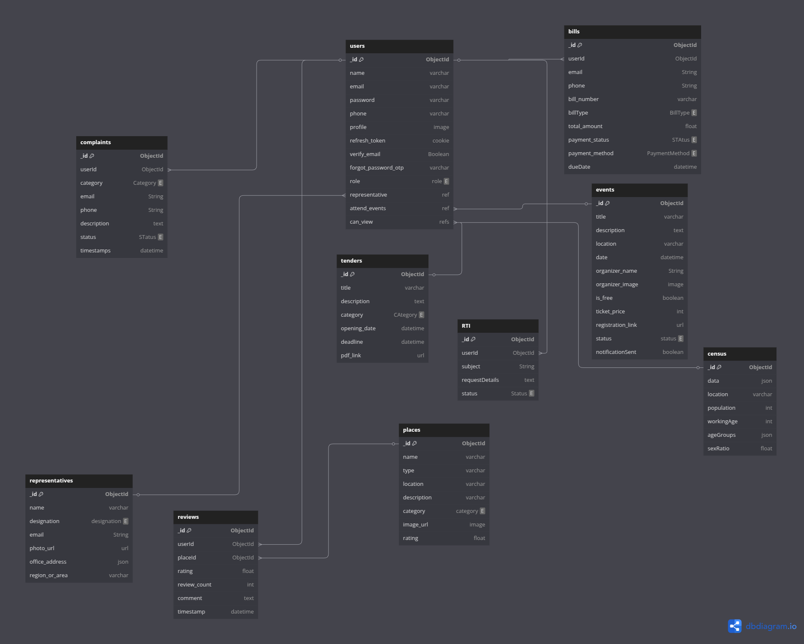
DataBase Schema

Slide 12
Implementation
Frontend Development: Describes the creation of the user interface using React.js and applying styling with Tailwind CSS for a responsive design that works across different devices.
Backend Development: Explains the development of the server-side logic and APIs using Firebase Functions or Node.js/Express.js to handle requests from the frontend and interact with the database.
Database Design: Focuses on setting up the database using Firebase Firestore (or MongoDB) to efficiently manage dynamic data like user profiles, complaints, and notifications.

Slide 13
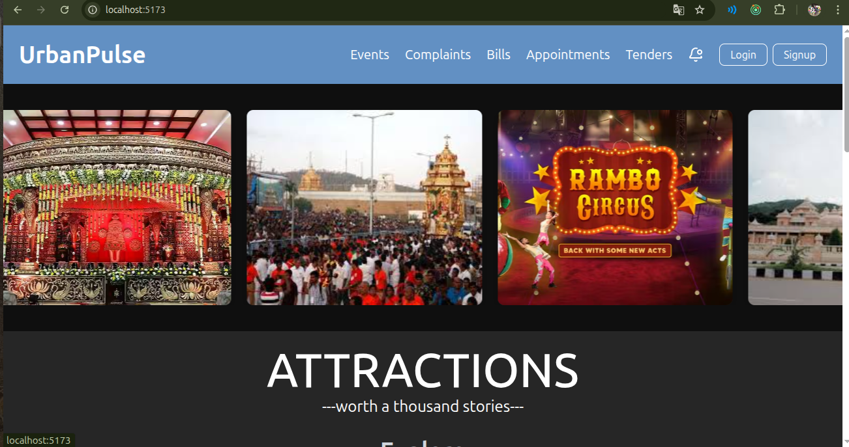
Home Page

Slide 14
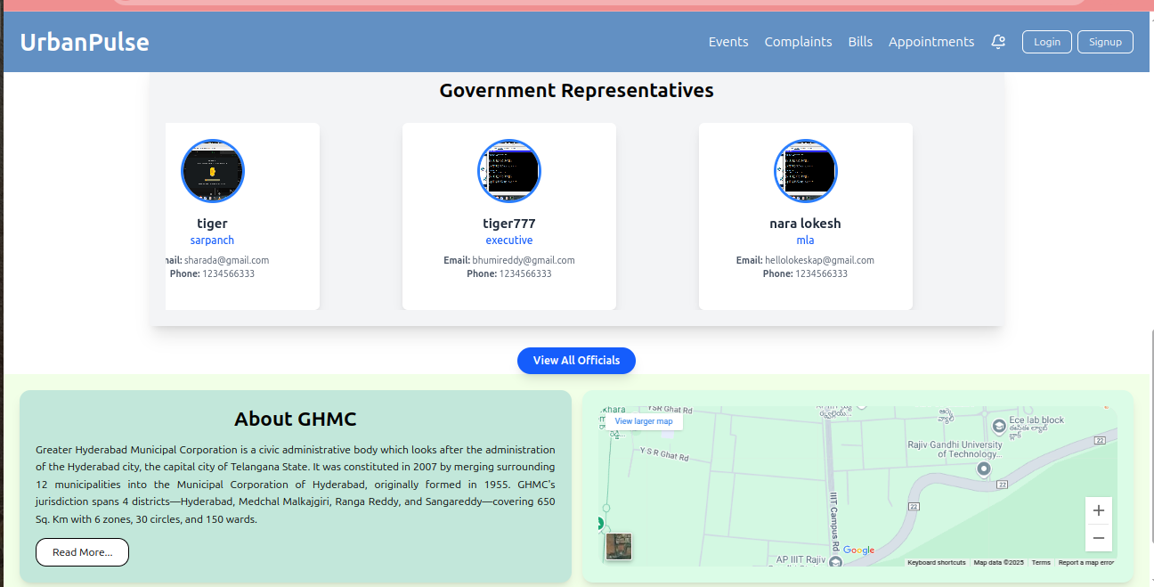
Home Page

Slide 15
Home Page Description:
The home page of UrbanPulse would likely serve as the central hub and the primary entry point for citizens accessing the platform. Its main goal would be to provide users with quick and intuitive access to the various municipal services and information offered.
A prominent search bar or navigation: Allowing users to quickly find specific services, information, or locations.
Quick links or icons for key modules: Providing direct access to the most frequently used features, such as:
Complaint Management
Utility Bill Payments/Reminders

Slide 16
Home Page Description:
A locality map view or section: Possibly featuring "scrolling highlights" of important landmarks, tourist spots, or public facilities as mentioned in the features. This could offer a visual and interactive element.
Sections displaying important updates or notifications: Highlighting recent government announcements, upcoming events, or reminders.
Access points to other information categories: Links or menus to explore tenders, historical data, census reports, and the government representatives directory.

Slide 17
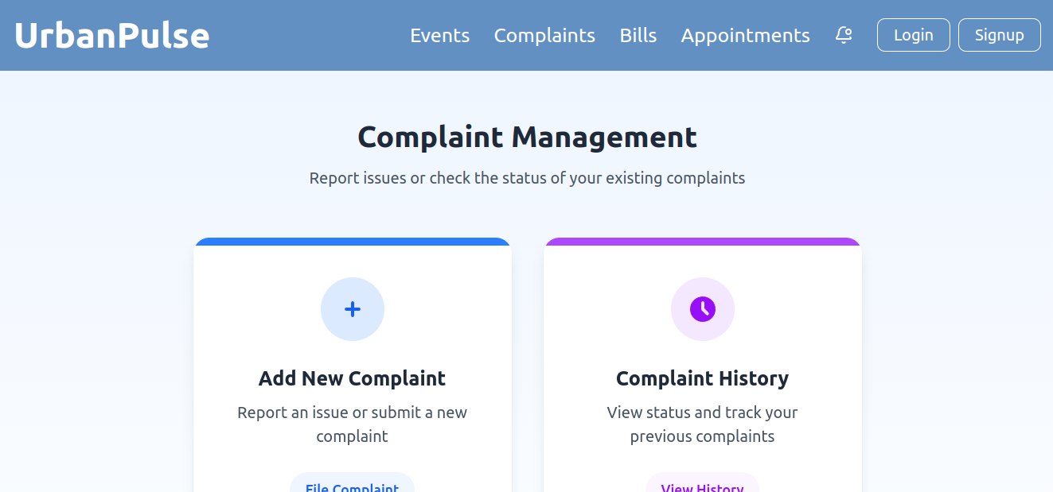
Complaint Management

Slide 18
Complaints Description: The Complaint Management module allows citizens to report complaints related to municipal services such as plumbing, electrical issues, water supply, and more. The module is designed to streamline the entire process, from complaint submission to resolution.
Complaint Categories: Users can submit complaints under various categories (plumbing, electrical, water supply, etc.), ensuring that the issue is routed to the correct department.
Complaint Tracking: Each complaint is assigned a unique ID, and users can track the status of their complaints in real-time. Admins are able to update the status of the complaint, and citizens are notified when the issue is resolved.
Admin Control: Admins can view and manage all complaints.

Slide 19
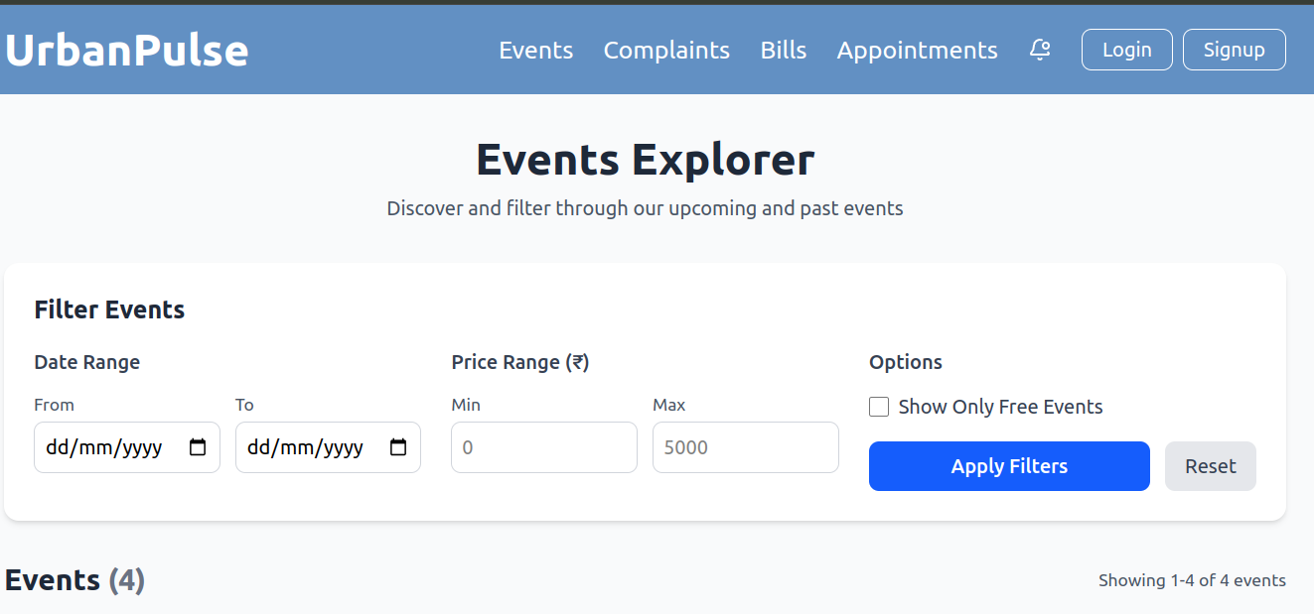
Events Explorer:

Slide 20
Events Description: The Event Notification module serves as a communication channel between the local government and the citizens regarding upcoming events, festivals, government programs, and public activities. It provides an easy way to keep the public informed and engaged with local events. Admin Managed:Admins have the ability to create event notifications, which can be tailored to specific areas or the entire locality.
Broadcasting: Notifications can be broadcast to all users or specific groups, ensuring that the right information reaches the right people.
Real-Time Notifications: Citizens receive timely notifications about events, ensuring they never miss out on local happenings.
User Interaction: Citizens can interact with the notifications, marking events as ‘interested’ or adding them to a personal calendar.

Slide 21
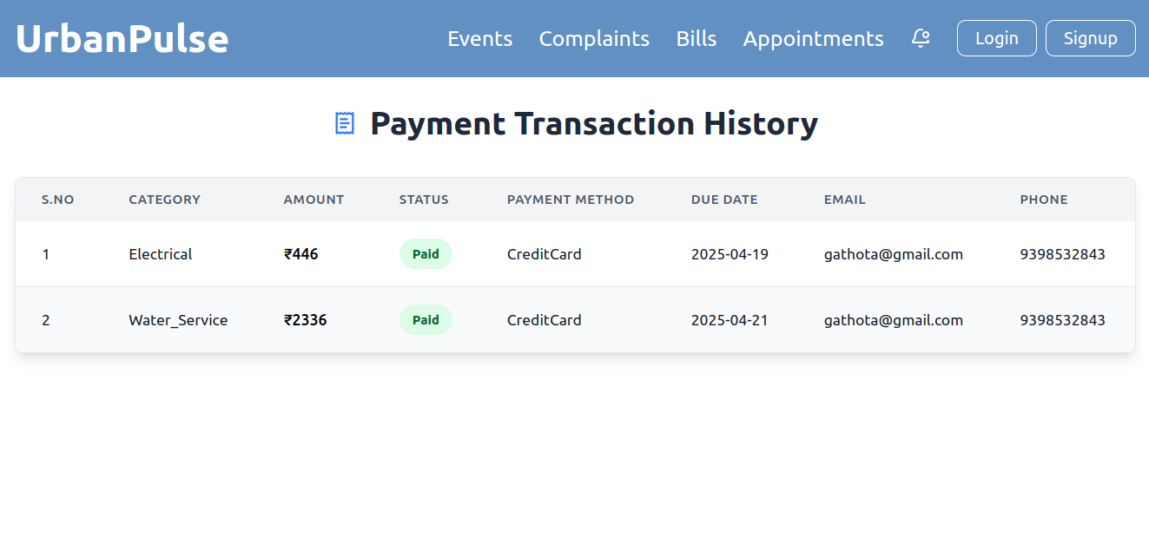
Bills Integration:

Slide 22
Bills Description: The Utility Bill Integration module consolidates all government-related utility bills such as property tax, water, electricity, and more into a unified platform, offering users a simple and efficient way to manage their payments. Bill Reminders: Users receive automated reminders for upcoming bill payments, preventing late fees and missed deadlines.
Payment Integration: Users can make payments directly through the platform (via integration with payment gateways) or opt for external payment systems, streamlining the process.
Bill History: The module keeps track of users’ past payments, offering easy access to their payment history for reference and record-keeping.
Admin Control: Admins can update and track utility bills for citizens and manage any issues related to incorrect charges or payments.

Slide 23
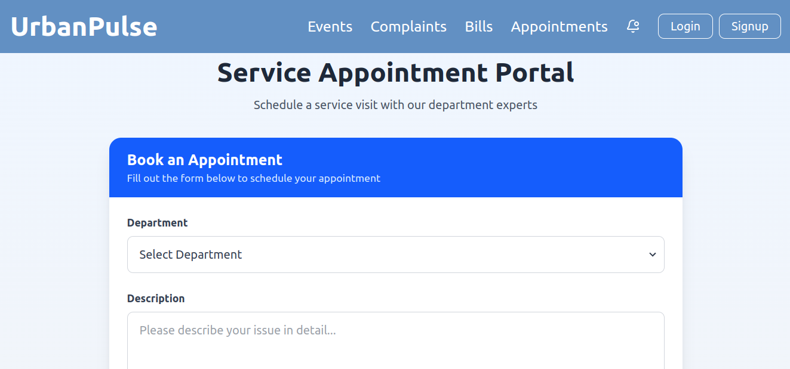
Appointments Scheduling:

Slide 24
Appointments Description: This module enables citizens to request appointments with government officers for specific services or consultations. Appointment Booking: Users can submit appointment requests for services like document verification, complaint resolution, or consultation with local officials.
Admin Approval: Admins review and approve appointments, assigning specific times and dates for meetings.
Notifications: Both users and officials receive notifications confirming or reminding them of the scheduled appointments.

Slide 25
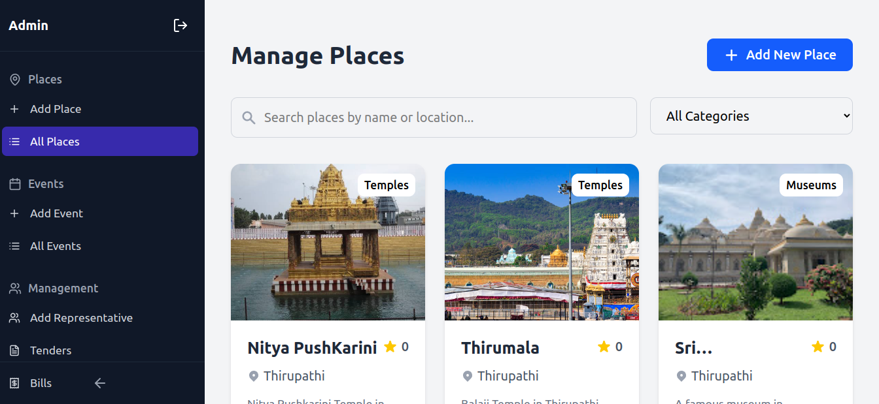
Admin Dashboard:

Slide 26
Admin Panel Description:
Place Management:
Admins can add and manage tourist or cultural locations such as temples, museums, and landmarks. Each place includes category tags, location details, and visibility settings for users. Places can be searched and filtered by name or category.
Event Management:
Admins can schedule and manage local events like festivals, public gatherings, and cultural programs. Events are categorized, and their details (date, venue, and description) are maintained for public visibility.
Representative Management:
Admins can assign or add local representatives responsible for specific areas or services. This ensures accountability and better coordination between departments and the public.

Slide 27
Admin Panel Description:
Tender Management:
Admins can oversee tender-related activities for public works or service contracts. Tender details, deadlines, and bidder information are maintained securely for transparency and compliance.
Bill Monitoring:
Allows admins to track payment records, outstanding dues, and billing cycles for various civic services. Helps ensure financial oversight and timely follow-ups.

Slide 28
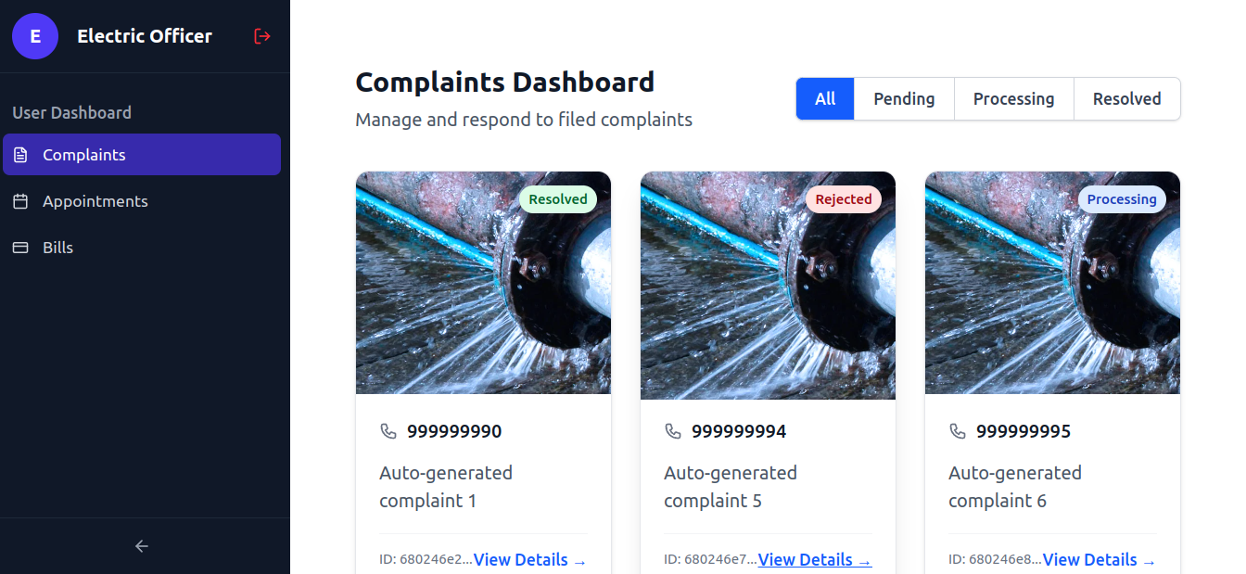
Electrical Officer Dashboard:

Slide 29
Electrical Officer Panel Description: Complaint Management: Users can submit and track complaints related to civic services such as plumbing, electrical, or water issues. They can view the status of their complaints and receive updates through notifications.
Event Notifications: Users can view notifications about local events, festivals, and programs.
Payment Reminders: Utility bills and other payments are tracked, and users receive reminders before the due date.

Slide 30
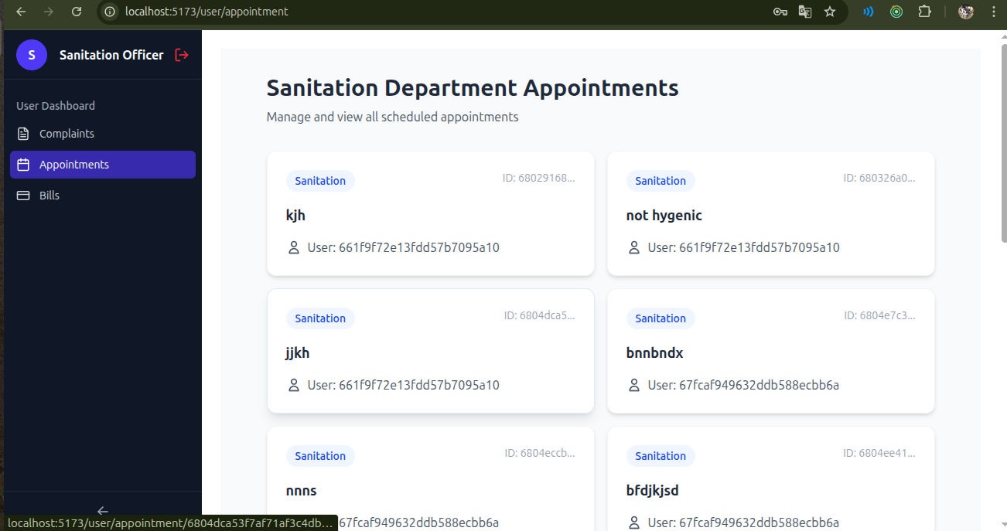
Sanitation Officer Panel Description:

Slide 31
Sanitation Officer Panel Description: Complaint Management:
Users can submit and monitor complaints related to water services, such as leaks, blockages, or supply issues. Each complaint's status is updated in real time, and users receive notifications as the issue progresses toward resolution.
Appointment Scheduling:
Users can schedule appointments with the Water Department for services like inspections, meter checks, or maintenance visits. Appointment details, status, and officer assignments are visible, ensuring timely assistance.
Bill Payments and Tracking:
Users can view their water utility bills, check payment statuses, and download past bills. Automatic reminders are sent before due dates to ensure timely payments and avoid penalties.

Slide 32
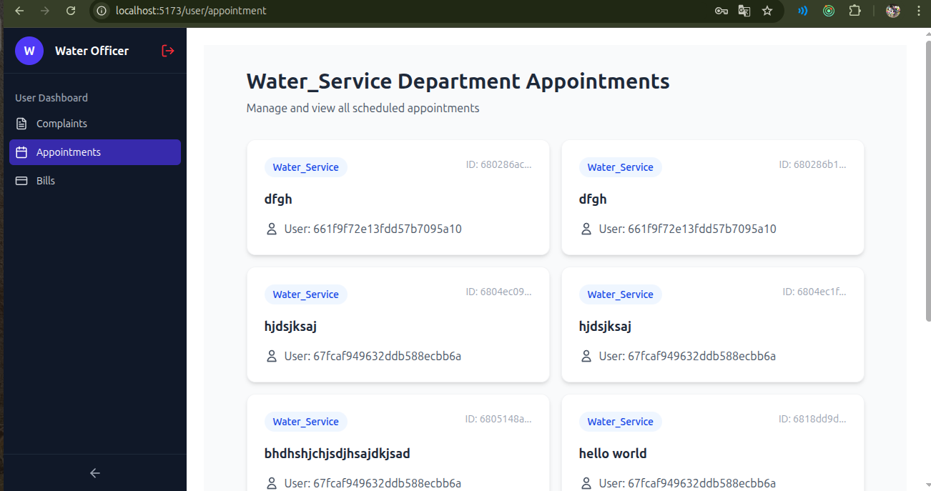
Water Officer Panel Description:

Slide 33
Water Officer Panel Description:
Complaint Management:
Users can submit and monitor complaints related to water services, such as leaks, blockages, or supply issues. Each complaint's status is updated in real time, and users receive notifications as the issue progresses toward resolution.
Appointment Scheduling:
Users can schedule appointments with the Water Department for services like inspections, meter checks, or maintenance visits. Appointment details, status, and officer assignments are visible, ensuring timely assistance.
Bill Payments and Tracking:
Users can view their water utility bills, check payment statuses, and download past bills. Automatic reminders are sent before due dates to ensure timely payments and avoid penalties.

Slide 34
Conclusion The deployment and maintenance of UrbanPulse have been integral to its success, ensuring that the system remains reliable, secure, and scalable. Through careful planning, testing, and the use of modern cloud services, the application was successfully deployed to production and continues to provide value to users. Ongoing monitoring, logging, and maintenance ensure that the system is always running smoothly and remains responsive to user needs, guaranteeing its long-term viability and success. Security is a critical aspect of the UrbanPulse project, as it handles sensitive user data, including personal information and complaints. Several layers of security were implemented to ensure the application is protected from common security threats.

Slide 35
Thank You

