Slide 1


K.RAMAKRISHNAN COLLEGE OF ENGINEERING (Autonomous) Accredited by NAAC with - 'A' Grade, NBA Accreditation of EEE DEPARTMENT OF ELRCTRICAL AND ELECTRONICS ENGINEERING
BATCH NO : 08
AUTOMATIC WALL PAINTING ROBOT CAR
GUIDED BY
Mr. A. JAINULAFDEEN
Assistant Professor
Electrical and Electronics Engineering
K.Ramakrishnan College of Engineering,
(Autonomous)
Samayapuram, Tiruchirappalli – 621 112

Slide 2
AUTOMATIC WALL PAINTING ROBOT CAR
PRESENTED BY
SRINITHI M - EE2145
SWETHA G - EE2146
THRISHA S - EE2149
YAZHINI K - EE2154
Department of Electrical and Electronics Engineering
Third Year / 6th Semester
K.RAMAKRISHNAN COLLEGE OF ENGINEERING
(Autonomous)

Slide 3
CONTENTS
Objective
Literature survey
Block diagram
Hardware and Software components
Data Collections
Methodology
Operation
Conclusion
Scope Of Project
Future Aspects
References

Slide 4
OBJECTIVE
Painting through the manpower takes more time ,because of the long process.
By using the automatic wall painting car, It spend less paint than the manual painting process.
Time taken for the painting process through the automatic wall painting car is less compared to the manual painting process.

Slide 5
OBJECTIVE
The design aims to satisfy the requirements of simplicity, lightness.
The automatic wall painting car is quiet affordable to peoples.The speed of the painting process of automatic wall painting car is high.
It is necessary to paint the interior walls of residential buildings using automatic wall painting car that can move.

Slide 6
LITERATURE SURVEY
AUTHOR | YEAR | REFERENCE BOOK
I.Aris, A.K. Parvez Iqbal, A.R. Ramli and S.Shamsuddin | 2005 | Design and development of a programmable painting robot for houses and building
B. Kahane, Y. Rosenfeld | 2004 | Balancing human and robot integration in building task.
Warszawshy, Y. Rosenfeld | 1994 | Robot for interior finishing works in building: feasibility analysis

Slide 7
LITERATURE SURVEY
AUTHOR | YEAR | REFERENCE BOOK
M. Sorour, M. Abdellatif, A. Ramadan and A. Abolsmail. | 2011 | Development of roller based interior wall painting robort.
Kyung-Seok Byun, Sung-Jae Kim, Jae-Bok Song. | 2002 | Design of a four wheeled omni-directional mobile robort with variable wheel arrangement mechanism.
B.E. Teoh and S.V. Ragavan. | 2011 | Paint bot- fpga based wall painting service robot prototype.

Slide 8
LITERATURE SURVEY
AUTHOR | YEAR | REFERENCE BOOK
Naticchia, A. Giretti, A. Carbonari. | 2007 | Set up of an automatic multi-colour system for interior wall painting.
Naticchia, A. Giretti, A. Carbonari. | 2006 | Set up of a robotized system for interior wall painting.
M. De Grassi, B. Naticchia, A.Giretti& A. Carbonari. | 2007 | Development of an automatic four colour spraying device carried by a robot.

Slide 9
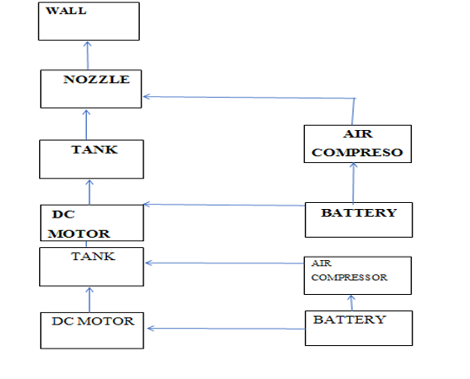
BLOCK DIAGRAM

Slide 10
COMPONENTS
Microcontoller atmega 328.
Battery.
IR sensor.
LED.
Wheels.
DC Motor.
Storage tank.
Spray or Nozzle

Slide 11
MICROCONTOLLER ATMEGA 328
A microcontroller is embedded inside of a system to control a singular function in a device.
The device requires 1.8 to 5.5 volts to operate.
It does this by interpreting data it receives from its I/O peripherals using its central processor.
The temporary information that the microcontroller receives is stored in its data memory, where the processor accesses it.

Slide 12
MICROCONTOLLER ATMEGA 328
A car might have many microcontrollers that control various individual systems within, such as the anti-lock braking system, traction control, fuel injection or suspension control.
All the microcontrollers communicate with each other to inform the correct actions.
Some might communicate with a more complex central computer within the car, and others might only communicate with other microcontrollers.
They send and receive data using their I/O peripherals and process that data to perform their designated tasks.

Slide 13
BATTERY
A battery is a device that stores chemical energy and converts it to electrical energy.
The first purpose of an auto battery is to provide power for starting your vehicle.
When a battery is supplying power, its positive terminal is the cathode and its negative terminal is the anode.

Slide 14
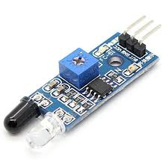
IR SENSOR
An electrical gadget that produces infrared light to
sense certain features of its environment is called a sensor.
Both the heat and motion of an item can be measured
by an IR sensor.
The only device that can detect IR light with the same wavelength
as an IR LED is an IR photodiode.

Slide 15
IR SENSOR
IR sensors use a specific light sensor to detect a specific light wavelength in the infrared (IR) spectrum.
Using an LED that emits light at the same wavelength as the sensor allows you to gauge the strength of the light that is being received.
When an object is close to a light sensor, light from the LED bounces off the object and enters the sensor.

Slide 16
LED
LED stands for Light Emitting Diode.
It's a semiconductor device that emits light when an electric current passes through it.
LEDs are widely used in various applications due to their efficiency, durability, and compact size.
Unlike traditional incandescent bulbs, which generate light by heating a filament.

Slide 17
LED
LEDs produce light through a process called electroluminescence.
Where electrons recombine with electron holes within the device, releasing energy in the form of photons (light).
LEDs come in various colors, including red, green, blue, white, and other colors, depending on the materials used in their construction.
They are commonly used for lighting in homes, offices, automobiles, electronic displays, indicators, signage, and many other applications.

Slide 18
WHEELS
The primary purpose of wheels in a remote control car is to provide mobility and movement.
The wheels are essential components of a remote control car, contributing to its performance, handling, and appearance.
Their design and functionality directly influence how the car moves and responds to the driver's inputs, making them integral to the overall driving experience.

Slide 19
DC MOTOR
DC motors are used in a wide range of applications, including robotics.
DC motors are ideal for robotics applications that require a motor with high torque at low RPMs.
They are especially useful for projects that require precise positioning or movement.
DC motors have high starting torque.
DC motors have a wide range of speed capabilities

Slide 20
DC MOTOR
Three main factors need to be considered when selecting a DC motor type they are:
Motor Speed: both minimum and maximum speed, with acceleration
Torque: maximum torque that can be generated and its relation to speed
Precision: of the motor’s operation and its repeatability.

Slide 21
STORAGE TANK
Storage tank is located at the top of the car.
It is used to store a variety of materials, from chemicals to foodstuffs and water.
In this we store colour water in order to paint the wall or object.
Storage tank are connected to spray.

Slide 22
SPRAY
Spray painting is a painting technique in which a device sprays coating material.
Spray is located at the back side of the car.
It is typically used for covering large surfaces with an even coating of liquid.
Single color aerosol paint cans are portable and easy to store.

Slide 23
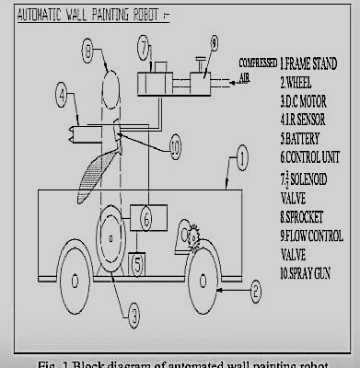
AUTOMATIC WALL PAINTING ROBOT

Slide 24
DATA COLLECTION
Set the painting car against the wall by using the remote control of the car.
The sprayer unit is used to spray paint in the wall and moved by remote control .
After that, fill the sprayer with paint, turn on the car and fix the car against wall , the sprayer unit spray the paint it reaches the desired amount of time

Slide 25
DATA COLLECTION
The spray unit of the automatic wall painting evenly sprayed on the wall.
Because the even distribution the wall painting process takes small amount of time.
The robot will then move by remote control, and the process will then be repeated.

Slide 26
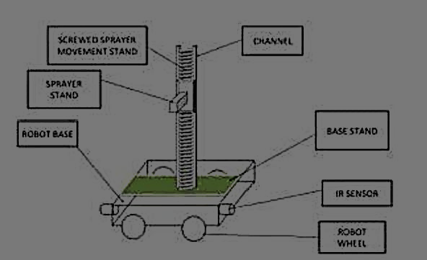
METHODOLOGY

Slide 27
METHODOLOGY
We thoroughly researched the Automatic Sensor Based Wall Painting car idea.
This project will be finished in sections. As a first step, we created a Painting Car structure, together with the components to be employed, and their ratings.
The system's net weight will determine which main component a geared motor to use. We select the motor rating by using approximation weights.

Slide 28
OPERATION
DC Motor is fixed in the automatic wall painting robot for operating the wheel.
The car moving is controlled by the remote control which is connected to the car.

Slide 29
OPERATION
The car charger is plug in to charge the car for the operation.
The car working in the energy stored in the car while charging the chargeable battery cell.
The battery cell which give the supply to the remote control.

Slide 30
CONCLUSION
1.Cost effective:
Automatic wall painting robots can reduce the need for human workers and save on labor costs.
2.Uniform coating:
Painting robots can ensure a more uniform application of paint, which can lead to a higher-quality finish.

Slide 31
CONCLUSION
3.Increased Efficiency:
One of the primary advantages of robotic construction is the significant increase in efficiency.
4.Enhanced Safety:
Construction sites can be hazardous environments, and safety is a paramount concern.
Robots are immune to fatigue, distractions, or risky behaviors that can lead to accidents.

Slide 32
CONCLUSION
5.Precision and Consistency:
Robotic systems excel in precision and consistency, ensuring that each task is performed with the utmost accuracy.
6.24/7 Operation:
Unlike human workers, who adhere to fixed working hours, robots can operate 24/7.
The ability to work non-stop also proves advantageous in meeting tight deadlines.

Slide 33
SCOPE OF THE PROJECT
Construction is a labor-intensive and hazardous business.
As a result, the value of construction robotics has been recognised and is expanding quickly.
Beginning in the early 1990s, robots and automation applications and activities in the construction sector aimed to improve worker perceptions of their workspace.

Slide 34
SCOPE OF THE PROJECT
It improve worker perceptions of optimise equipment operations.
Following this, the construction industry's use of robotics and automation has rapidly advanced

Slide 35
FUTURE ASPECTS
With the higher supporting column, robot can be used for painting an even larger section of wall.
Adjustment of color density can be done.
Arm can be provided for more flexibility.
Voice indication or display can be interfaced for the level of paint in the container

Slide 36
FUTURE ASPECTS
To improve safety by eliminating works on scaffolds.
To make machine structure simple to enable easy mounting.
To be usable not only on internal and external walls of structures but also in various other places such as on walls of civil structures.

Slide 37
REFERENCES
[1]. Johan Forsberg Roger Aarenstrup Ake Wernersson(2000), ‘‘A Construction Robot for Autonomous Plastering of Walls and Ceilings”, Vol 6, pp192-196.
[2]. Mohamed T. Sorour, Mohamed A. Abdellatif, Ahmed A. Ramadan, and Ahmed A. AboIsmail(2011)‘‘Development of Roller-Based Interior Wall Painting Robot” ,Vol 59, pp 2309-2316.

Slide 38
REFERENCES
[3]. S.m.s. Elattar(2008), ‘‘Automation and robotics in construction” -Emirates journal for engineering research, Vol 13, pp 21-26.
[4].Vani Mukundan , Mohamed Sirajudeen K I , Nidhinsha , Sheron B Joseph, “AUTOMATIC SENSOR BASED WALL PAINTING ROBOT”, International Journal of Advances in Engineering & Scientific Research, Vol.4, Issue 1, Jan-2017, pp 49-56

Slide 39
REFERENCES
[5]. Miss. Kamble Sunayana Nivrutti, Prof. Gund V. D., et al, “Multimodal Biometrics Au-thentication System Using Fusion Of Fingerprint And Iris”, International Journal of Trends in Scientific research and Development (IJTSRD), Sep-Oct 2018, Vol 2, Issue 6, pp 1282-1286
[6].Prof. Kazi K. S., “Situation invariant Face Recognition using PCA and Feed forward Neural Networks”, Proceeding of ICAEST, Feb 2016,ISBN: 978 - 81 – 930654 – 5 – 4, pp 260-263

Slide 40
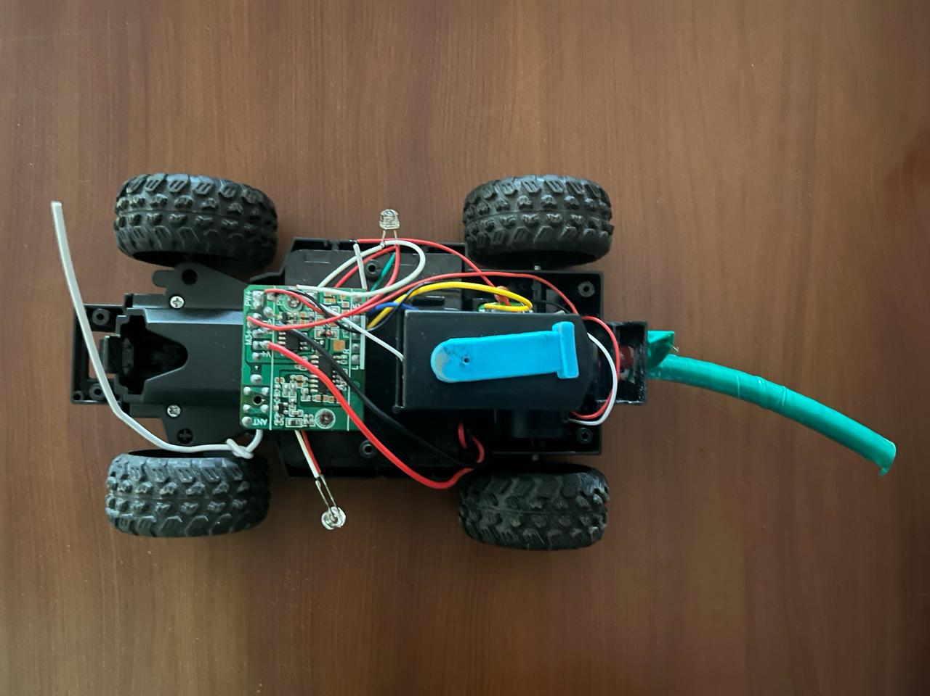

Slide 41


