Slide 1
大群双细胞

Slide 2
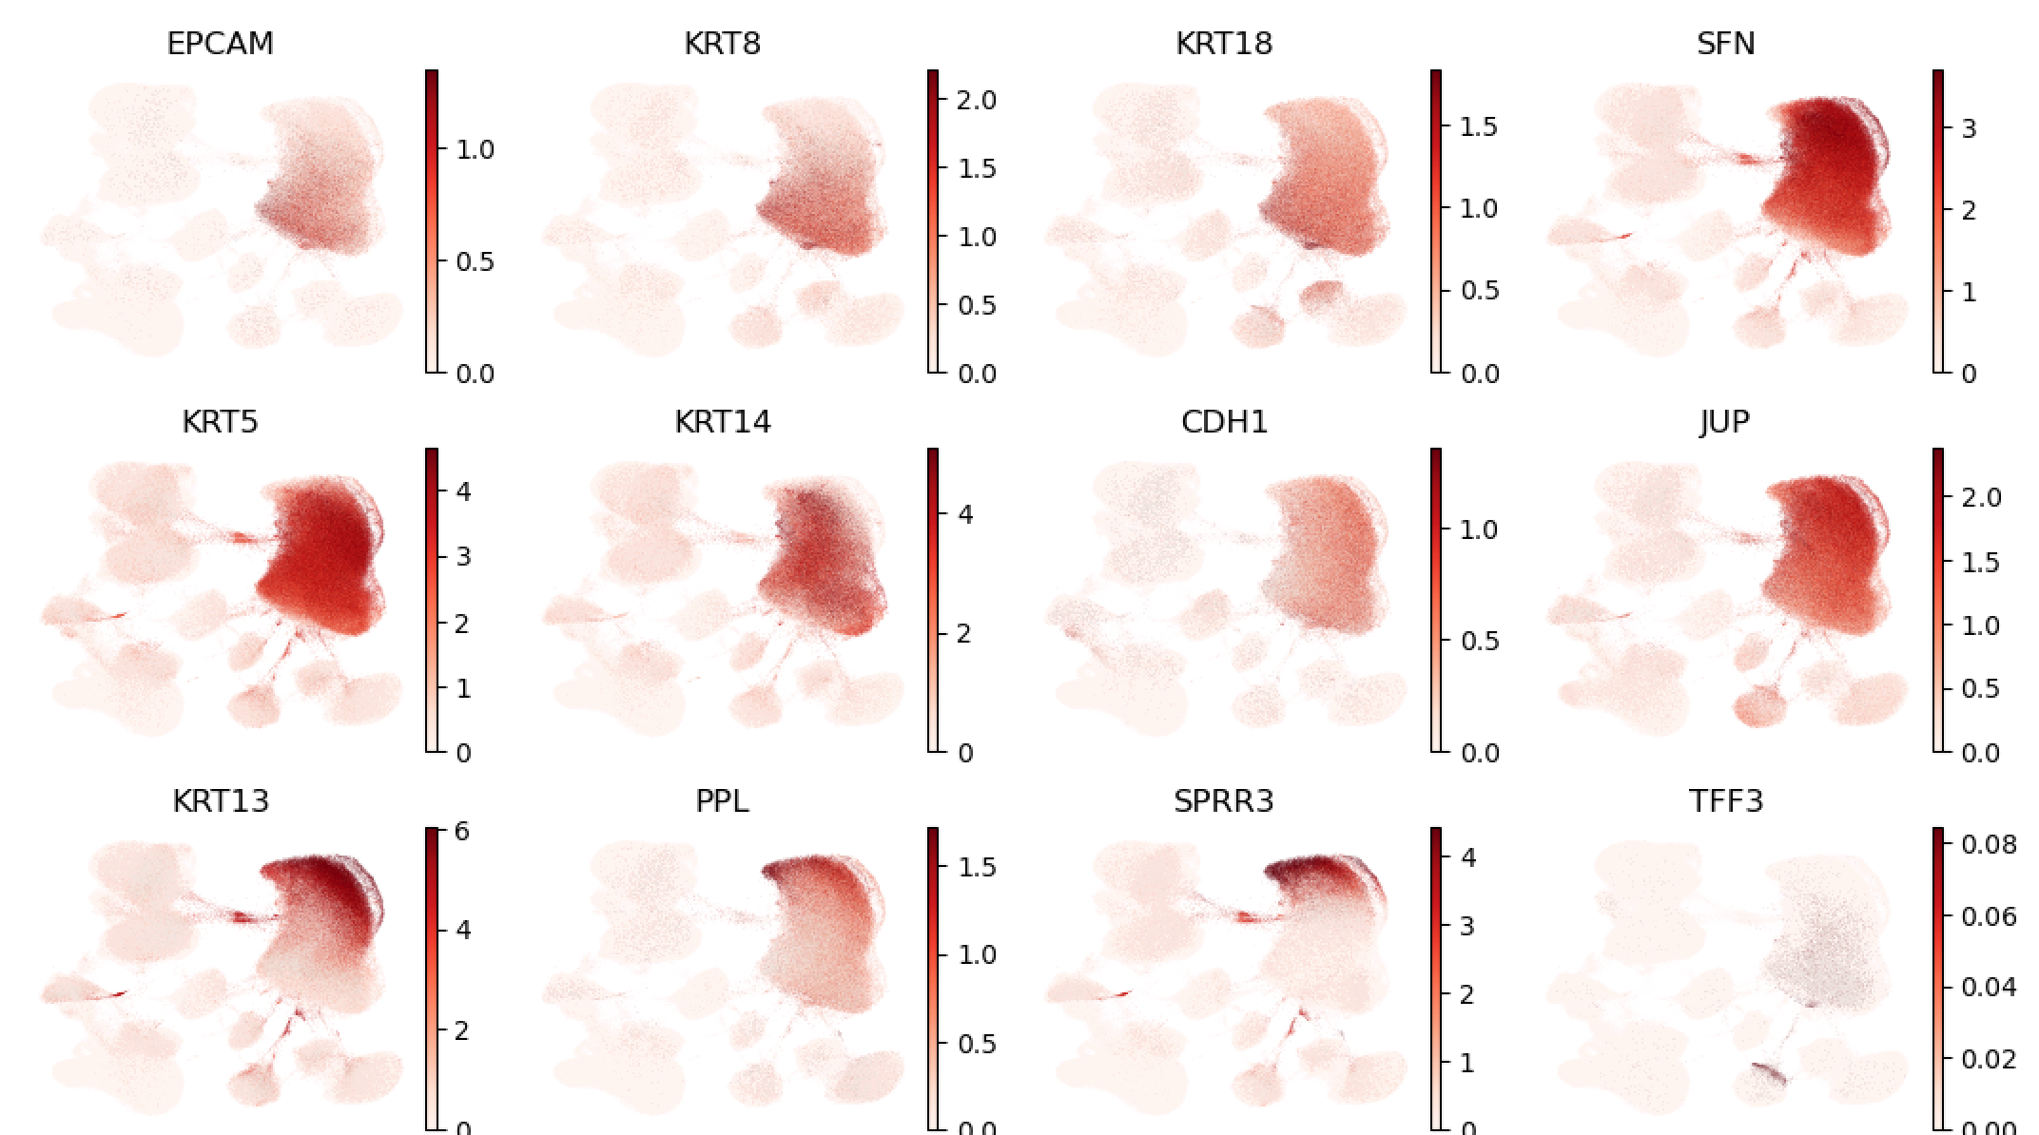
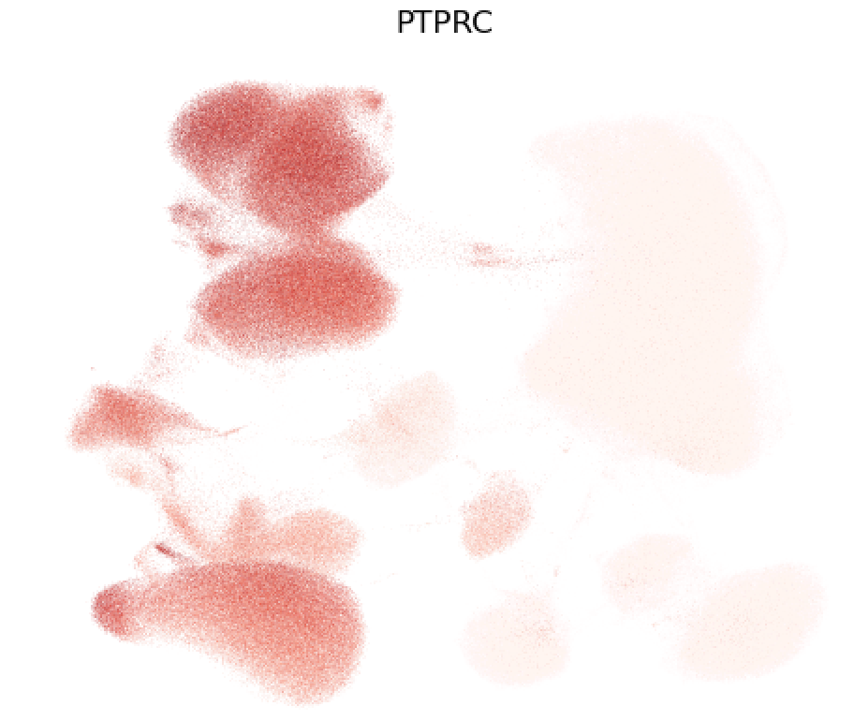
Epi VS Immune

Slide 3
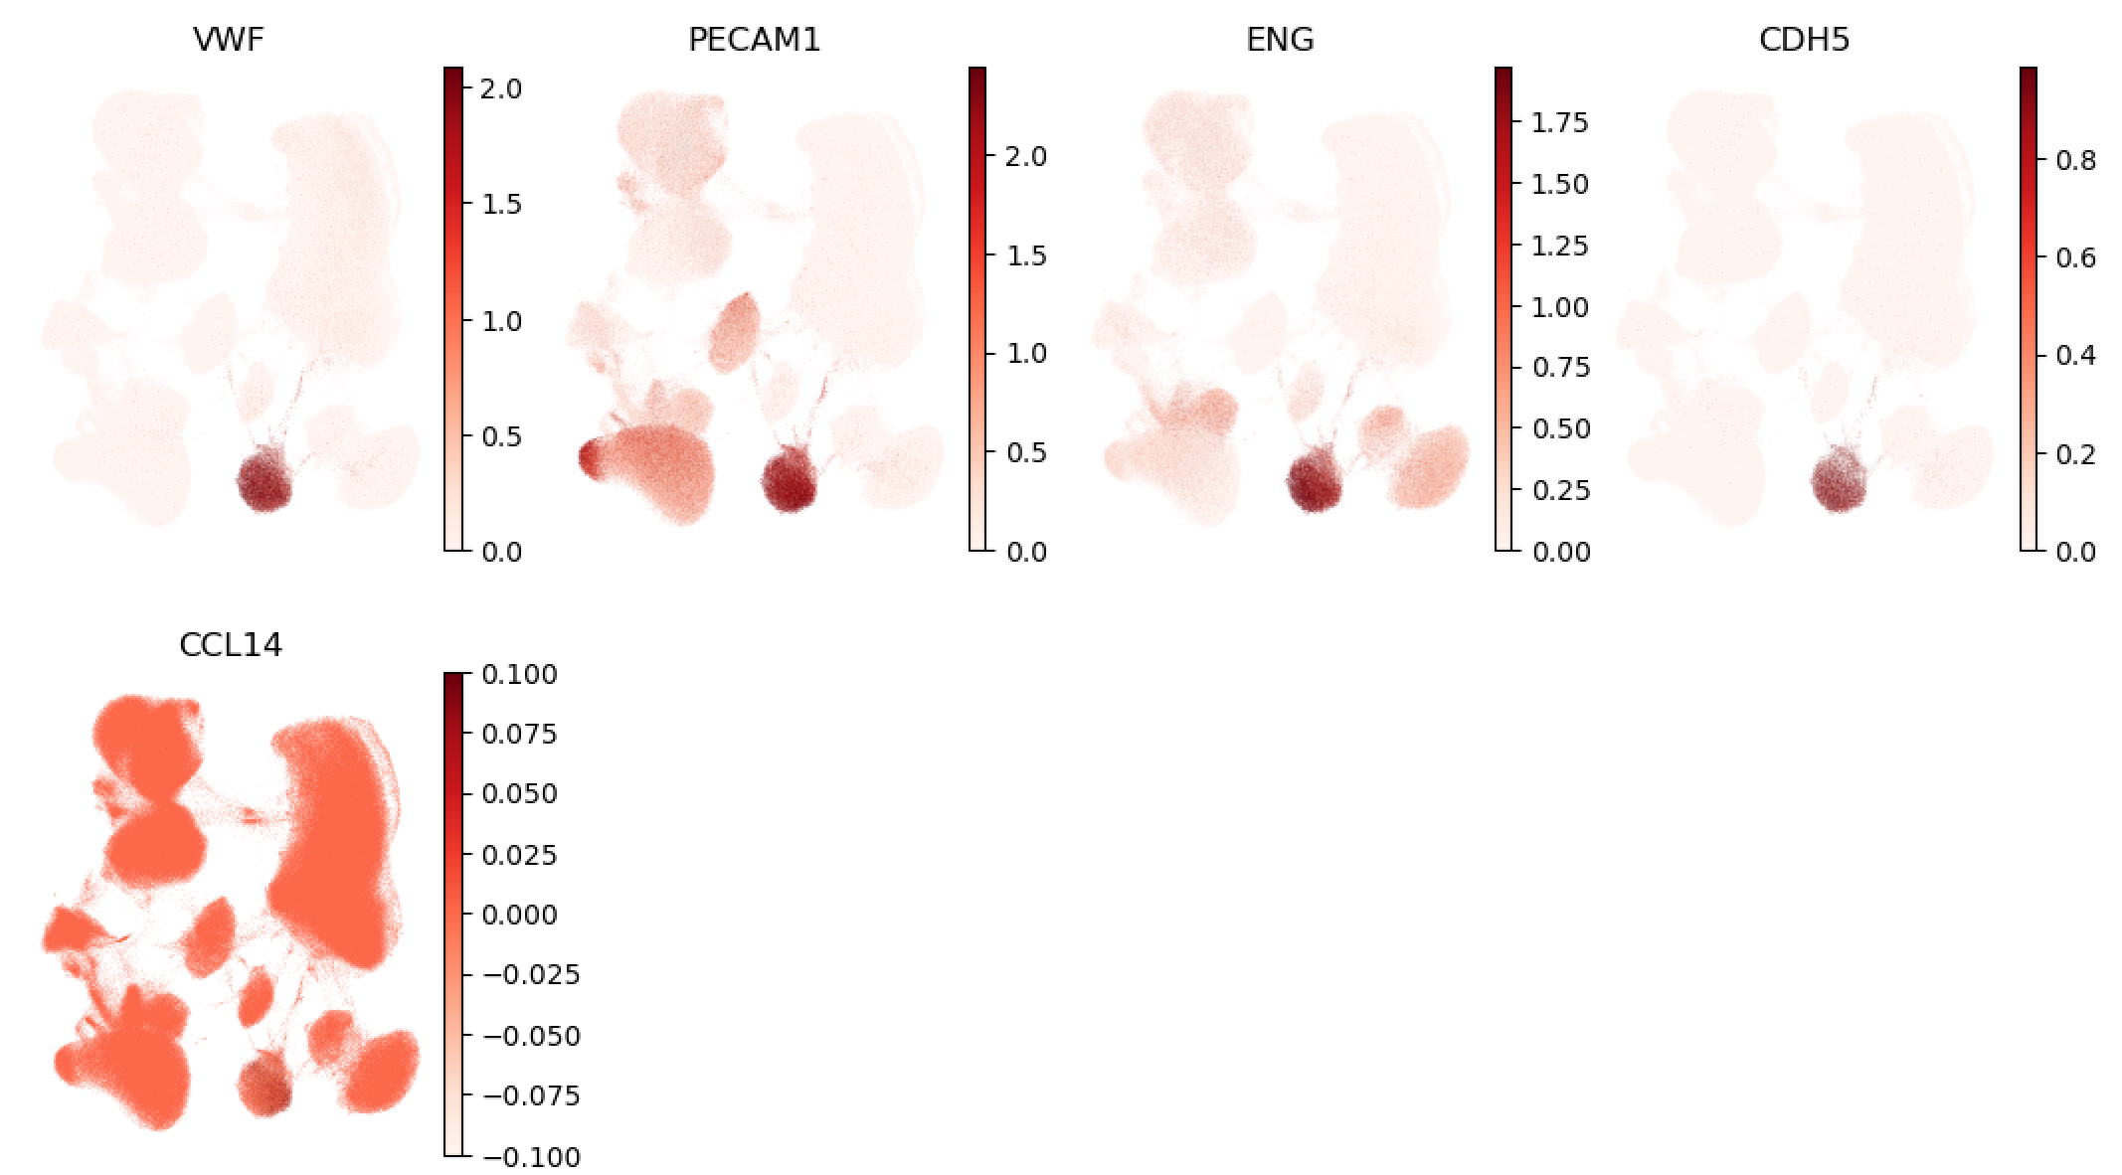
Endo VS Immune

Slide 4
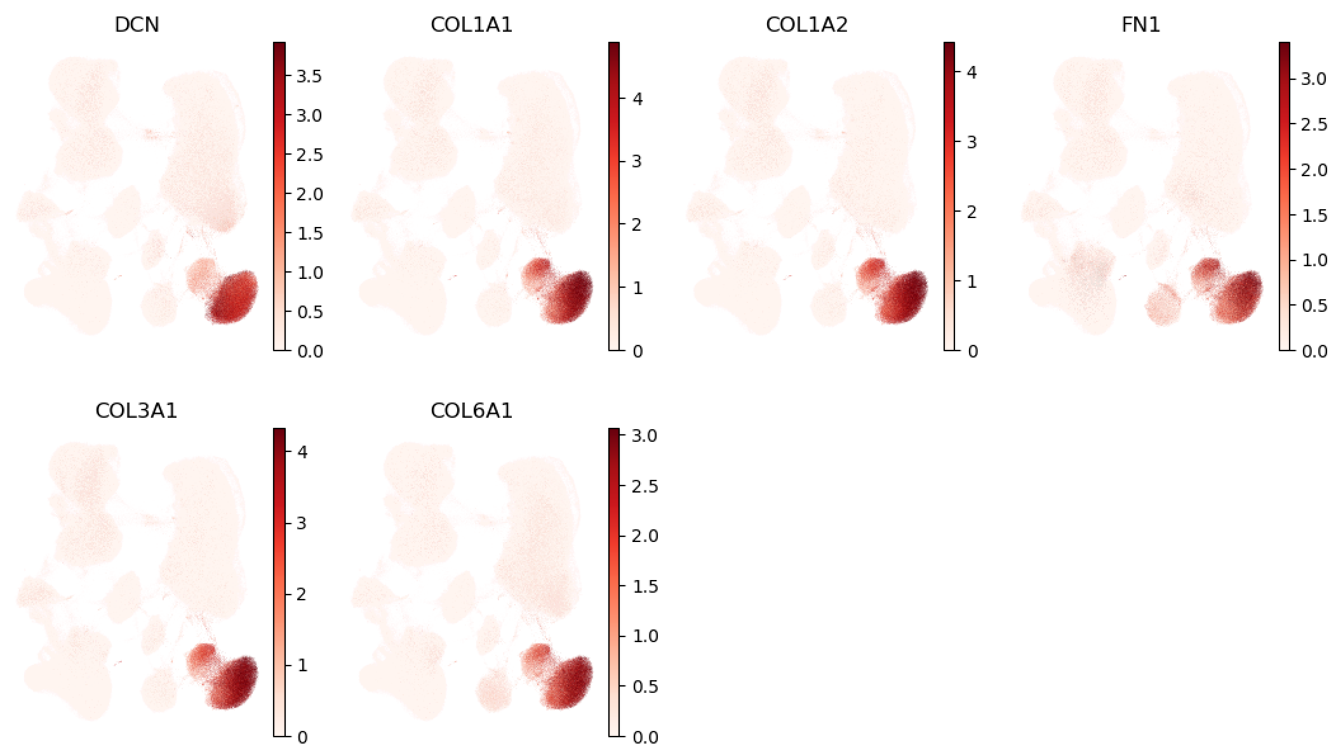
Fib VS Immune

Slide 5
Epi VS Endo

Slide 6

Epi VS Fib

Slide 7
Endo VS Fib

Slide 8
免疫双细胞

Slide 9
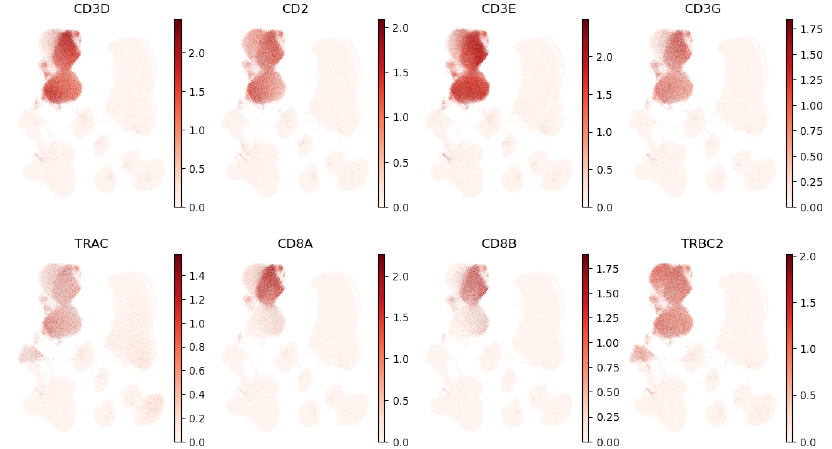
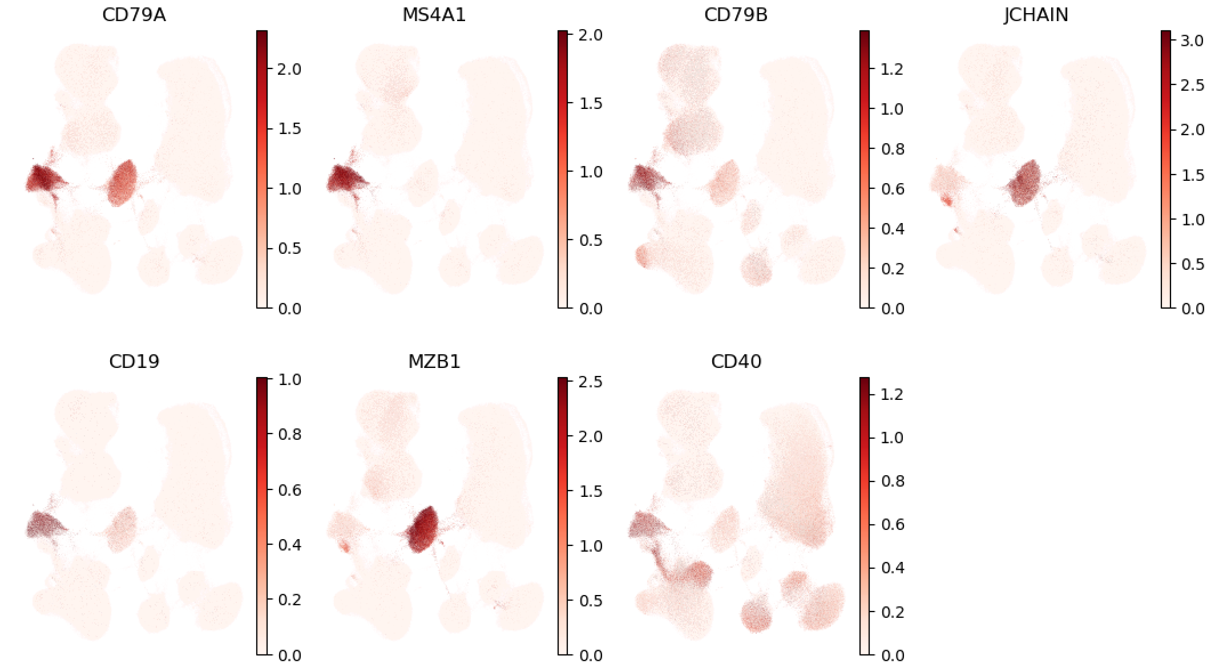
T VS B

Slide 10
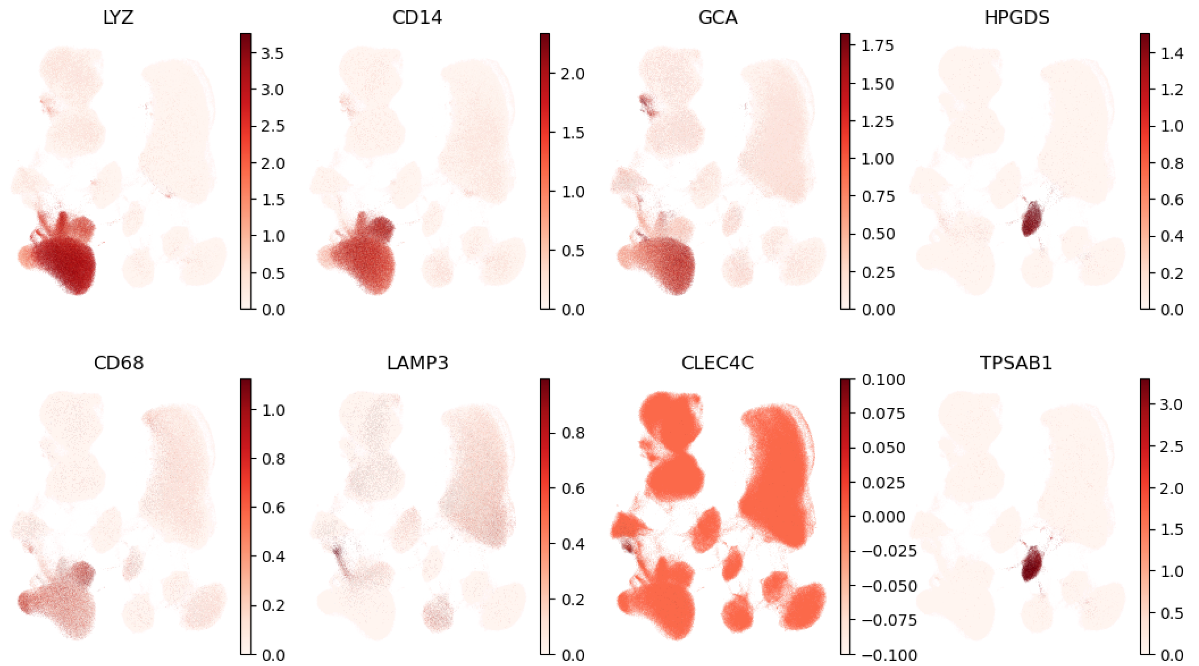
T VS Myeloids

Slide 11
B VS Myeloids

