Slide 1
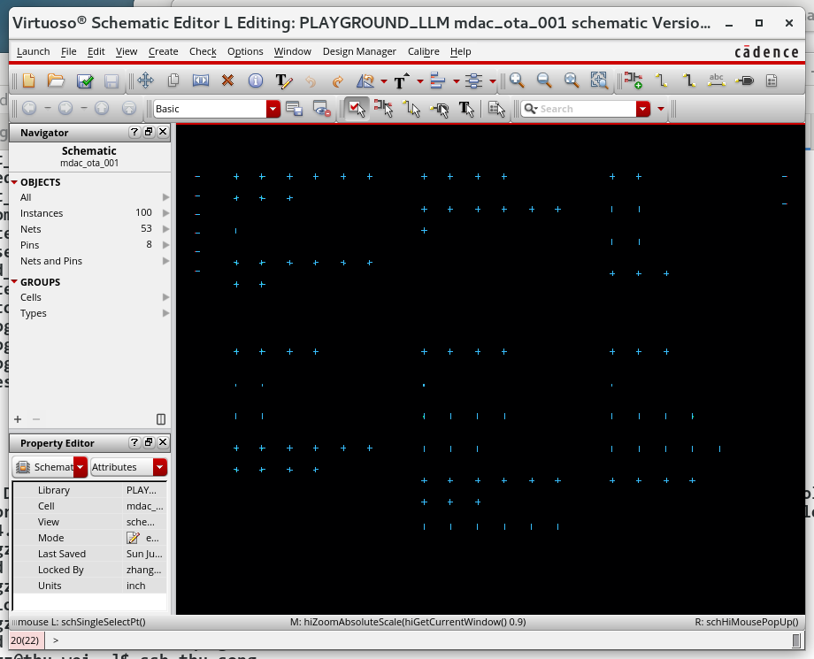
OPEN AMS LIBRARY · CIRCUIT 001
Fully Differential MDAC OTA
Release verification · TSMC 28 nm · 0.9 V Compact and full-geometry Spectre netlists
July 2026

Slide 2
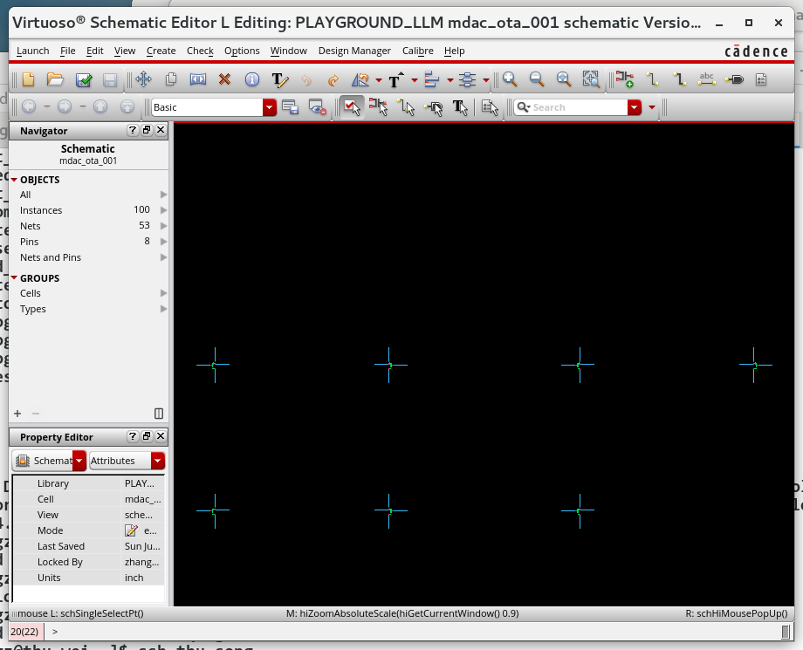
The topology targets gain, low-voltage headroom, and fast MDAC recovery
Two-stage fully differential OTA
• NMOS-input folded-cascode first stage • PMOS-cascode local gain boosting • NMOS common-source second stage • Independent CMFB1 and CMFB2 loops • 0.95 pF Miller compensation per side • One 20 µA external bias reference
67 MOS devices in the released schematic core
2

Slide 3
Full geometry clears nominal gain, speed, and settling targets
TT · 27 °C · VDD = 0.9 V · Spectre X CX
Also verified: 77.17° differential PM · 455.9 µVrms output noise · 6.456 mW
99.48 dB
2.093 GHz
0.0329%
Open-loop DC gain
Open-loop UGBW
Worst residue settling
26.50 kHz dominant pole
326.8 MHz closed-loop BW
8-cycle MDAC sequence
3

Slide 4
High loop gain coexists with 326.8 MHz closed-loop bandwidth
Full-geometry nominal result; all values measured from the released Spectre decks
Metric | Result | Metric | Result
Open-loop DC gain | 99.480 dB | Closed-loop gain | 7.99918 V/V
Open-loop −3 dB BW | 26.496 kHz | Closed-loop gain error | −0.01025%
Open-loop UGBW | 2.09266 GHz | Closed-loop −3 dB BW | 326.843 MHz
Differential-loop UGF | 264.857 MHz | Differential-loop GM | 23.883 dB
Positive output swing | +449.949 mV | Negative output swing | −449.949 mV
Static core headroom | 42.704 mV | Swing core headroom | 41.592 mV
Output common mode | 444.154 mV | Common-mode error | −5.846 mV
4

Slide 5
Every monitored loop retains more than 63° phase margin
Full-geometry nominal result; design target is greater than 60°
63.40° minimum
Gain-boost loop is the limiting loop
23.88 dB DM gain margin
Nominal differential-loop robustness
82.48° at ±450 mV
Swing-point stability improves over nominal
5

Slide 6
Noise, large-signal recovery, and energy metrics complete the nominal picture
These metrics are often hidden by a gain/UGBW-only summary
Metric | Result | Metric | Result
Integrated output noise | 455.943 µVrms | ADC-input noise | 56.993 µVrms
10 MHz noise density | 23.365 nV/√Hz | Worst settling error | 0.032921%
Final transient CM error | −5.820 mV | Single-DUT current | 7.173 mA
Single-DUT power | 6.456 mW | Energy / conversion | 64.560 pJ
14-bit normalized energy | 3.940 fJ/step | Bias reference | 20 µA
Nominal sample rate | 100 MS/s | Amplification window | 5.0 ns
Residue gain | 8 V/V | Load per output | 860 fF
6

Slide 7
Explicit CDF geometry changes speed and current by about 11%
The two netlists share topology, W/L, and testbench. The delta comes from diffusion, resistance-geometry, spacing, stress, and proximity fields.
Compact W/L/nf
Full CDF geometry · release reference
99.264 dB gain 1.879 GHz UGBW 75.07° DM phase margin 0.0275% settling error 5.790 mW
99.480 dB gain 2.093 GHz UGBW (+11.3%) 77.17° DM phase margin 0.0329% settling error 6.456 mW (+11.5%)
The full-geometry result exactly replays the Maestro-generated netlist.
7

Slide 8
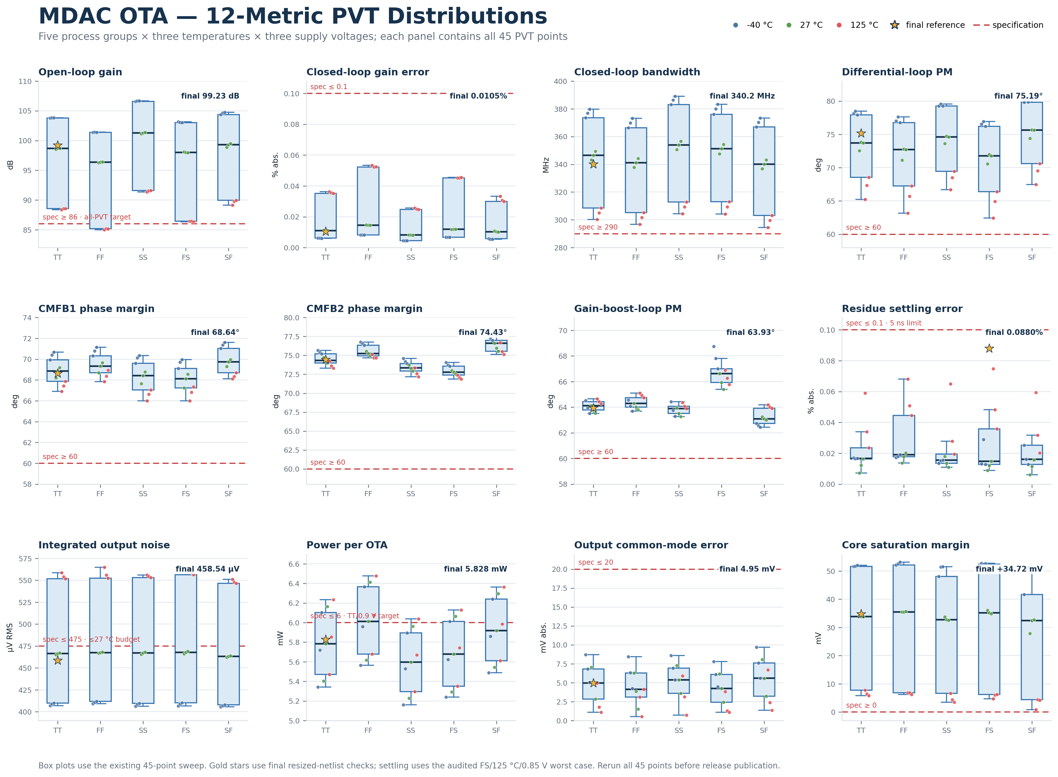
The compact-netlist PVT audit passed 45/45 corners
PVT evidence has not yet been rerun with the full-geometry netlist
85.0–106.7 dB
Open-loop gain
62.4°
Minimum phase margin
0.075%
Worst settling error
50.7–58.6 µV
ADC-input noise at ≤27 °C
8

Slide 9
The GitHub package separates DUT fidelity from shared verification
Two interchangeable DUTs
One shared testbench
One run entry point
ota_core.scs ota_core_full_geometry.scs Same ota_core port order; include one per run.
tb_ac.scs tb_tran.scs AC, DC, STB, noise, and eight-cycle residue transient.
run-spectre.sh Select full/simple and Spectre/APS/CX/AX/MX/LX/VX. Full + CX is the default.
4 wrapper decks · 0 Spectre errors · no private laboratory paths committed
9

Slide 10
RELEASE CONCLUSION
Full geometry is the release reference
Nominal AC/DC/STB/noise/tran verified
Compact version retained for readable design review
Next sign-off step: rerun the 45-point PVT matrix with full geometry

