Slide 1
Reinforcement Learning
Sha Yuan
antha@qq.com
Knowledge Engineering Group
Tsinghua University

Slide 2
Outline
Preliminaries
Asynchronous Advantage Actor-Critic (A3C)
On policy vs. Off Policy
Proximal Policy Optimization (PPO)

Slide 3
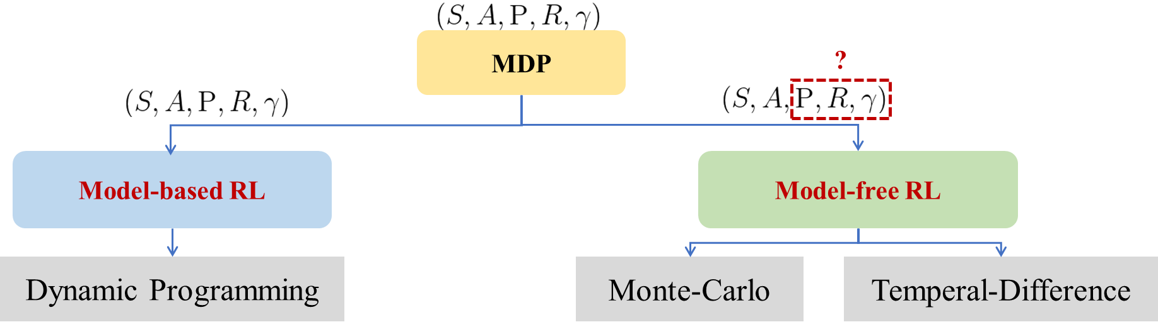
Model-based vs. Model-free
Notes:
Almost all Reinforcement Learning problem can be formulated as Markov Decision Process.

Slide 4
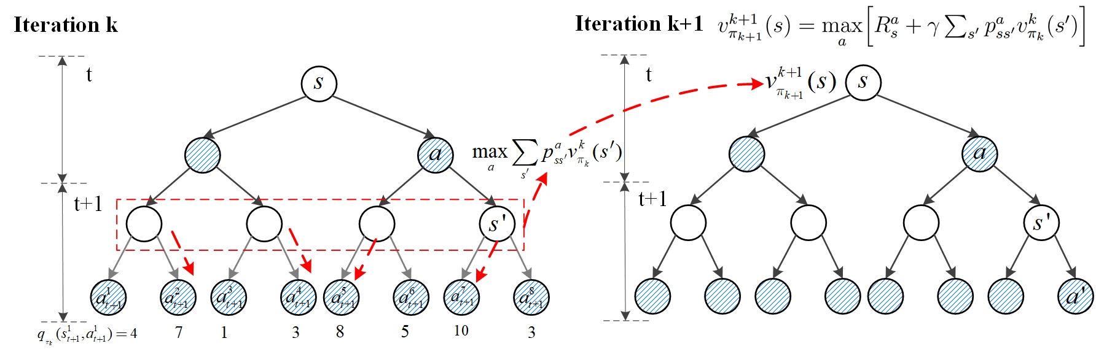
Dynamic Programming

Slide 5

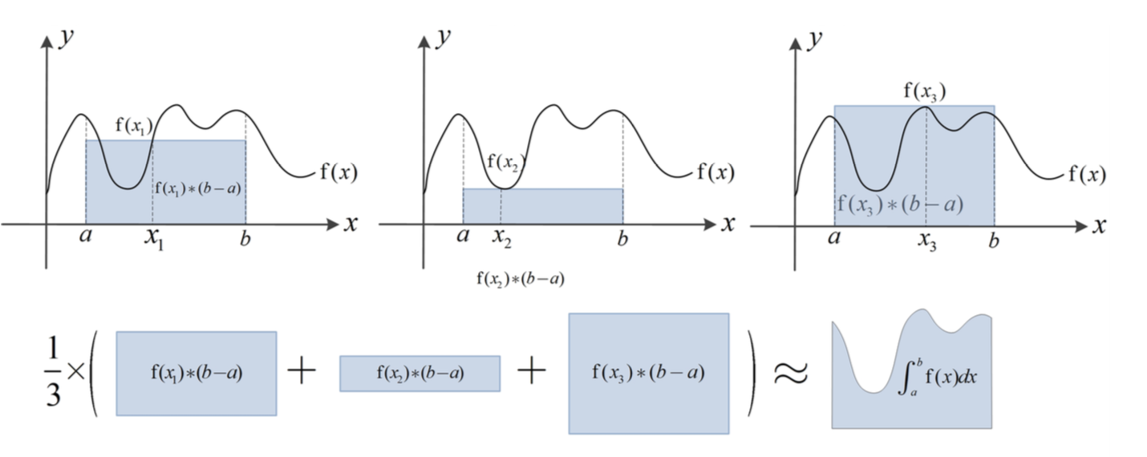
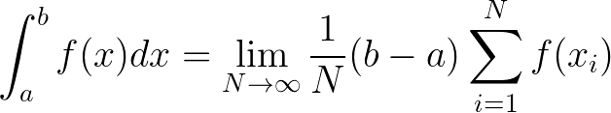
Monte-Carlo
Example - Estimate using Expectation method (Average).

Slide 6
Monte-Carlo
Based on the Strong Law of Large Numbers：
- the probability of events is estimated by the frequency of events obtained from a large number of experiments.
All of them need to be saved
Space inefficient
Notes:
Estimate the expected value of the original problem by constructing a sequence of samples from randomly MDP sampling.
Each sample sequence called an Episode must be complete.

Slide 7
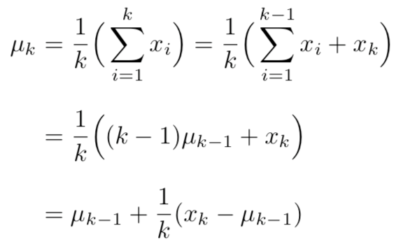



Monte-Carlo
Incremental Average method
Only need to save and compute

Slide 8


Temporal-Difference
TD(0)
Because , we have formulas derivation below ：
TD-target
TD-error

Slide 9
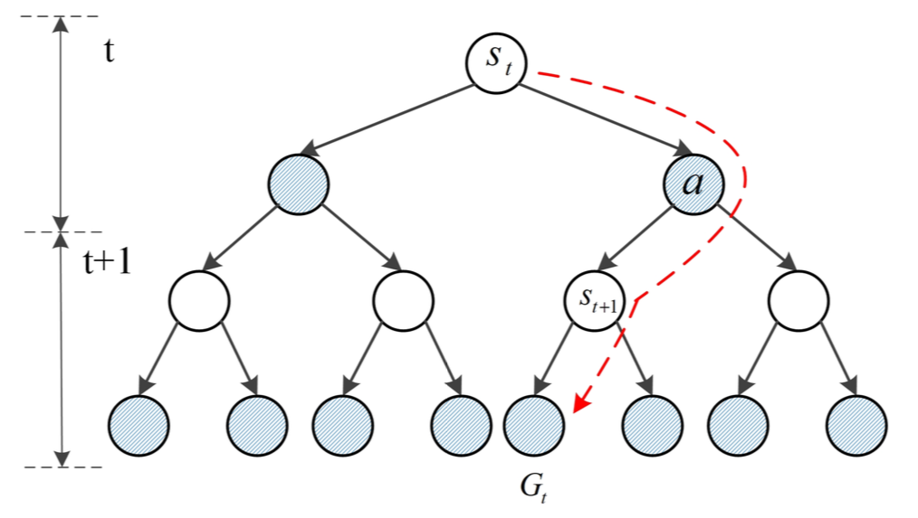
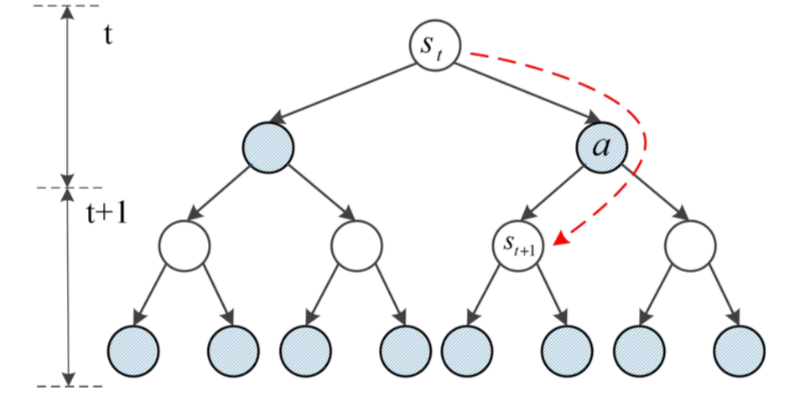
MC vs. TD
Monte-Carlo
Temporal-Difference
Notes:
MC: Each sample sequence called an Episode must be complete.
TD: Do not need a complete interaction sequence.

Slide 10



Approximate Solution Methods
In many tasks, the state space is enormous or continuous.
Reinforcement Learning + Function Approximation
Function Approximation (Supervised Learning)
Step 1
Define a set of functions
Step 2
Goodness of function
Step 3
Pick the best function
Notes:
Gradient descent

Slide 11
Approximate Solution Methods
Policy approximation
Value approximation
AC
Learning a Actor
Actor + Critic
Learning a Critic

Slide 12
Outline
Preliminaries
Asynchronous Advantage Actor-Critic (A3C)
On policy vs. Off Policy
Proximal Policy Optimization (PPO)

Slide 13





Actor-Critic
interacts with the environment
MC or TD
Update actor from based on
Learning
?
Learning a Actor
Learning a Critic
Notes:
parameterized

Slide 14
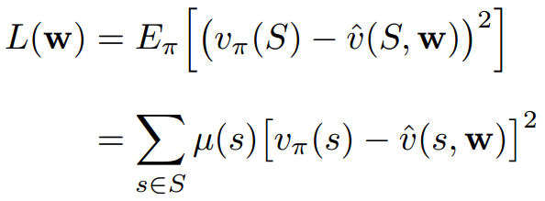
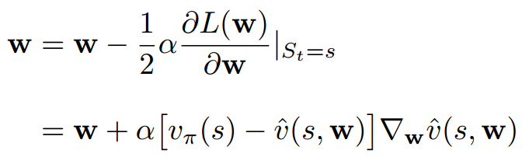
Learning a Critic
Function: linear, neural network, etc.
Loss: mean-squared error, MSE
Optimization: stochastic gradient descent

Slide 15
Learning a Critic
Monte-Carlo based approach
Temporal-difference approach

Slide 16
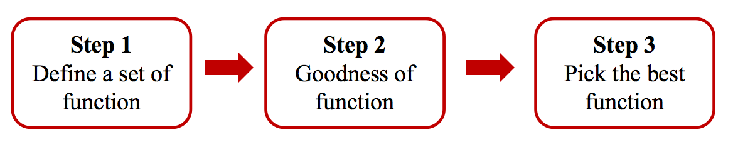
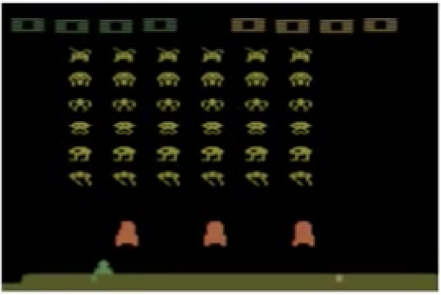
Learning an Actor
Step 1 – Function of Actor
Use NN as actor
left
0.8
right
0.1
...
...
fire
0.1

Slide 17



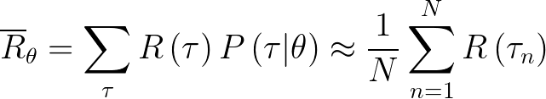
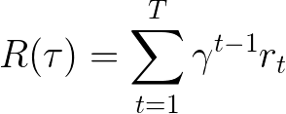
Learning an Actor
Step 2 - Goodness of Actor
Given an actor with network parameter .
Use the actor to play the video game N times and otain ,
Alternatively, sample from a probability distribution N times.
Total reward of a trajectory

Slide 18



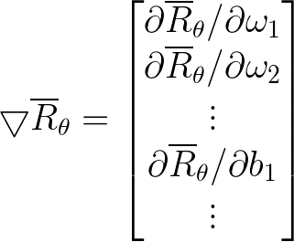

Learning an Actor
Policy Gradient Ascent
Start with :
...
Notes:
gradient descent

Slide 19

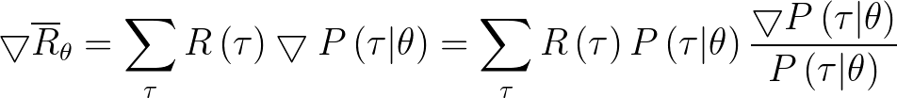

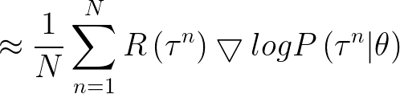

Learning an Actor
Policy Gradient Ascent
7
?
Notes:
Abbreviation

Slide 20

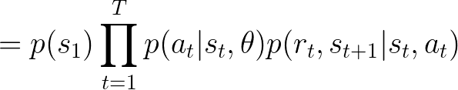
Learning an Actor
Policy Gradient Ascent

Slide 21
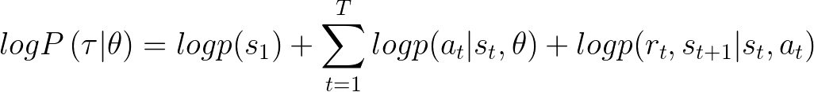
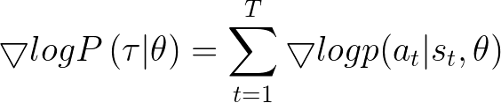
Learning an Actor
Policy Gradient Ascent
These two terms are not related to

Slide 22
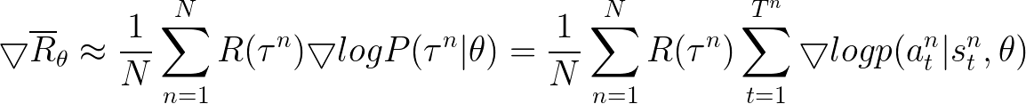
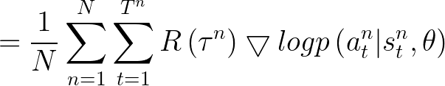
Learning an Actor
Policy Gradient Ascent

Slide 23





Learning an Actor
Policy Gradient Ascent
Start with :
Learning a better
...
is positive, increase by tuning
In , machine takes when seeing
is negative, decrease by tuning

Slide 24

Learning an Actor
Main Cause
a₃ may brings higher reward. In this case, its probability should has been increased.
Add a Baseline
When is always 0 :
Initial
Final
a₁
0.7
a₁
0.75
after finishing all tuning
s
a₂
0.2
a₂
0.22
a₃
0.1
a₃
0.03
(a₃ was not sampled during training unfortunately)
Softmax:
The sum of all outputs is 1
a₁
a₂
a₃
a₁
a₂
a₃

Slide 25
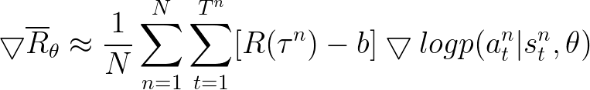
Learning an Actor
Add a Baseline
When is always 0 :
Avoid the probabilities of actions unsampled decreasing unreasonablely by adding a baseline.

Slide 26
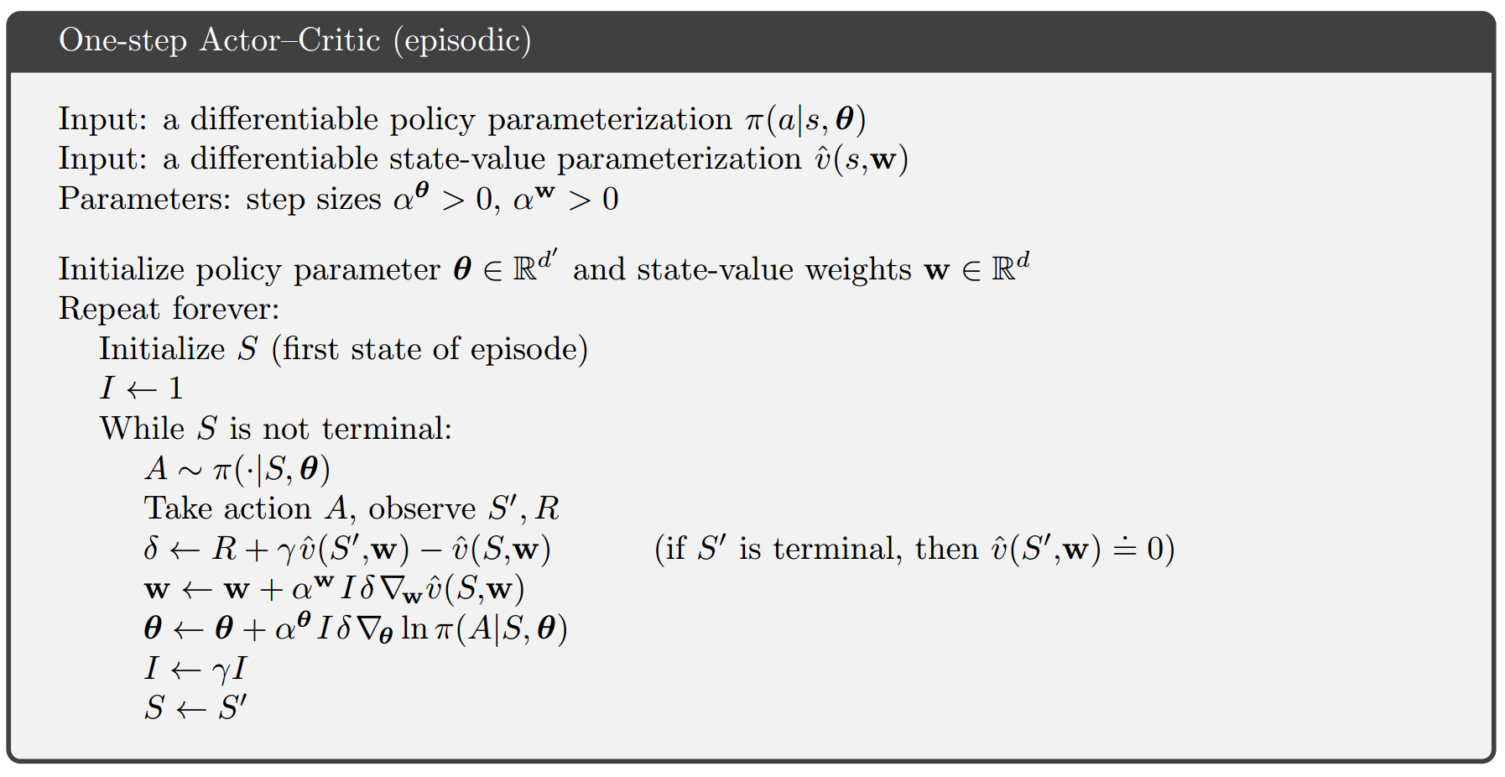
Actor-Critic

Slide 27

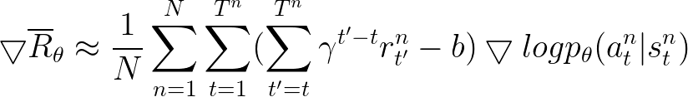



Advantage Actor-Critic
Advantage Function
Baseline

Slide 28

Advantage Actor-Critic
Advantage Function
Estimate two networks?
Or can only estimate one?
√
Advantage Function

Slide 29
Advantage Actor-Critic
Architecture
Network
a₁
a₂
Network
...
s
a_{j}
Network
Some of the parameters of Actor network and Critic network can be shared.

Slide 30
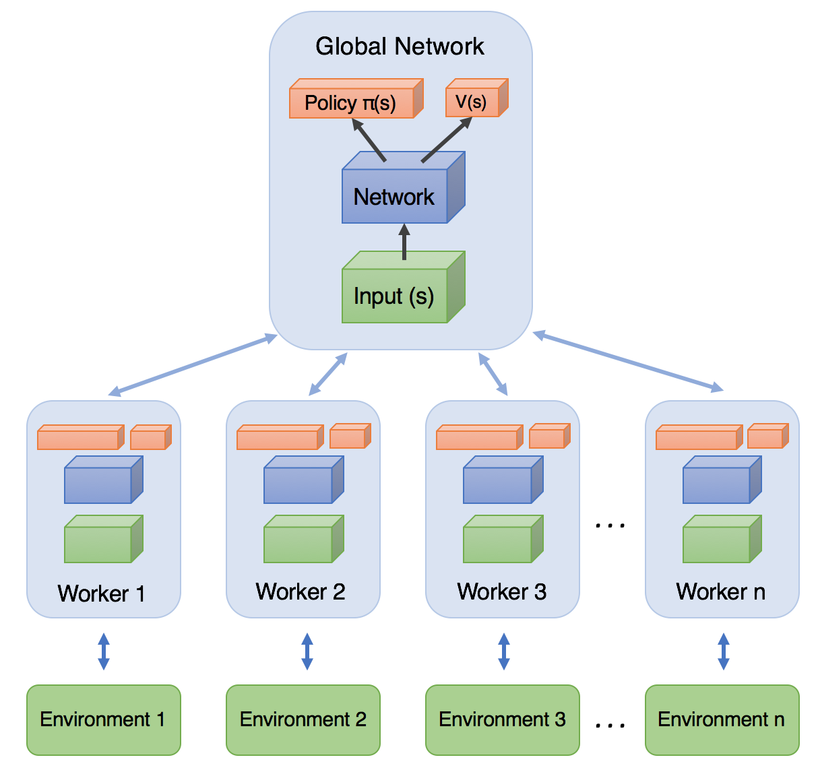


Asynchronous Advantage Actor-Critic
A3C
other workers also update models
Image Source: https://medium.com/emergent-future/simple-reinforcement-learning-with-tensorflow-part-8-asynchronous-actor-critic-agents-a3c-c88f72a5e9f2

Slide 31
Outline
Preliminaries
Asynchronous Advantage Actor-Critic (A3C)
On policy vs. Off Policy
Proximal Policy Optimization (PPO)

Slide 32
On-policy & Off-policy
On-policy methods attempt to evaluate or improve the policy that is used to generate behavior.
Robot
play chess
Man
Off-policy methods evaluate or improve a policy different from that used to generate behavior.
Man
play chess
Man
watch
Robot

Slide 33


Off-policy
Importance Sampling
Importance Sampling: a general technique for estimating expected values under one distribution (original distribution) given samples from another.
Suppose the probability density function of the original distribution is :
If samples from original distribution have small variance, estimate the properties of original distribution using Monte-Carlo methods.
If samples from original distribution have large variance, introduce another distribution with probability density function .
Notes:
Off-policy learning is implemented based on Importance Sampling.

Slide 34






Off-policy
Importance Sampling
The original distribution with probability density function .
Another distribution with probability density function .
When , .

Slide 35



Off-policy
Importance Sampling
The original distribution with probability density function .
Another distribution with probability density function .
importance weight:
Original problem: Solve for the expectation of under .
Solve for the expectation of under .

Slide 36
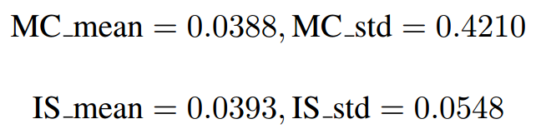
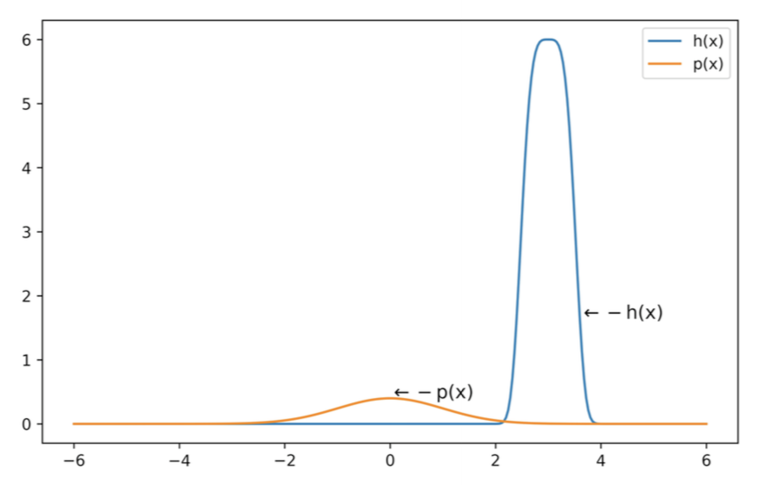
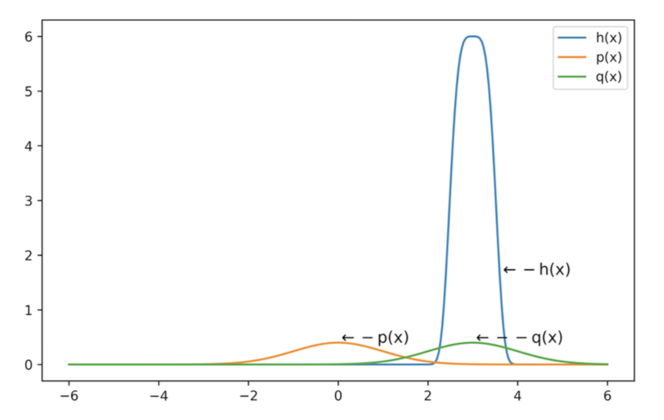
Off-policy
Sample times n = 10000
Importance Sampling
is almost 0 outside [-2,2] in x-axis.
Lower the sampling variance using Importance Sampling
is almost 0 outside [2,4] in x-axis.

Slide 37
Outline
Preliminaries
Asynchronous Advantage Actor-Critic (A3C)
On policy vs. Off Policy
Proximal Policy Optimization (PPO)

Slide 38


Off-policy Gradient
On-policy
Off-policy
Use to collect data. When is updated, we have to sample training data again.
Goal: Using the sample from to train . is fixed, so we can re-use the sample data.
Imporance Sampling

Slide 39




Off-policy Gradient
Gradient for update
From gradient roll back to J

Slide 40

PPO
Add Constraint
cannot be very different from .
Constraint on behavior not parameters.
KL divergence (relative entropy) : evaluate asymmetry of two probability distribution
Notes:
Relative entropy: evaluate asymmetry of two probability distribution

Slide 41
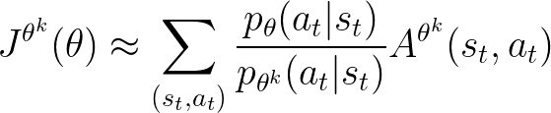






PPO
PPO algorithm
Initial policy parameters
In each iteration
Using to interact with the environment to collect and compute advantage
Find optimizing
Update parameters several times
If , increase
Adaptive KL Penalty
If , decrease

Slide 42
Reference
Sutton, Richard S., and Andrew G. Barto. "Reinforcement learning: An introduction." (2017).
David Silver, UCL Course on RL http://www0.cs.ucl.ac.uk/staff/d.silver/web/Teaching.html
Hung-yi Lee, Deep Reinforcement Learning, http://speech.ee.ntu.edu.tw/~tlkagk/courses_MLDS18.html
袁莎, 白朔天, 唐杰: 强化学习, 清华大学出版社, 2020

Slide 43
Thanks!

