Slide 1
2017 CHIAYI Hackathon
THUIM

Slide 2
129,609
18.12 %
100%
老年人口 No.1
老年佔總人口比例 No.1
Total success!

Slide 3

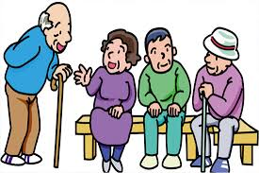

如何面臨老齡化帶來的衝擊
Optimization
Adulthood stay ?

Slide 4
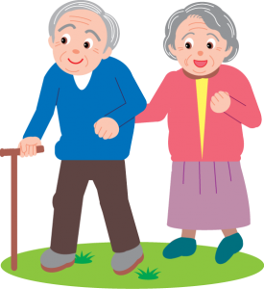

Elderly
Friendly

Slide 5


Connection between Welfare and Elderly

Slide 6
Datasets
Here you have a list of items
And some text
But remember not to overload your slides with content

Slide 7
Thanks!
Any questions?
You can find me at:
@username
user@mail.me

