Slide 1




User Browsing Graph:
Structure, Evolution and Application
Yiqun Liu, Yijiang Jin, Min Zhang, Shaoping Ma, Liyun Ru
State Key Lab of Intelligent Technology and Systems
Tsinghua University, Beijing, China
2009/02/10

Slide 2
Search Engine vs. Users
How many pages can search engine provide
  1 trillion pages in the index (official Google blog 2008/07)
How many pages can user consume?
  235 M searches per day for Google (comScore 2008/07)
  7 billion searches per month
  Even if all searches are unique (NOT possible!)
  Tens of billions of pages can meet all user requests
  For the foreseeable future, what people can consume is millions, not billions pages (Mei et al, WSDM 2008)
Page quality estimation is important for all search engines

Slide 3




Web Page Quality Estimation
Previous Research
  Hyperlink analysis algorithms
    PageRank, Topic-sensitive Pagerank, TrustRank …
  Two assumptions
    proposed by Craswell et al 2001
Recommendation
Topic locality
A
B
A
B

Slide 4
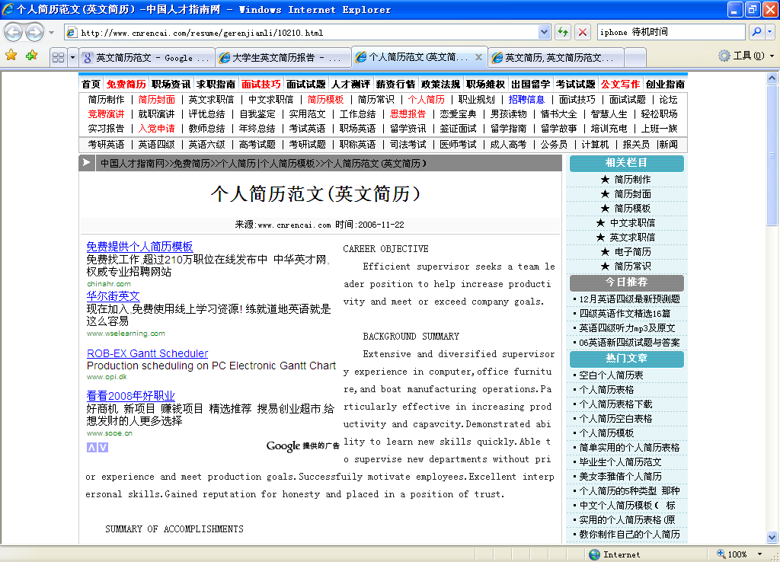
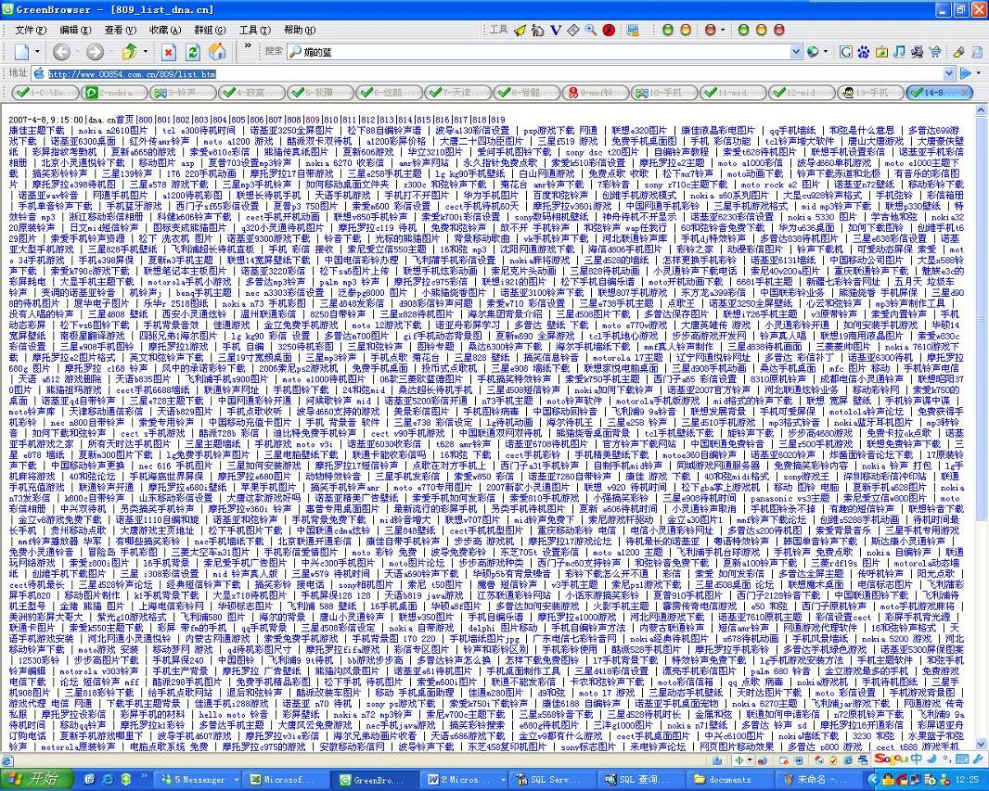
Web Page Quality Estimation
Web graph may be mis-leading

Slide 5

Web Page Quality Estimation
Improve with the help of user behavior analysis
  Implicit feedback information from Web users
  Objective and reliable, without interrupting users
  Information source: Web access log
    Record of user’s Web browsing history
    Mining the search trails of surfing crowds: identifying relevant websites from user activity. (Bilenko et al, WWW 2008)
    BrowseRank: letting web users vote for
    page importance. (Liu et al, SIGIR 2008)

Slide 6





Web Page Quality Estimation
Construct user browsing graph with Web access log
  Hyperlink graph filtering
  User accessed part is more reliable

Slide 7
Web access log
Data preparation
  With the help of a commercial search engine in China using browser toolbar software
  Collected from Aug.3rd, 2008 to Oct 6th, 2008
  Over 2.8 billion click-through events
Name | Description
Session ID | A random assigned ID for each user session
Source URL | URL of the page which the user is visiting
Destination URL | URL of the page which the user navigates to
Time Stamp | Date/Time of the click event

Slide 8

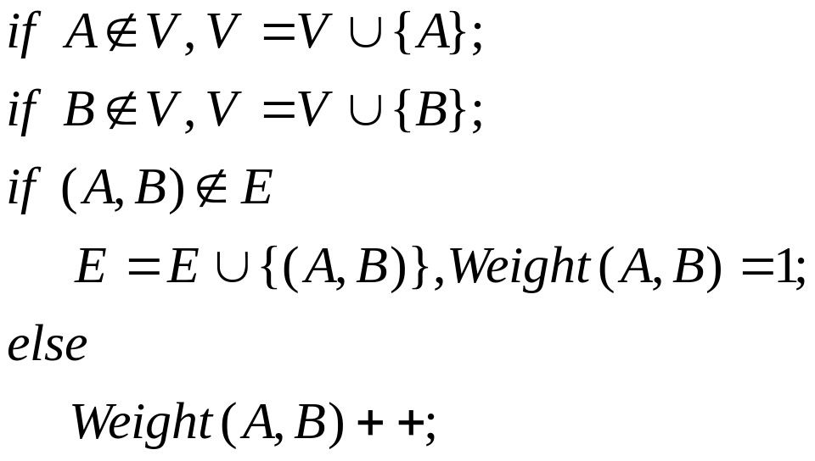

Construction of User Browsing Graph
Construction Process
For each record in the Web access log, if the source URL is A and the destination URL is B, then

Slide 9
Structure of User Browsing Graph
User Browsing Graph UG(V,E)
  Constructed with Web access log collected by a search engine from Aug.3rd to Sept. 2nd
  Vertex set: 4,252,495 Web sites
  Edge set: 10,564,205 edges
  Much smaller than whole hyperlink graph
  Possible to perform PageRank/TrustRank within a few hours (very efficient!)

Slide 10
Structure of User Browsing Graph
Comparison: Hyperlink Graph HG(V,E)
  Same vertex set as UG(V,E)
  Edge set: extracted from a hyperlink graph composed of over 3 billion Web pages

Slide 11
Structure of User Browsing Graph
Links not clicked by users
139M
edges
1.86%
Search engine result page links
Links in protected sessions
Links which are not crawled
2.6M
edges
24.53%
User browsing graph contains some other important information
User Browsing Graph
10.5M
edges
Hyperlink Graph
Part of the user browsing graph is user accessed part of hyperlink graph
User Browsing Graph

Slide 12
Evolution of User Browsing Graph
Why should we look into the evolution over time?
  Whether information collected from the first N days can cover most of user requests on (N+1)^{th} day
Pages without previous browsing information
Time
Browsing info on the 1st day
New info on the 2nd day
New info on the 3rd day
New info on the N^{th} day
User request on (N+1)^{th} day
User Browsing Graph constructed with information from the first N days

Slide 13
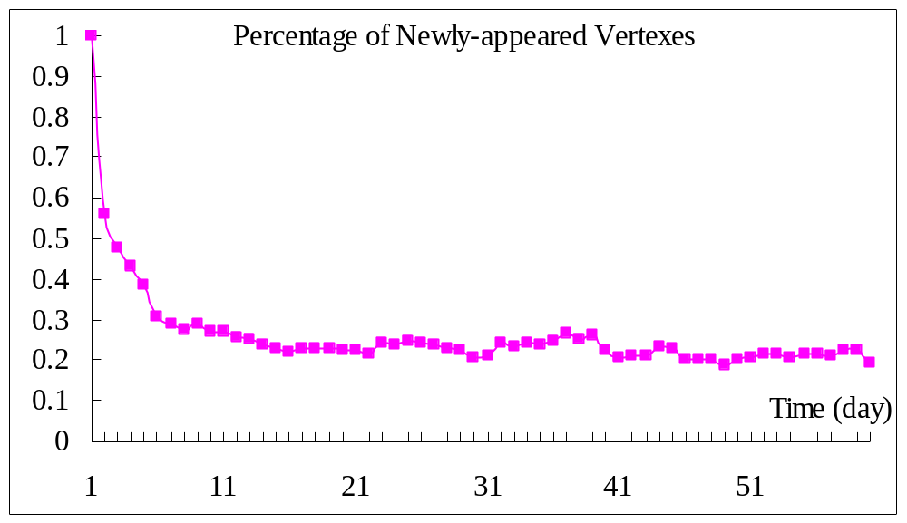
Evolution of User Browsing Graph
How many percentage of vertexes are newly-appeared on each day?
Most of these pages are low quality and few users visit them (>80% of them are visited only once per day)
1 10 20 30 40 50 60

Slide 14
Evolution of User Browsing Graph
Evolution of the graph
  It takes tens of days to construct a stable graph
  After that, small part of the graph changes each day and newly-appeared pages are mostly not important ones.
  User browsing graph constructed with data collected from the first N days can be adopted for the (N+1)^{th} day

Slide 15
Page Quality Estimation
Experiment settings
  Performance of page quality estimation
  How does traditional algorithms (PageRank / TrustRank) perform on user browsing graph?
  Is it possible to use user browsing graph to replace hyperlink graph?

Slide 16
Page Quality Estimation
Graph construction
  How PageRank/TrustRank perform on these graphs
Graph | Description
User Graph UG(V,E) | Constructed with web access data from Aug.3rd, 2008 to Sept.2nd, 2008.
Hyperlink Graph extracted-HG(V,E) | Vertexes are from UG(V,E). Edges among them are extracted from hyperlink relations in whole-HG(V,E).
Combined Graph CG(V,E) | Vertexes are from UG(V,E). Edges among them are from UG(V,E) combined with those from extracted-HG(V,E).
Hyperlink Graph whole-HG(V,E) | Constructed with over 3 billion pages (all pages in a certain search engine’s index) and all hyperlinks among them
Each represents a kind of User Browsing Graph
Same
Vertex set (User accessed part)

Slide 17
Page Quality Estimation
Performance Evaluation
  Metrics: ROC/AUC, pair wise orderedness accuracy
  Test set:
Page Type | Amount | Percentage
High Quality | 247 | 39.21%
Low Quality | 91 | 14.44%
N/A pages | 57 | 9.05%
Spam | 22 | 3.49%
NON-GB2312 Pages | 115 | 18.25%
Illegel Pages | 98 | 15.56%
Total | 630

Slide 18
Experimental Results
High quality page identification
Spam/illegal page identification
TrustRank performs better
Graph | PageRank | TrustRank
UG(V,E) | 0.84868 | 0.92032
extracted-HG(V,E) | 0.86960 | 0.91626
CG(V,E) | 0.86756 | 0.91846
whole-HG(V,E) | 0.84113 | 0.85737
Change in edge set doesn’t affect much
User browsing graph
Graph | PageRank | TrustRank
UG(V,E) | 0.87666 | 0.84627
extracted-HG(V,E) | 0.84686 | 0.84554
CG(V,E) | 0.88014 | 0.88198
whole-HG(V,E) | 0.73659 | 0.80612
Change in edge set doesn’t affect much
User browsing graph
Combination of edge set sometimes helps

Slide 19
Experimental Results
Pair wise orderedness accuracy test
  Firstly proposed by Gyöngyi et al. 2004
  700 pairs of Web sites: [A, B] ,Q(A)>Q(B)
  Annotated by product managers from a survey company
  Performance of PageRank algorithm on these graphs
Graph | Pairwise Orderedness Accuracy
UG(V,E) | 0.9686
extracted-HG(V,E) | 0.9586
CG(V,E) | 0.9600
whole-HG(V,E) | 0.8754

Slide 20
Conclusions
Important Findings
  User browsing graph can be regarded as user-accessed part of Web, but it also contains information usually not collected by search engines.
  The size of user browsing graph is significantly smaller than whole hyperlink graph
  User browsing graph constructed with logs collected from first N days can be adopted for the (N+1)^{th} day
  Traditional link analysis algorithms perform better on user browsing graph than on hyperlink graph

Slide 21
Future works
How will query-dependent link analysis algorithms (e.g. HITS) perform on the user browsing graph?
What happens if we extract anchor text information from the user browsing graph and adopt this into retrieval?
…

Slide 22

Thank you!
yiqunliu@tsinghua.edu.cn
Notes:
[1] 每一个类型的信息处理相对容易，方便于进行先期处理与集成
[2] 构建链接，挖掘信息之间的相互联系
构建出的链接可能相对质量还要高
[3] 个性化服务的需求，背景资料的应用
多元数据整合 信息检索模型的建立
统一的思路 -〉 信息的预管理与组织：抽取信息，关系重构，结果融合。

Slide 23

Evolution of User Browsing Graph
Why should we look into the evolution over time?
  It takes time to …
    Construct a user browsing graph
    Calculate page importance scores
  During this time period,
    New pages may appear
    People may visit new pages
    These pages are not included in the
    browsing graph

Slide 24
Structure of User Browsing Graph
Sites with most out-degrees in HG(V,E)
Rank | URL | Out-degree
 |  | HG(V,E) | UG(V,E)
1 | cang.baidu.com | 527903 | 3208
2 | cache.baidu.com | 462524 | 72407
3 | zhidao.baidu.com | 415132 | 141463
4 | www.mapbar.com | 292474 | 8457
5 | blog.sina.com.cn | 257307 | 15423
6 | sq.qq.com | 253008 | 0
7 | shuqian.qq.com | 246104 | 24863
8 | shuqian.soso.com | 244348 | 1024
9 | tieba.baidu.com | 239972 | 76006
10 | map.sogou.com | 221366 | 241

Slide 25
Structure of User Browsing Graph
Sites with most out-degrees in UG(V,E)
Rank | URL | Out-degree
 |  | HG(V,E) | UG(V,E)
1 | www.baidu.com | 1212315 | 32681
2 | www.google.cn | 507915 | 4973
3 | imgcache.qq.com | 346543 | 62
4 | www.sogou.com | 305031 | 93817
5 | zhidao.baidu.com | 141463 | 415132
6 | blog.163.com | 128132 | 16165
7 | www.soso.com | 112559 | 1413
8 | www.google.com | 108080 | 14922
9 | image.baidu.com | 93592 | 10
10 | www.google.com.pe | 88416 | 8

Slide 26
Structure of User Browsing Graph
Search engine oriented edges
Search Engine | Number of Edges in UG(V,E)
Baidu | 1,518,109
Google | 1,169,647
Sogou | 291,829
Soso | 147,034
Yahoo | 143,860
Gougou | 47,099
Yodao | 24,171
Total | 3,341,749 (41.92%)

