Slide 1
Disease Prediction from Symptoms
MOHAMMED SHAZIN ABBAS NITEESH KUMAR PANDEY
C LOKESH SWARUP
ANKUSH KUMAR

Slide 2
Disease Prediction from Symptoms
In the realm of healthcare, the ability to predict and identify diseases early on plays a pivotal role in improving patient outcomes and reducing the burden on healthcare systems. The project titled "Disease Prediction from Symptoms" endeavours to harness the power of advanced data analytics and machine learning to create a robust and accurate system for predicting diseases based on reported symptoms.

Slide 3

Disease Prediction from Symptoms
1. INTRODUCTION
2. PROPOSED SOLUTION
3. Model Architecture
4. Experiment details

Slide 4
INTRODUCTION
In the contemporary landscape of healthcare, the integration of machine learning has become pivotal for enhancing disease diagnosis and prognosis. This project delves into the realm of predictive medicine, specifically focusing on the use of machine learning algorithms to forecast diseases based on symptomatic manifestations.
With the increasing availability of health data and the advancements in machine learning, there is a growing interest in utilizing these technologies for disease prediction. This project builds upon existing research and aims to contribute to the development of effective and interpretable models for disease prognosis based on symptom data.

Slide 5
Algorithms Explored
Naïve Bayes
Naive Bayes classifiers are a collection of classification algorithms based on Bayes’ Theorem. It is not a single algorithm but a family of algorithms where all of them share a common principle, i.e. every pair of features being classified is independent of each other.
Decision Tree
A decision tree is a structure that includes a root node, branches, and leaf nodes. Each internal node denotes a test on an attribute, each branch denotes the outcome of a test, and each leaf node holds a class label. The topmost node in the tree is the root node.

Slide 6
Algorithms Explored
Random Forest
Random Forest is a classifier that contains a number of decision trees on various subsets of the given dataset and takes the average to improve the predictive accuracy of that dataset." Instead of relying on one decision tree, the random forest takes the prediction from each tree and based on the majority votes of predictions, and it predicts the final output.
Gradient Boosting
Gradient Boosting is a powerful boosting algorithm that combines several weak learners into strong learners, in which each new model is trained to minimize the loss function such as mean squared error or cross-entropy of the previous model using gradient descent.

Slide 7




Proposed Solution
Data Preprocessing
Feature
Selection
Model
Training
Model
Evaluation

Slide 8
Feature Selection:
Techniques such as correlation analysis and feature importance ranking from ensemble models guide the selection process, streamlining the model without compromising its predictive power.
Model Training:
The dataset is divided into training and testing sets to facilitate the evaluation of model performance. During training, the algorithms learn to recognize patterns and associations between symptoms and diseases, iteratively refining their predictive capabilities.
Model Evaluation:
The evaluation process involves comparing the predictive capabilities of each algorithm and understanding their strengths and weaknesses in the context of symptom-based disease prediction.
Interpretability and Validation:
The interpretability of the chosen algorithms is carefully examined to ensure that the predictions can be understood and trusted by healthcare professionals.
Algorithm Selection:
The project explores the effectiveness of Naive Bayes, Decision Tree, Random Forest, and Gradient Boosting algorithms.

Slide 9
MODEL ARCHITECTURE:
Dataset Loading and Inspection:
The project begins by acquiring a comprehensive dataset containing information on diseases and their associated symptoms. This dataset is loaded into a Pandas Data Frame for further analysis
Data Preprocessing:
Missing values in the dataset are handled using a forward-fill method, ensuring the continuity of information.
Disease-Symptom Dictionary Formation:
A dictionary (`disease_symptom_dict`) is created, mapping diseases to their corresponding symptoms. This dictionary captures the intricate relationships between diseases and symptoms in the dataset.
Count of Disease Occurrence:
Another dictionary (`disease_symptom_count`) is established to track the count of disease occurrences. This count provides insights into the prevalence of each disease in the dataset.

Slide 10
MODEL ARCHITECTURE:
Combining Labels with Disease Column:
The one-hot encoded labels are concatenated with the disease column, creating a new dataset (`df_concat`) that encapsulates diseases along with their associated one-hot encoded symptoms.
Grouping and Summing for Symptom Aggregation:
To handle multiple symptoms associated with each disease, the dataset is grouped by disease, and symptom occurrences are summed across each group.
Visualizing the Decision Tree:
The Decision Tree model is visualized using the graphviz library, providing a graphical representation of the decision-making process. This visualization aids in understanding how the model makes predictions based on symptoms.
Model Evaluation:
The accuracy of the trained model is evaluated on the entire dataset, providing insights into its overall performance.
- The model is employed to predict diseases based on symptoms, and the results are compared against the actual disease occurrences for verification.

Slide 11
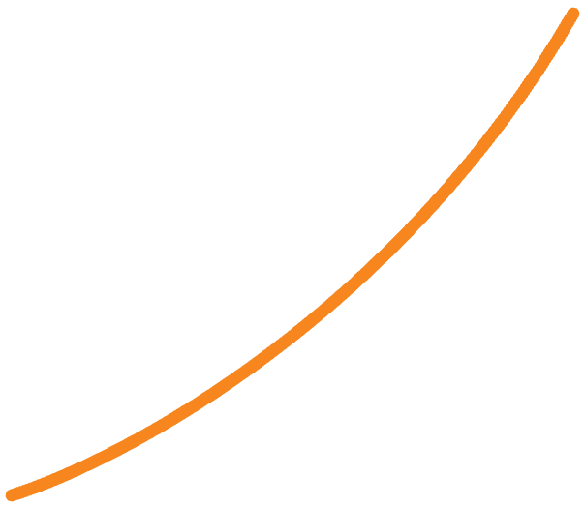

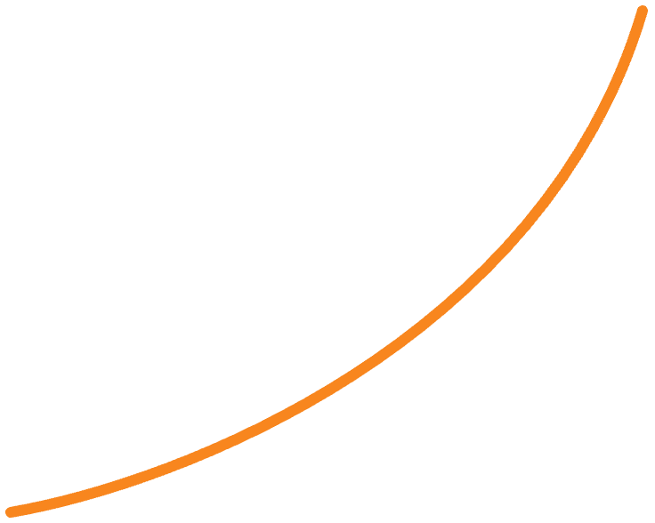
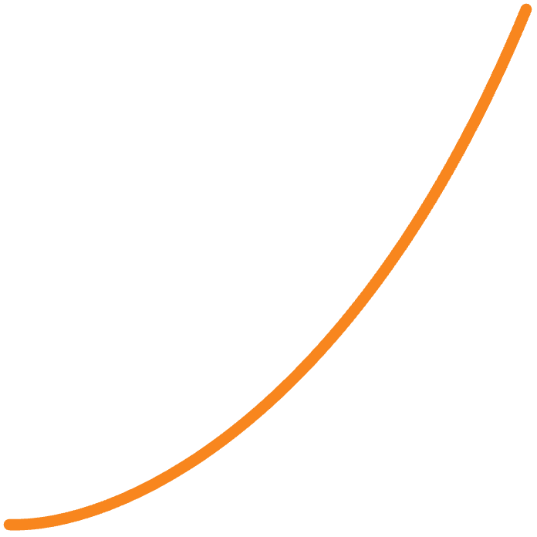


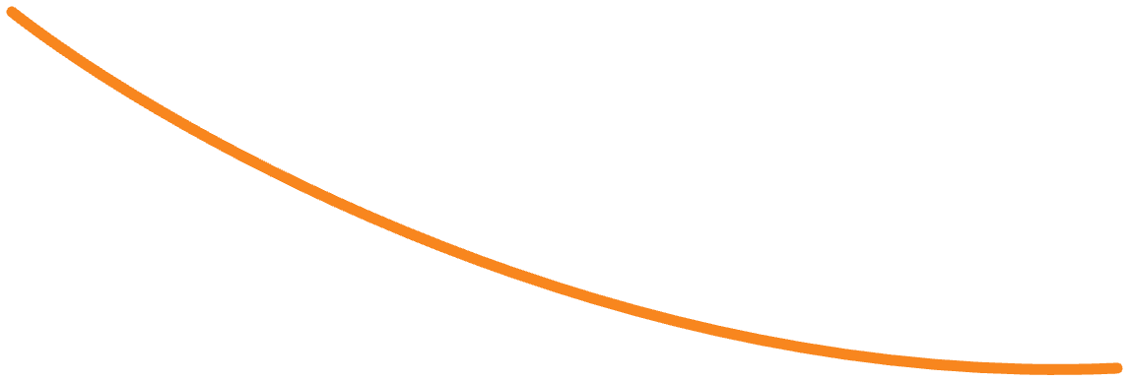

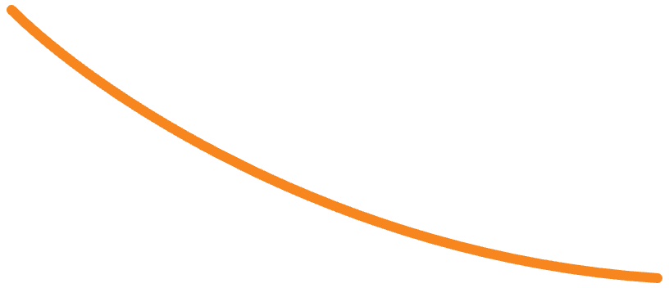
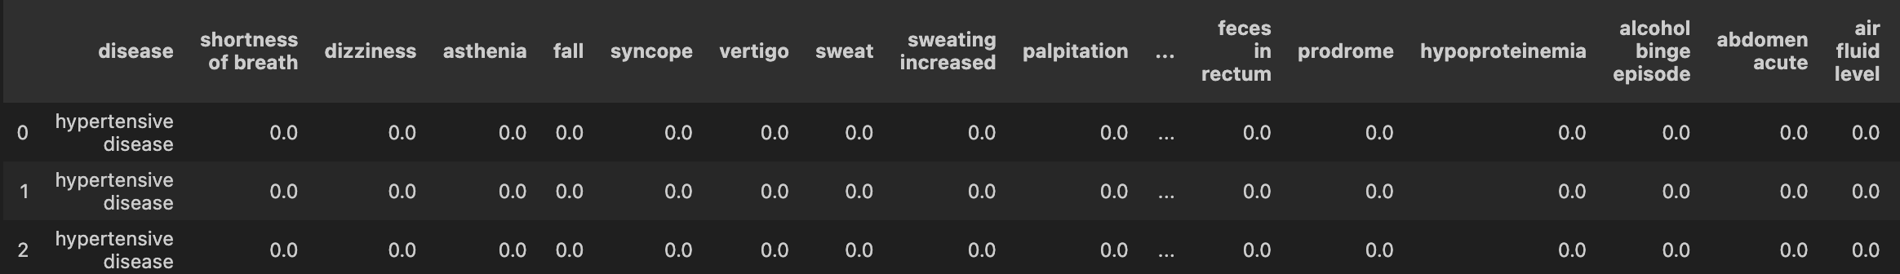
EXPERIMENTATION DETAILS
PROJECT# | TEAM | DEADLINE | TIME THAT REMAINS | TASKS THAT REMAIN
46412321=091 | 616 | 30.10.2023 | 02:15:02 | 161
46409821=590 | 199999 | 10.11.2023 | 00:02:04 | 8
46417171=717 | 17 | 17.07.2017 | 17:17:17 | 17
46454356=077 | 9 | 18.15.1413 | 19:18:15 | 14131
46423454=432 | 12 | 15.11.9125 | 91:21:59 | 12159

Slide 12
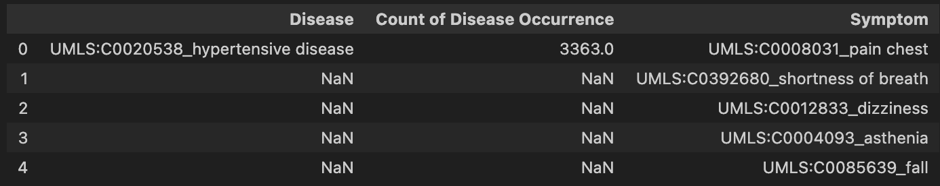
EXPERIMENTATION DETAILS
Dataset Loading and Examination:
http://people.dbmi.columbia.edu/~friedma/Projects/DiseaseSymptomKB/index.html
2. Data Cleaning:
- The forward-fill method is employed to handle missing values. This technique involves filling NaN values with the last observed non-null value in the dataset, ensuring continuity and completeness in the data.

Slide 13
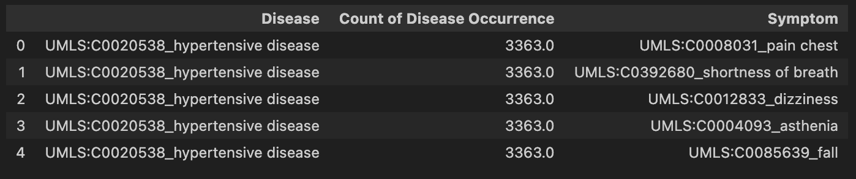
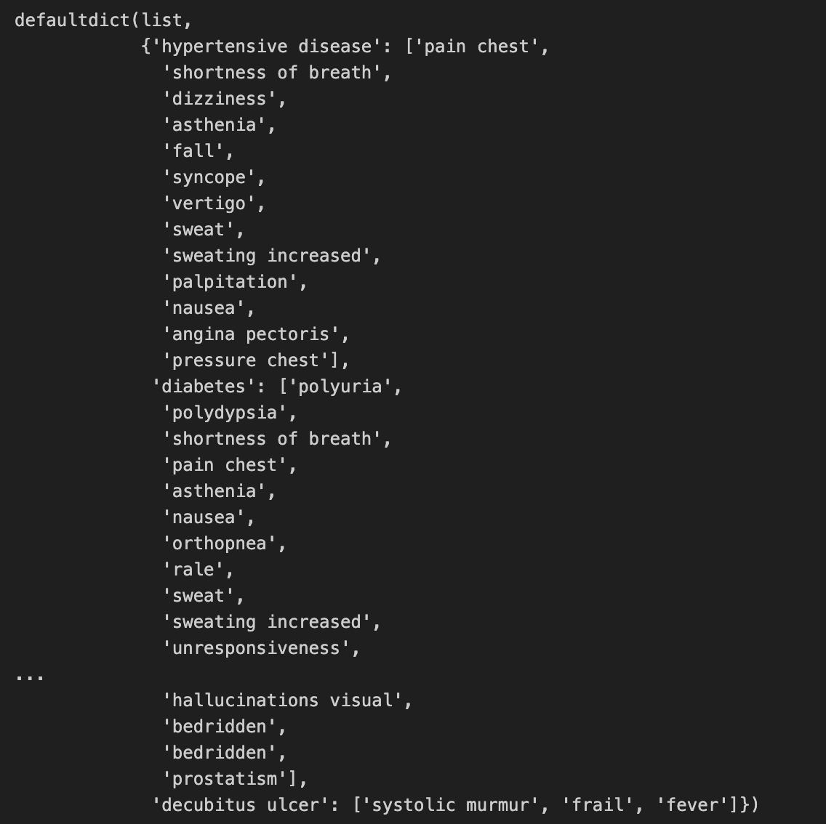
EXPERIMENTATION DETAILS
3. Processing Disease and Symptom Names:

Slide 14
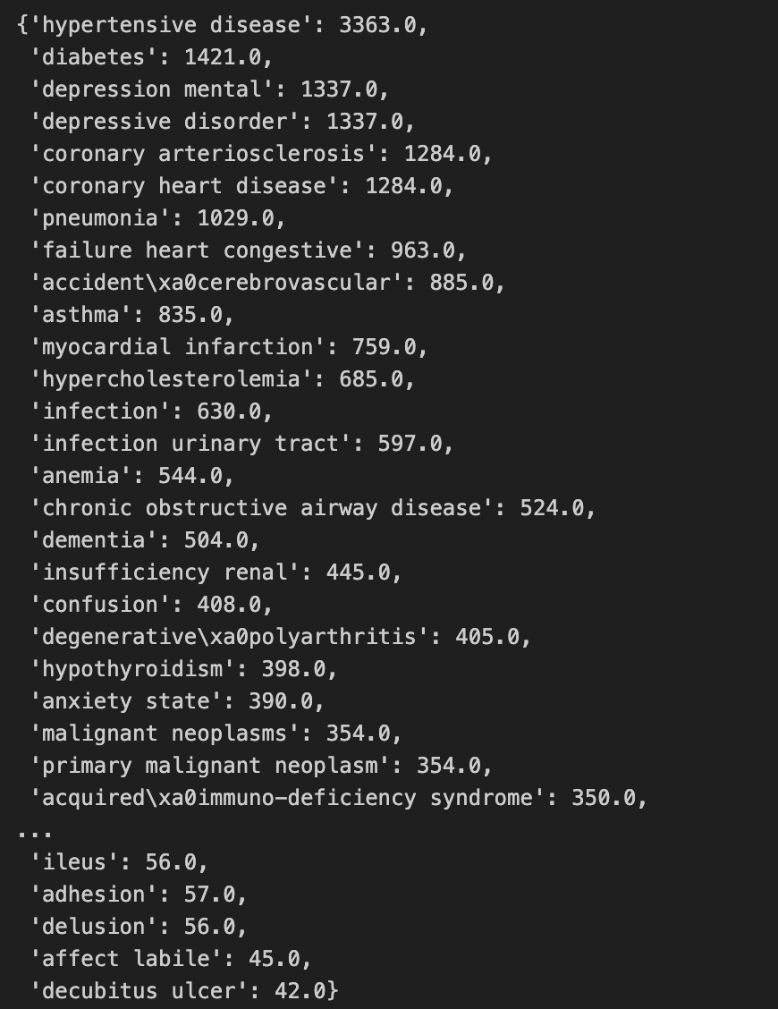
EXPERIMENTATION DETAILS
Count of Disease Occurrence:
The count of disease occurrences is tracked and stored in a separate dictionary (`disease_symptom_count`).
This count represents the frequency of each disease in the dataset.

Slide 15
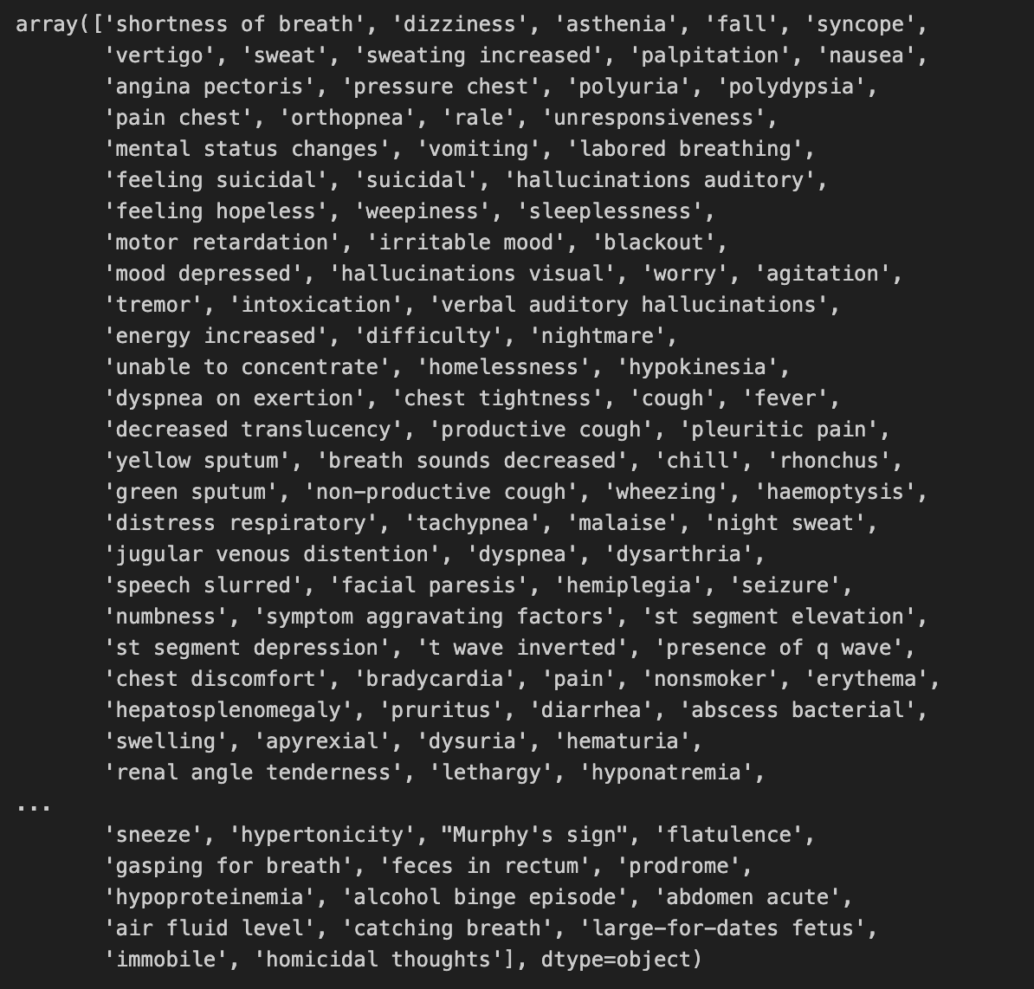
EXPERIMENTATION DETAILS
One-Hot Encoding of Symptoms:
Label encoding is initially applied to convert symptom names into numerical values.

Slide 16
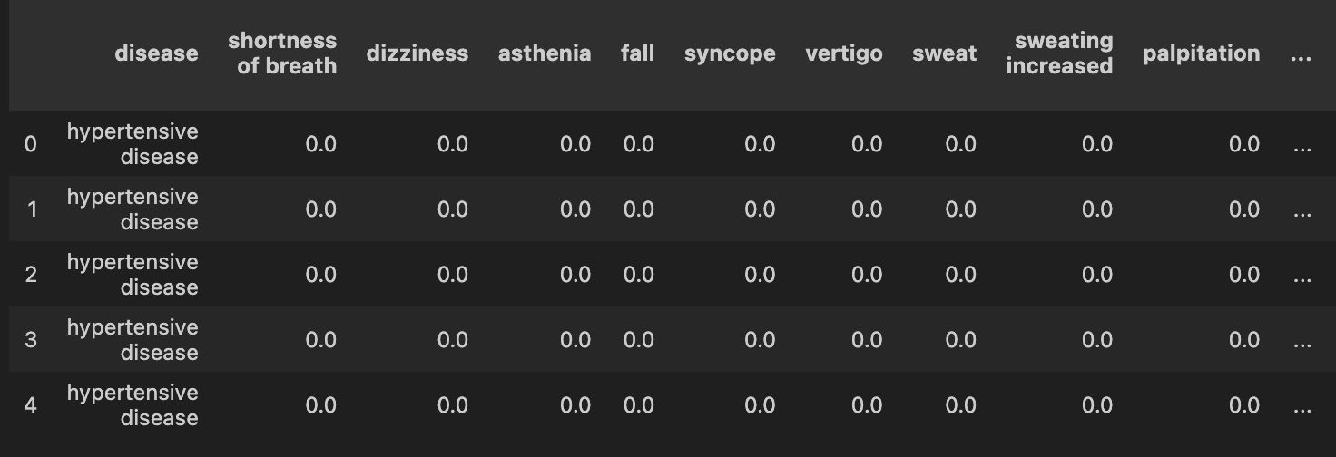
EXPERIMENTATION DETAILS
Combining One-Hot Encoded Labels with Disease Column:
- The one-hot encoded labels are concatenated with the disease column to form a new dataset.
- This dataset represents diseases along with their associated one-hot encoded symptoms.

Slide 17

EXPERIMENTATION DETAILS
Visualizing The Decision Tree
Decision Tree is visualized using the graphviz library, providing a graphical representation of the decision-making process

Slide 18
THANK YOU
MOHAMMED SHAZIN ABBAS NITEESH KUMAR PANDEY
C LOKESH SWARUP
ANKUSH KUMAR

