Slide 1

An Efficient Algorithm for Line Clipping in 2-D Computer Graphics
THU EE 赵若愚
2023.5.24

Slide 2
Task:
To clip lines with a rectangular window.

Slide 3
Review
traversing method
midpoint subdivision
Cohen-Sutherland
Liang-Barsky

Slide 4
traversing method
midpoint subdivision
Cohen-Sutherland
Liang-Barsky
Tips:
Set the start and end point.
Do sampling when traversing.
The idea of discrete points, handling small line segments in practice.

Slide 5
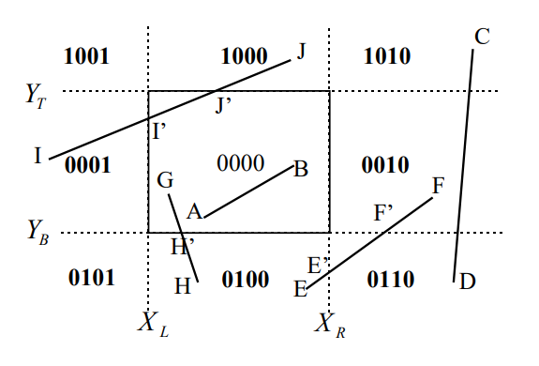
traversing method
midpoint subdivision
Cohen-Sutherland
Liang-Barsky
Tips:
Full use of start and end point.
Further complicating judgments for a few cases.

Slide 6
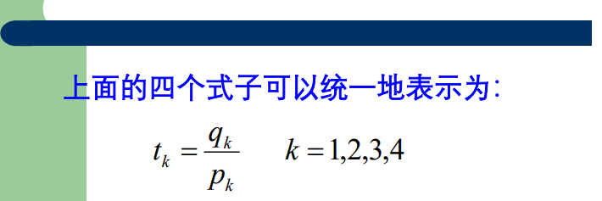
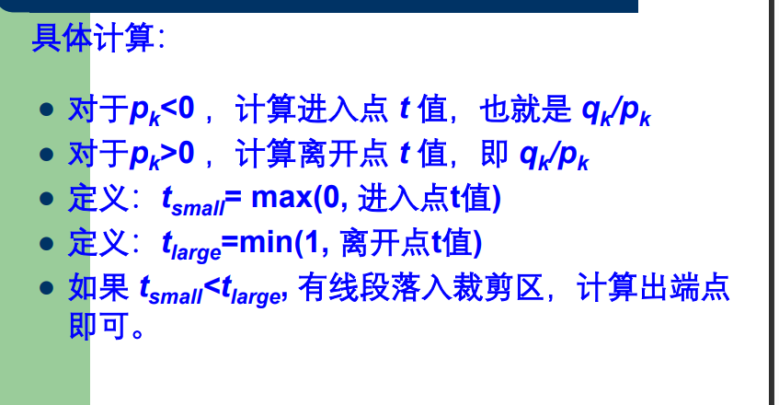
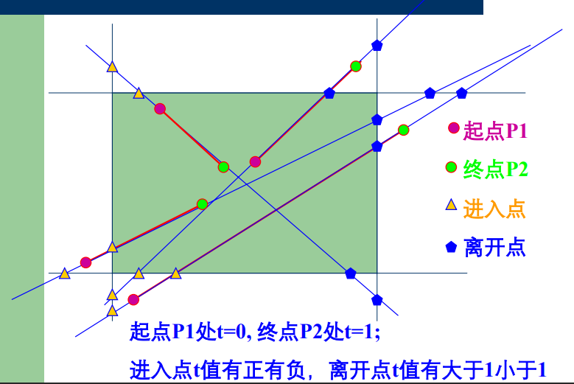
traversing method
midpoint subdivision
Cohen-Sutherland
Liang-Barsky
Tips:
Comparison between starting/ending points and intersections.

Slide 7
Inadequacy:
Cohen-Sutherland:
Not universal enough, further complicating judgments for a few cases.
Liang-Barsky:
The handling of some obvious cases is not easy enough.

Slide 8
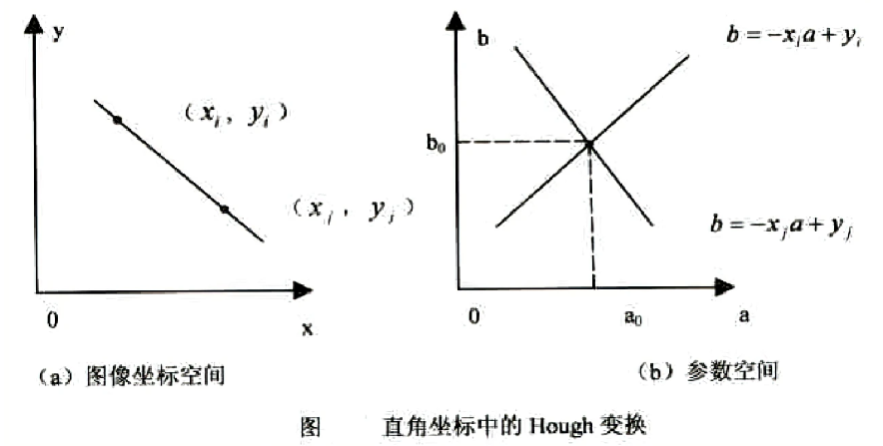

My Algorithm
Hough transform:
Line
in rectangular window
Point
in specific area

Slide 9
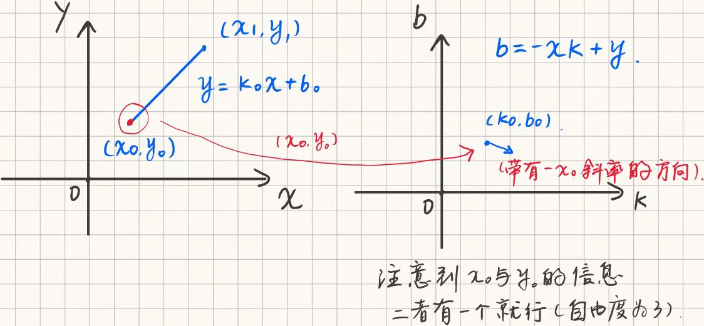
My Algorithm

Slide 10
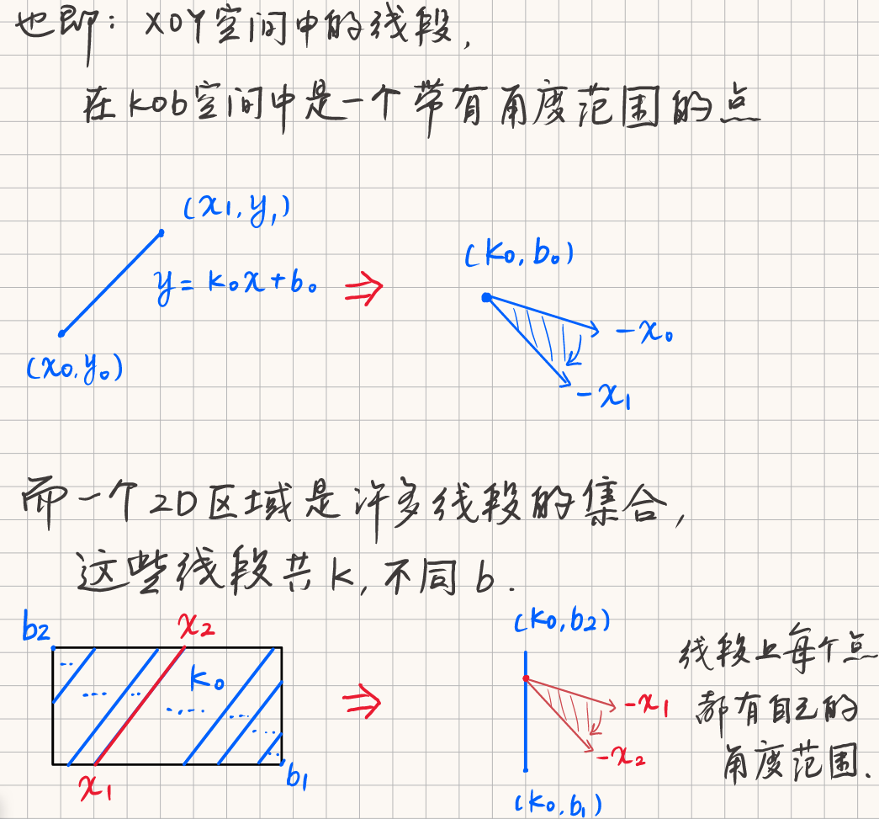
My
Algorithm

Slide 11
My Algorithm
Preliminary thought
For each given line segment, the two intersections with the rectangular window can be calculated directly through k and b.
Then just compare the position relations between the starting/ending points and the two intersections.

Slide 12
My Algorithm
Inadequacy:
How to deal with disjoint situations?
For each given line segment, several personalized calculations are needed. It’s complicated.

Slide 13
My Algorithm
Optimize:
fix k and move b → fix b and move k (easy to find out disjoint situations).
Move rectangular window to the origin (reduce the dimension by introducing more presupposition knowledge).

Slide 14
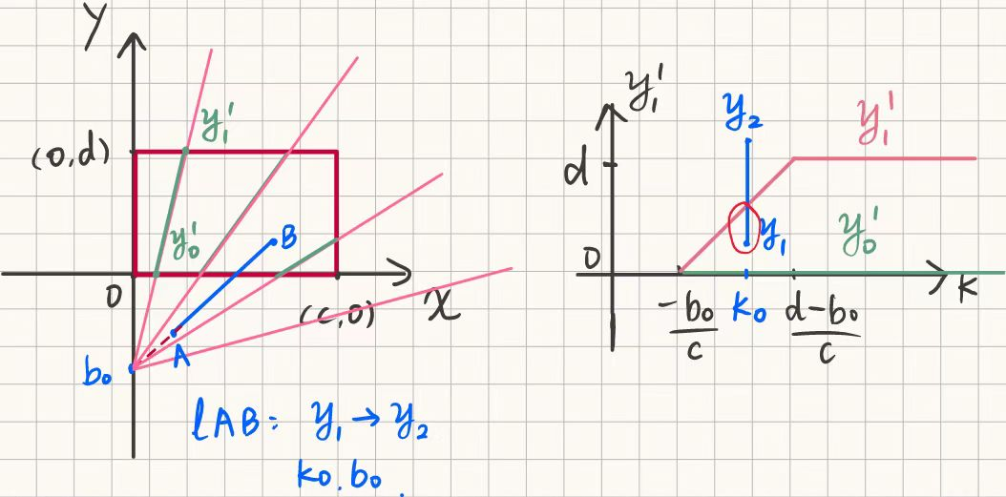
My Algorithm
Final:

Slide 15
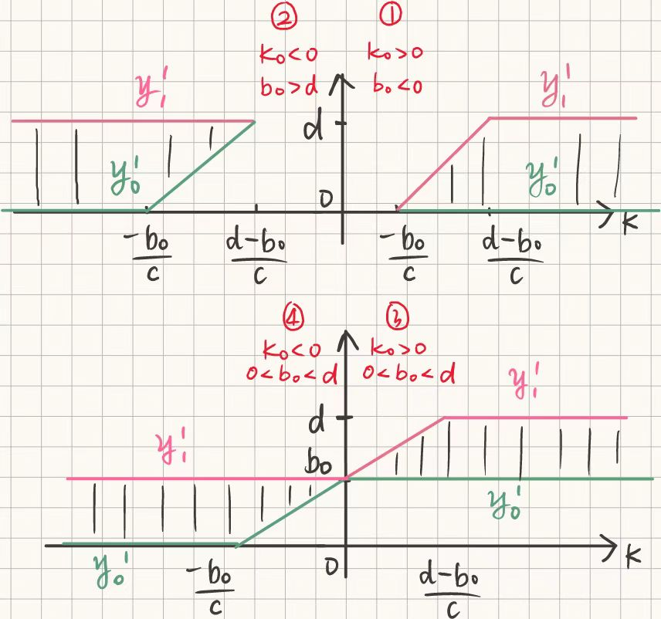
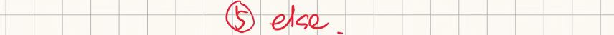
My Algorithm
Final:

Slide 16
My Algorithm
Final:
Calculate k0 & b0 by (x0, y0) & (x1,y1).
Determine which case it is (①~⑤), based on the range of k0 & b0.
Do 1-D clipping with the information from the curve in the corresponding case (take the intersection of [y0, y1] and [y0’, y1’]).
Plot the line with the two ordinates.

Slide 17
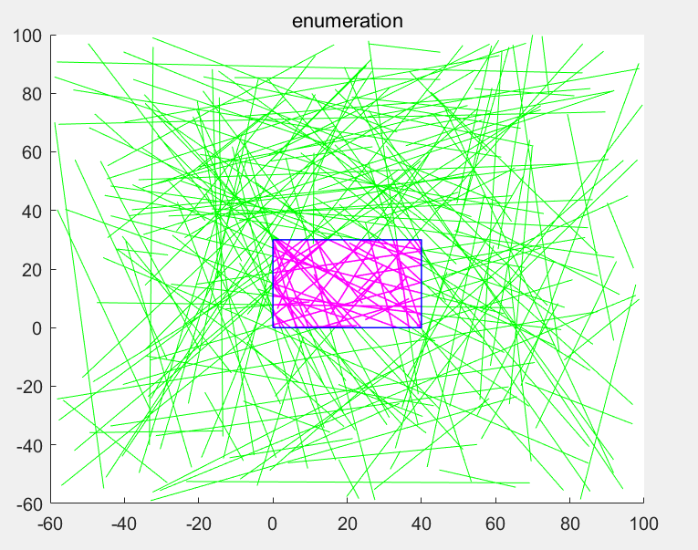
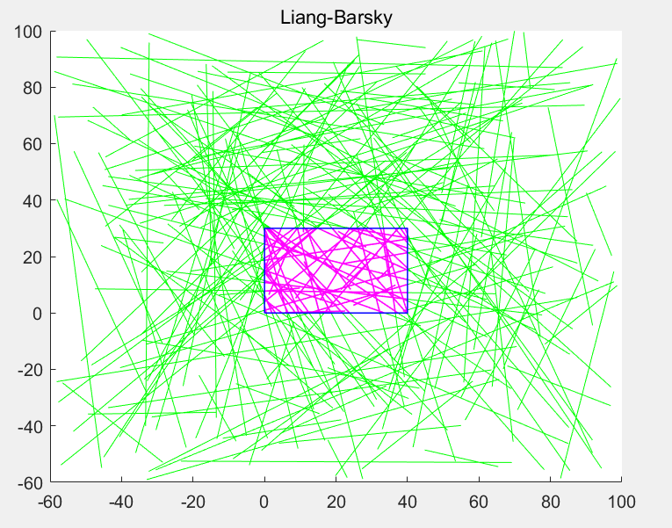
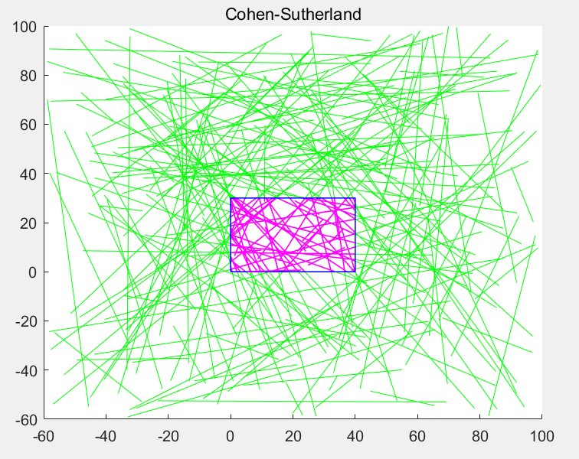
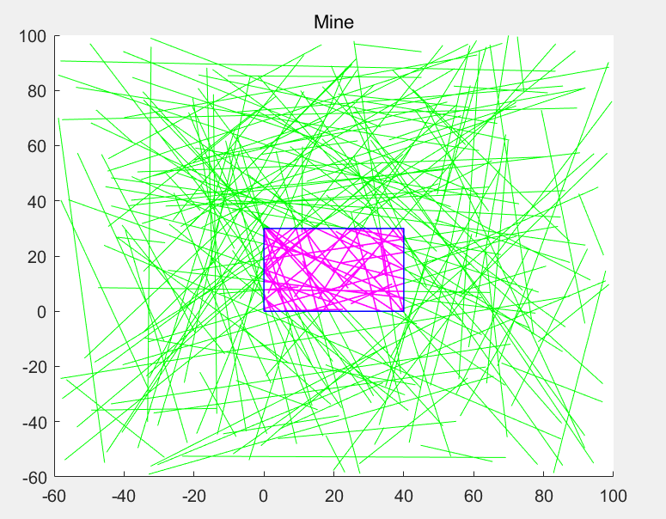
n=200
Result
traversing
Liang-Barsky
All’re right.
Cohen-Sutherland
Mine

Slide 18

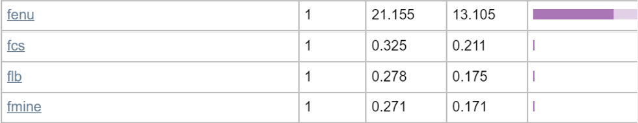
Time Comparison
n=200
traversing
Cohen-Sutherland
Liang-Barsky
Mine
Hugely better than traversing method.

Slide 19
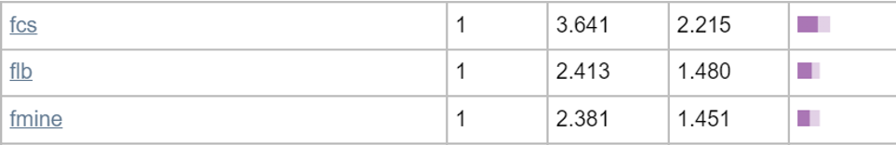
Time Comparison
n=2000
Cohen-Sutherland
No.3
Liang-Barsky
No.2
Mine
No.1

Slide 20
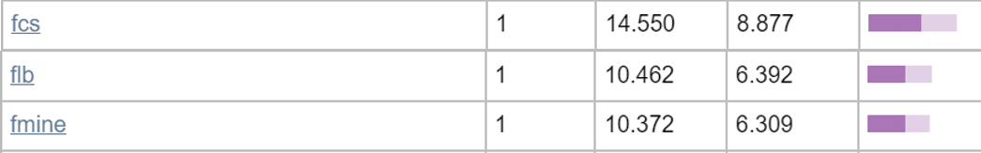
Time Comparison
n=10000
Cohen-Sutherland
No.3
Liang-Barsky
No.2
Mine
No.1
My algorithm got the best result!
slightly better than L-B, better than C-S.

Slide 21
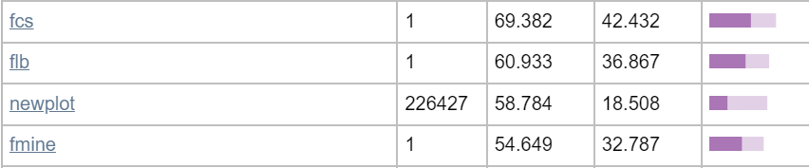
Time Comparison
n=50000 with optimizations in code
Cohen-Sutherland
No.3
Liang-Barsky
No.2
Mine
No.1
My algorithm got the best result!

Slide 22
Thank you! Feel free to talk/argue with me.
THU EE 赵若愚
2023.5.24

