Slide 1
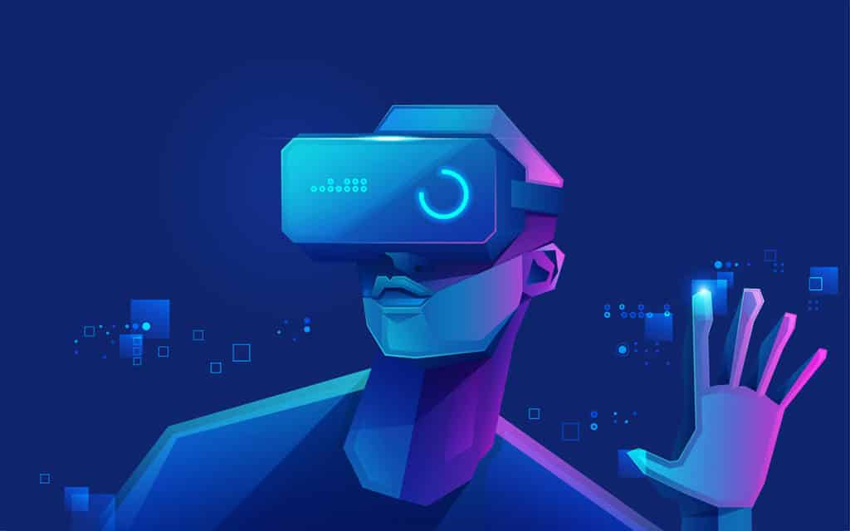
VR SAFTEY TRAINING FOR A LATHE
Source - VR

Slide 2
AGENDA
Objectives
Physical to Digital
Blender
Unity
Challenges
Future Possibilities

Slide 3
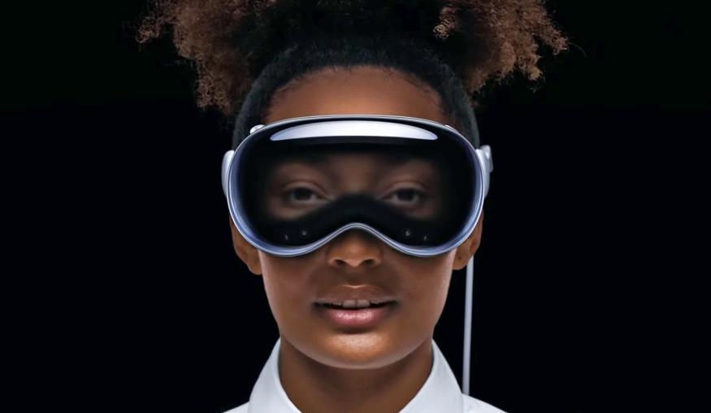
OBJECTIVES
Inexpensive Safety training
Locomotion - Continuous Movement with snap turn
Lathe machine polished and made interactable with simplistic hands
Head movement enabled
Movable work piece that can attach to the lathe
Screen with safety instructions
NPC/ Avatar made interactable
Sound effects - hazard area, lathe
Source - apple.com

Slide 4

PHYSICAL TO DIGITAL
Polycam (Photogammetry)
Knowledge transfer from the instructor
gltf file => .obj File
Source - Physical to digital

Slide 5

BLENDER
Clean up
Sperate moving parts
Create new parts
Fix surfaces and shapes
Textures

Slide 6
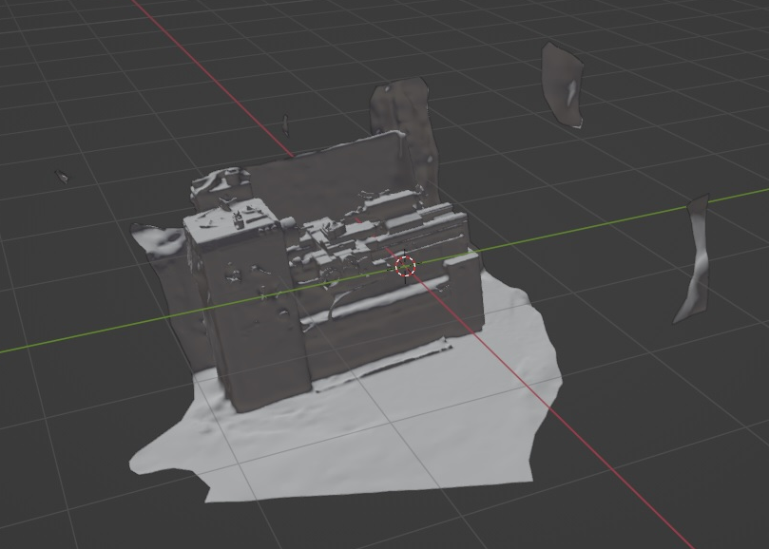
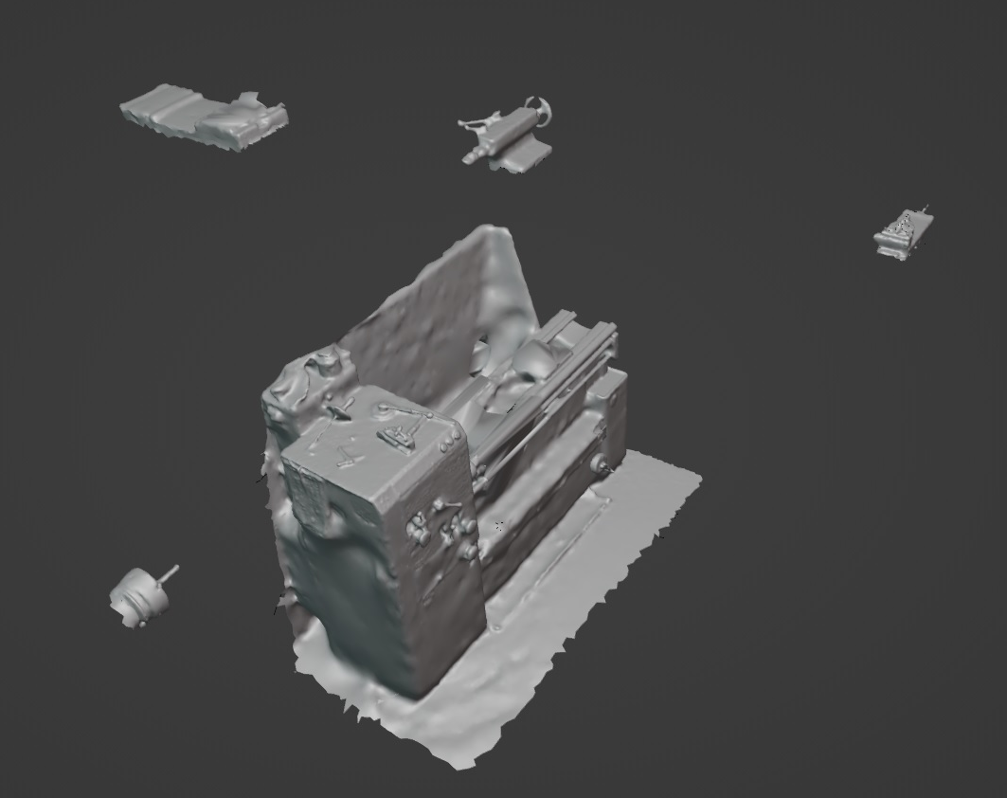
BEFORE AND AFTER

Slide 7

UNITY
Import Lathe
Add all new and old parts of Lathe
Define relations between objects
Joints
Scripts
NPC
Sound
Enviroment
No Go Zones

Slide 8
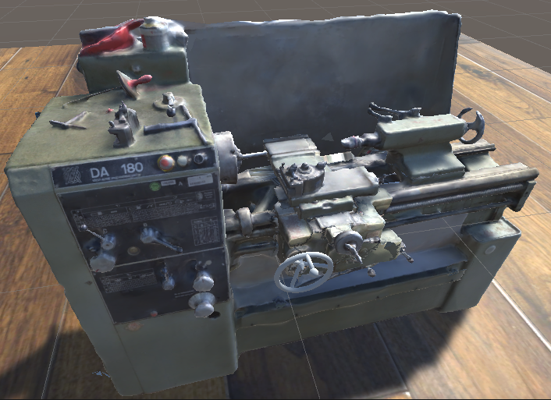
UNITY
Import Lathe
Add all new and old parts of Lathe
Define relations between objects
Joints
Scripts
NPC
Sound
Enviroment
No Go Zones
Animations

Slide 9

CHALLENGES
Collisions
Dependencies and Versions
Testing without VR
Using VR Hands
Proper NPC tutorial
Proper lathe functionality
Source - Challenges

Slide 10
FUTURE POSSIBILITIES
Connect NPC to ChatGPT with speech to text
Collisions
Realistic Control of Lathe – machining workpiece
Creating the complete lathe in blender

