Slide 1
XGBoosters
SLITT Datathon 2023
V. Vipooshan
S. Sarankan
T. Thuvaaragan

Slide 2
Problem Statement
identifying in a list of server-side events those that are suspicious of being non-human generated

Slide 3
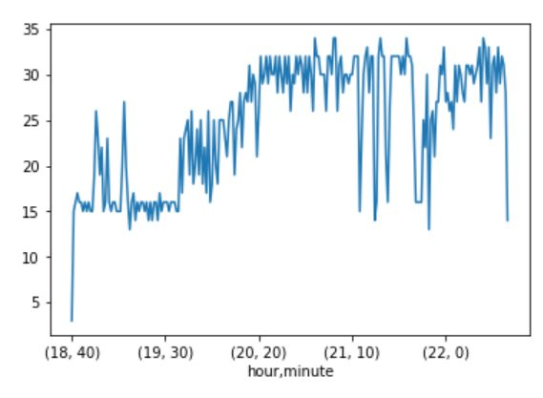
Approach
Our Assumptions in determining the Non_Human_Actions
A user cannot do high no of actions per minute
Session Id -3511262826

Slide 4
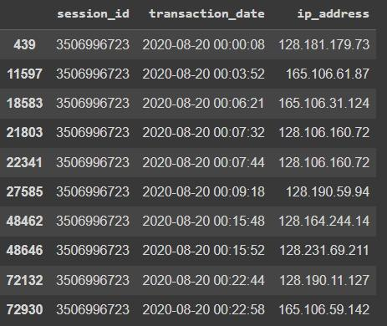
2. A user will do more no of action_type (Distinct action type ) than bots
3. There is a chance for suspicious activity if there are more distinct IP address for unique session.
9 Different ip_address for
Session id =3506996723

Slide 5
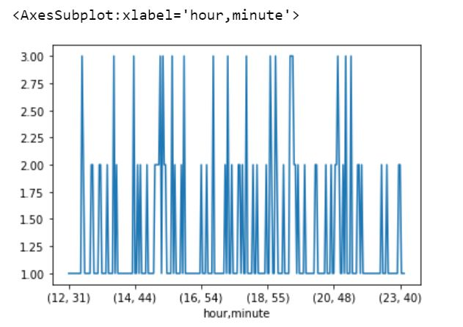
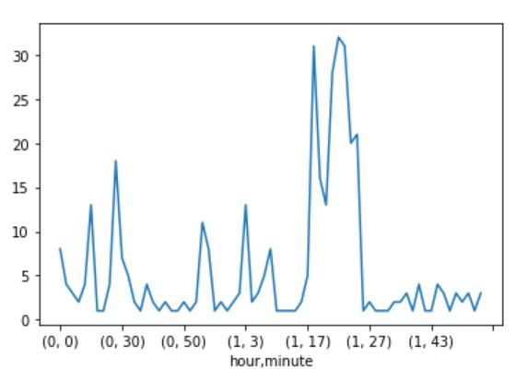
4. A bot’s action pattern will display a difference than that of users. There will be a stationarity in the bot’s action pattern.
Bot behavior Human behaviour
Session Id -3509848836
Session Id - 3506282987

Slide 6
Feature Engineering
Cannot directly use the given dataset
We have created new features
No of events happened for a session Id in a specific minute
No of unique distinct IP addresses for a session ID
Label Encoding
Clustering Purpose.

Slide 7
Methodology
Our pipeline consist of 2 main parts
Clustering algorithm
Excluding based on suspicious action pattern

Slide 8
Clustering algorithm
Why clustering ?
Non supervised learning problem
We have used K-Means clustering Algorithms as the Clustering algorithm
Already done Label Encoding .
2 clusters .

Slide 9
Handling suspicious action pattern
We have already found that there will be difference in action pattern for bots.
Clustered output is now the input
We use stationary test to determine the pattern of actions.
We can exclude sessions with same pattern (Bots) with also considering
No of actions per minute
No of Unique IP address per session

Slide 10
Handling suspicious action pattern
2nd component was also a validation for 1st component
Eg : session id of 3506996723

Slide 11
Thank You

