Slide 1


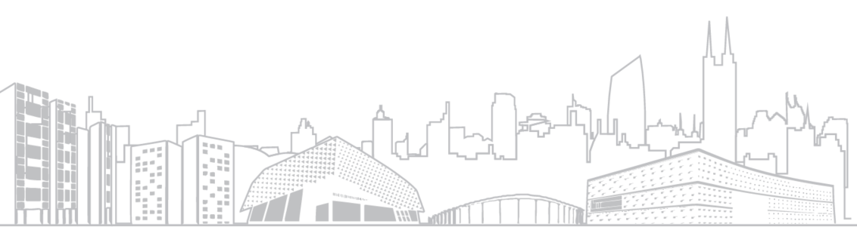
Summery of the Week

Slide 2
Content
The results of 500 rounds
The result after adjusting the learning rate
New discoveries about SFL-v2

Slide 3
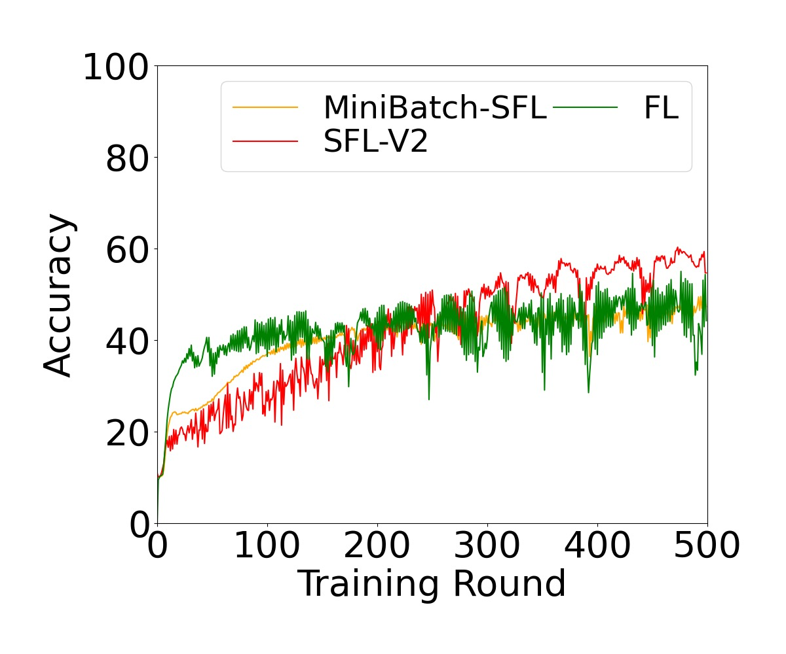
Test result of 500 rounds
Non-IID=0.9

Slide 4
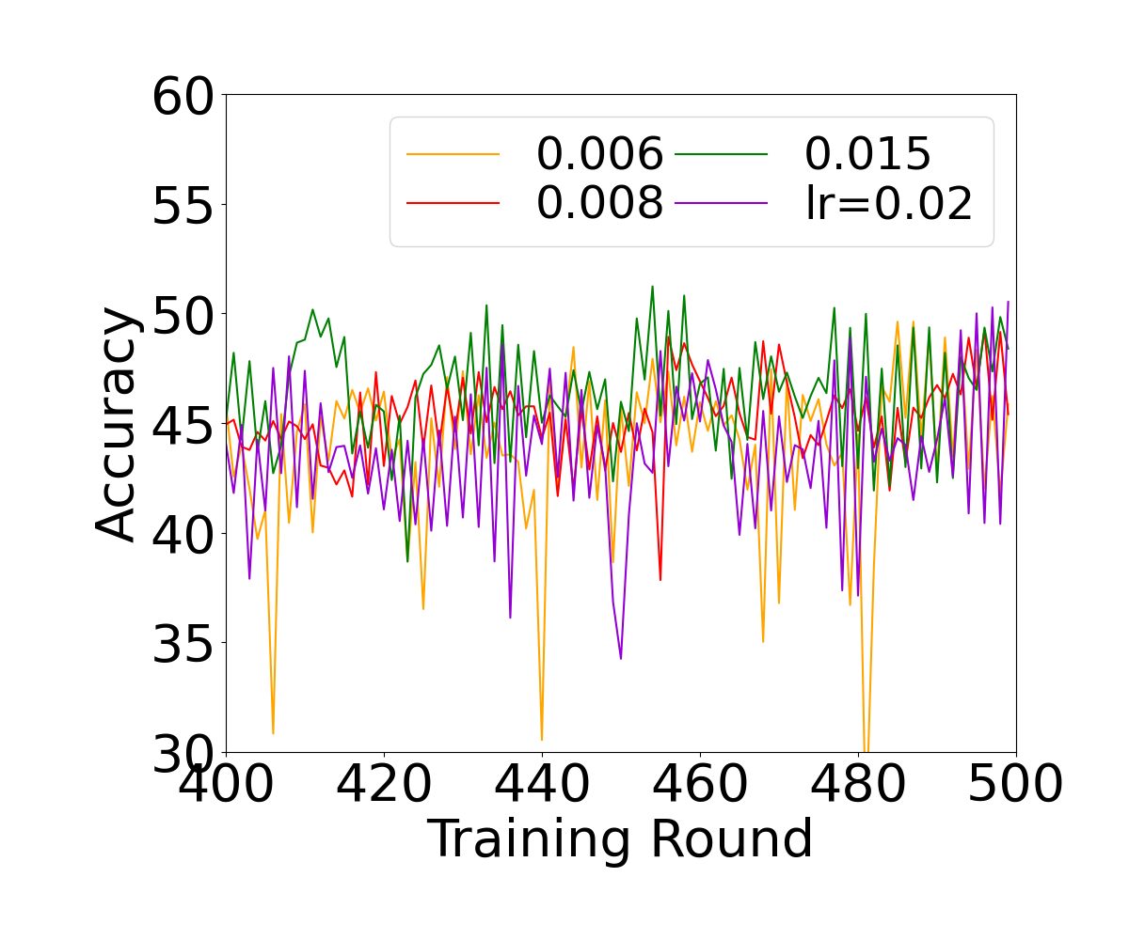
The result after adjusting the learning rate
Non-IID=0.9

Slide 5
New discoveries about SFL-v2
Layer1
Layer2
Layer3
Layer4
Layer1
Layer2
Additional Layer1
Additional Layer2
Layer3
Layer4

Slide 6
THANK YOU

