Slide 1


Summary of the Week

Slide 2
Experimental Results
 | ResNet18 | ResNet34 | Simple CNN | VGG16 | VGG18
Cifar10 | Y | Y | N | N | N
Cifar100 | Y | Y | N | N | N
MNIST | Y | Y | N | N | N
FMNIST | Y | Y | N | N | N
HAM10000 | N | N | ? | ? | ?

Slide 3
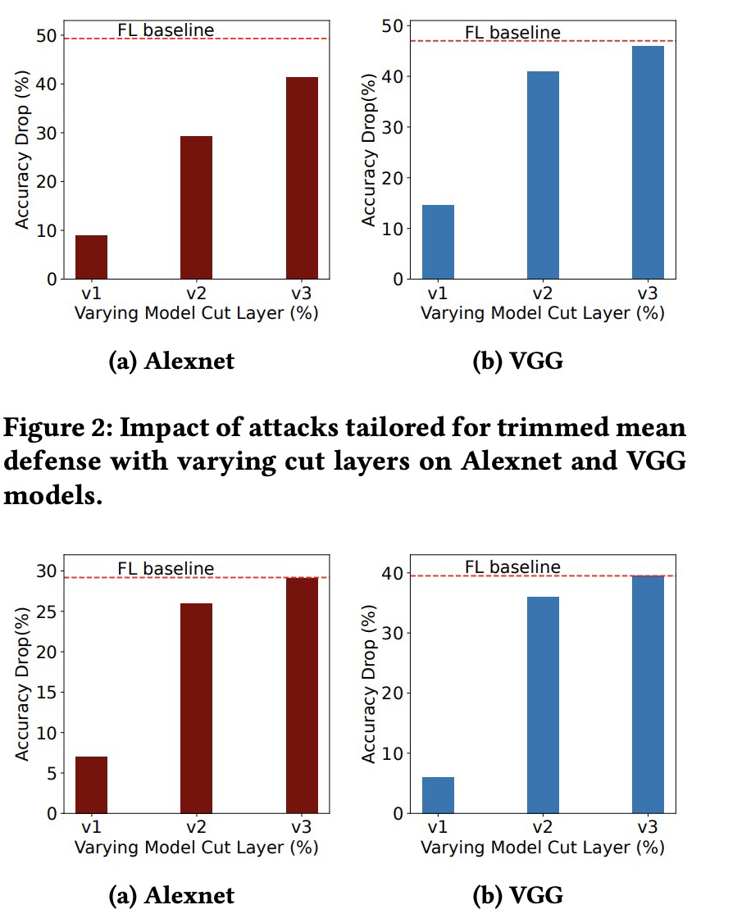
Opposite conclusion
Khan, M. A., Shejwalkar, V., Houmansadr, A., & Anwar, F. M. (2022, November). Security analysis of splitfed learning. In Proceedings of the 20th ACM Conference on Embedded
Networked Sensor Systems (pp. 987-993).

Slide 4
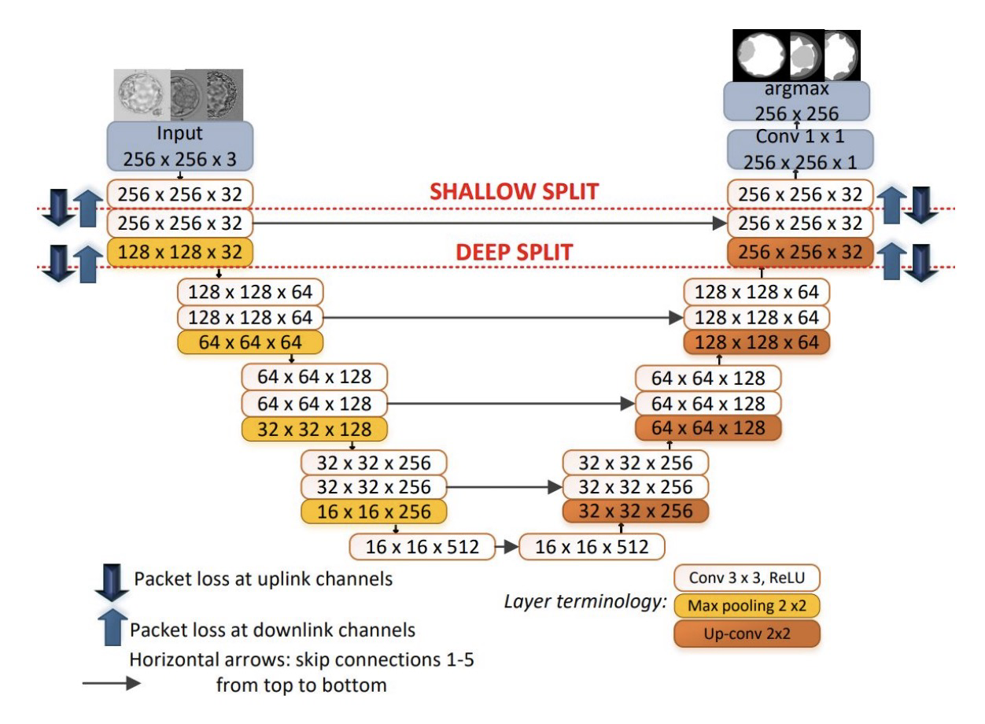
Cut layer feasibility
Shiranthika, C., Kafshgari, Z. H., Saeedi, P., & Bajić, I. V. (2023, October). SplitFed resilience to packet loss: Where to split, that is the question. In International Conference on Medical Image
Computing and Computer-Assisted Intervention (pp. 367-377). Cham: Springer Nature Switzerland.

Slide 5
THANK YOU

