Slide 1



Summery of the Week

Slide 2
Content
Analysis of the paper
Raspberry PI model running speed
Accuracy test of the model
The difficulty of the Raspberry PI experiment

Slide 3
Analysis of the paper
Increase running speed by 10%
The test accuracy is low
Transmission delay cannot be completely eliminated

Slide 4
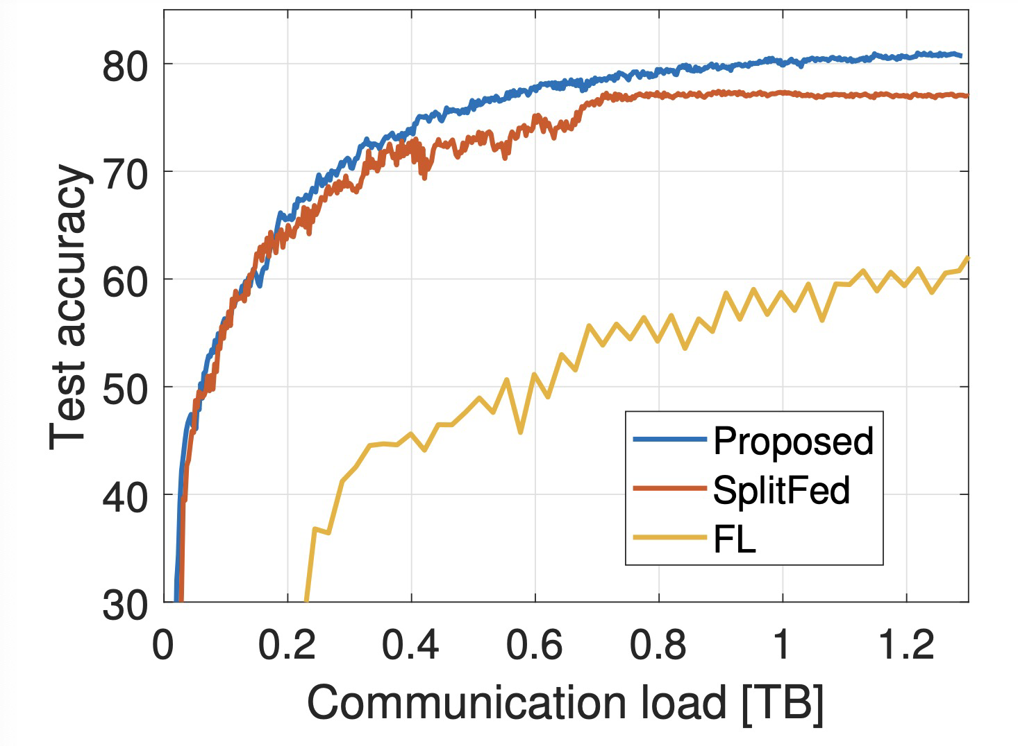
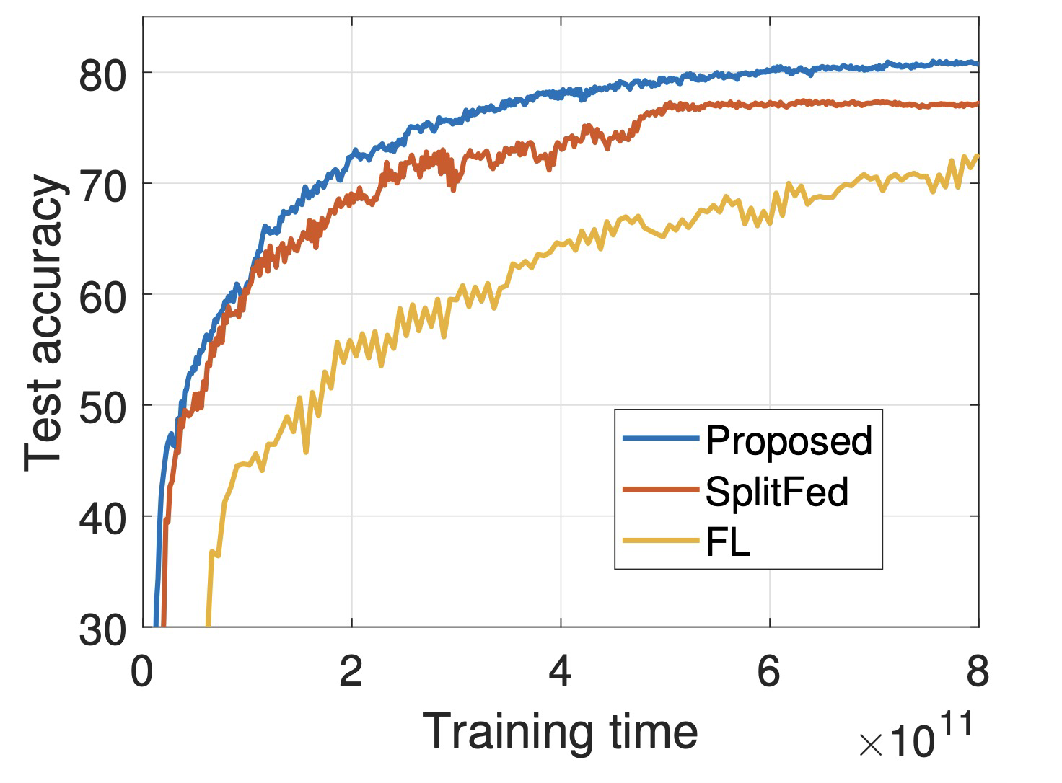
Analysis of the paper

Slide 5
Raspberry PI model running speed
Each mini-batch takes 1s to compute and 6s to transmit
Each round requires 9970 operations and 997-9970 transfers
cifar10 data training takes 443-1938 hours to complete

Slide 6
Accuracy test of the model
The training speed is too slow to get a good model
The reliability of training is proved from the side

Slide 7
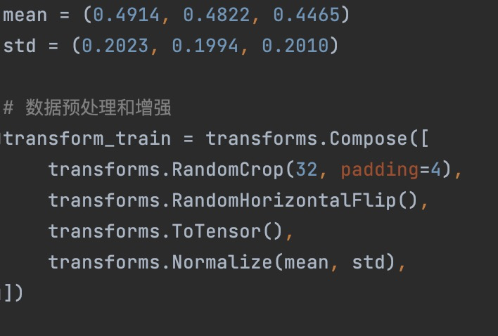
Accuracy test of the model

Slide 8
The difficulty of the Raspberry PI experiment
The proportion of communication time is too large
Each minibatch is trained separately, making it impossible to make good use of the gpu

Slide 9
THANK YOU

