Slide 1

FedCorr: Multi-Stage Federated Learning for Label Noise Correction
12332463 Geng Tian
Department of Computer Science and Engineering, Southern University of Science and Technology, Shenzhen, China

Slide 2
Experimental Progress
Cifar10 with different noise rate(IID and non-IID)
FMNIST with different noise rate(IID and non-IID)
Cifar100 with different noise rate(non-IID).
SFLCorr on Cifar10(IID and non-IID)

Slide 3
Paper Structure
Convergence analysis: MSE and Cross-Entropy
SFL with different noise rate
SFLCorr improves the accuracy

Slide 4
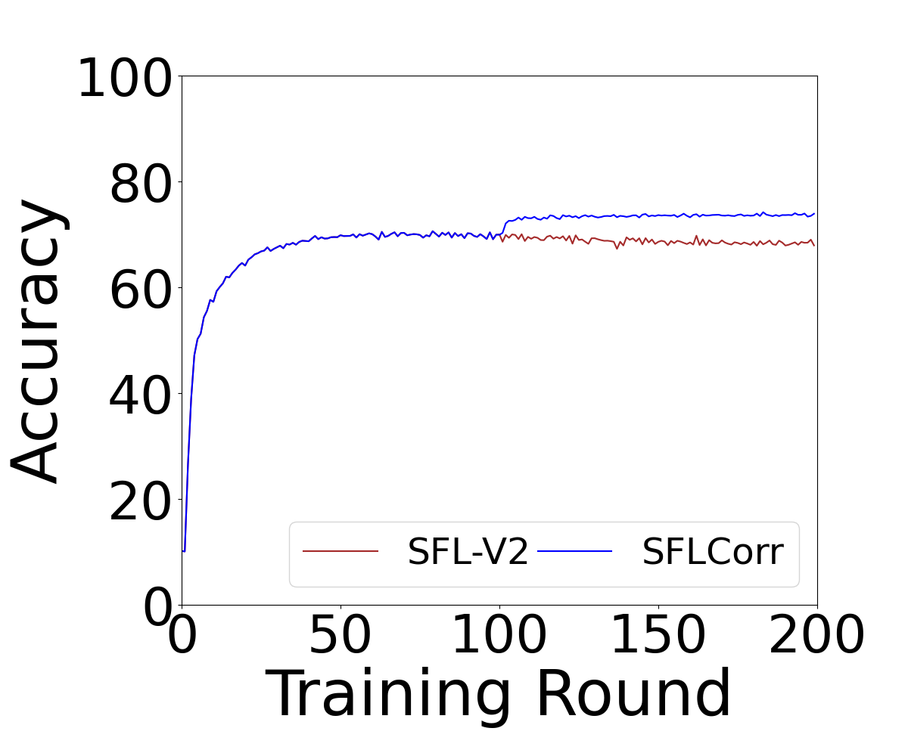
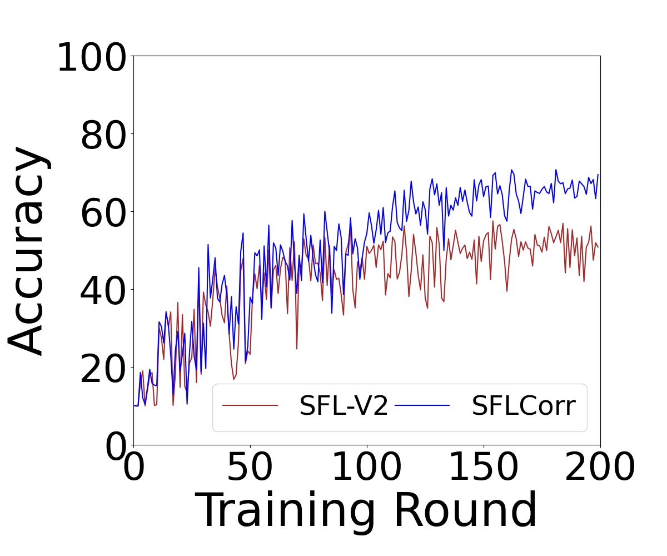
Experimental Result

Slide 5
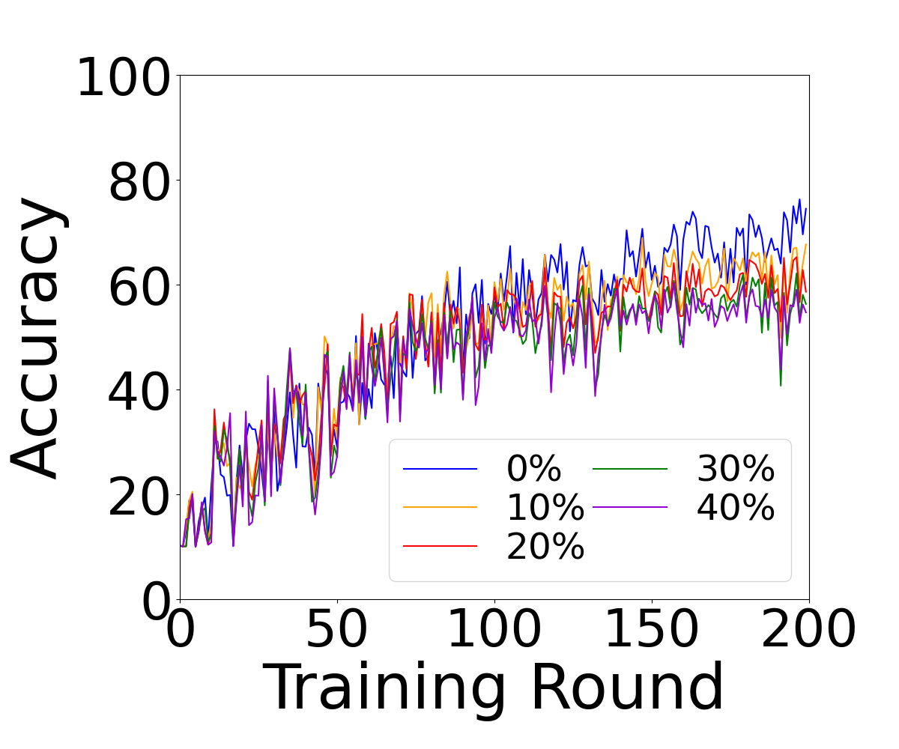
Experimental Result

Slide 6
Thank You! Questions are welcome!
For further questions and comments, please feel free to contact me at 12332463@mail.sustech.edu.cn

