Slide 1


Summary of the Week

Slide 2
Content
More results of SplitFed under data noise
Some ideas about combining the proofs of the two papers

Slide 3
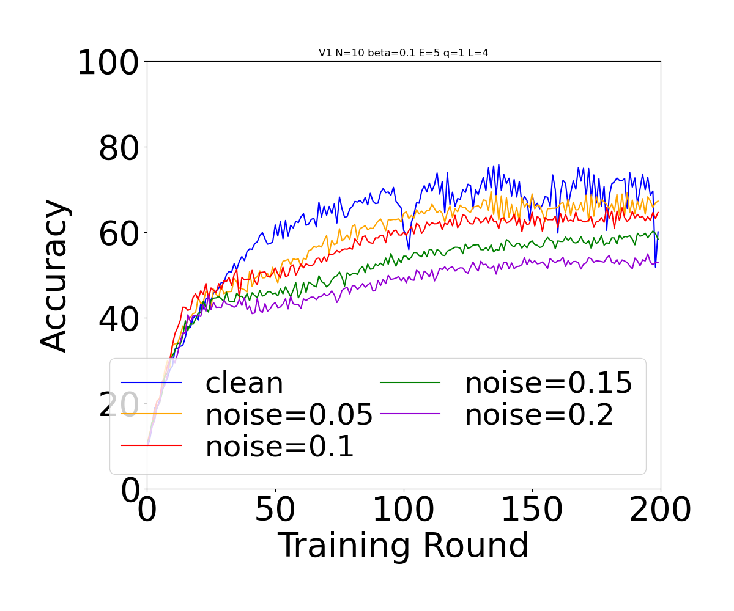
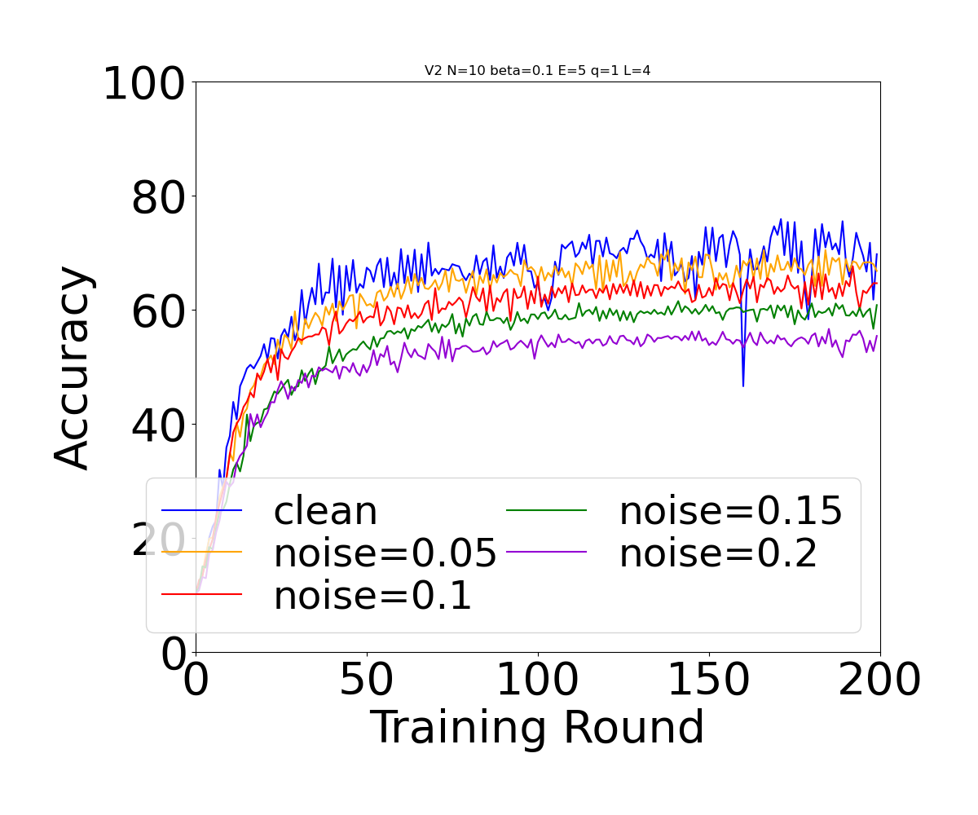
Noise in SplitFed

Slide 4
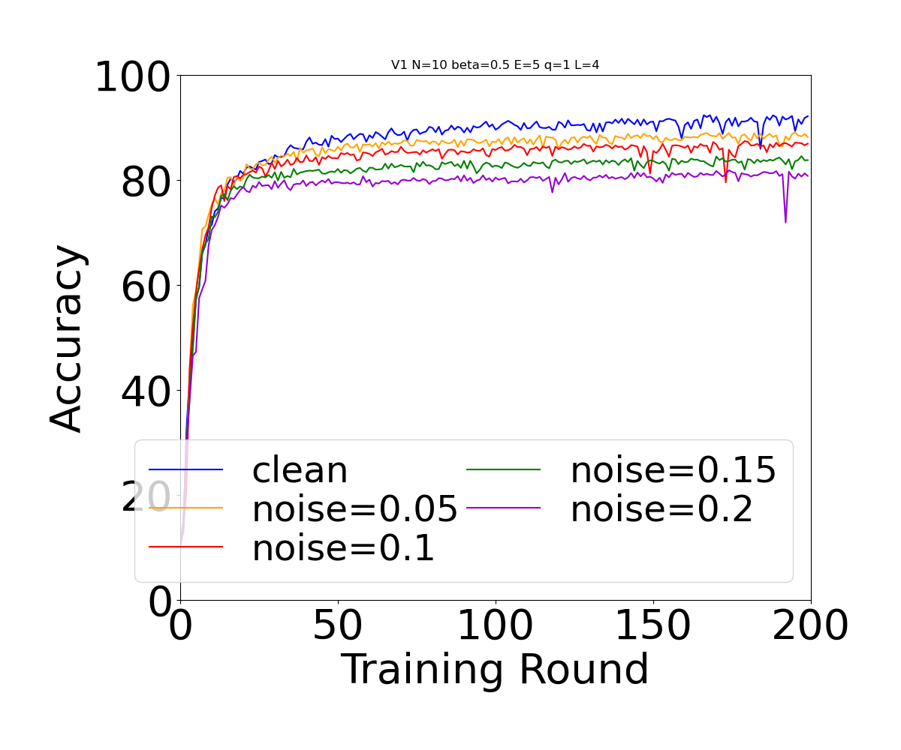
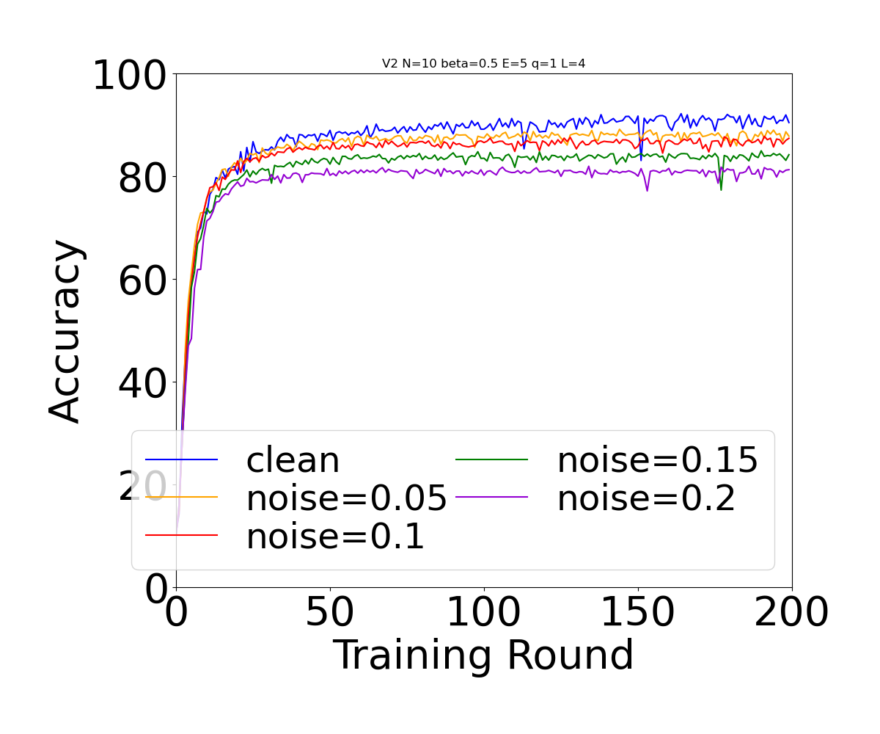
Noise in SplitFed

Slide 5
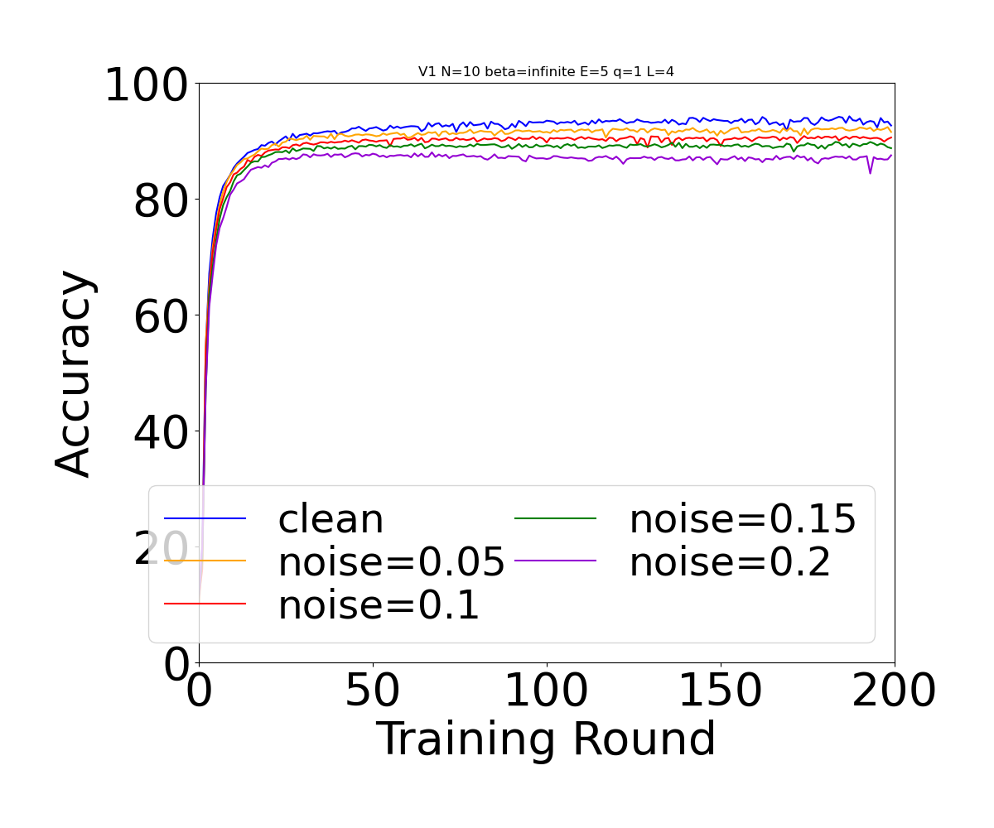
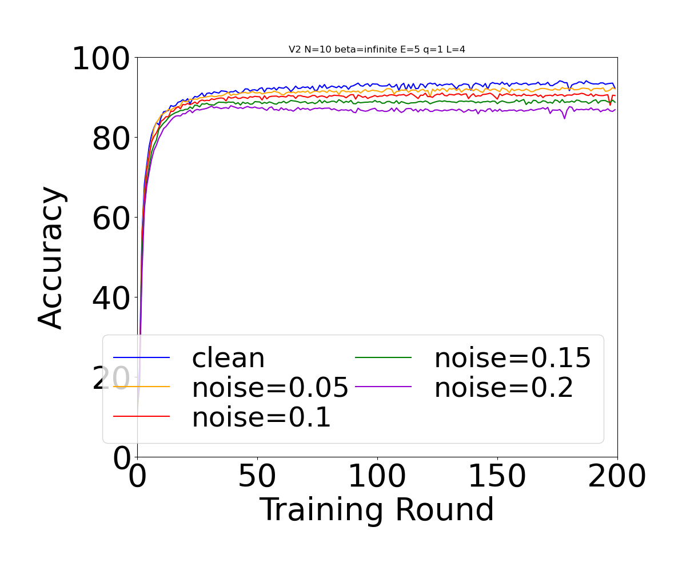
Noise in SplitFed

Slide 6
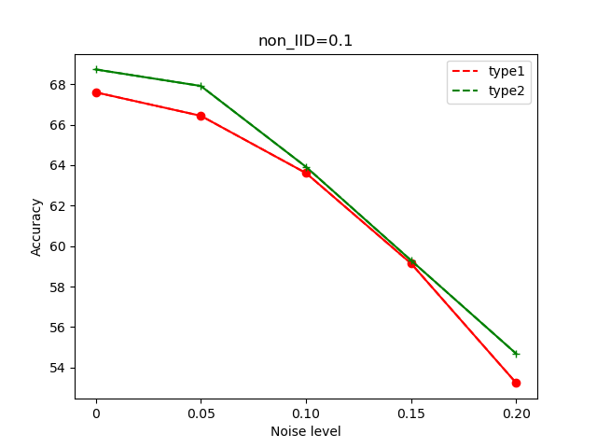
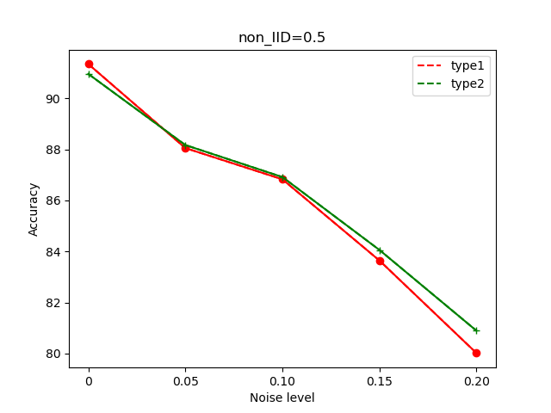
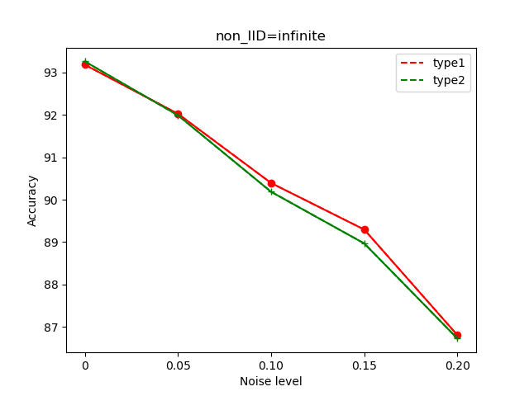
Noise in SplitFed

Slide 7
Expectation
We have completed the convergence proof for SplitFed
Can we try to prove the convergence of SplitFed with noisy data
Can we try to prove the mathematical relationship between the convergence rate of SplitFed and the noise level

Slide 8
Convergence proof
This proof can be used on different SplitFed algorithms
This proof provides a way to split server and client
This proof does not involve comparisons between different data cases

Slide 9
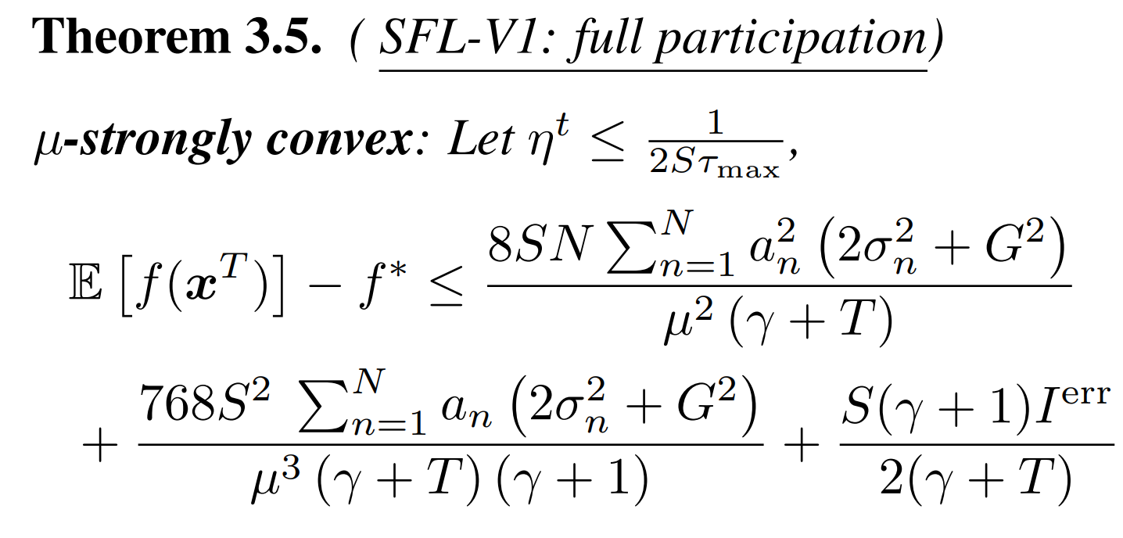
Data distribution in proof

Slide 10
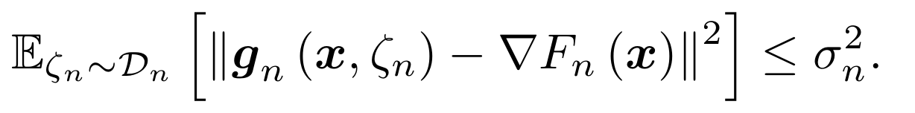

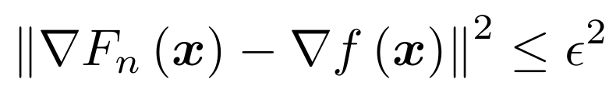
Data distribution in proof

Slide 11
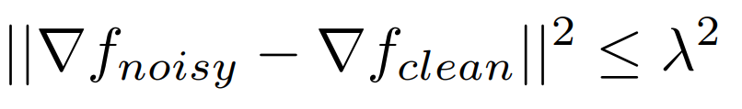
Data distribution in proof
Define f as a loss function

Slide 12
Generalization proof
The proof shows that generalization error is proportional to the degree of noise
This proof is a general proof. It can not represent some of SplitFed's features

Slide 13
Expectation
We have completed the convergence proof for SplitFed
Can we try to prove the convergence of SplitFed with noisy data
Can we try to prove the mathematical relationship between the convergence rate of SplitFed and the noise level

Slide 14
THANK YOU

