Slide 1


Summary of the Week

Slide 2
Content
Some teminology in SCAFFOLD
Inference after adding noisy data
Some questions

Slide 3
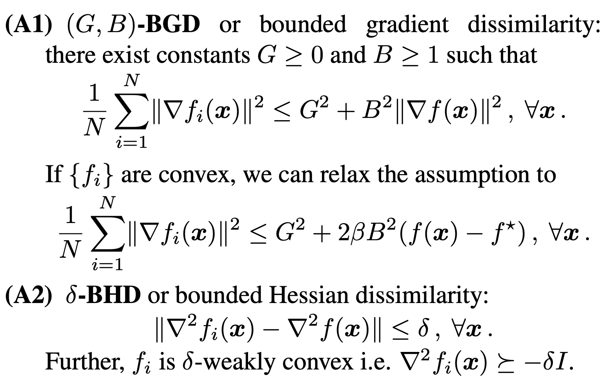
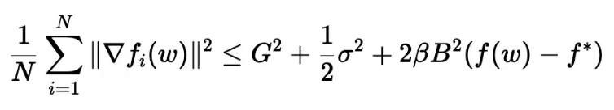
Some teminology in SCAFFOLD

Slide 4
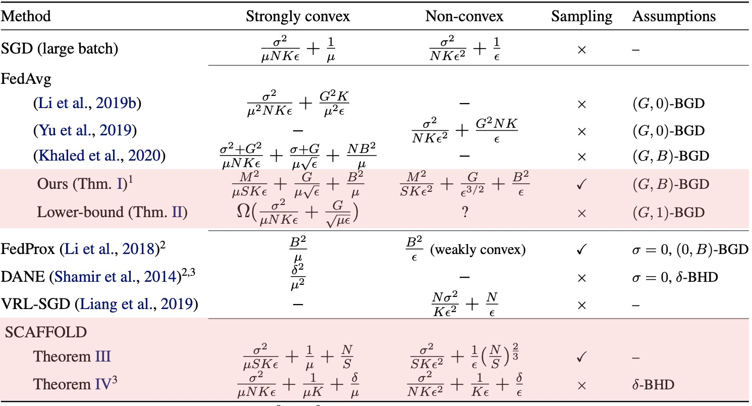
Some teminology in SCAFFOLD

Slide 5
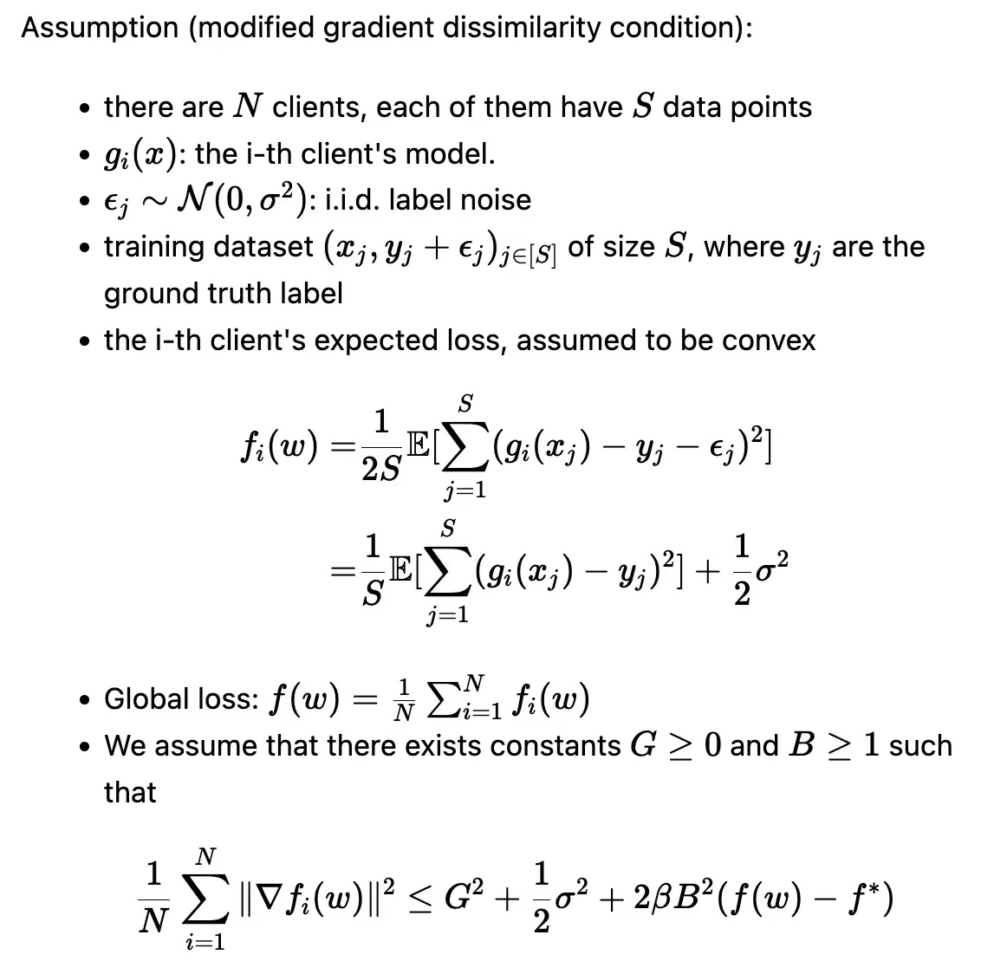
Inference after adding noisy data

Slide 6
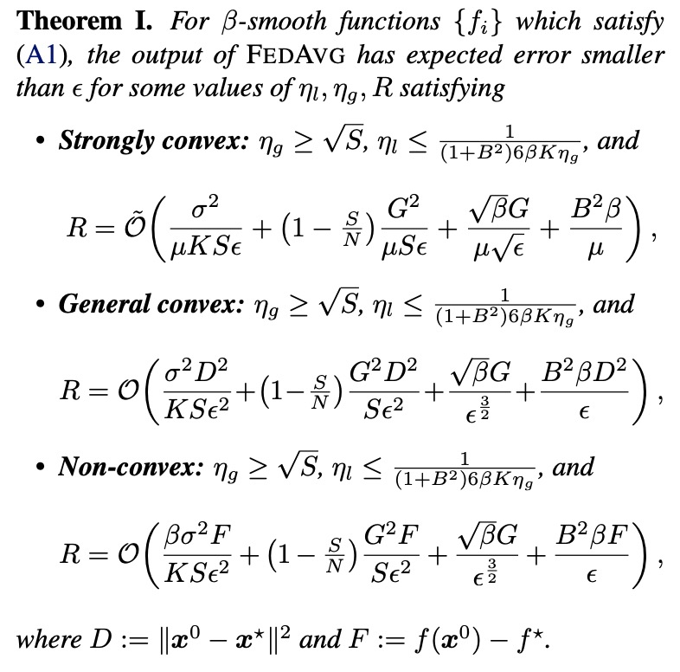
Inference after adding noisy data

Slide 7
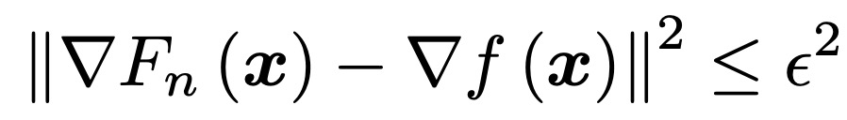
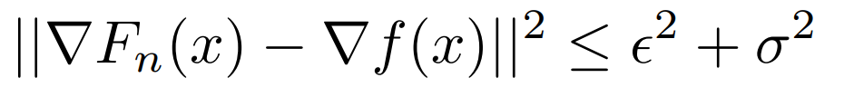
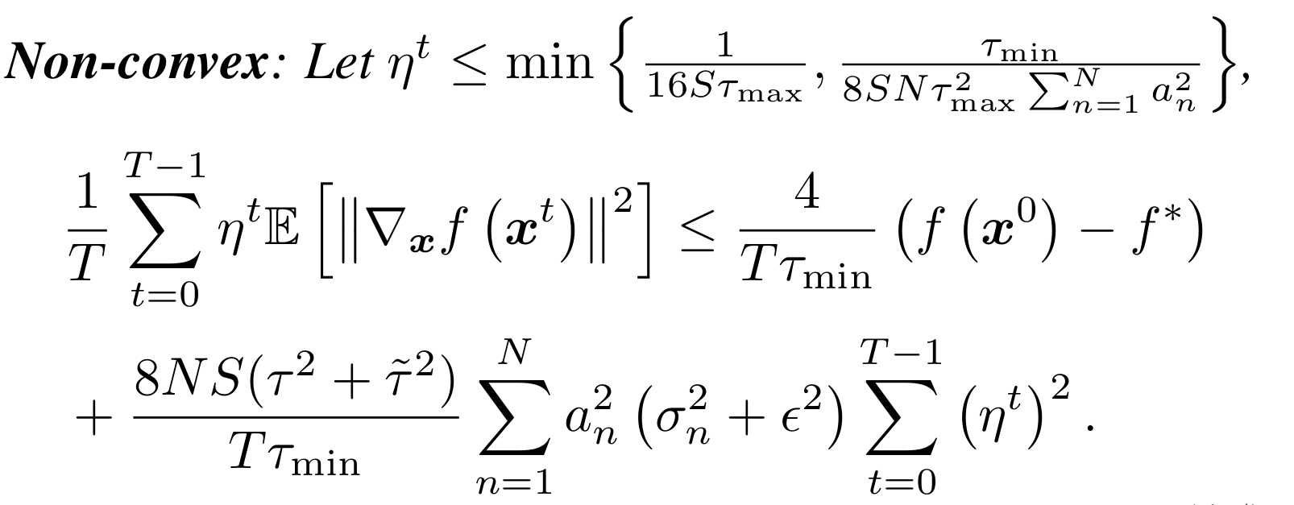
Inference after adding noisy data

Slide 8
Some questions

Slide 9
THANK YOU

