Slide 1


Summary of the Week

Slide 2
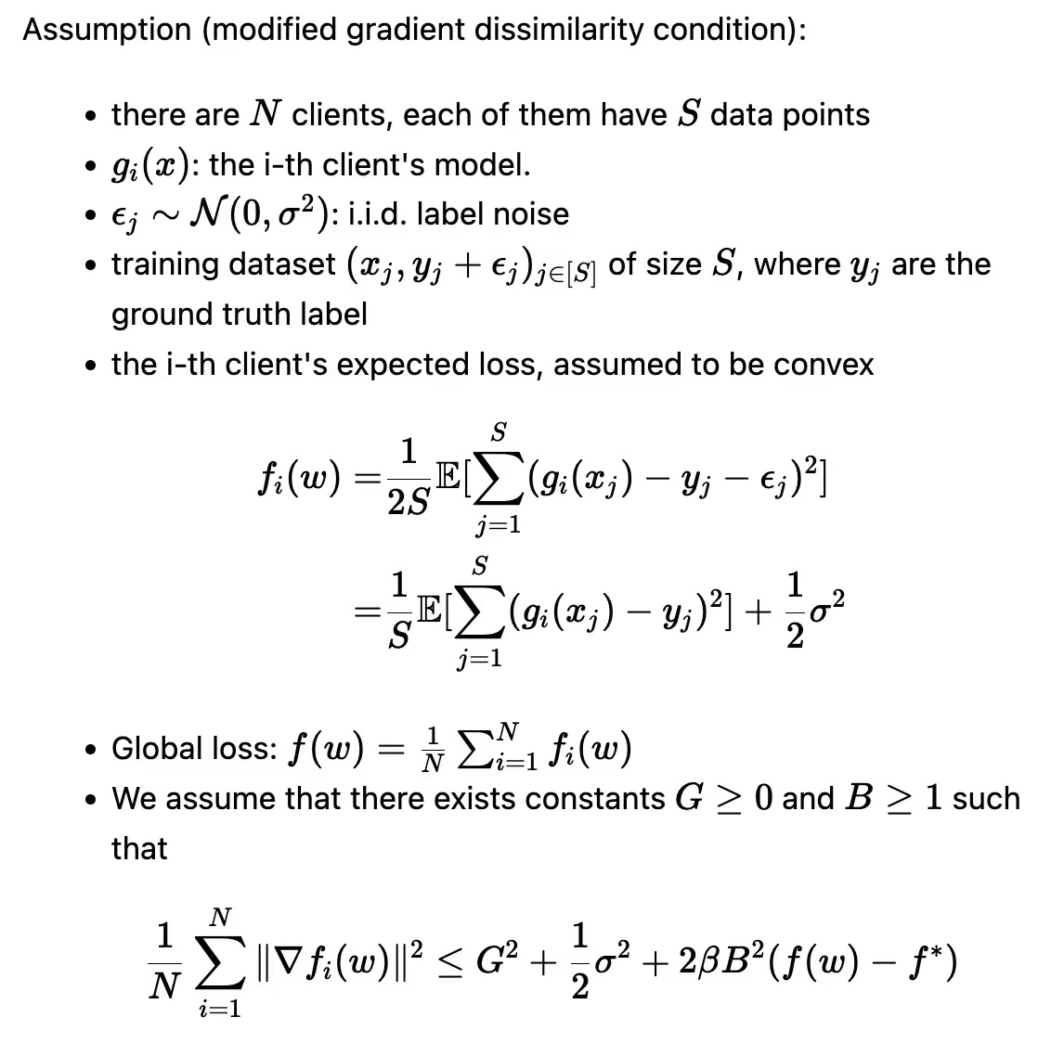
Some questions

Slide 3
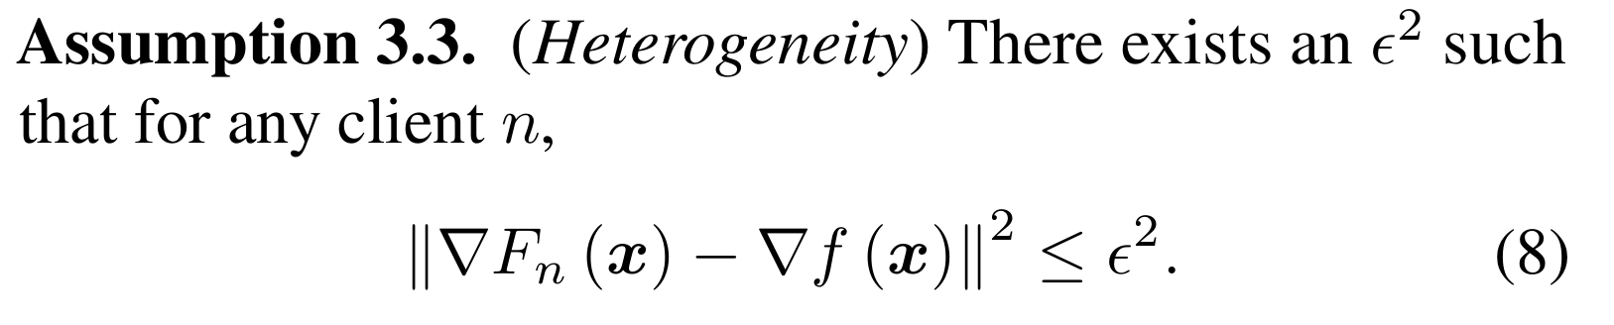
Different Loss Functions
Cross Entropy
Mean Square Error
Log Loss

Slide 4
THANK YOU

