Slide 1

Week Summarry
12332463 Geng Tian
Department of Computer Science and Engineering, Southern University of Science and Technology, Shenzhen, China

Slide 2
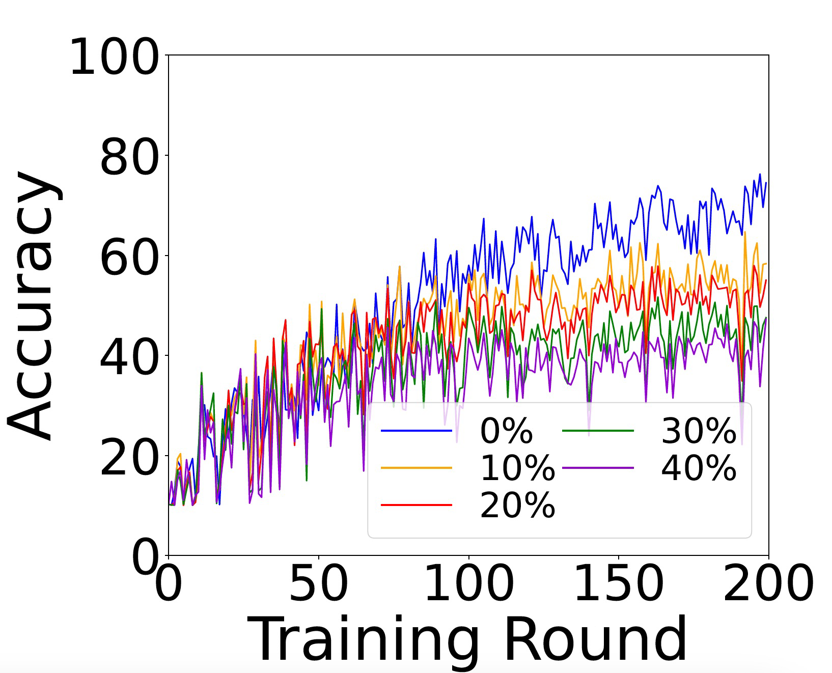
Cifar10: Random Flipping

Slide 3
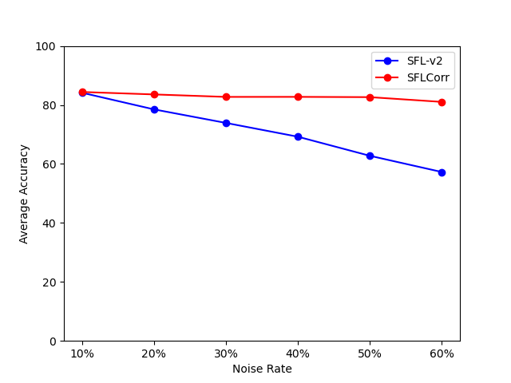
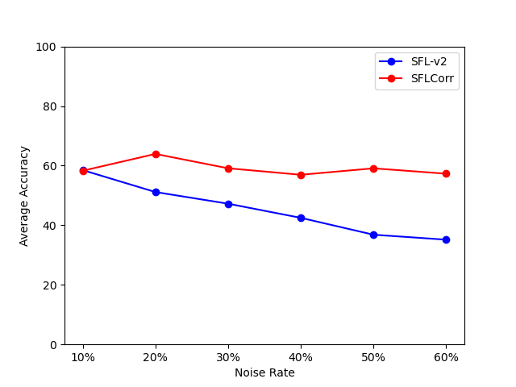
Cifar10: Random Flipping

Slide 4
Cifar10: Instance Depedent

Slide 5
Cifar10: Instance Depedent

Slide 6
Cifar100: Random Flipping

Slide 7
Cifar100: Random Flipping
SFLCorr对Cifar100的准确率提升还没有实验结果

Slide 8
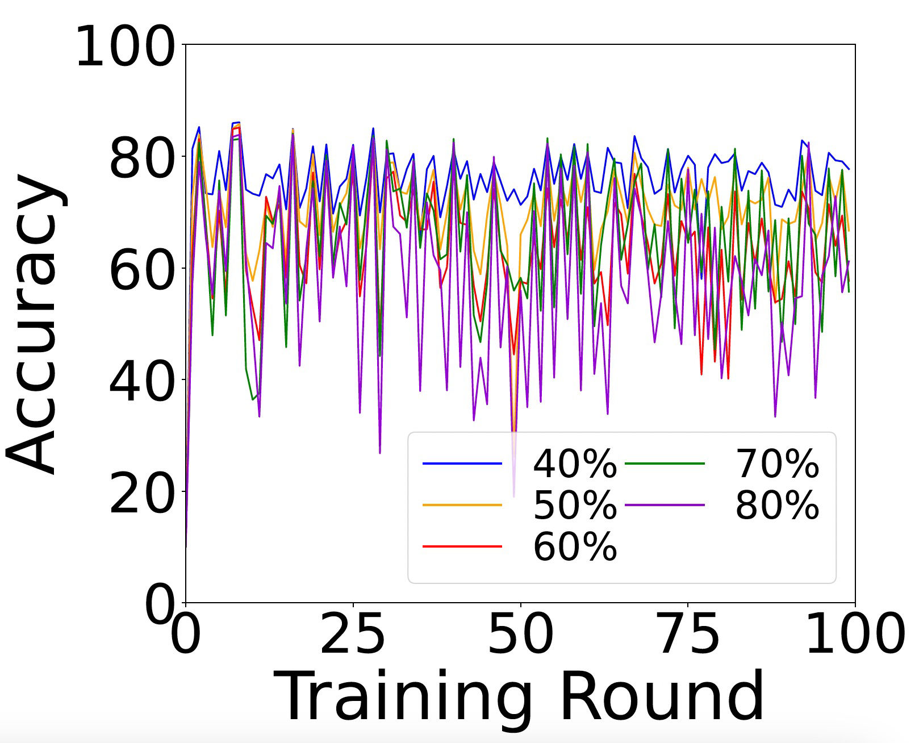
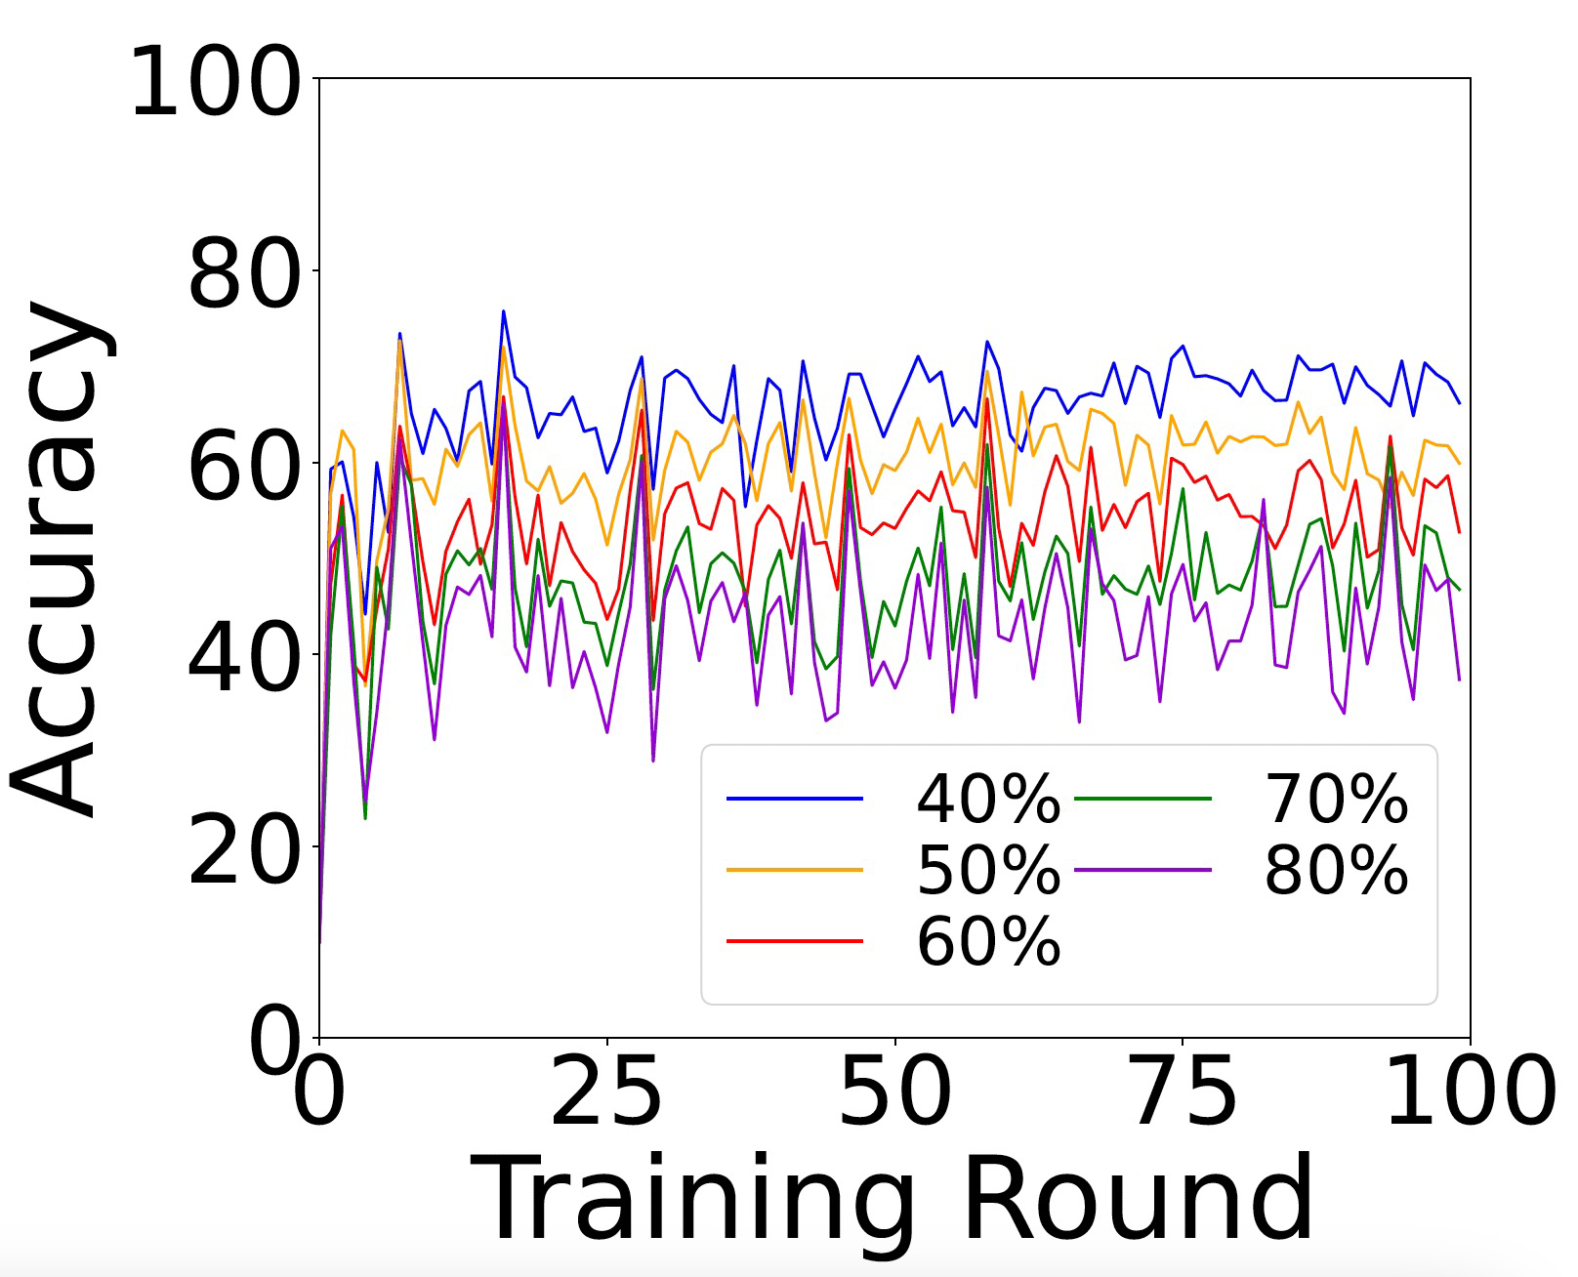
FMNIST: Random Flipping

Slide 9
FMNIST: Random Flipping

Slide 10
Experiments
标签噪声对收敛性的影响
1. Random Flipping 2. Instance Depedent
Cifar10, Cifar100, FMNIST
SFLCorr对准确率的提升
1. Random Flipping
Cifar10, Cifar100, FMNIST
2. 与其他FL算法比较

Slide 11
Thank You! Questions are welcome!

