Slide 1

Week Summarry
12332463 Geng Tian
Department of Computer Science and Engineering, Southern University of Science and Technology, Shenzhen, China

Slide 2
Experiments
标签噪声对收敛性的影响
1. Random Flipping 2. Instance Depedent
Cifar10, Cifar100, FMNIST
SFLCorr对准确率的提升
1. Random Flipping 2. Instance Depedent
Cifar10, Cifar100, FMNIST
2. 与其他FL算法比较(FedCorr, FedNoRo, JointOpt, DivideMix)

Slide 3
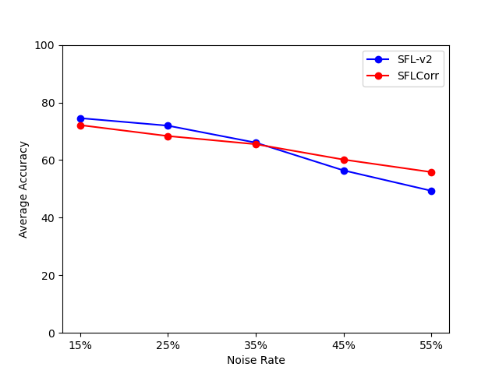
Cifar10: Instance Depedent
Cifar10

Slide 4
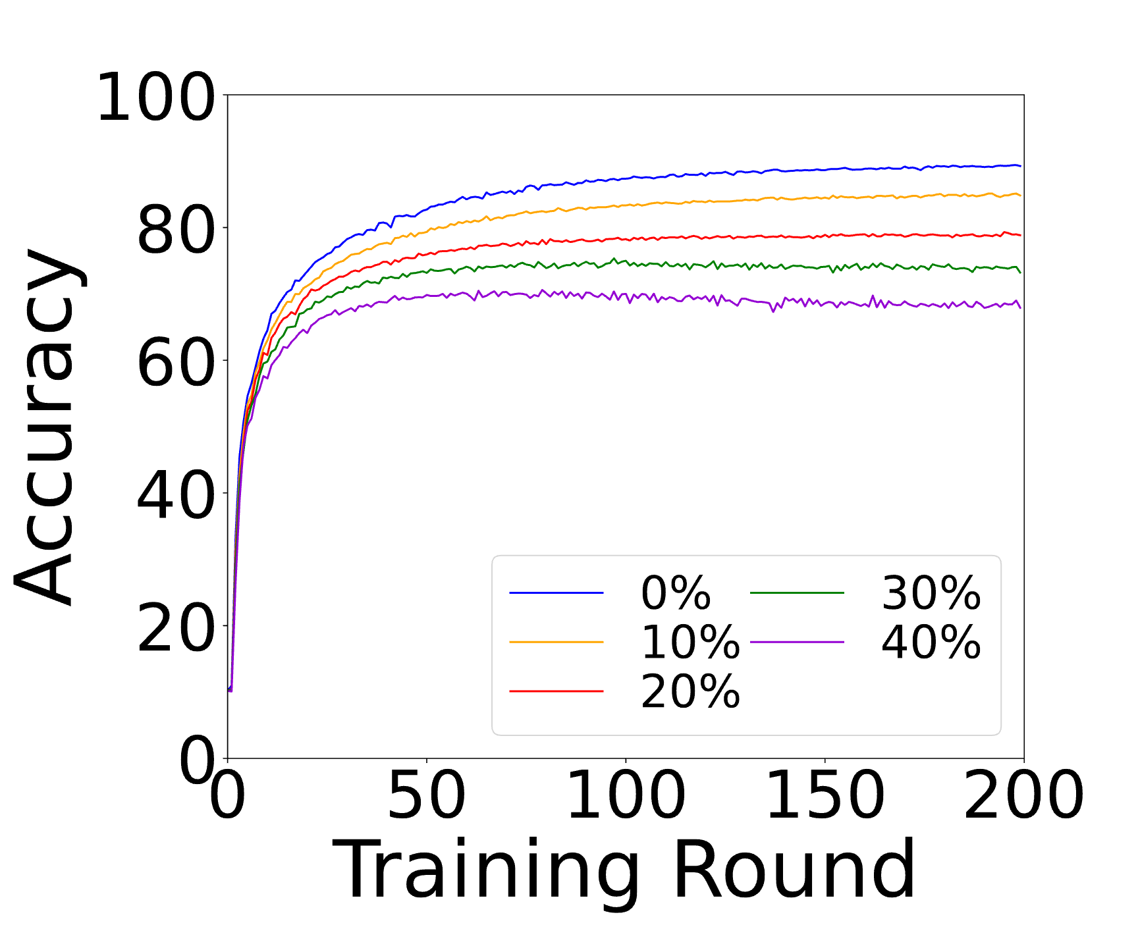
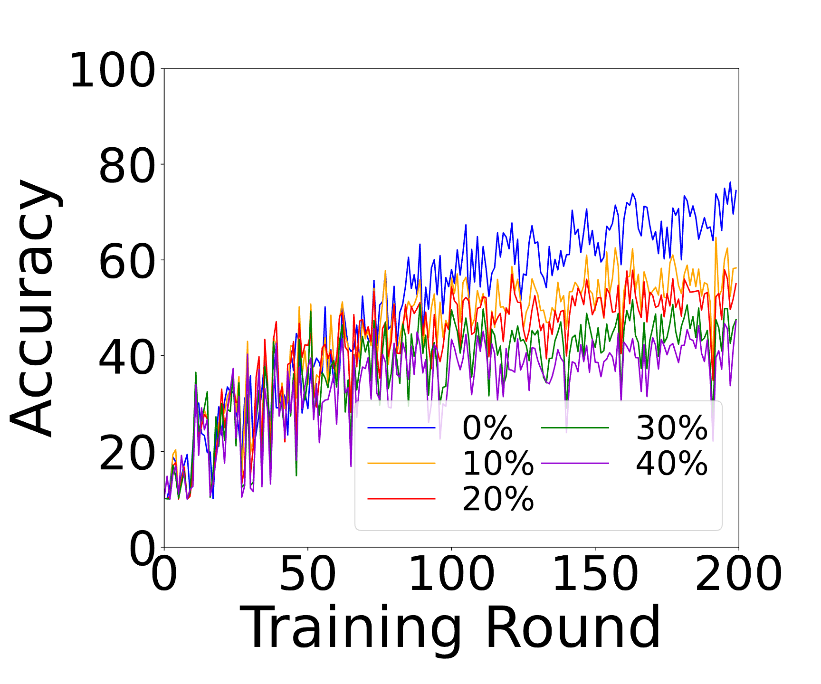
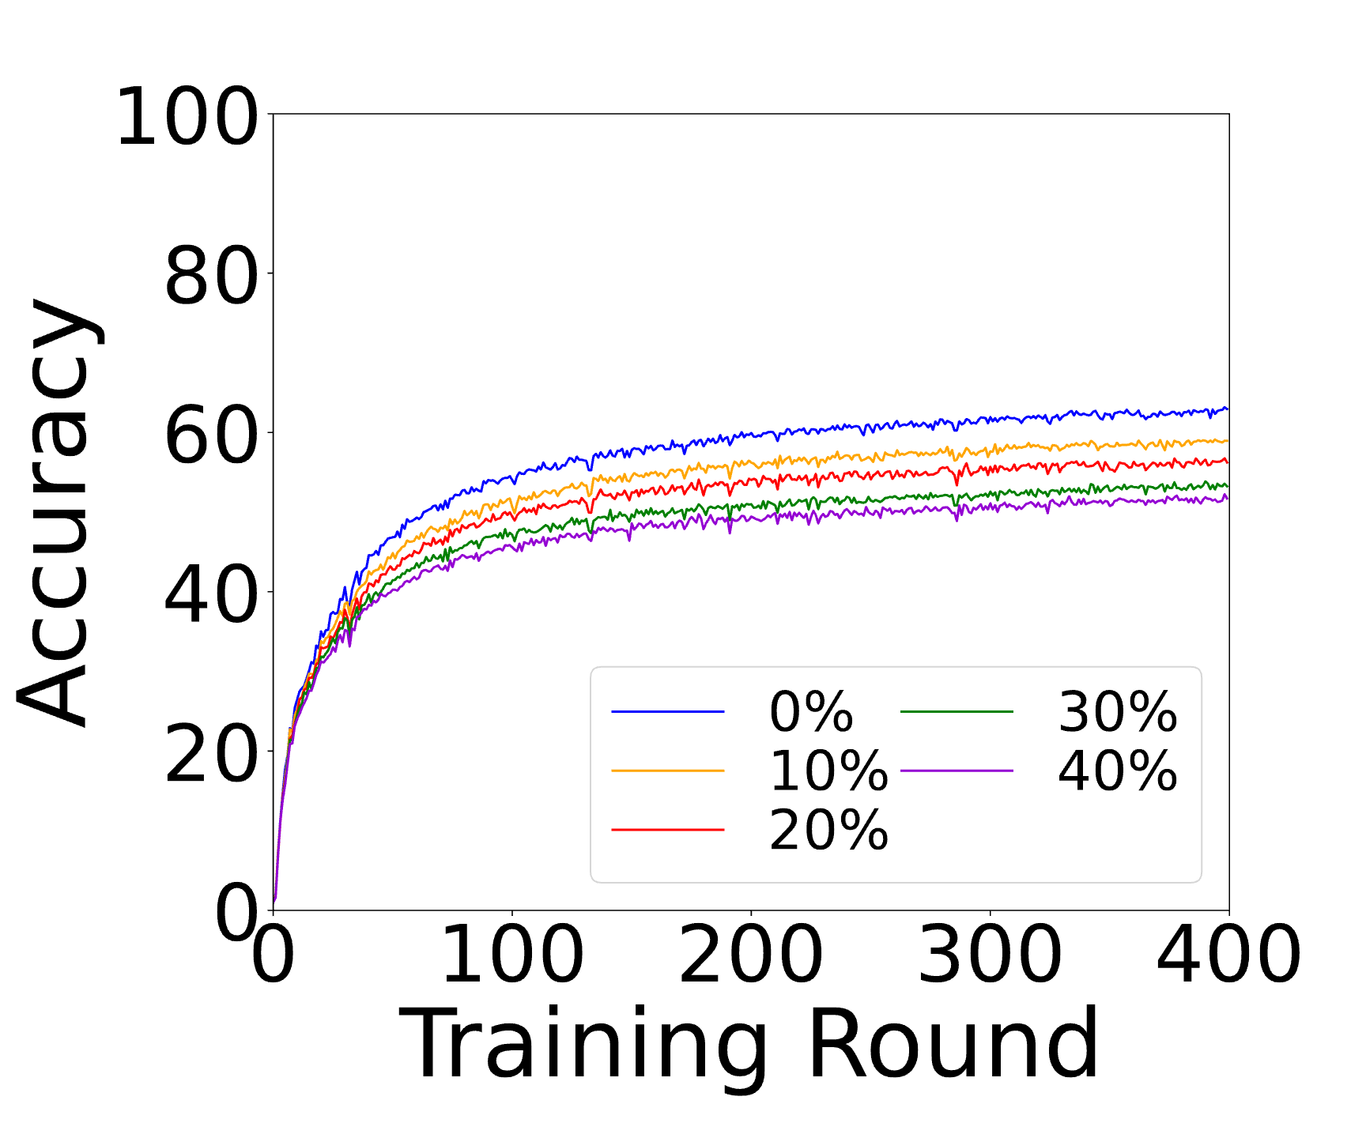
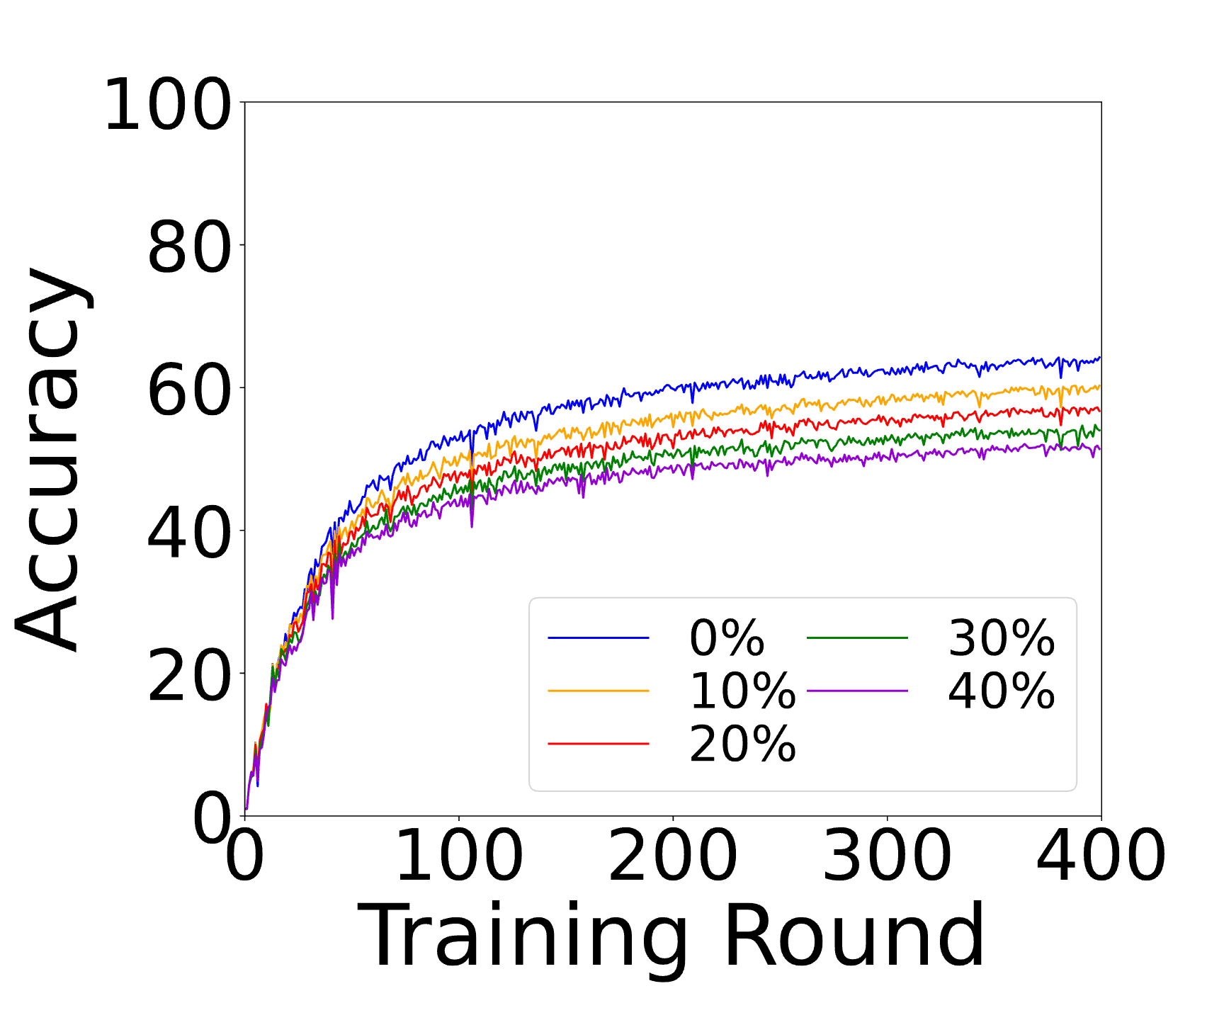
Convergence: Random Flipping
Cifar10
Cifar100

Slide 5
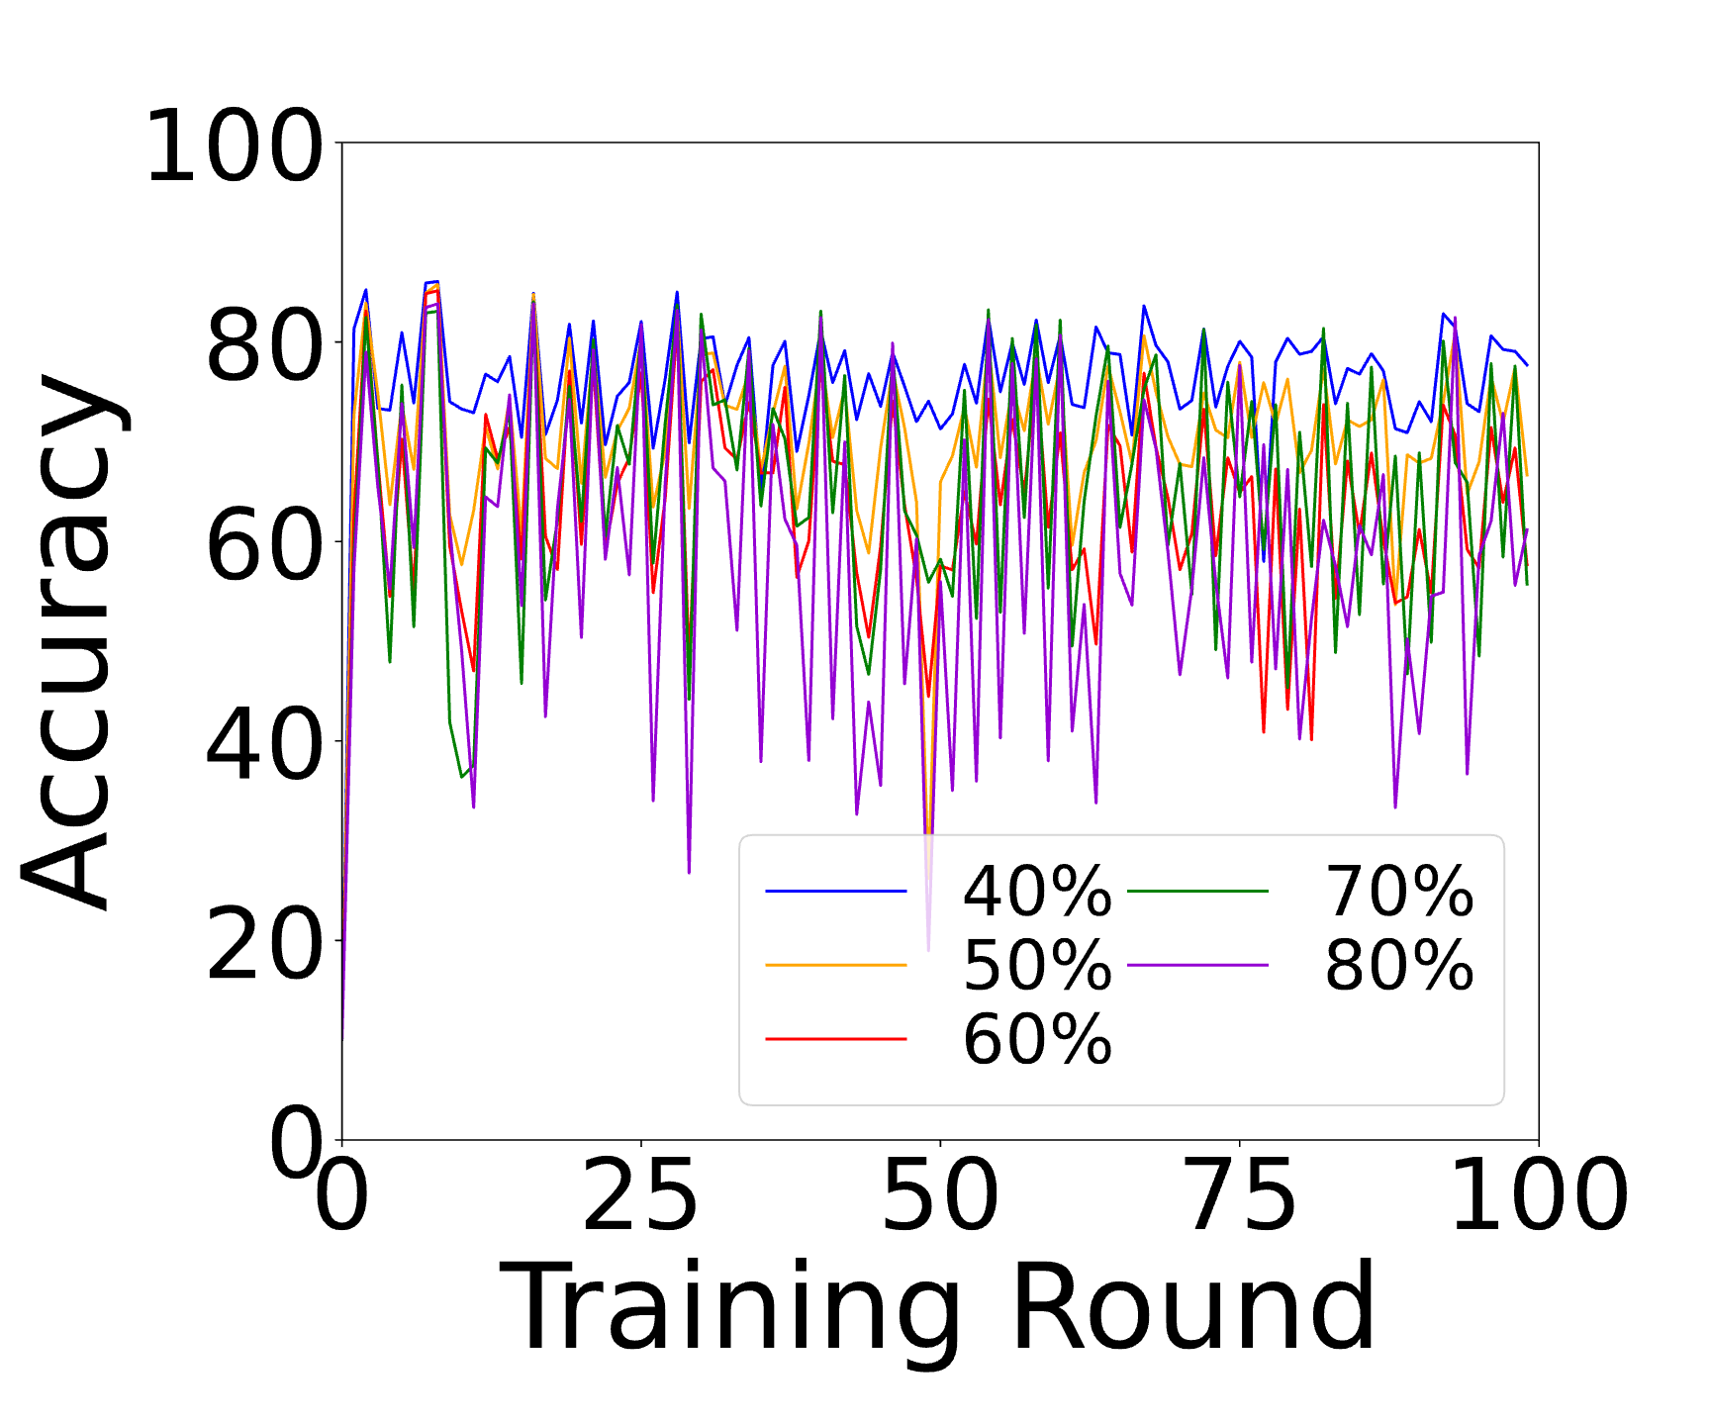
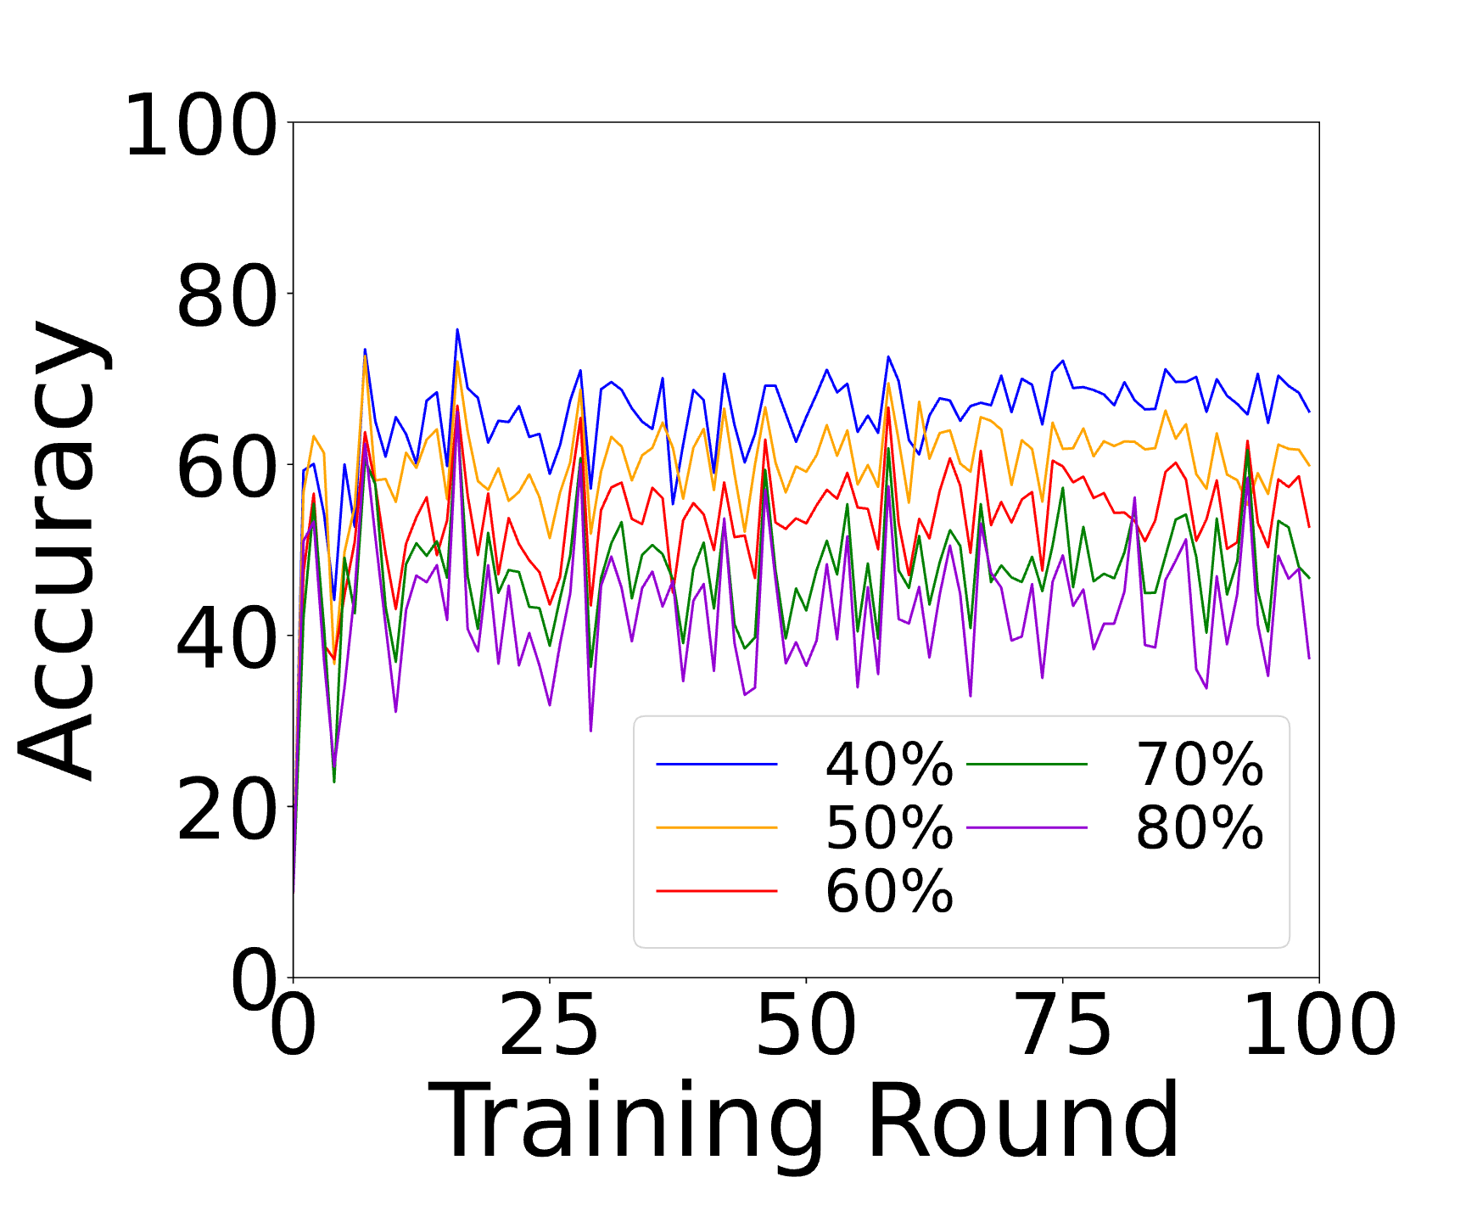
Convergence: Random Flipping
FMNIST

Slide 6
Convergence: Instance Depedent

Slide 7
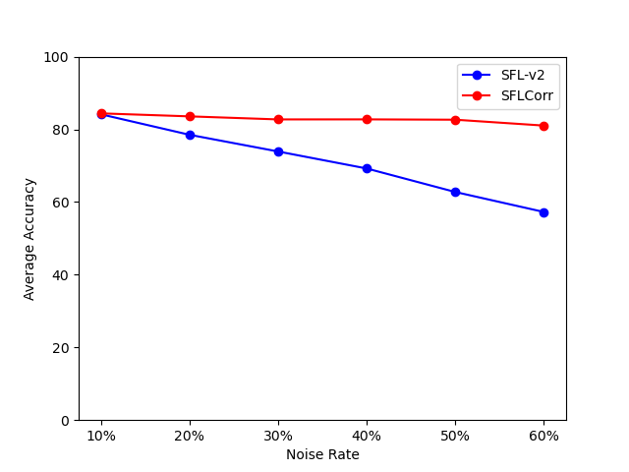
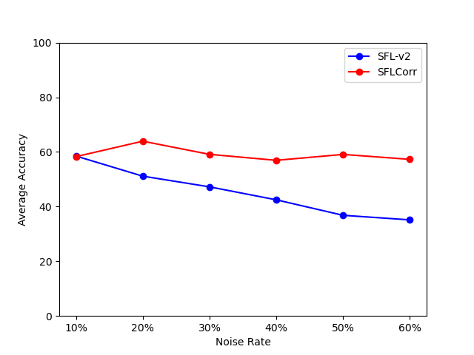
Cifar10: Random Flipping
Cifar10
FMNIST

Slide 8
Thank You! Questions are welcome!

