Slide 1


Summary of the Week

Slide 2
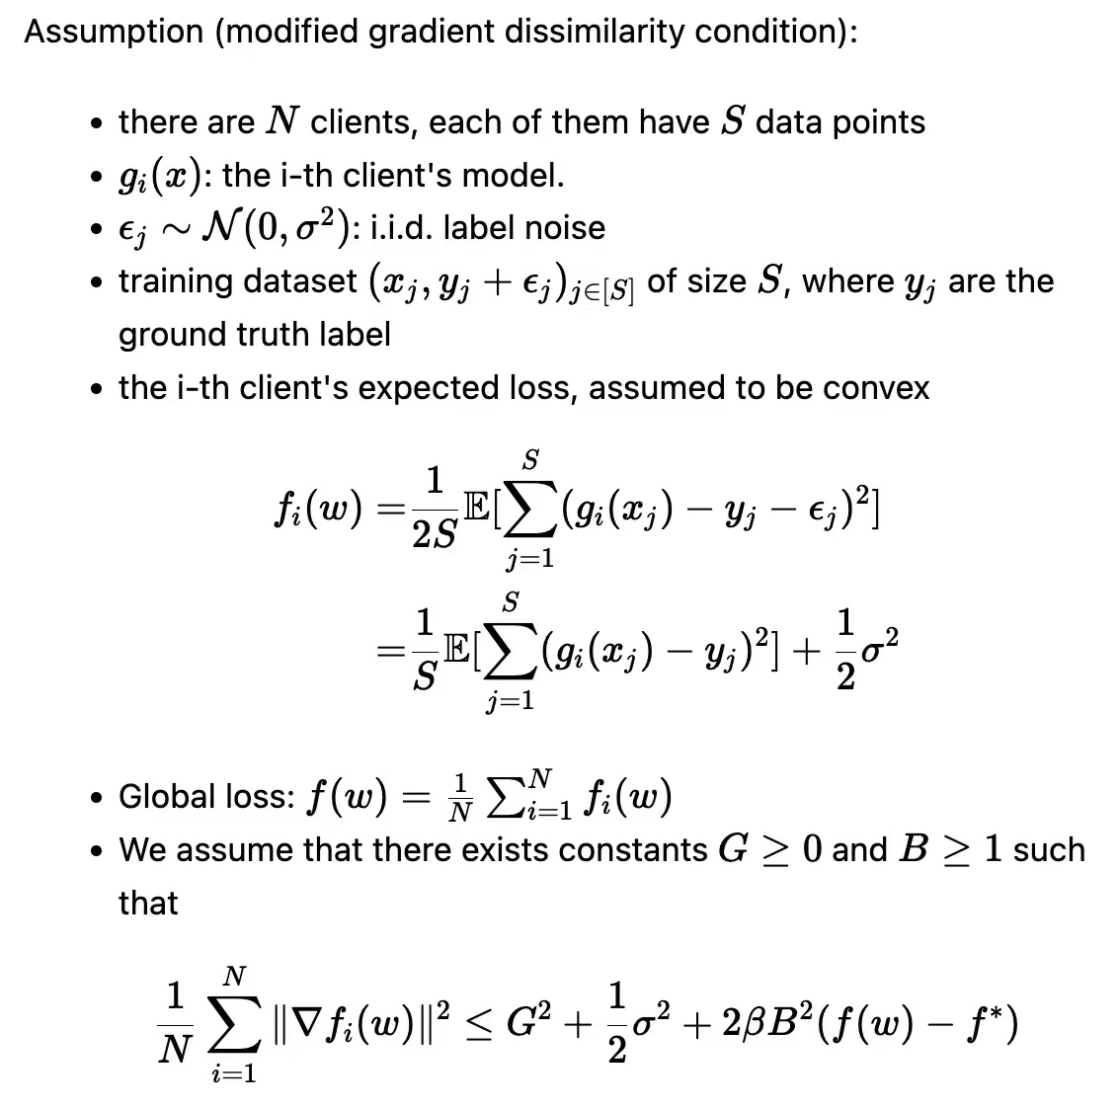
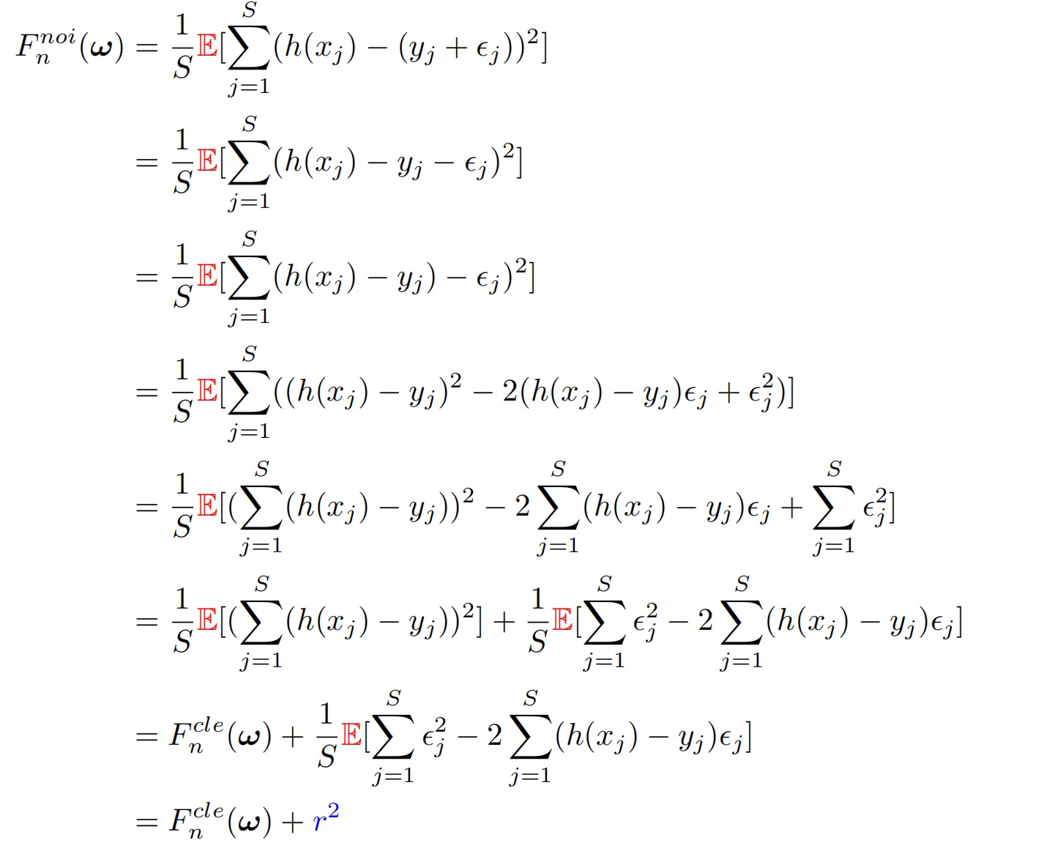
The meaning of E

Slide 3
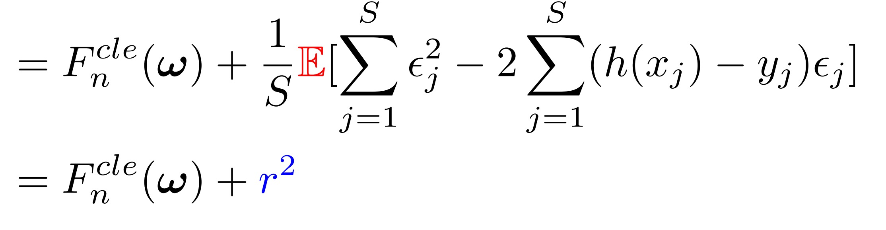
Experience shows that loss increases

Slide 4
The value of loss was verified by experiment

Slide 5
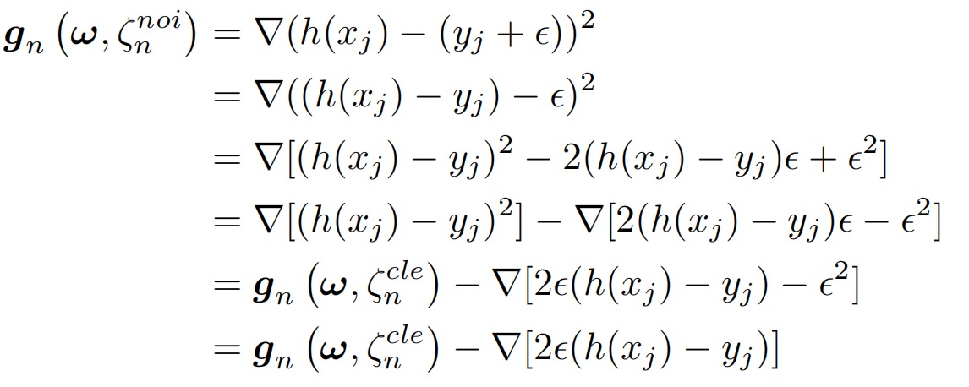
The meaning of ζ
1. It is convenient to derive results.
2. Able to express a single data and more clearly
the difference between the overall

Slide 6
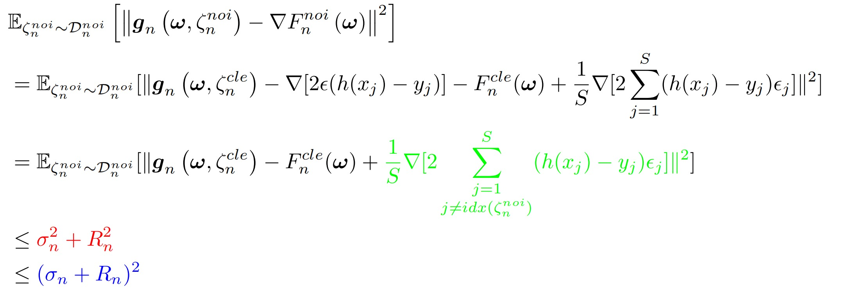
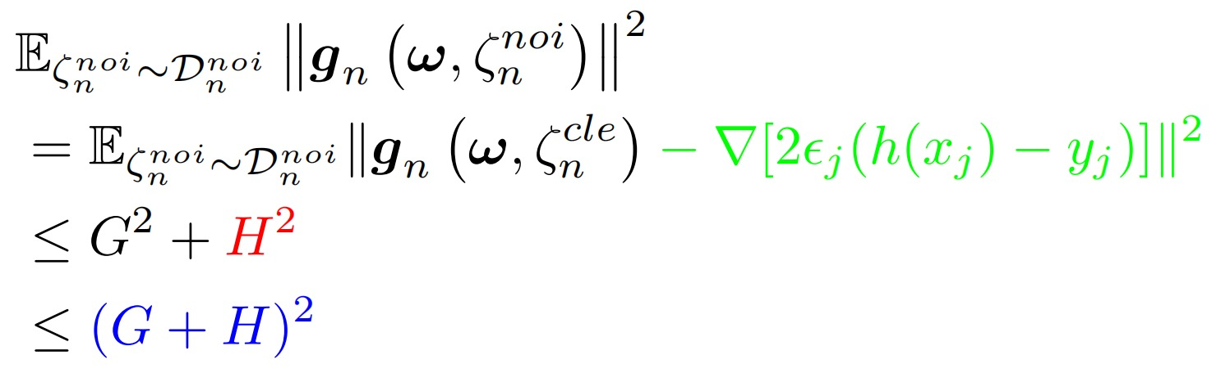
The expression of the result

Slide 7
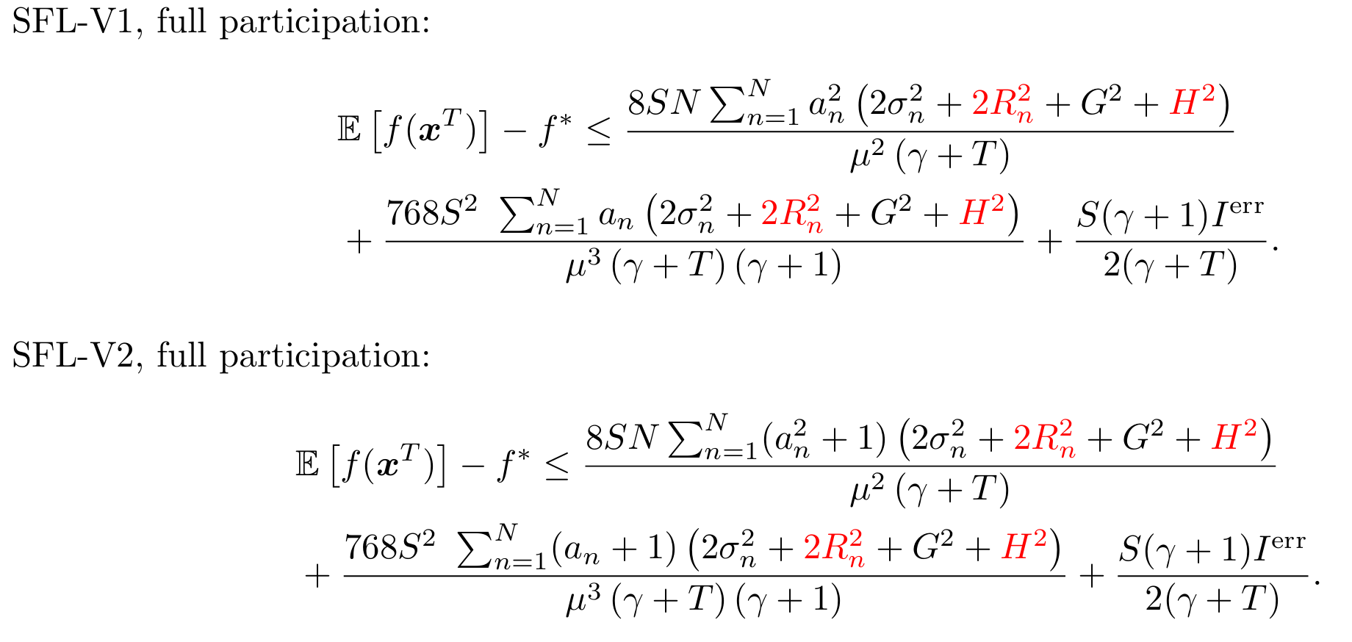
Phased result

Slide 8
THANK YOU

