Slide 1


Summary of the Week

Slide 2
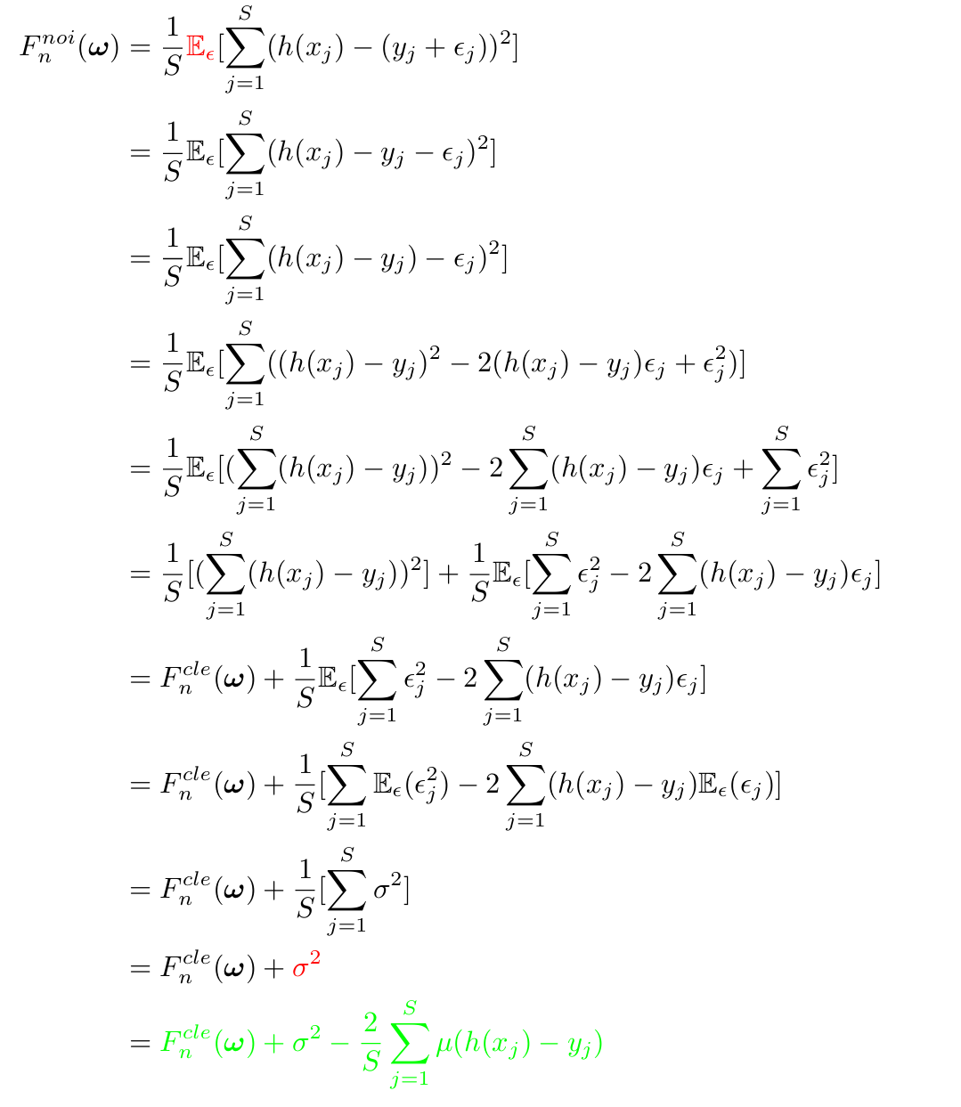
Result of loss function

Slide 3
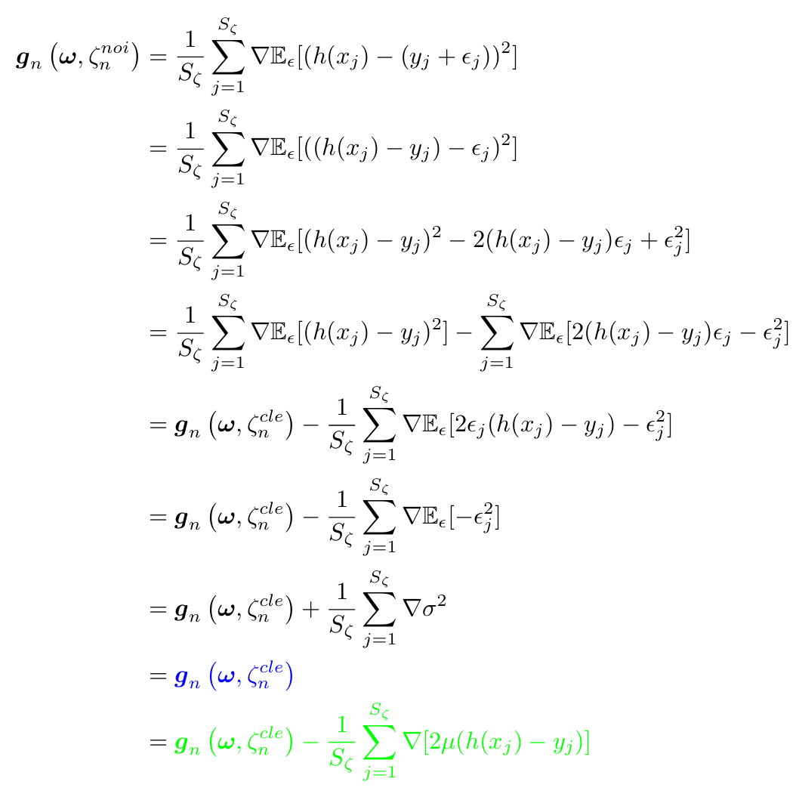
No change in gradient

Slide 4
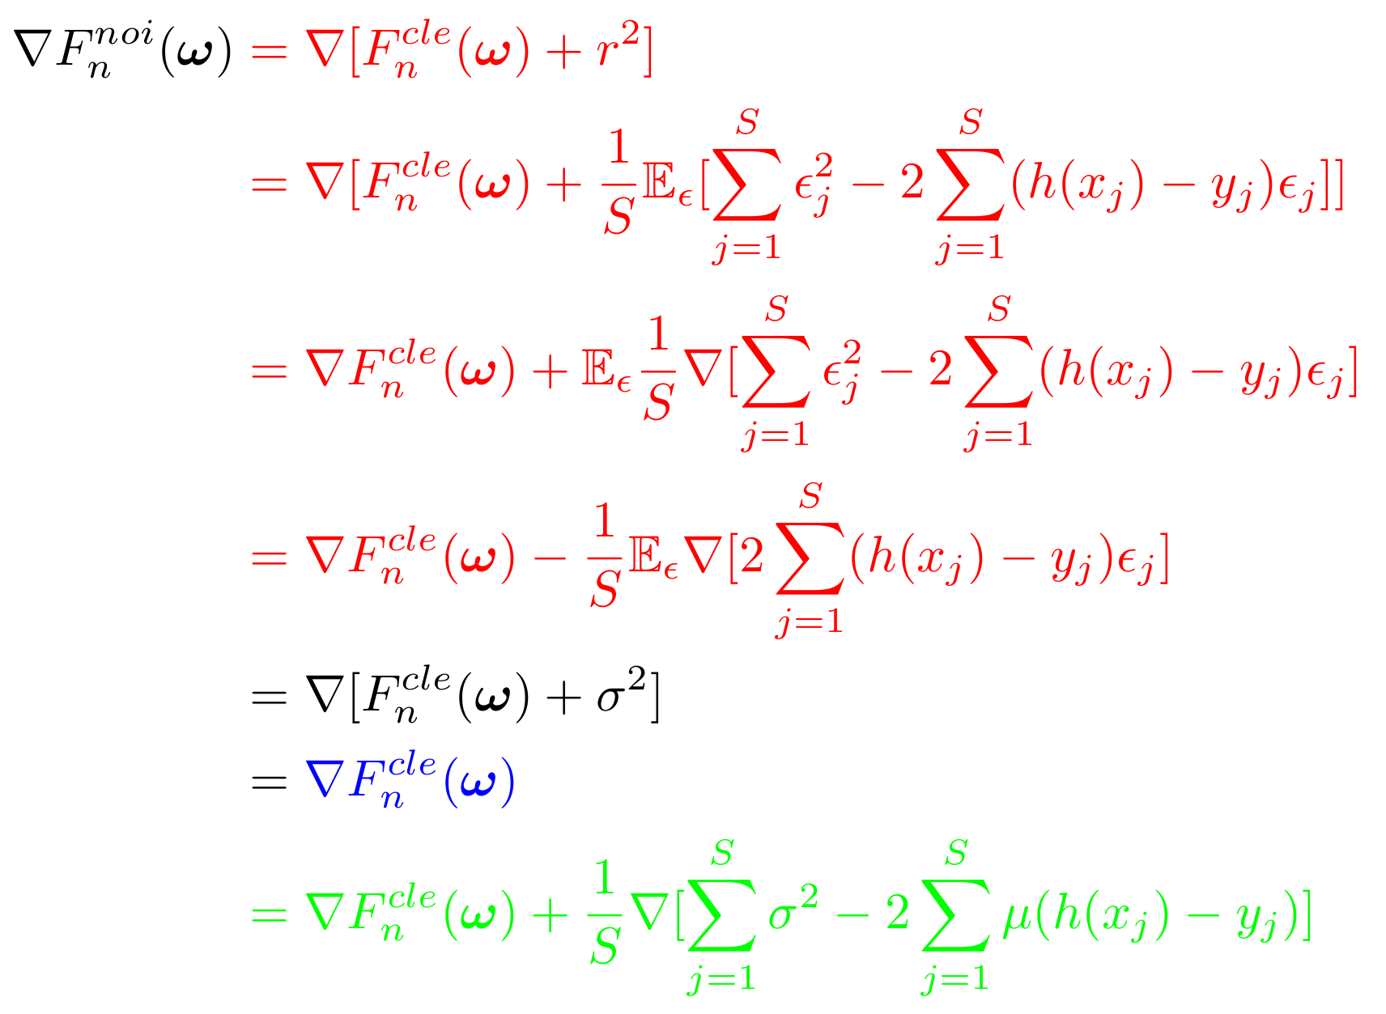
No change in gradient

Slide 5
The meaning of ζ

Slide 6

Change to a different distribution

Slide 7
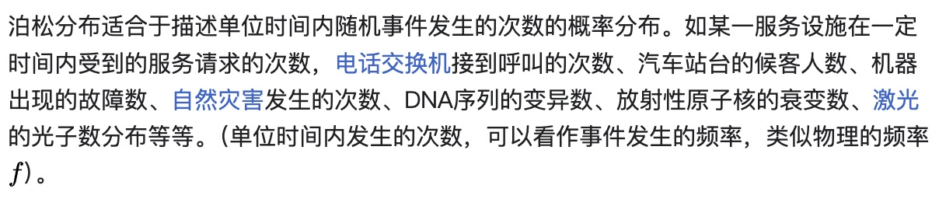
Realistic data noise

Slide 8
THANK YOU

