Slide 1


Summary of the Week

Slide 2
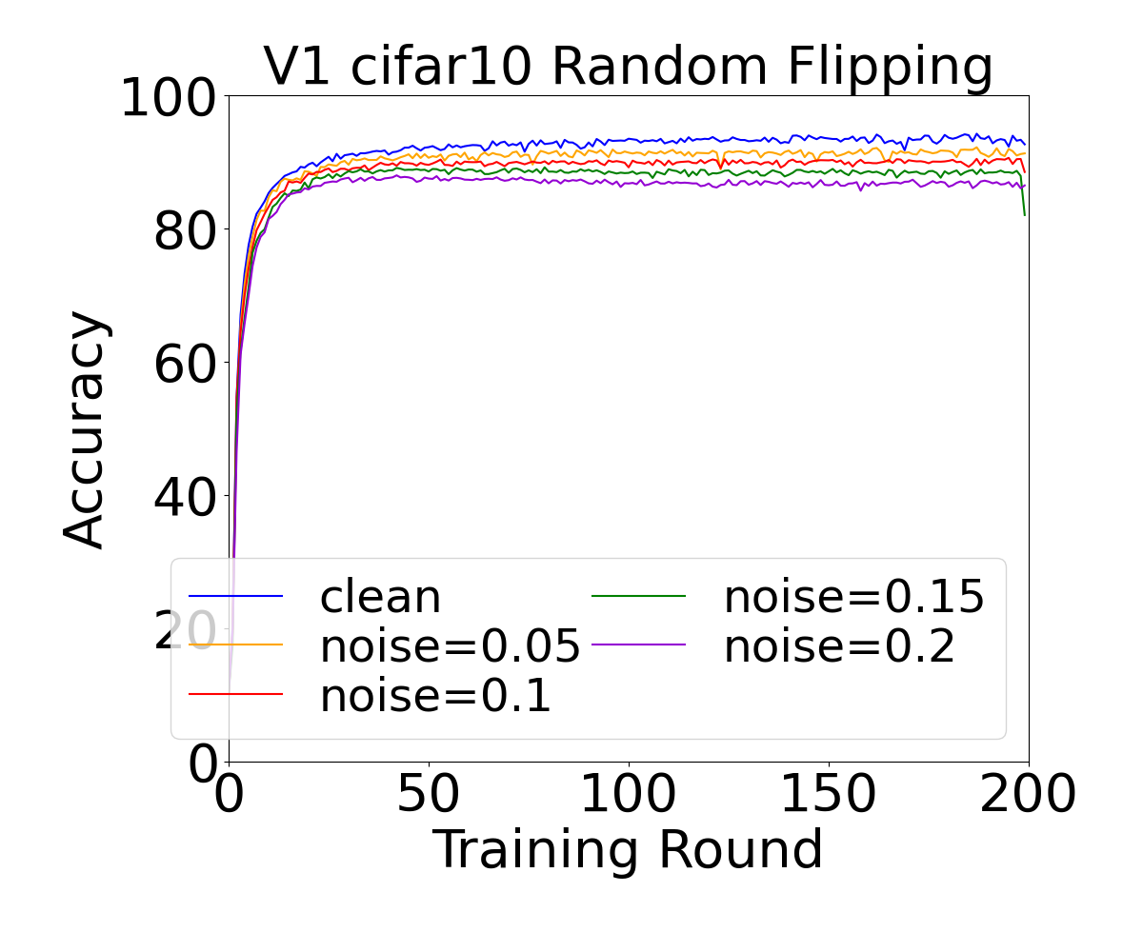
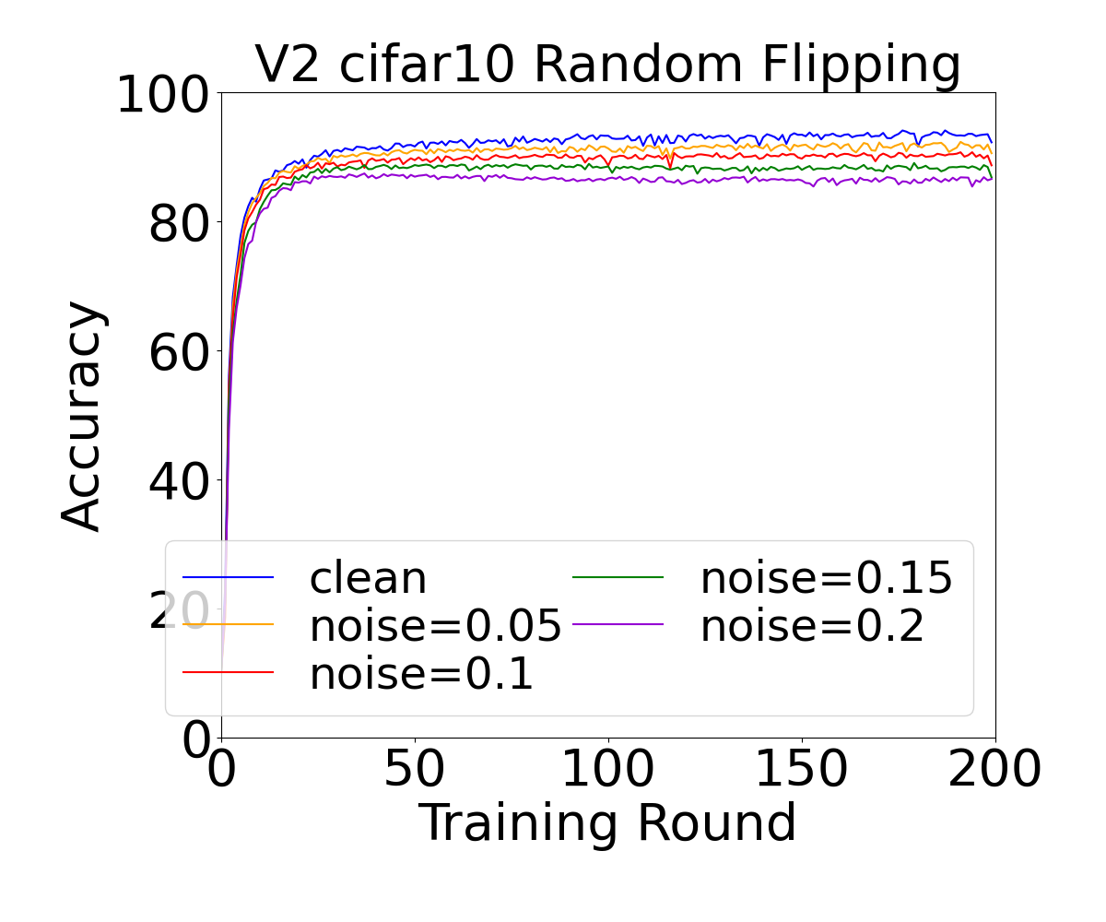
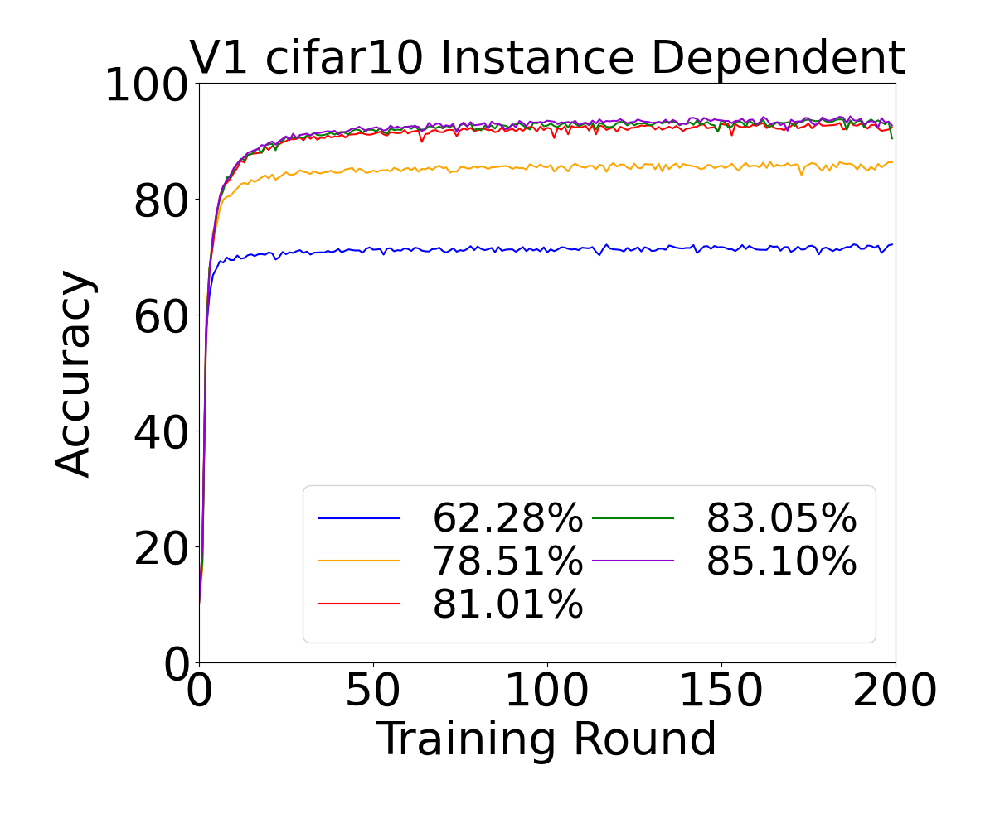
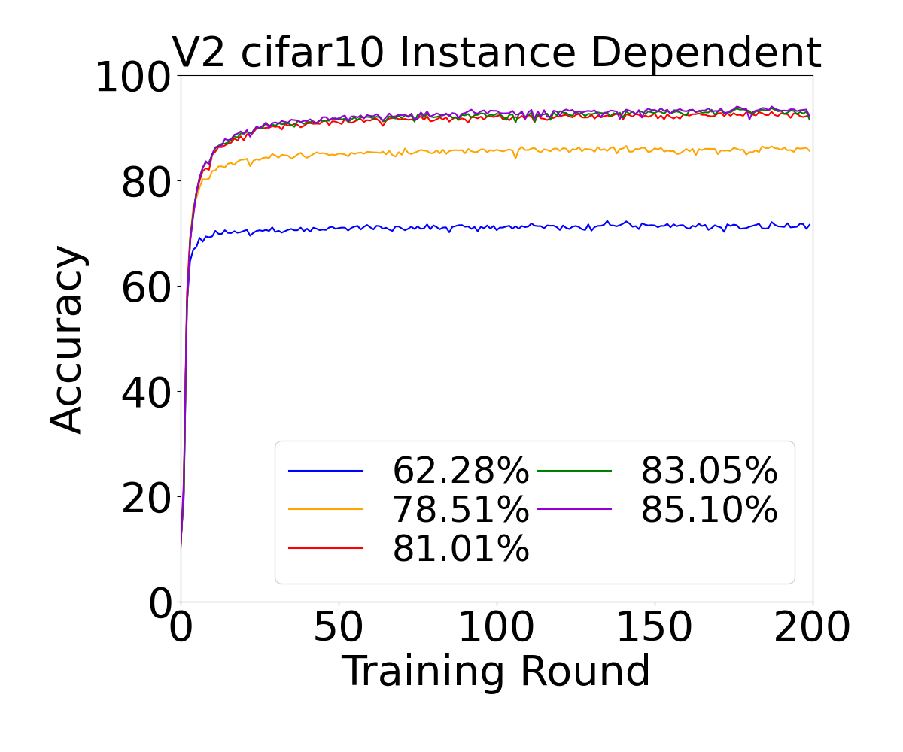
Result of Accuracy
N=10,β=+∞

Slide 3
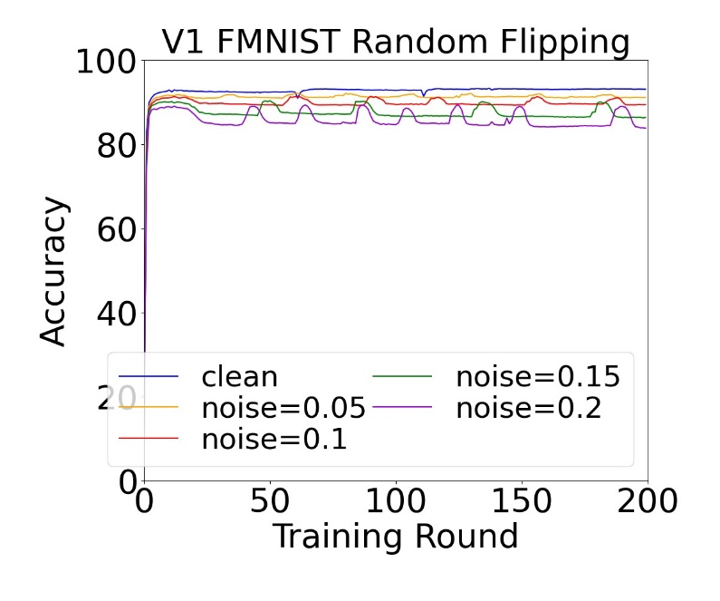
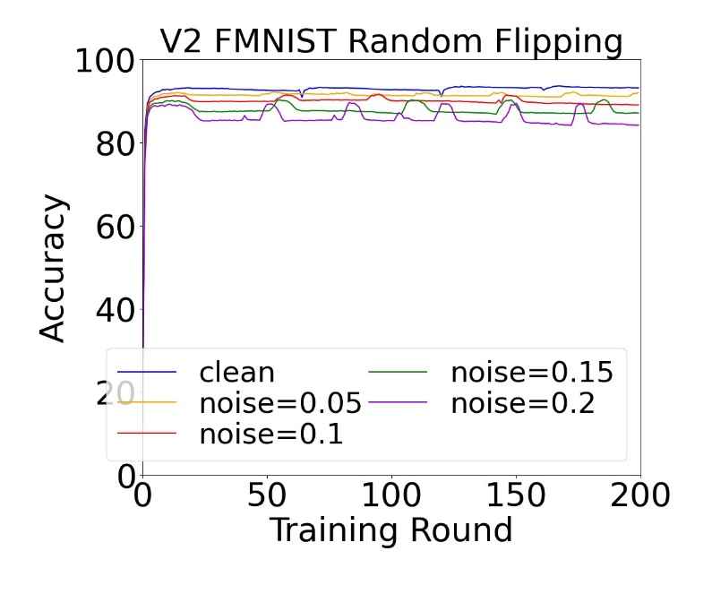
Result of Accuracy
N=10,β=+∞

Slide 4
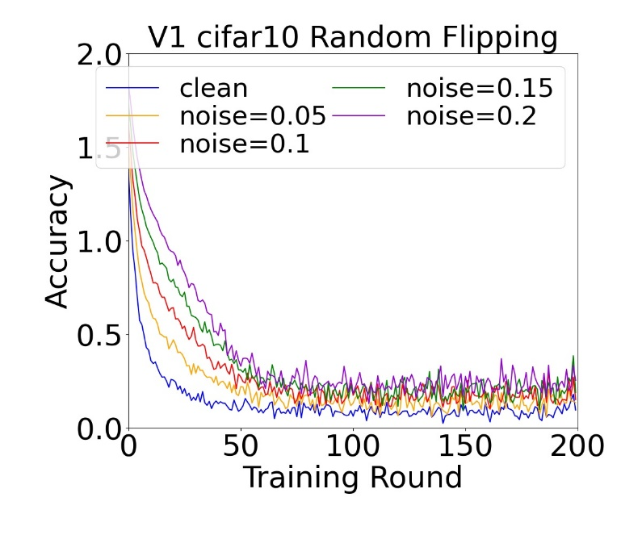
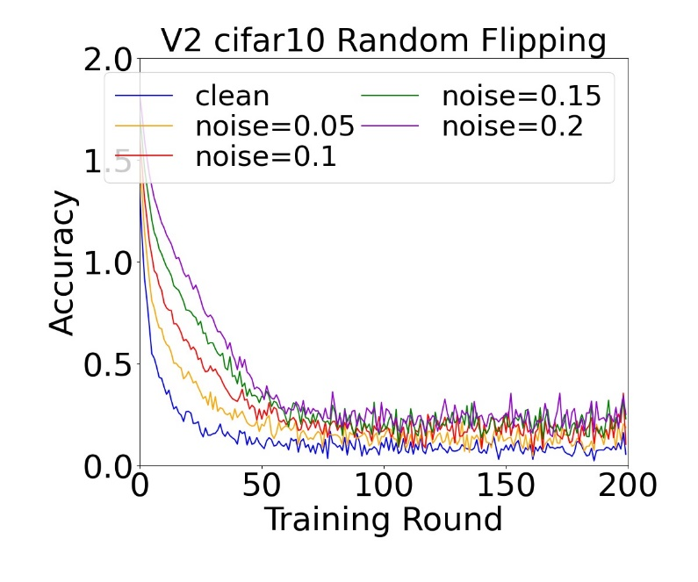
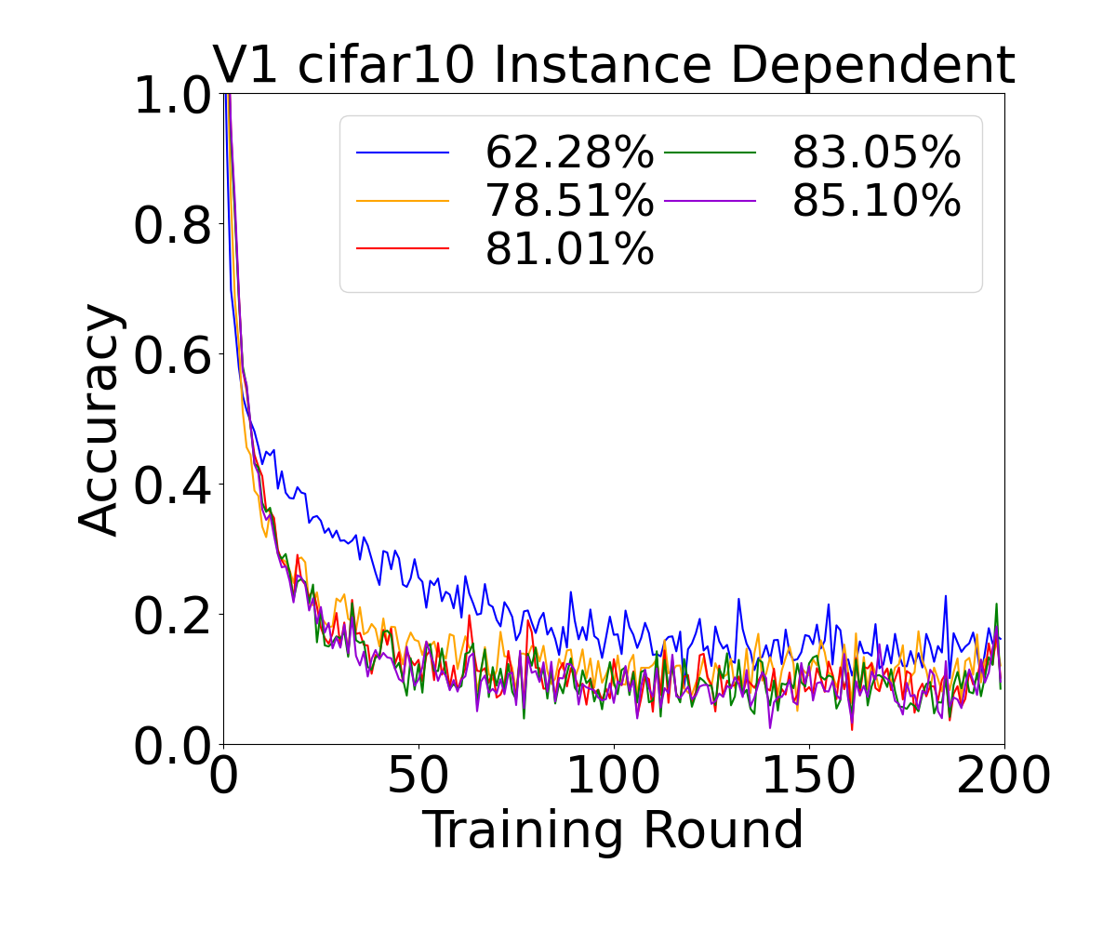
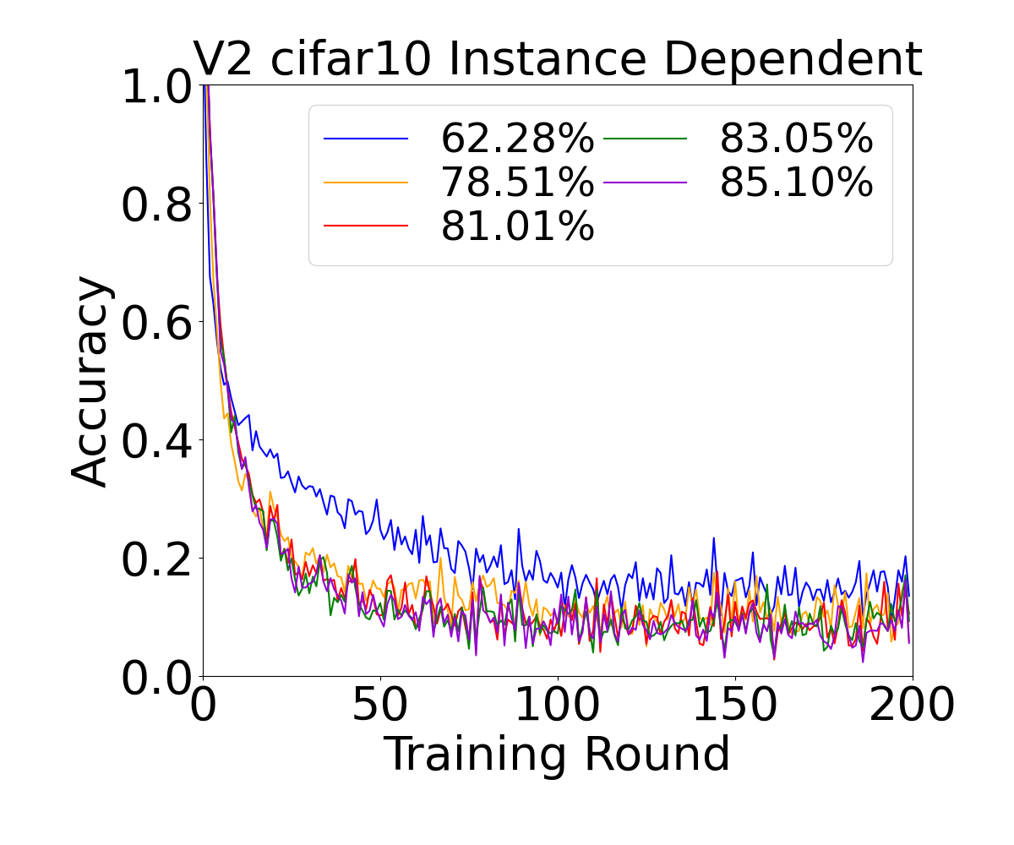
Result of Loss
N=10,β=+∞

Slide 5
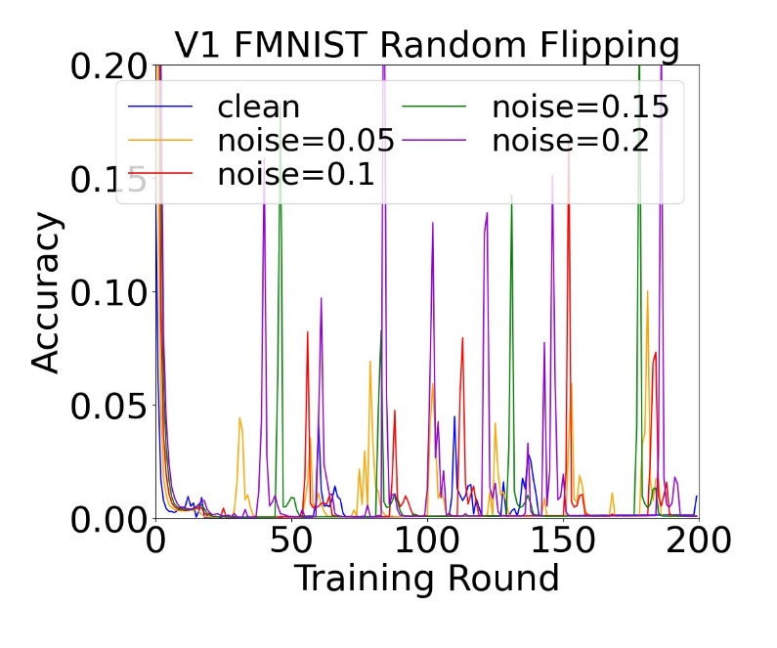
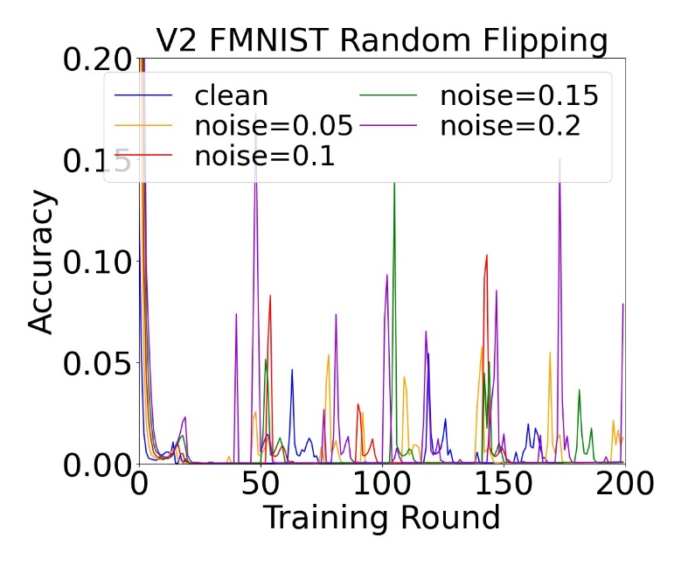
Result of Loss
N=10,β=+∞

Slide 6
Future Expectations
1. Include both non-iid and noise
2. Noise or non-iid which has the bigger effect
3. LID scores
4. Explore ways to make algorithms more adaptive to noise

Slide 7
THANK YOU

