Slide 1



Summary of minibatch-SFL

Slide 2
Content
Limitations of SFL layering
Minibatch-SFL does not improve accuracy
The use of the conclusions is too narrow

Slide 3
Limitations of SFL layering
The impact of data sets on layering
The impact of deep learning models on layering
The impact of non-IID data on layering

Slide 4
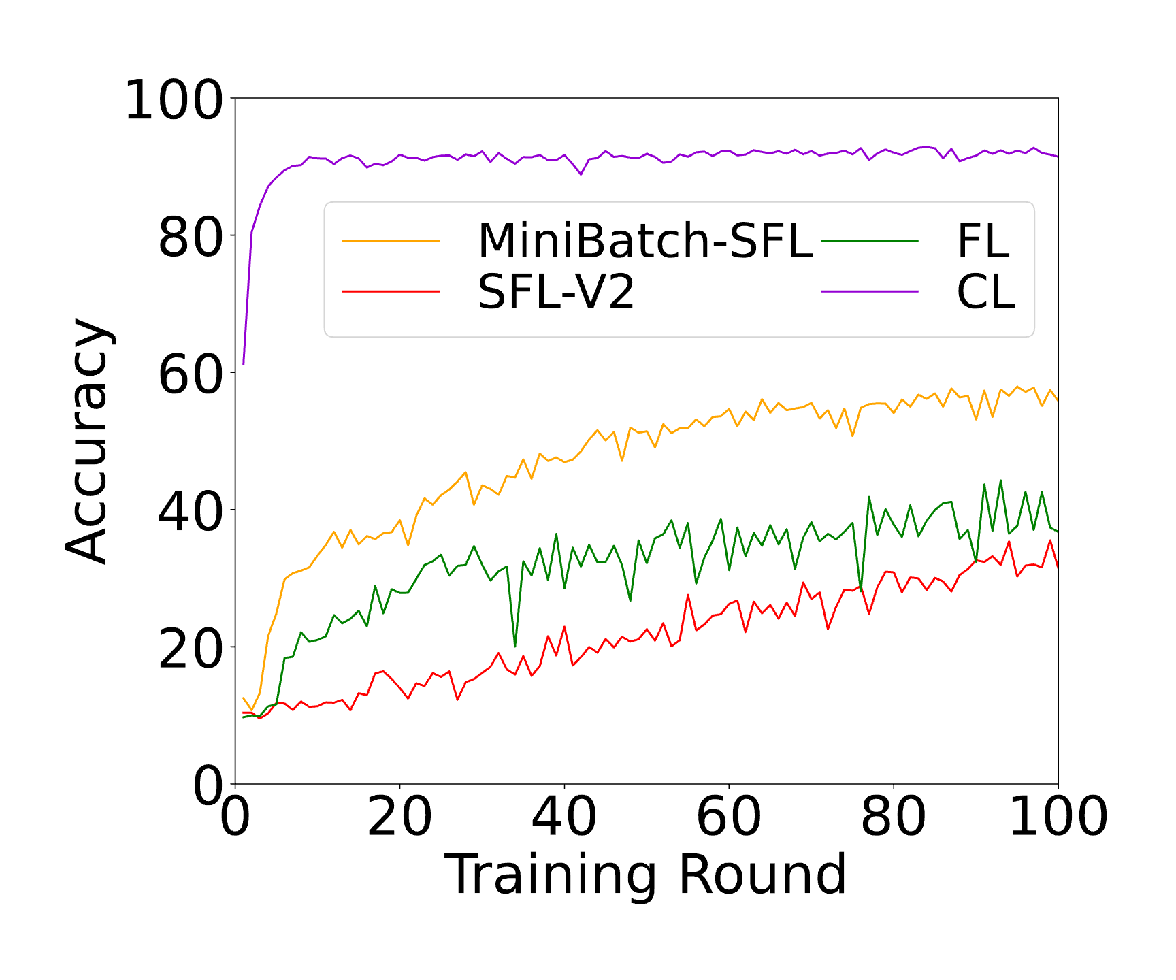
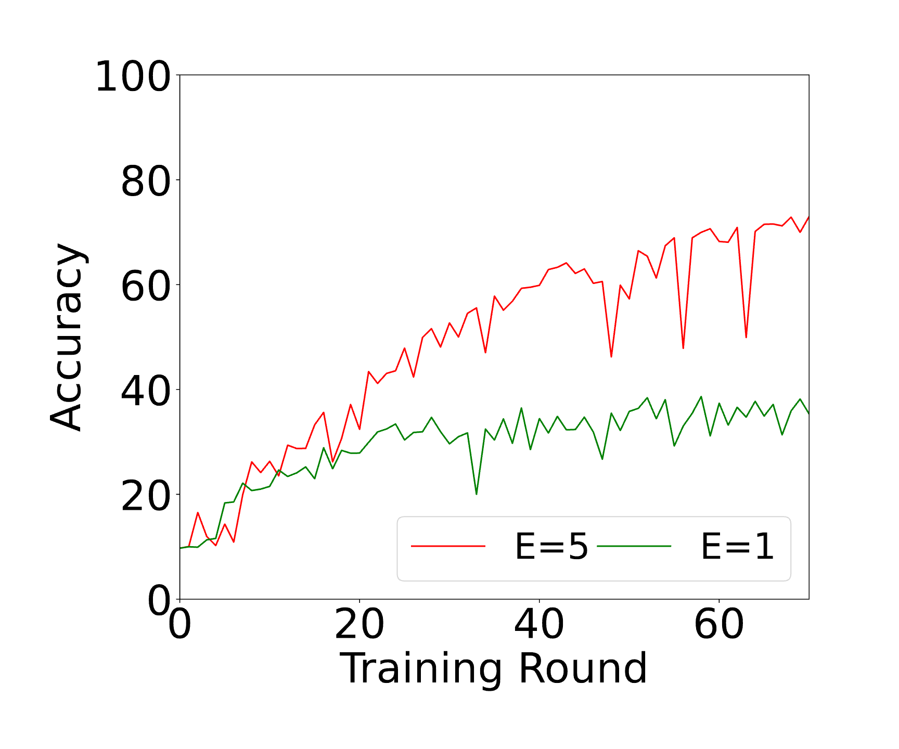
Minibatch-SFL does not improve accuracy

Slide 5
The use of the conclusions is too narrow
The conclusions mainly include accuracy and formula 8&10
The current conclusions apply only to ResNet
The current results are quite different from our initial expectations

Slide 6
THANK YOU

