Slide 1



Apply SplitFed to FedCorr: Detecting Unreliable Edge Learning Users
12332463
Geng Tian

Slide 2
Main Reference Paper
[1]“Security and privacy on 6g network edge: A survey,” IEEE Communications Surveys & Tutorials, 2023.
[2]“A survey on space-air-ground-sea integrated network security in 6g,” IEEE Communications Surveys & Tutorials, vol. 24, no. 1, pp. 53–87, 2021.
[3]“Fedcorr: Multi-stage federated learning for label noise correction,” in Proceedings of the IEEE/CVF Conference on Computer Vision and Pattern Recognition, pp. 10184–10193, 2022.
[4]“Splitfed: When federated learning meets split learning,” in Proceedings of the AAAI Conference on Artificial Intelligence, vol. 36, pp. 8485–8493, 2022.

Slide 3
Content
Research Background
Research Target
Major Challenge
The Existing Solution
The New Proposed Solution
Solution Feasibility Analysis

Slide 4

Research Background
Edge computing is widely
used in 6G networks
Users who participate in edge
computing are not necessarily
reliable
https://zh.vietnamplus.vn/%E8%B6%8A%E5%8D%97%E5%BA%94%E7%A0%94%E7%A9%B6%E5%BC%80%E5%8F%916g%E7%BD%91%E7%BB%9C%E6%8A%80%E6%9C%AF/135884.vnp

Slide 5
Research Background
Noise vs Non-IID
Noise: The data is maliciously modified and cannot reflect the original characteristics
Non-IID: Data labels are not evenly distributed

Slide 6
Research Background
Attackers vs Victims
Attackers: User who intentionally compromises network security
Victims: Users whose data has been contaminated

Slide 7
Research Target
The network system can accurately identify attackers and victims
The network system can detect noise data and non-IID data

Slide 8

Major Challenge
The attacker will not cooperate with
the network system to detect unreliable
users
https://www.sgss8.net/tpdq/13309818/

Slide 9
Major Challenge
In the process of detecting unreliable users, the network system must not violate the privacy of users
The network system should support the large-scale data transfer generated by edge computing

Slide 10
The Existing Solution
Fedcorr: Multi stage federated learning for label noise correction
Use federated learning as an edge learning framework
Use LID to detect unreliable users

Slide 11
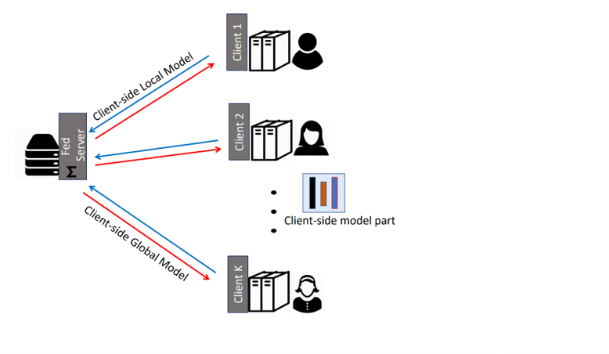
Structure of the Federated learning

Slide 12
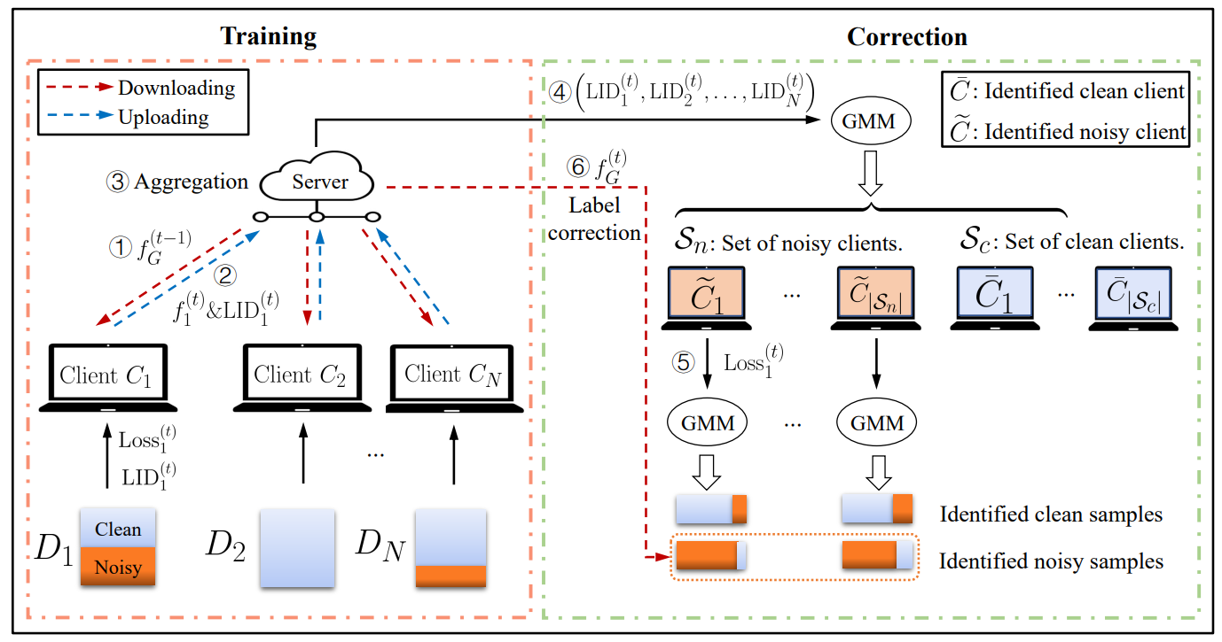
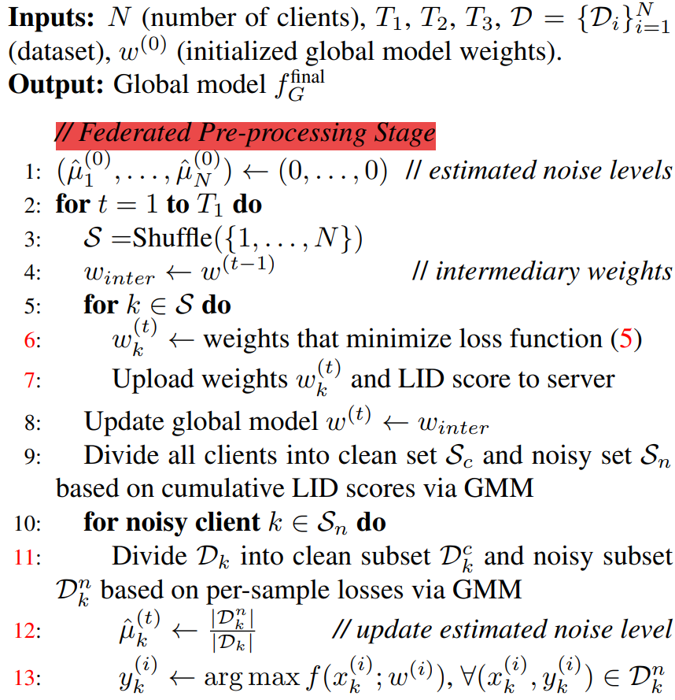
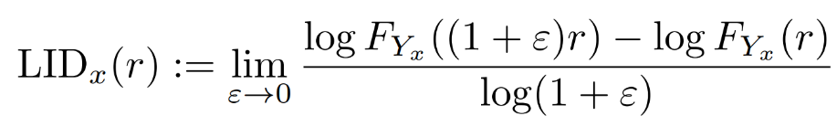
The Existing Solution

Slide 13
The New Proposed Solution
Use SplitFed learning instead of federated learning
The solution is capable of detecting non-IID data
All testing is done without the user's knowledge, preventing some users from not cooperating

Slide 14
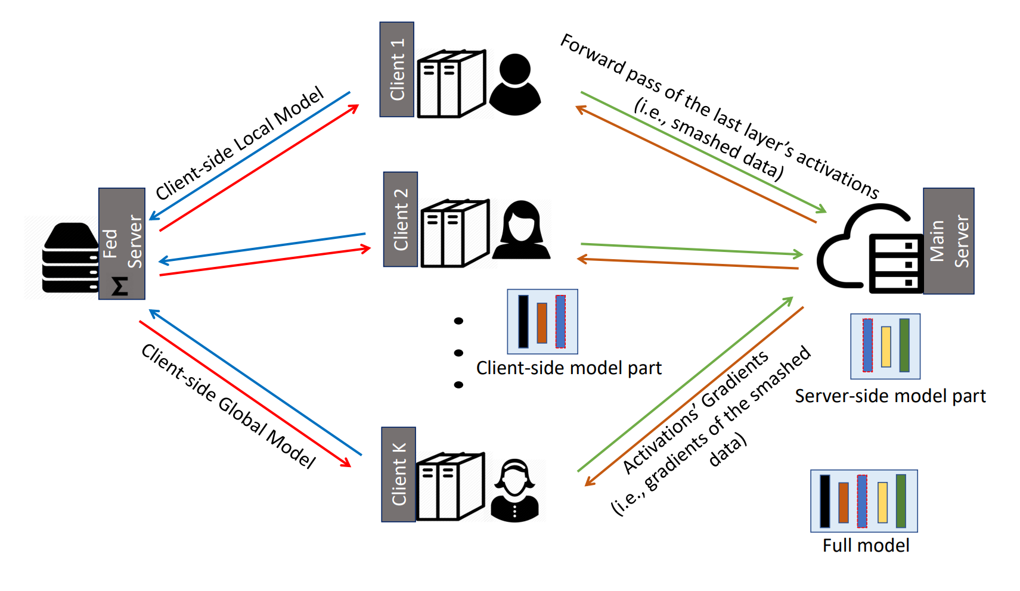
Structure of the SplitFed

Slide 15
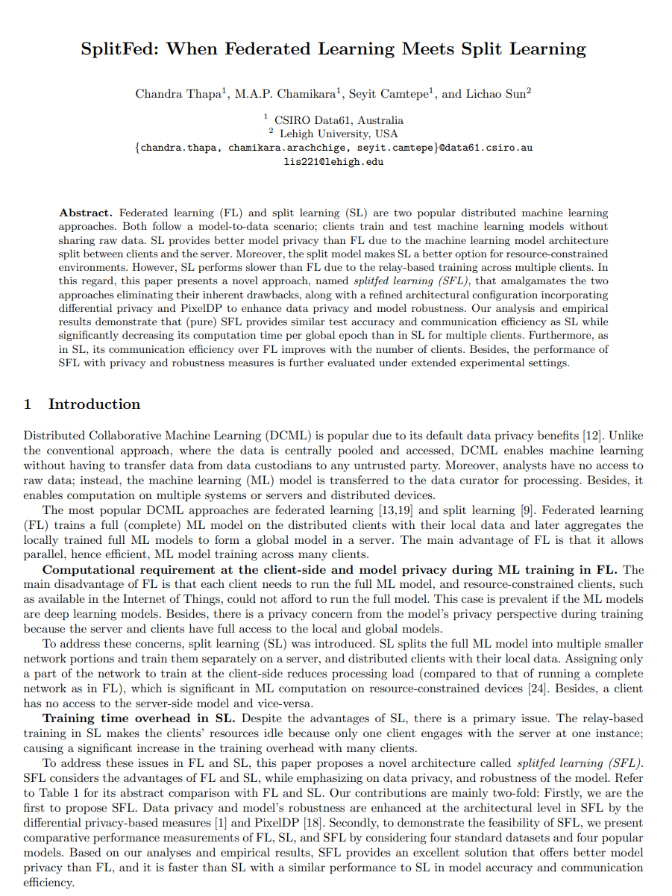
Solution Feasibility Analysis
SplitFed-v1
SplitFed-v2
SplitFed-v3

Slide 16
Solution Feasibility Analysis
Federated learning
SplitFed learning
non-IID=0
93.68%
94.01%
non-IID=0.5
93.46%
93.18%
non-IID=0.9
87.00%
87.20%
non-IID=0.95
81.52%
83.31%

Slide 17
Solution Feasibility Analysis
non-IID=0
non-IID=0.5
non-IID=0.9
non-IID=0.95

Slide 18
THANK YOU

