Slide 1



Summery of the Week

Slide 2
Content
Raspberry PI system construction
The running speed of the Raspberry PI system
The Raspberry PI accuracy problem

Slide 3
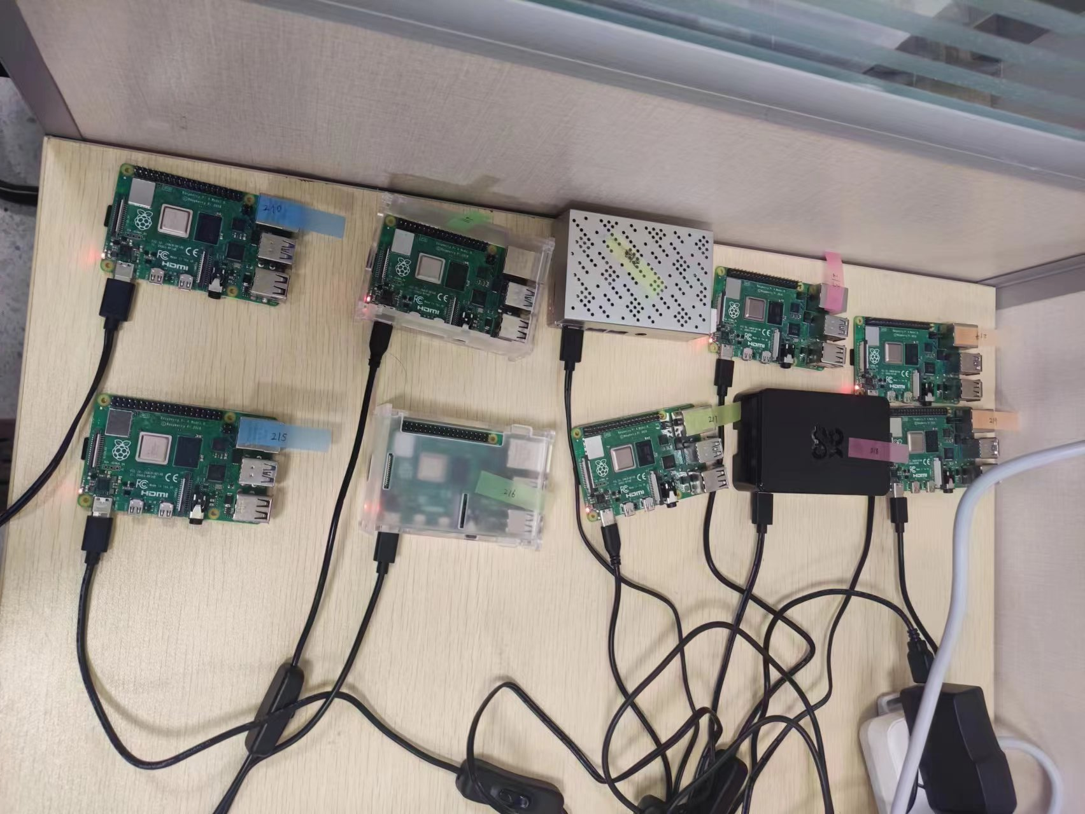
Raspberry PI system construction

Slide 4
The running speed of the Raspberry PI system
Each Mini-batch takes 4 minutes
It takes a long time for the system to train an epoch
It is difficult to get a model with multiple users

Slide 5
The Raspberry PI accuracy problem
The Raspberry PI system aims to detect data such as energy consumption
When training with different modes, it needs to use different parameters, which may affect the accuracy
The training speed of Raspberry PI is too slow to detect the accuracy of the model

Slide 6
THANK YOU

