Slide 1



Summery of the Week

Slide 2
Content
Raspberry PI test results
Reasons for differences results of different layers
Raspberry PI power changes

Slide 3
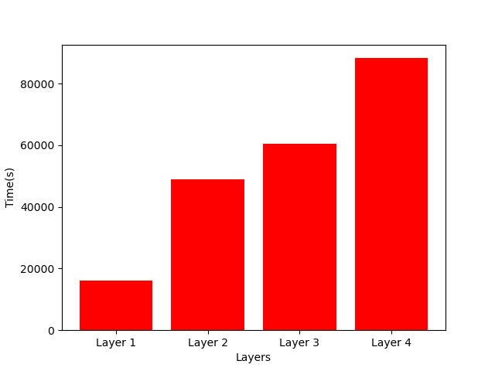
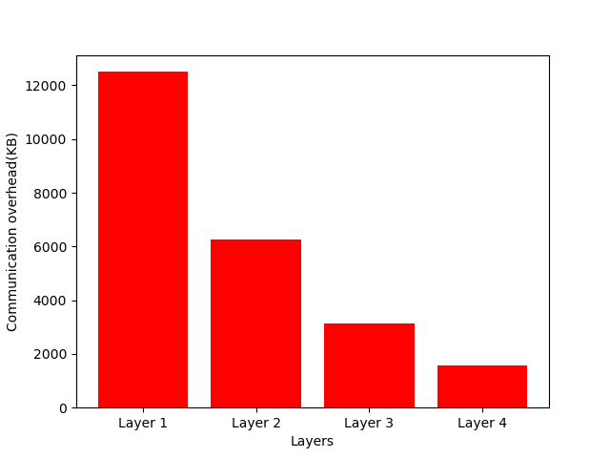
Raspberry PI test results

Slide 4
Reasons for differences results of different layers
The running time of the Raspberry PI affects energy consumption
When the Raspberry PI runs different layered models, the various parameters are basically the same

Slide 5
Raspberry PI power changes
The Raspberry PI is about 3.5W when calculated
The Raspberry PI is about 5.5W when transmitted
The Raspberry PI is about 6.7W when waited

Slide 6
THANK YOU

