Slide 1


Summary of the Week

Slide 2
Random Flipping vs Instance Dependent
1. Under the two noise modes, the variation trend of accuracy is different
2. Overfitting occurs when random flipping, but not when instance dependent
3. The accuracy is a proportional function when random flipping and
a piecewise function when instance dependent

Slide 3
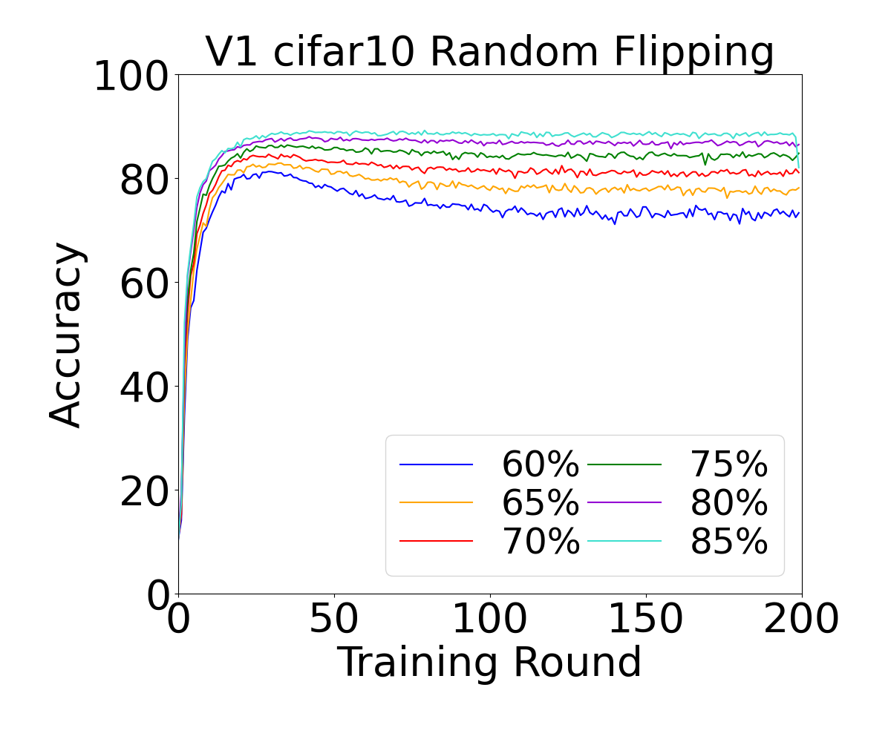
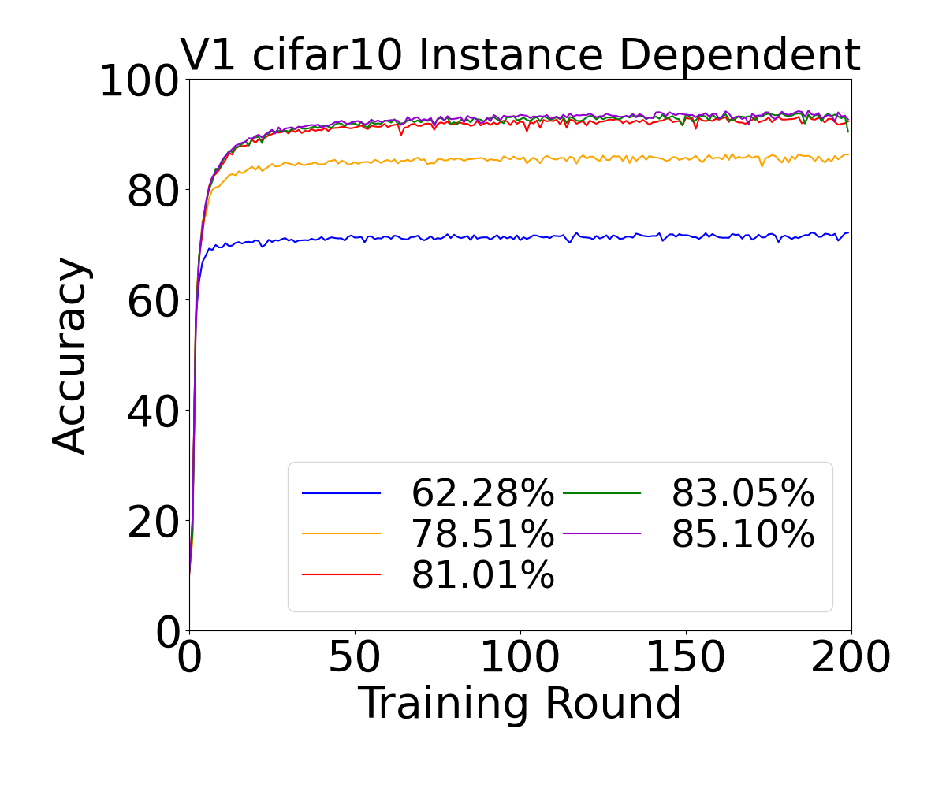
Result of V1 Accuracy
N=10,β=+∞

Slide 4
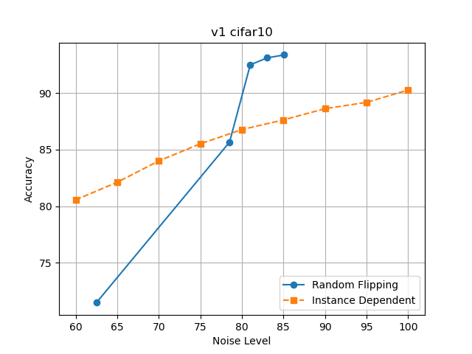
Result of V1 Accuracy
N=10,β=+∞

Slide 5
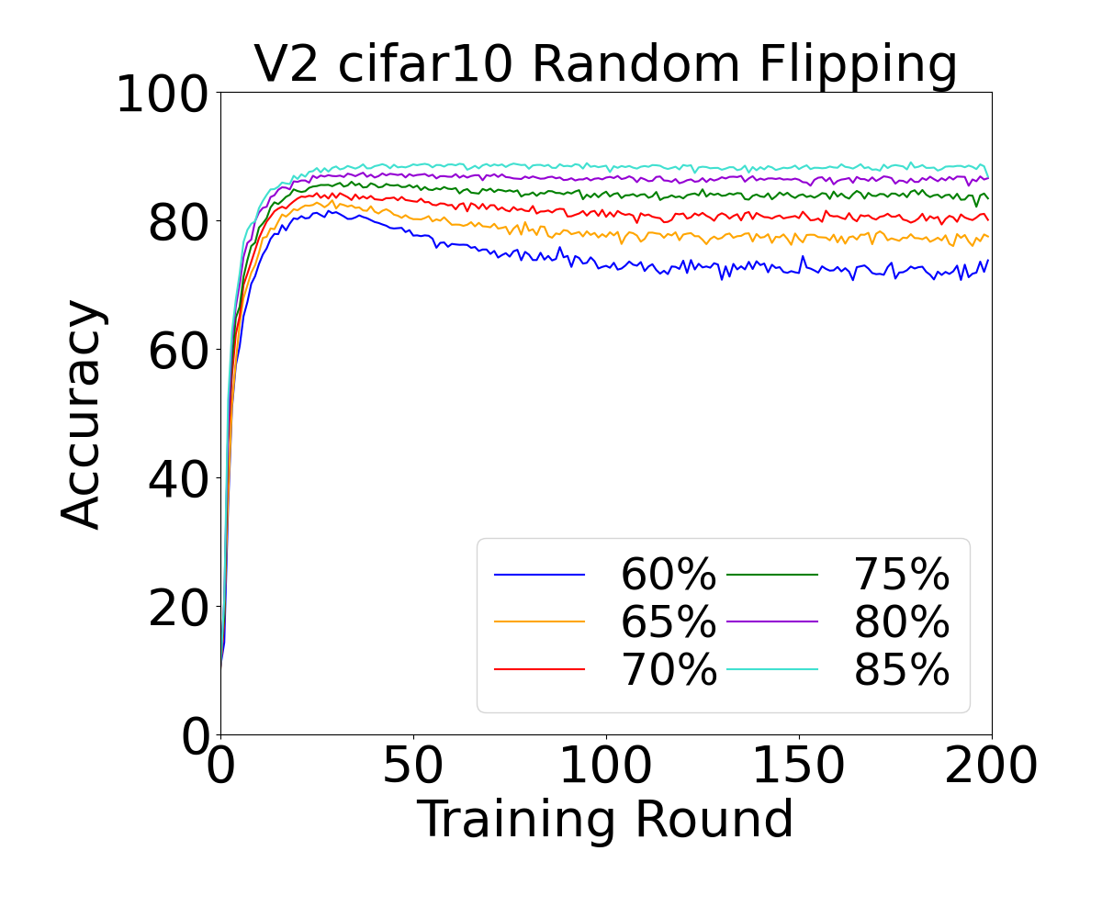
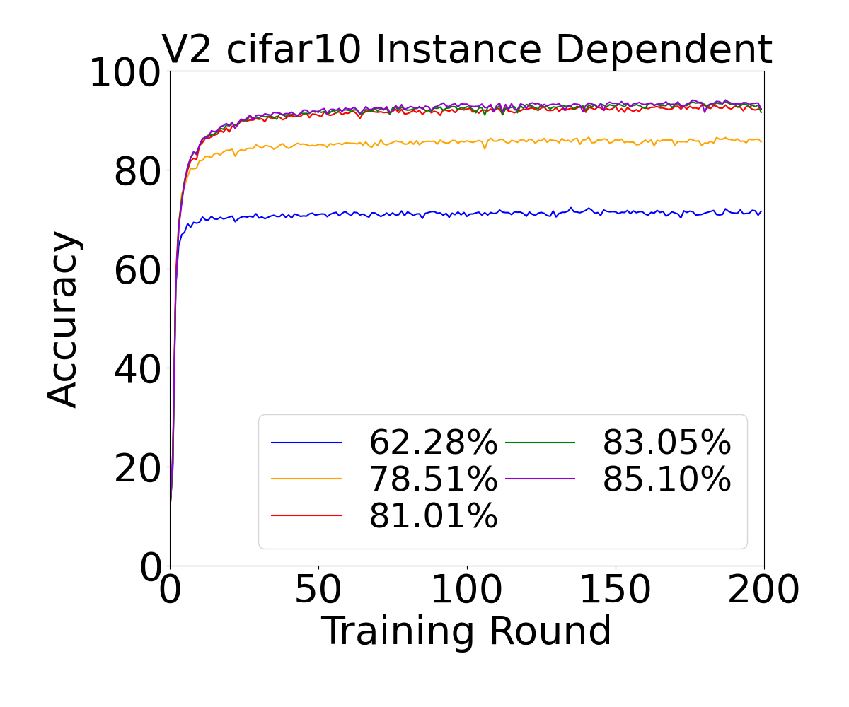
Result of V2 Accuracy
N=10,β=+∞

Slide 6
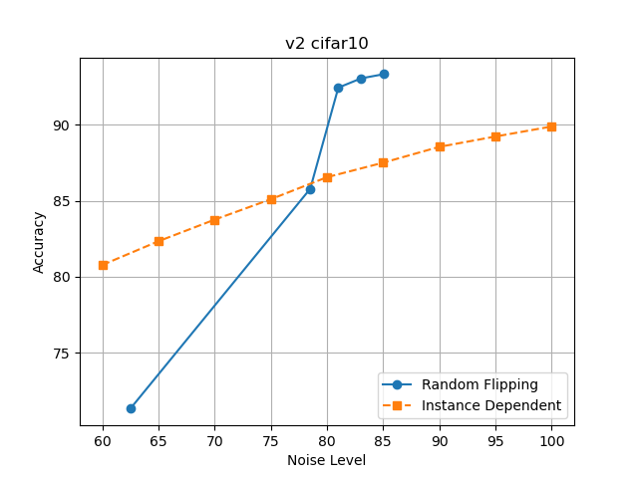
Result of V2 Accuracy
N=10,β=+∞

Slide 7
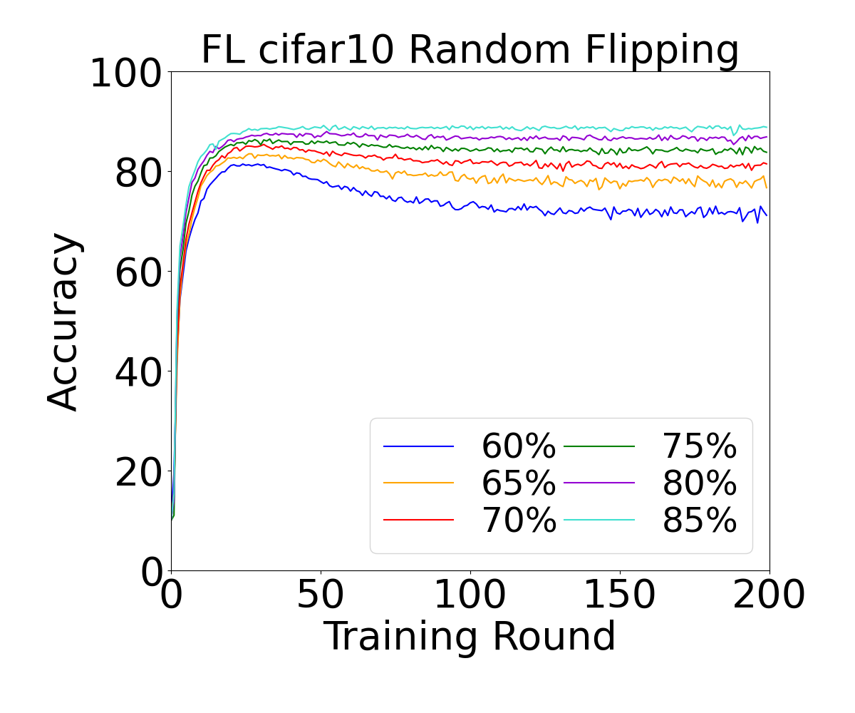

Result of FL Accuracy
N=10,β=+∞

Slide 8
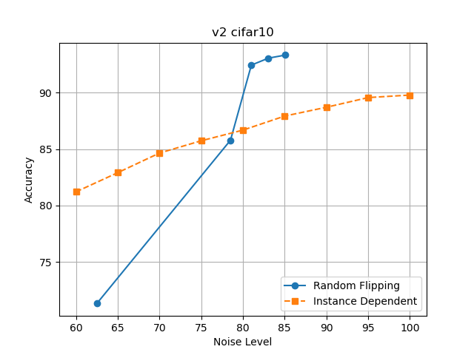
Result of FL Accuracy
N=10,β=+∞

Slide 9
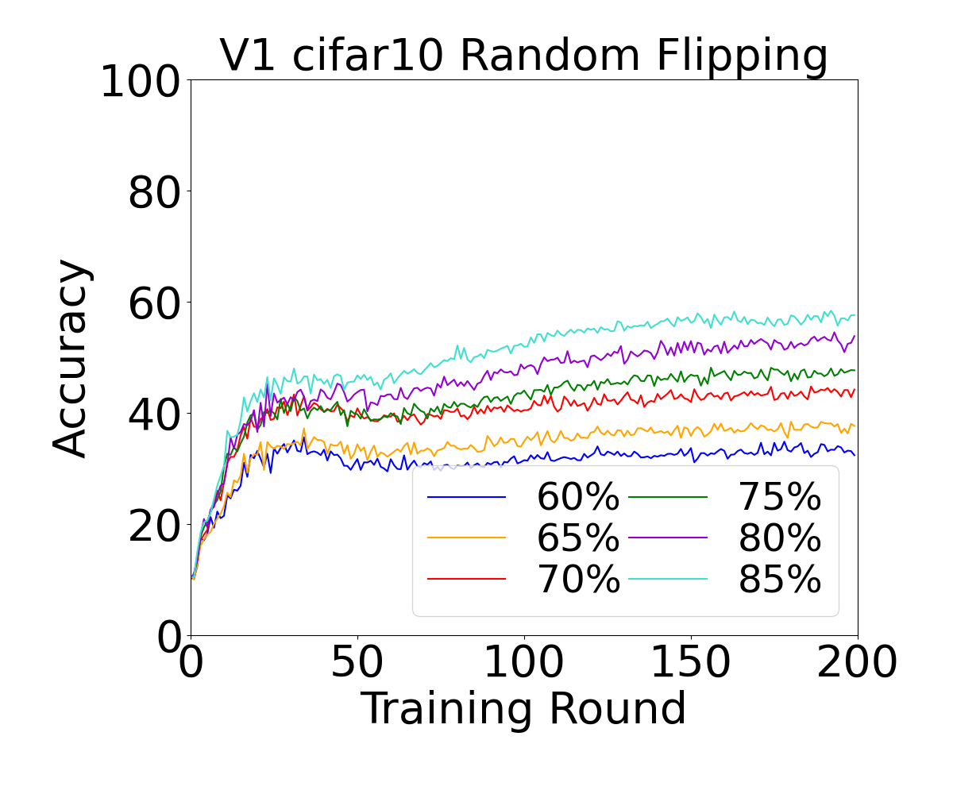
Result of V1 Accuracy
N=10,β=0.1

Slide 10
Schedule
1. The performance of the model when there are many users or only some
users participate
2. The strategy of proof

Slide 11
Main idea of the article
1. Data in the real world always contains noise
2. Splitfed is a popular edge learning framework
3. Proof of convergence including noise
4. Experimental results
5. Conclusion: Random flipping has a greater effect on noise, random flipping will cause overfit, non-IID can eliminate overfit, and the relationship between accuracy and noise

Slide 12
THANK YOU

