Slide 1


Summary of the Week

Slide 2
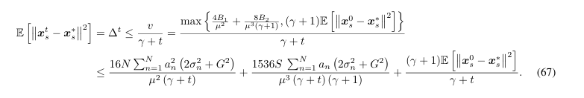
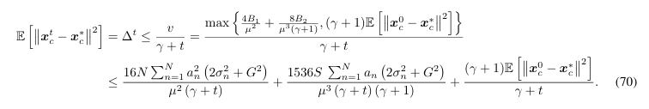
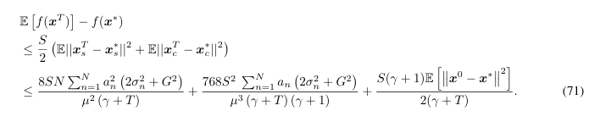
Random Flipping vs Instance Dependent

Slide 3
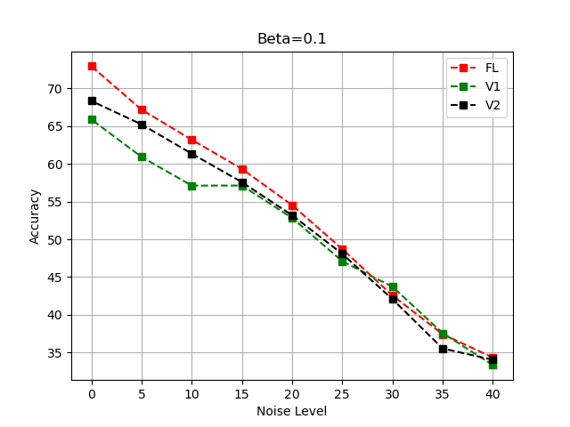
Accuracy comparison

Slide 4
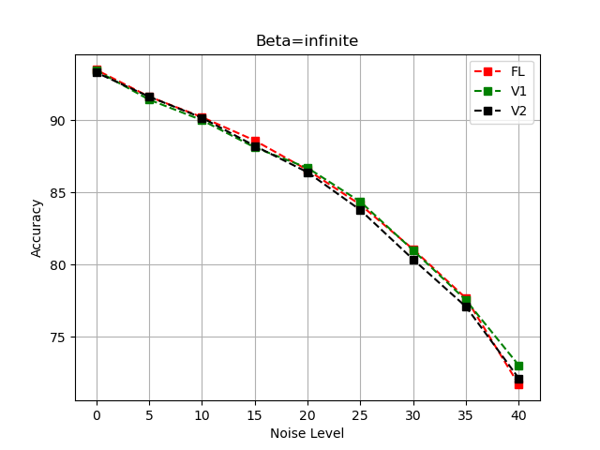
Accuracy comparison

Slide 5
THANK YOU

