Slide 1



Summery of the Week

Slide 2
Content
Test results for randomly selected users
Network structure of different algorithm frameworks

Slide 3
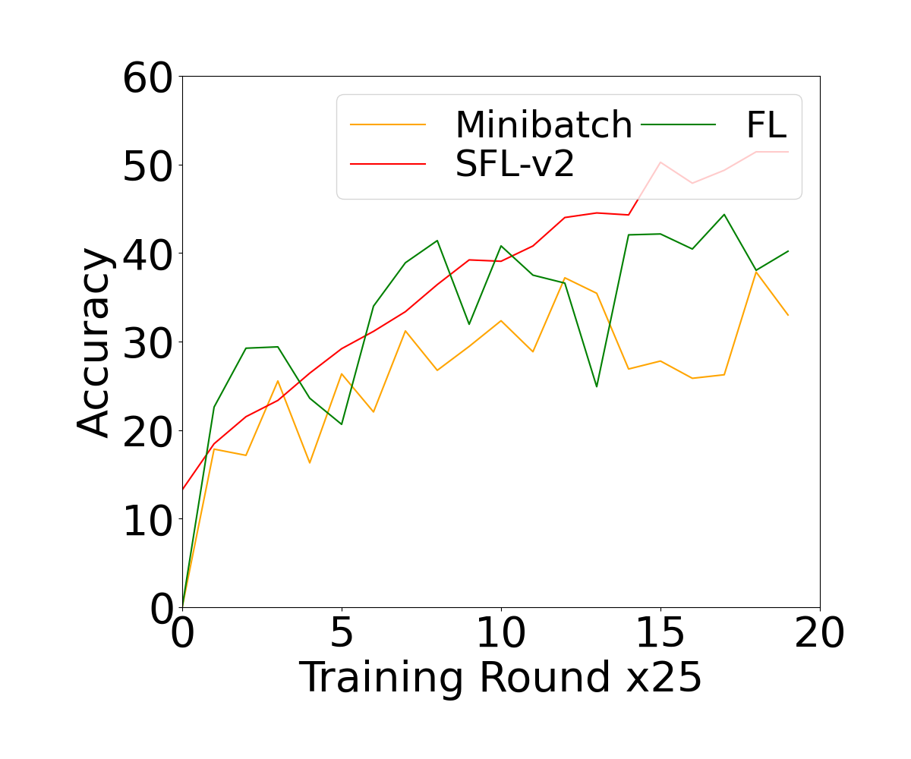
Test results
Non-IID=0.9
Rate=0.2

Slide 4
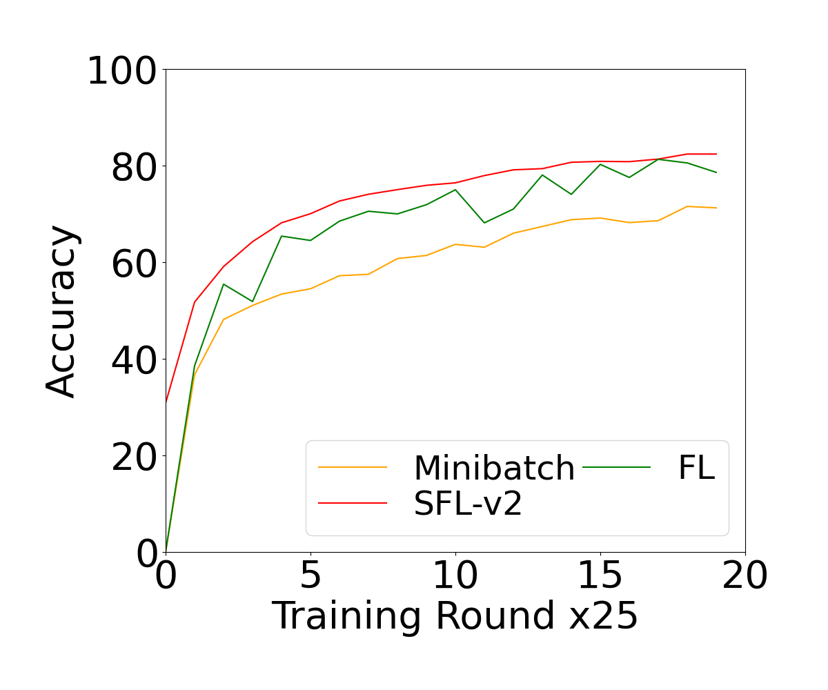
Test results
Non-IID=0.5
Rate=0.2

Slide 5
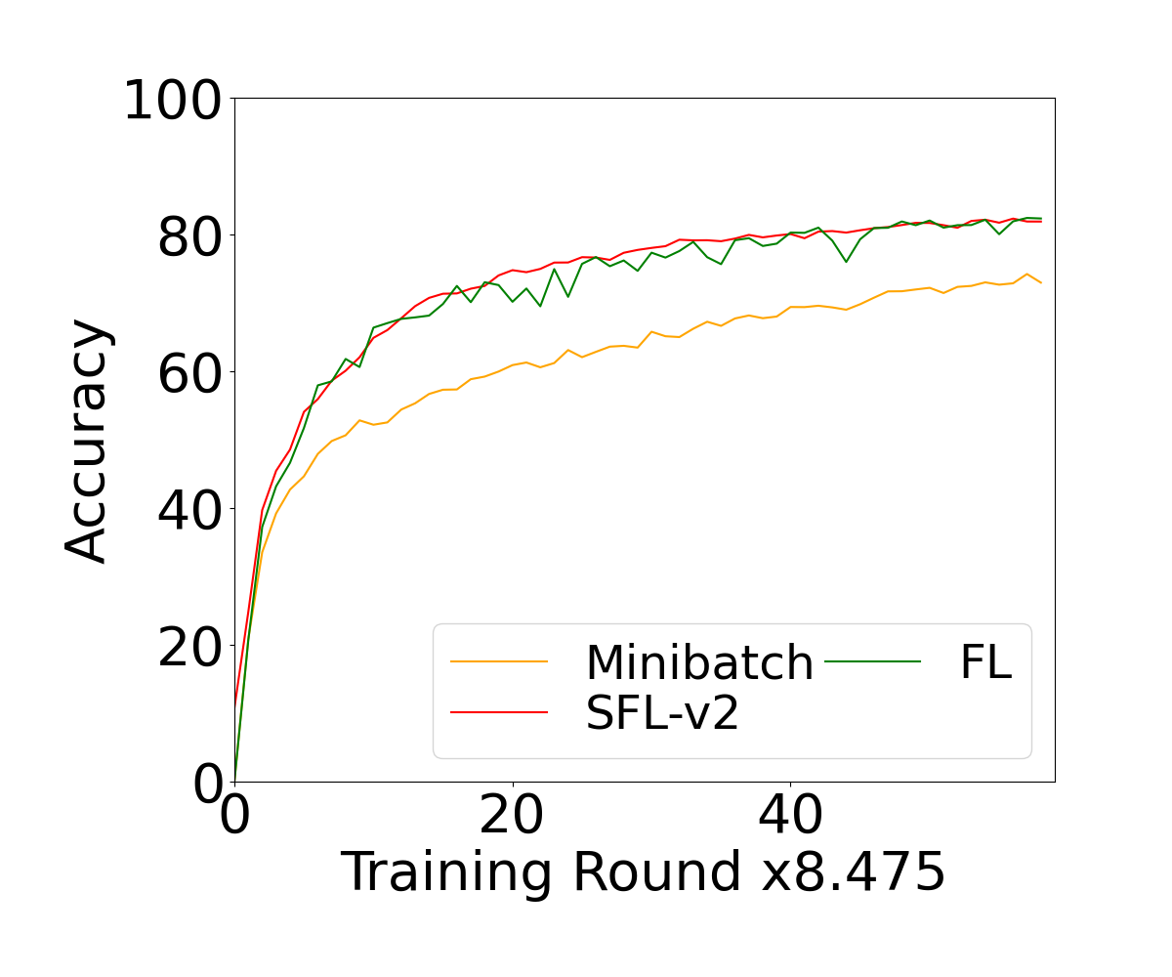
Test results
Non-IID=0.5
Rate=0.5

Slide 6
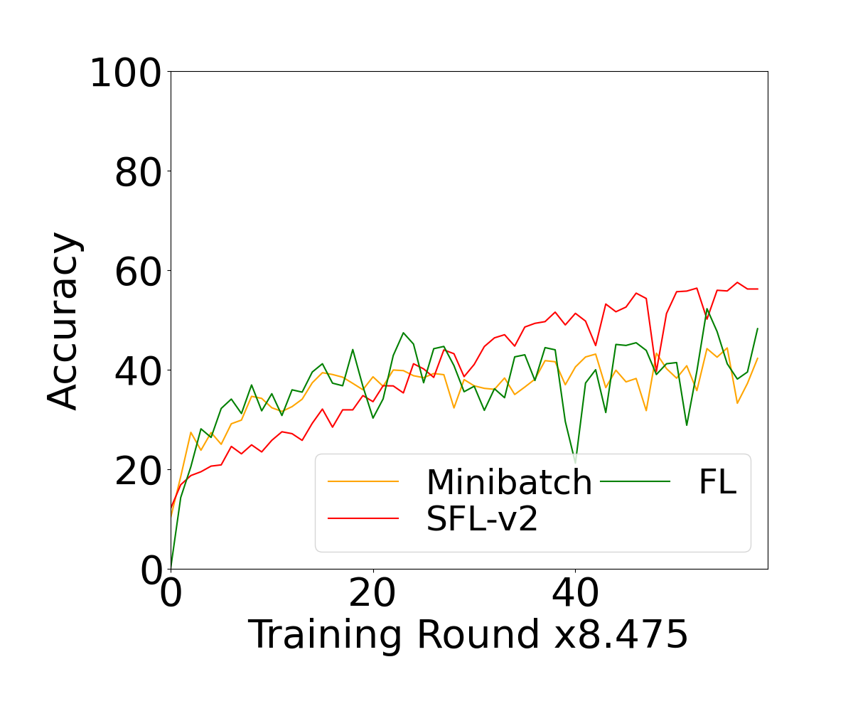
Test results
Non-IID=0.9
Rate=0.5

Slide 7
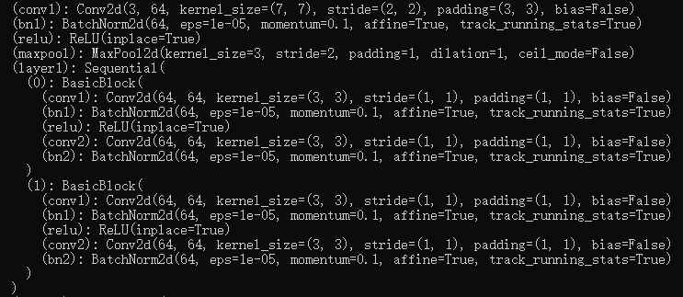
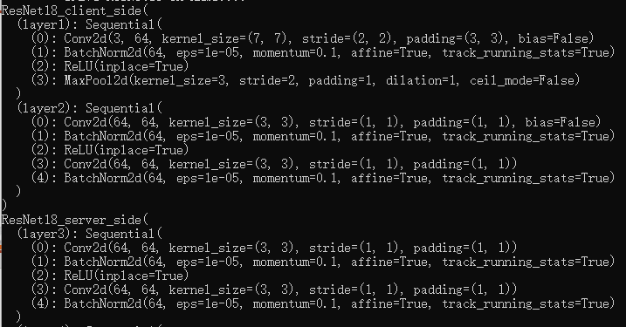
Network structure

Slide 8
THANK YOU

