Slide 1

FedCorr: Multi-Stage Federated Learning for Label Noise Correction
12332463 Geng Tian
Department of Computer Science and Engineering, Southern University of Science and Technology, Shenzhen, China

Slide 2
Advantage of FedCorr
Improves the accuracy of federated learning on noniid data.
Improve the accuracy of federated learning under noise labels.
Correct noise labels in the data set.

Slide 3
Starting Point
Non-IID data and noise labels are always present in federated learning
There are no labels working to correct errors in federal learning

Slide 4
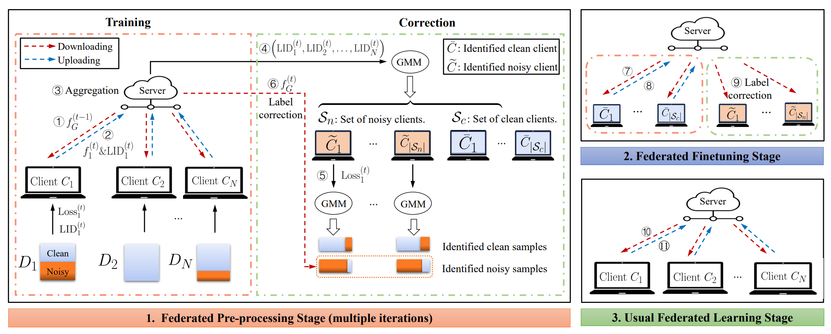
Algorithm Overview

Slide 5
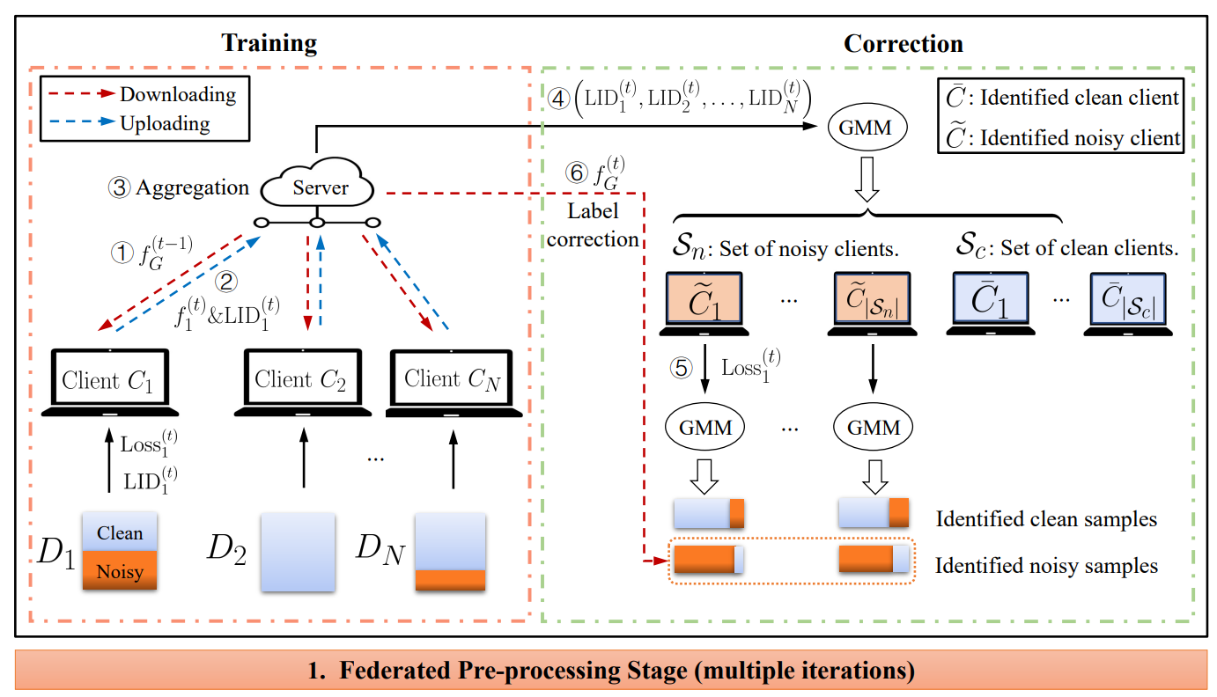
First Step of FedCorr
1. Data is not distributed independently between clients(non-IID)
2. Some clients have label noise in their data

Slide 6
First Step of FedCorr
Follow the steps of federated learning to train the model
Calculate local intrinsic dimensionality(LID) while training the model

Slide 7
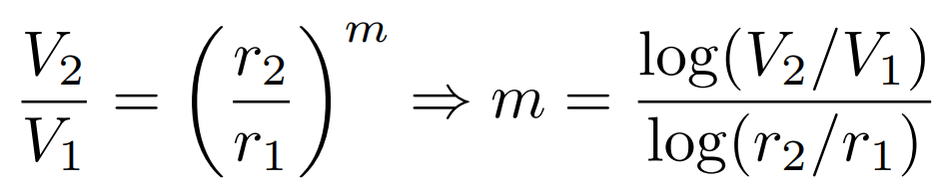
First Step of FedCorr

Slide 8
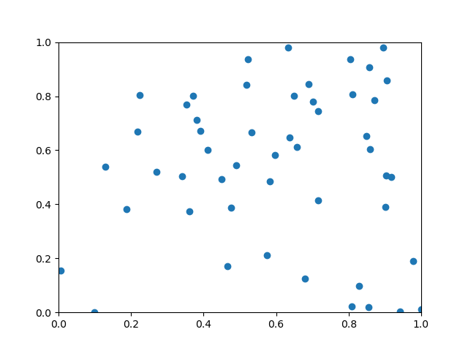
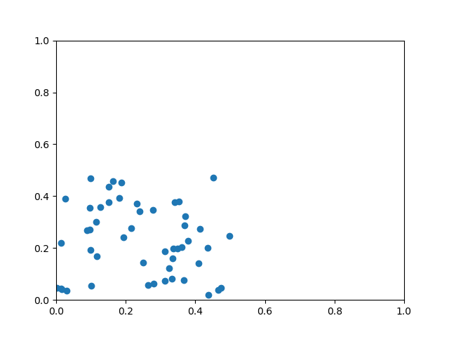
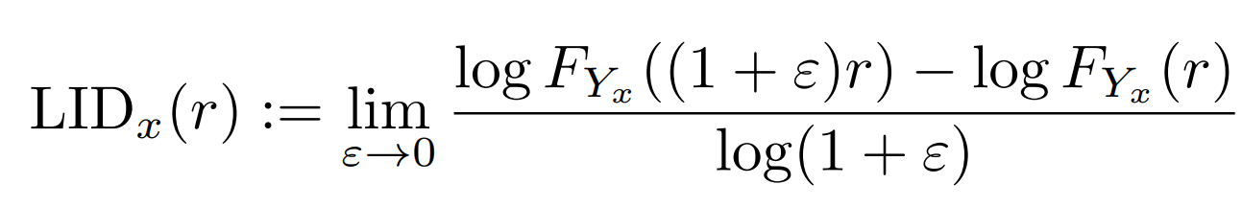
First Step of FedCorr
Noise Data
Clean Data

Slide 9
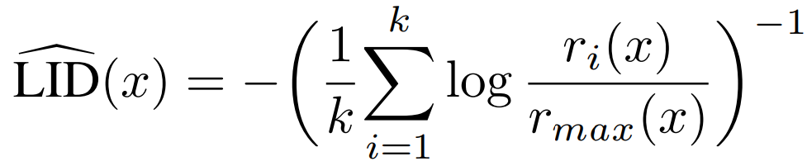
First Step of FedCorr

Slide 10
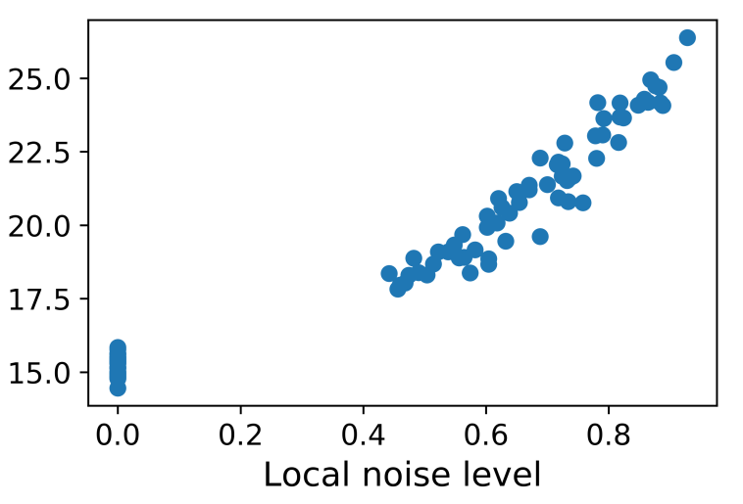
First Step of FedCorr
GMM and LID were used to predict noise clients and noise rate

Slide 11
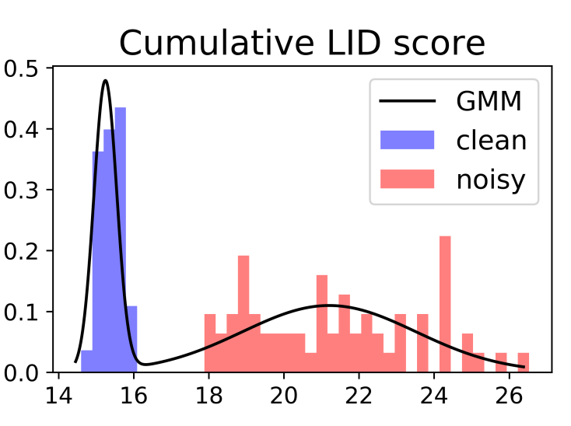
First Step of FedCorr
LID

Slide 12
First Step of FedCorr
Clients are divided into noisy clients and clean clients

Slide 13
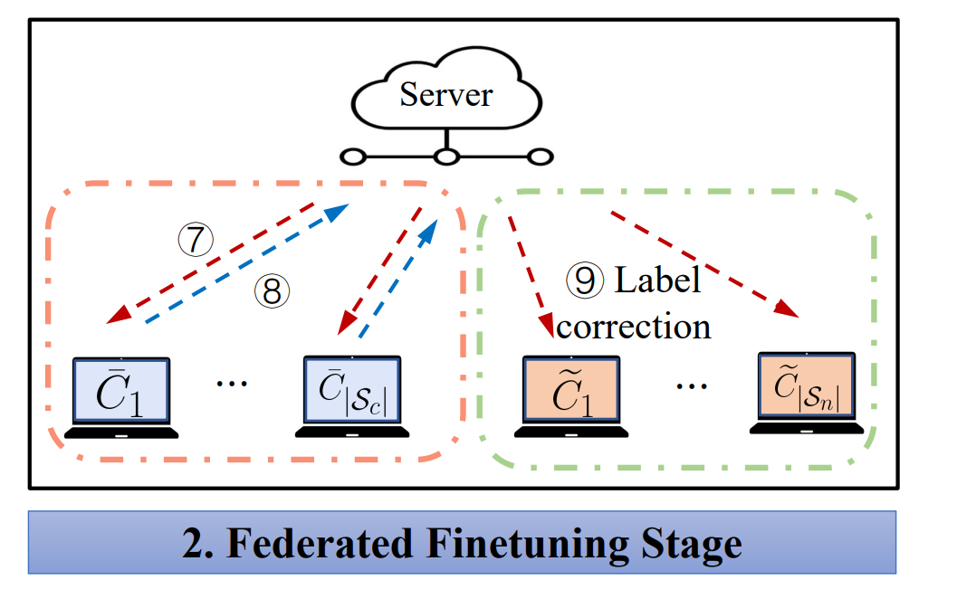
Second Step of FedCorr
Fine-tune the model using data from clean clients

Slide 14
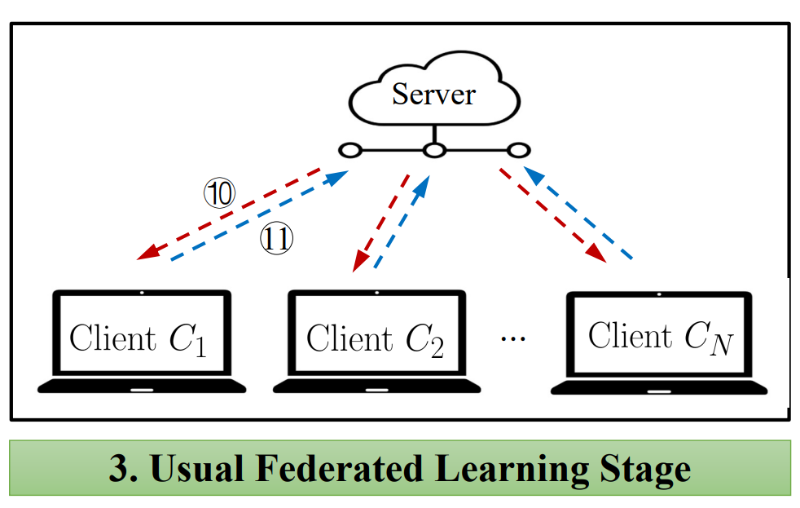
Third Step of FedCorr
The model was trained using both the corrected noise data and clean data

Slide 15
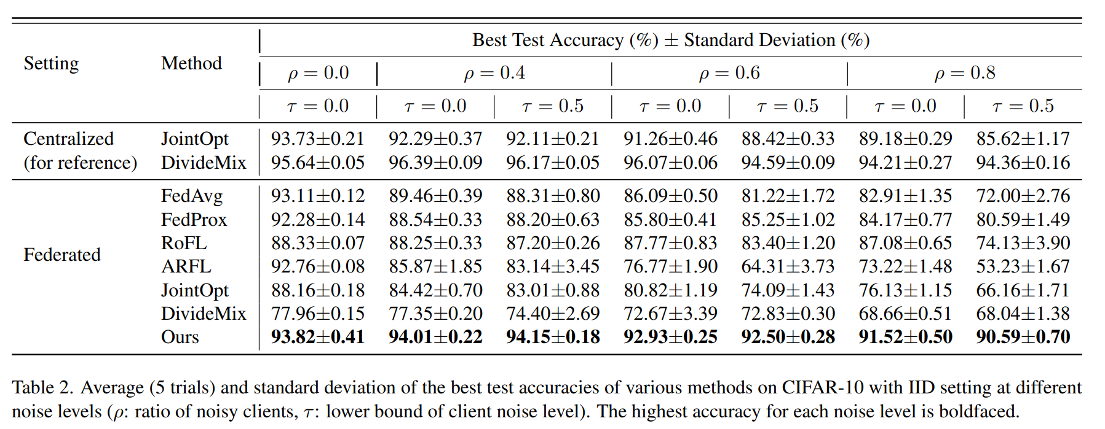
Experimental Result

Slide 16
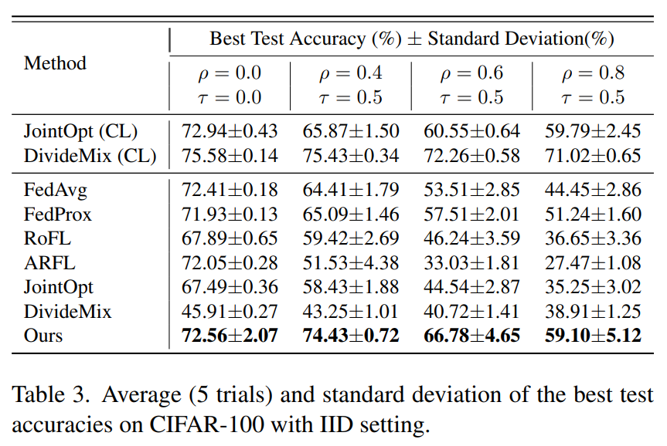
Experimental Result

Slide 17
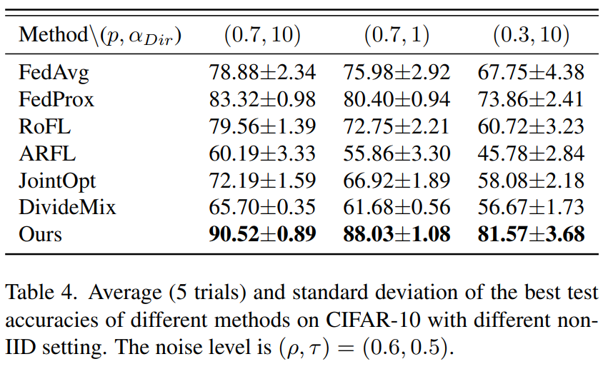
Experimental Result

Slide 18
Thank You! Questions are welcome!
For further questions and comments, please feel free to contact me at 12332463@mail.sustech.edu.cn

