Slide 1



Summery of the Week

Slide 2
Content
Verify the feasibility of the code
potential problem
A new training logic

Slide 3
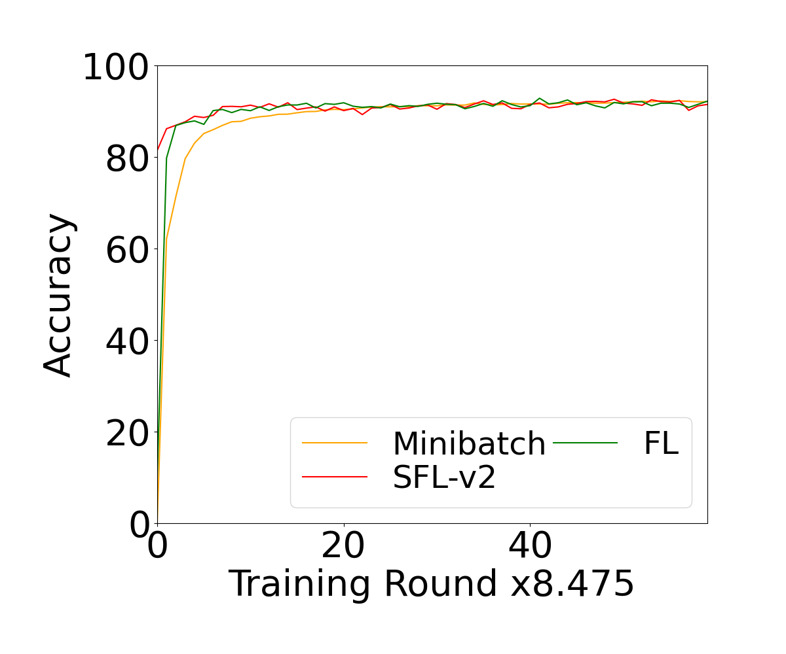
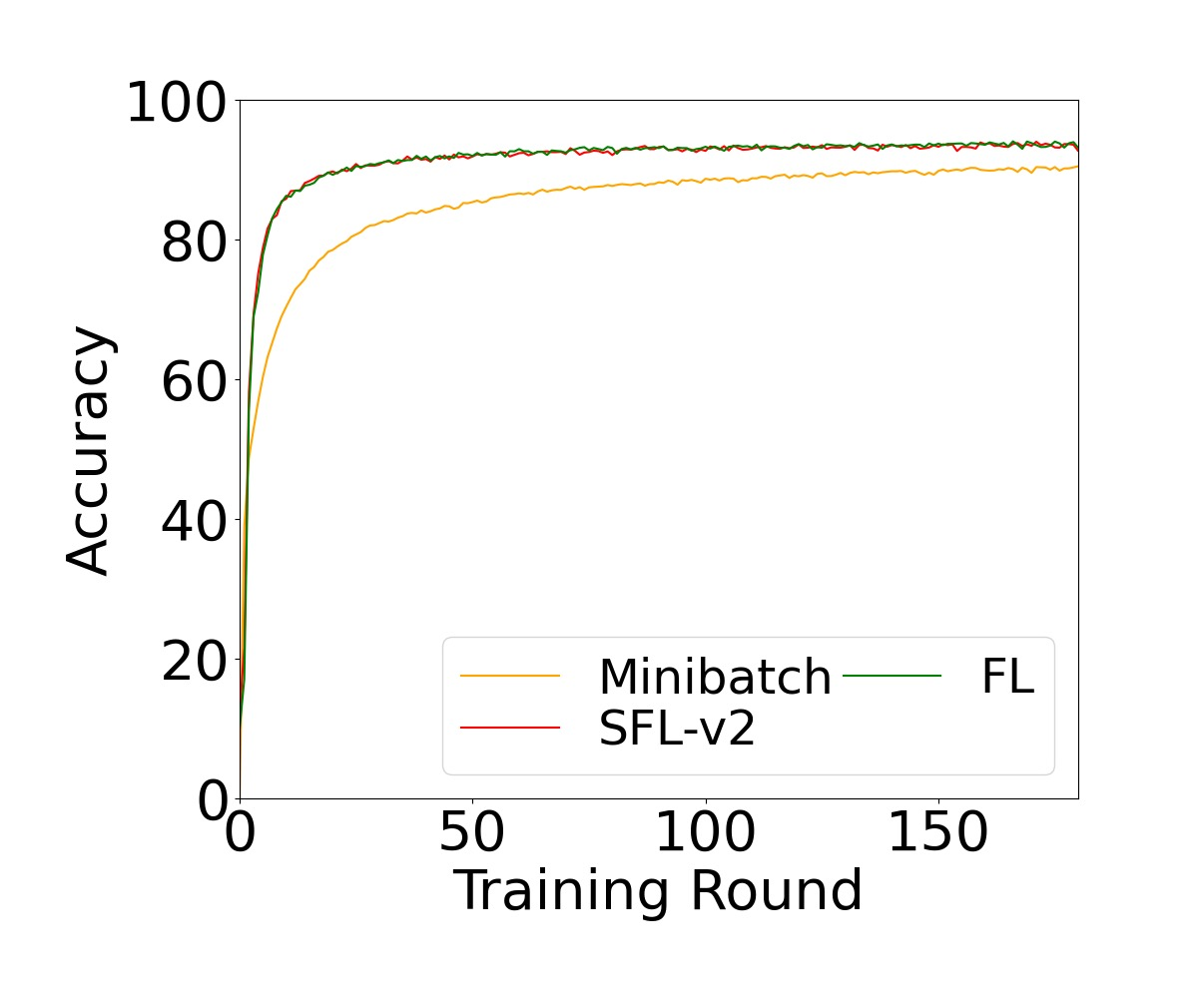
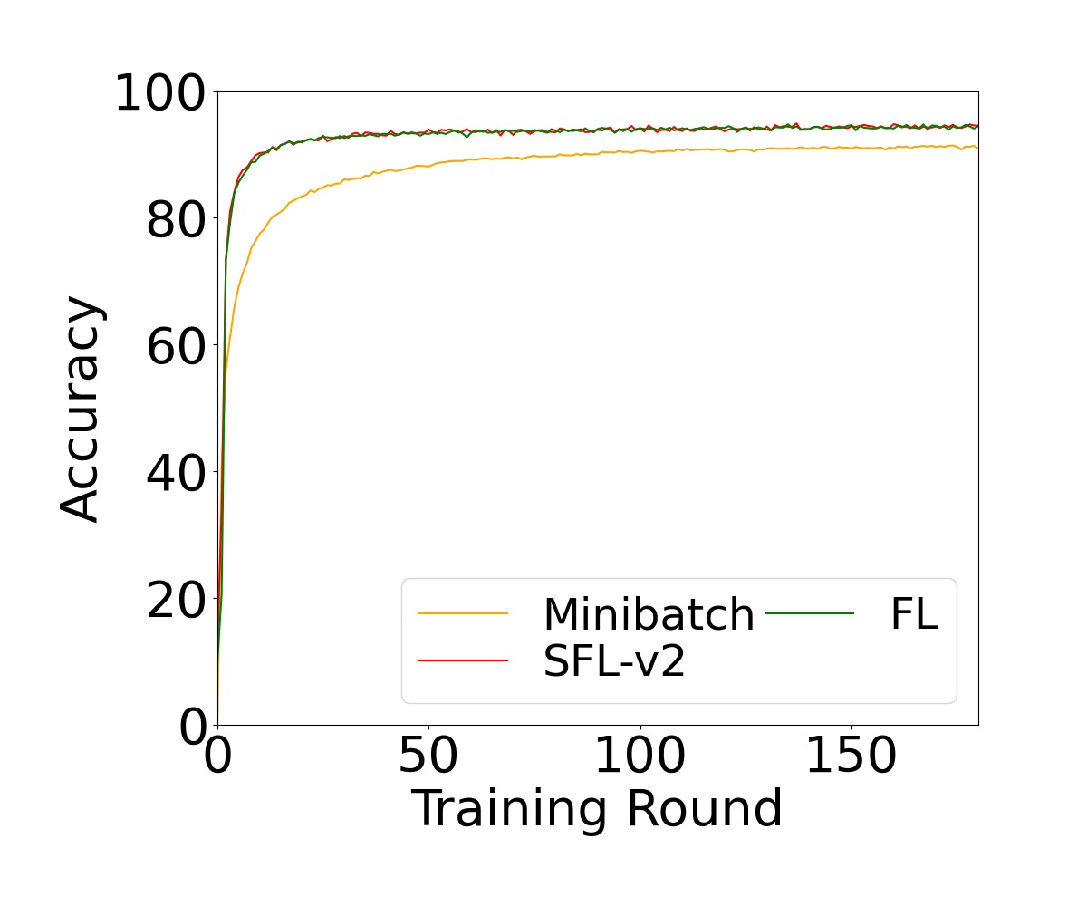
Test results

Slide 4
Potential problem
The original code framework is too complex
Rewrite the test part of the code
Ensure the logical accuracy of the code

Slide 5
A new training logic
If the number of users is n, the server updates for n times
The server is trained after receiving all user data
The server mixes all user data before training to eliminate non-iid

Slide 6
THANK YOU

