Slide 1

Week Summarry
12332463 Geng Tian
Department of Computer Science and Engineering, Southern University of Science and Technology, Shenzhen, China

Slide 2
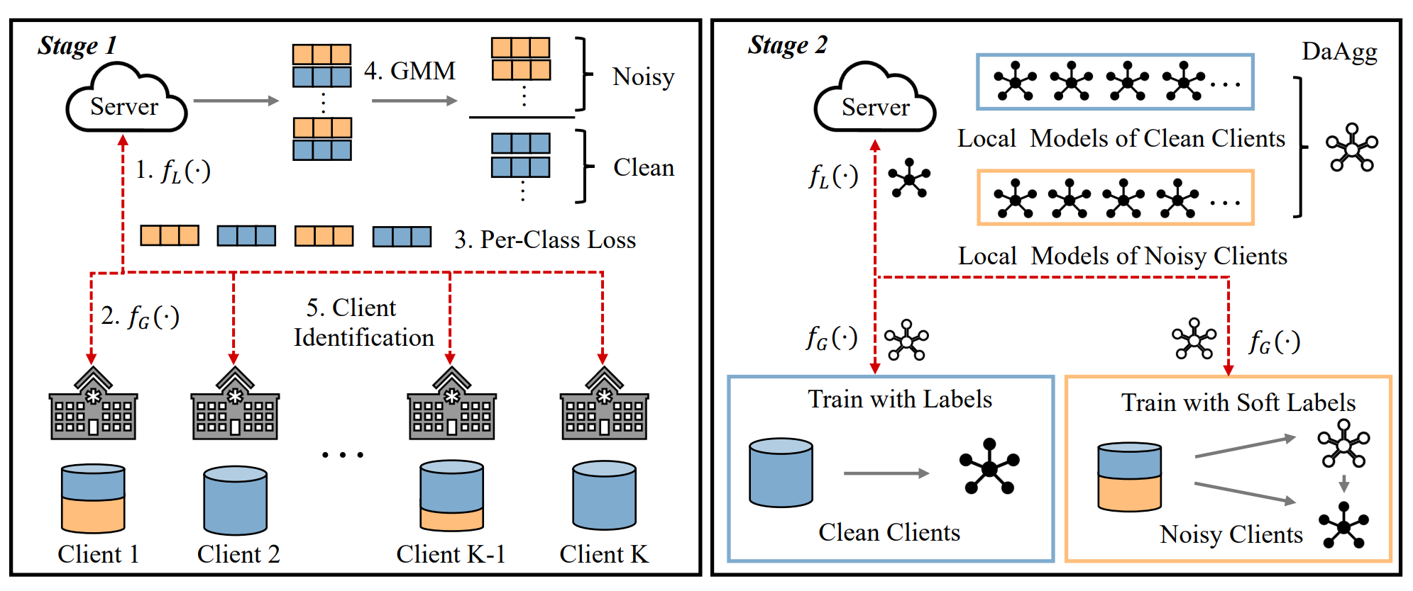
FedNoRo
[1]Wu N, Yu L, Jiang X, et al. FedNoRo: Towards Noise-Robust Federated Learning by Addressing Class Imbalance and Label Noise Heterogeneity[J].

Slide 3
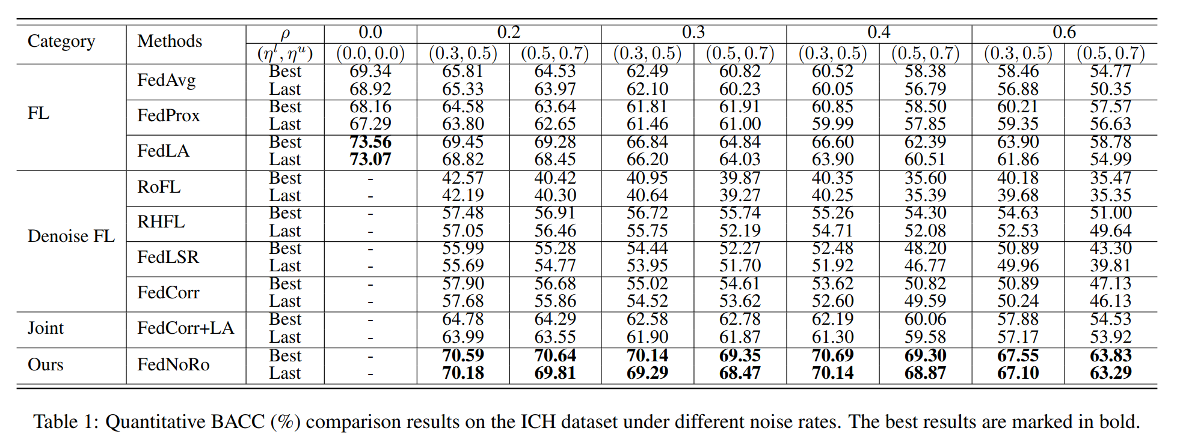
FedNoRo
[1]Wu N, Yu L, Jiang X, et al. FedNoRo: Towards Noise-Robust Federated Learning by Addressing Class Imbalance and Label Noise Heterogeneity[J].

Slide 4
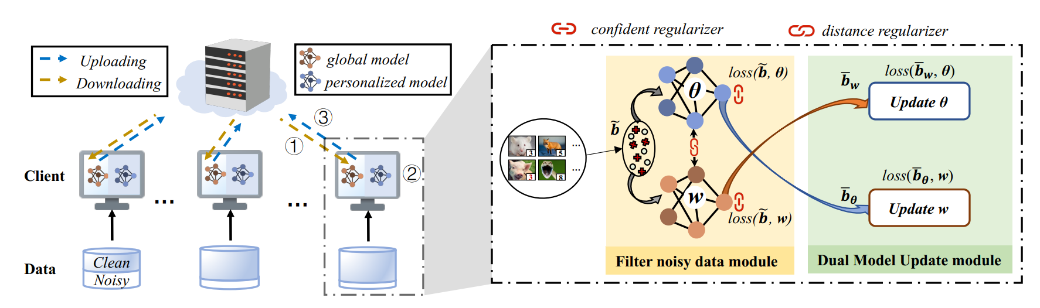
FedFixer
[1] Ji X, Zhu Z, Xi W, et al. FedFixer: Mitigating Heterogeneous Label Noise in Federated Learning[C]//Proceedings of the AAAI Conference on Artificial Intelligence. 2024, 38(11): 12830-12838.

Slide 5
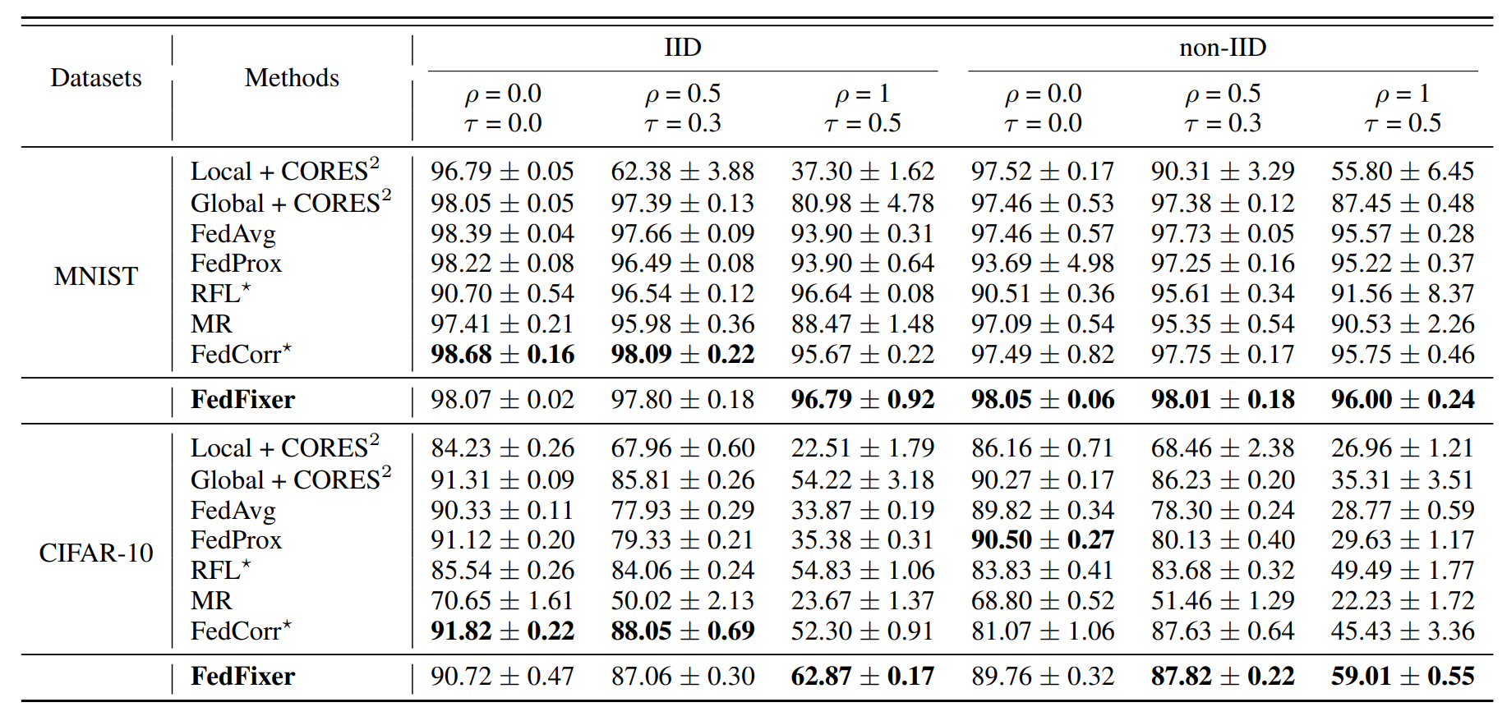
FedFixer
[1] Ji X, Zhu Z, Xi W, et al. FedFixer: Mitigating Heterogeneous Label Noise in Federated Learning[C]//Proceedings of the AAAI Conference on Artificial Intelligence. 2024, 38(11): 12830-12838.

Slide 6
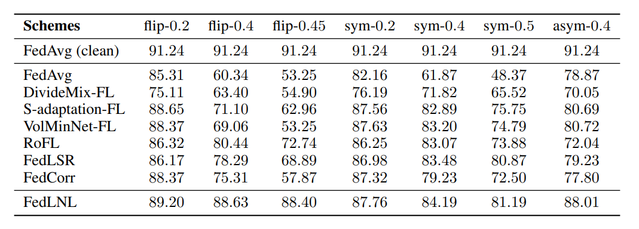
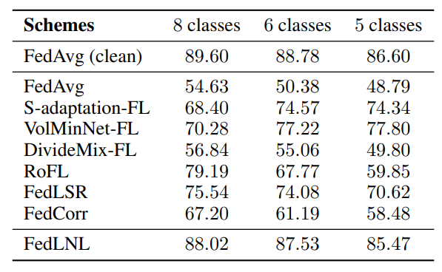
FedLNL
[1] Zhou X, Wang X. Federated label-noise learning with local diversity product regularization[C]//Proceedings of the AAAI Conference on Artificial Intelligence. 2024, 38(15): 17141-17149.

Slide 7
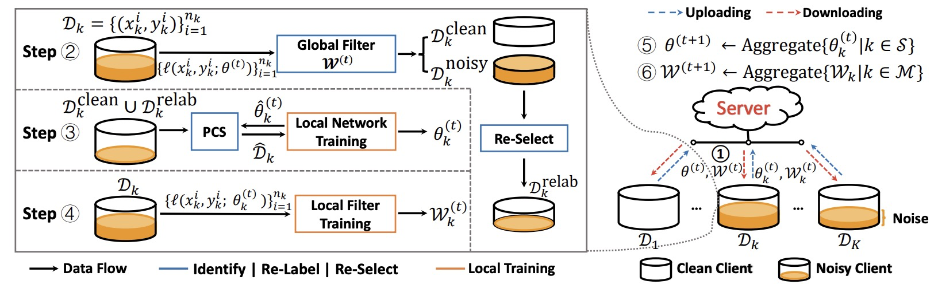
FedDiv
[1] Li J, Li G, Cheng H, et al. FedDiv: Collaborative Noise Filtering for Federated Learning with Noisy Labels[C]//Proceedings of the AAAI Conference on Artificial Intelligence. 2024, 38(4): 3118-3126.

Slide 8
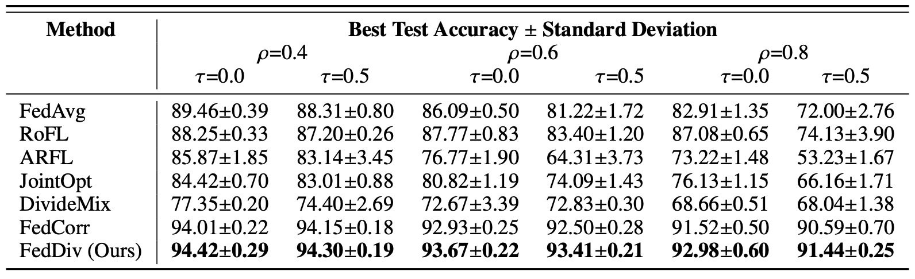
FedDiv
[1]Li J, Li G, Cheng H, et al. FedDiv: Collaborative Noise Filtering for Federated Learning with Noisy Labels[C]//Proceedings of the AAAI Conference on Artificial Intelligence. 2024, 38(4): 3118-3126.

Slide 9
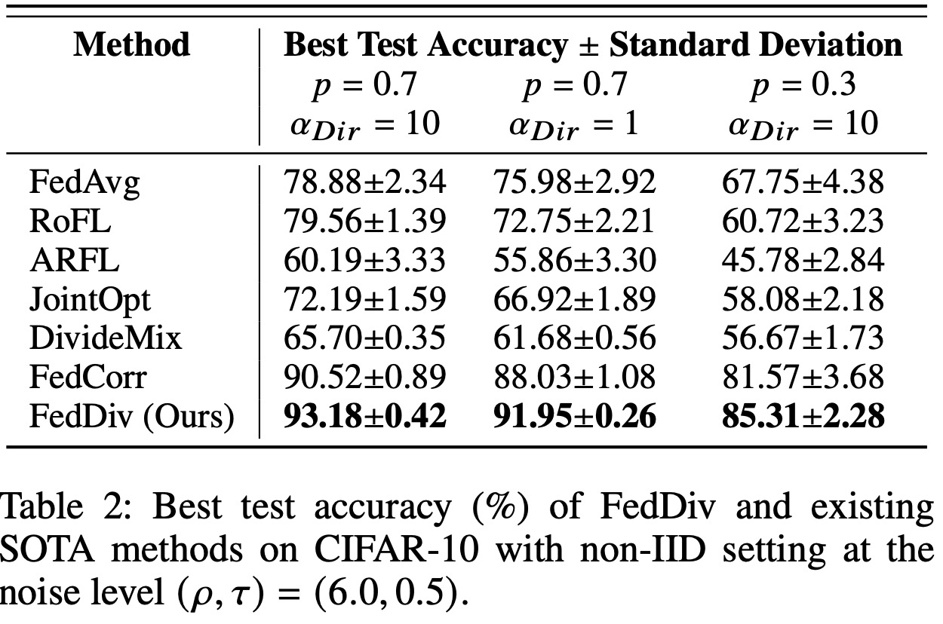
FedDiv
[1] Li J, Li G, Cheng H, et al. FedDiv: Collaborative Noise Filtering for Federated Learning with Noisy Labels[C]//Proceedings of the AAAI Conference on Artificial Intelligence. 2024, 38(4): 3118-3126.

Slide 10
Non-IID
1. Dirichlet distribution
2. Label percentage
3. Classes of Label

Slide 11
FedCorr
1. Noise clients cannot be detected when non-IID is severe
2. Add a detection step in front of FedCorr: entropy of non-IID noise data

Slide 12

Entropy of non-IID Noise Data
1. Collect the occurrence probability of each label in each clients’ data.
2. According to the label of probability to compute entropy.

Slide 13
Entropy of non-IID Noise Data
3. Calculate the entropy of each client’s label
4. Calculate the standard deviation of the entropy of all users' labels.
5. If the standard deviation is greater than 0.1, it is considered that non-IID and label noise currently exist.
6. The client whose label entropy is greater than the average is a noisy user

Slide 14
Entropy of non-IID Noise Data
If the standard deviation is greater than 0.1, it is considered that non-IID and label noise currently exist.
IID without label noise | Non-IID without label noise
IID with label noise | Non-IID with label noise

Slide 15
Entropy of non-IID Noise Data
6. The client whose label entropy is greater than the average is a noisy client
[1] Li J, Socher R, Hoi S C H. Dividemix: Learning with noisy labels as semi-supervised learning[J]. arXiv preprint arXiv:2002.07394, 2020.
[2] Yao Y, Gong M, Du Y, et al. Which is better for learning with noisy labels: the semi-supervised method or modeling label noise?[C]//International conference on machine learning. PMLR, 2023: 39660-39673.

Slide 16
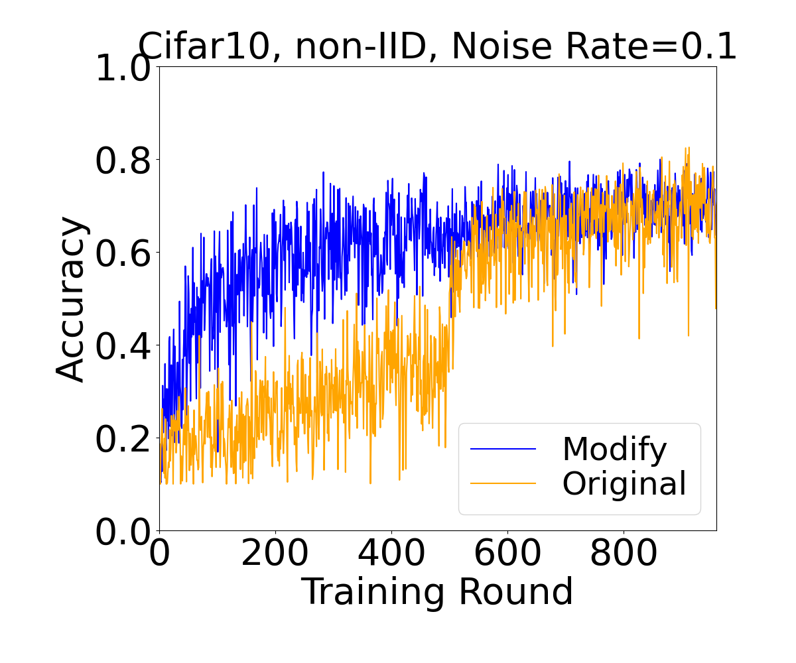
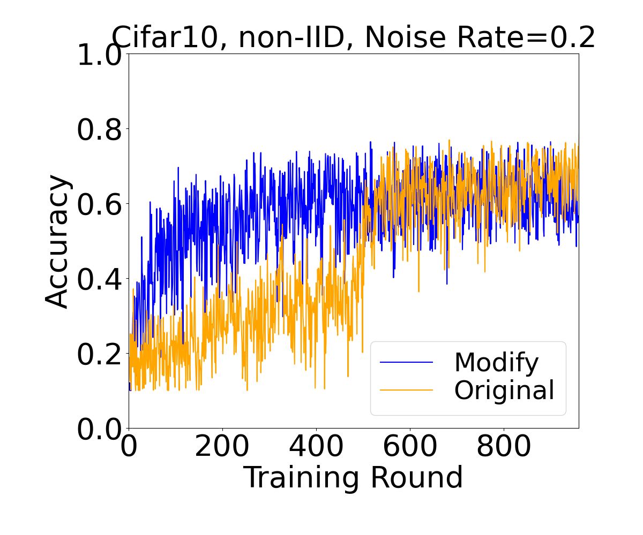
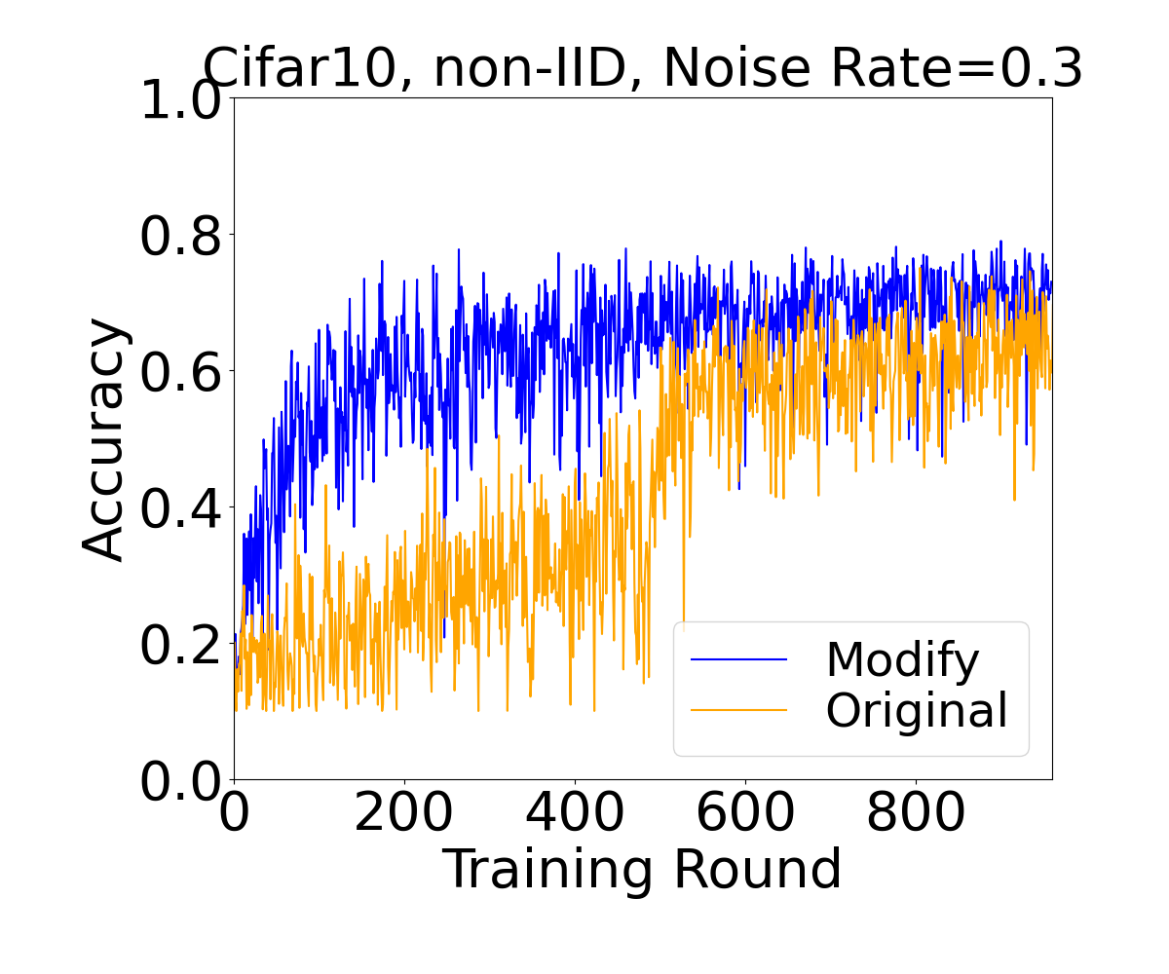
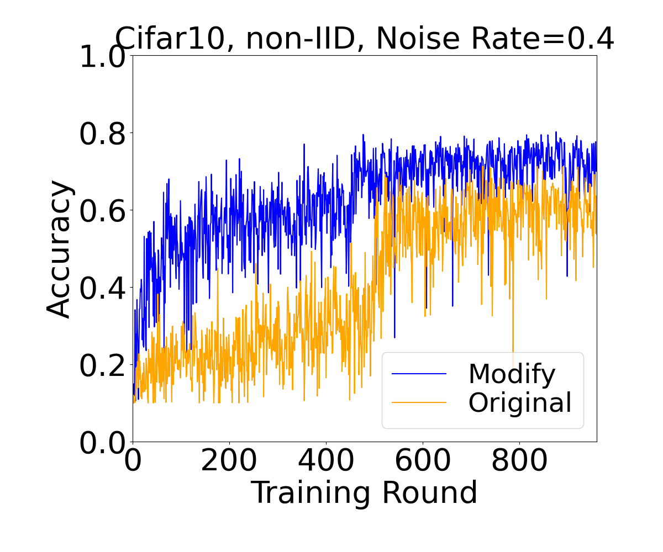
Modified FedCorr

Slide 17
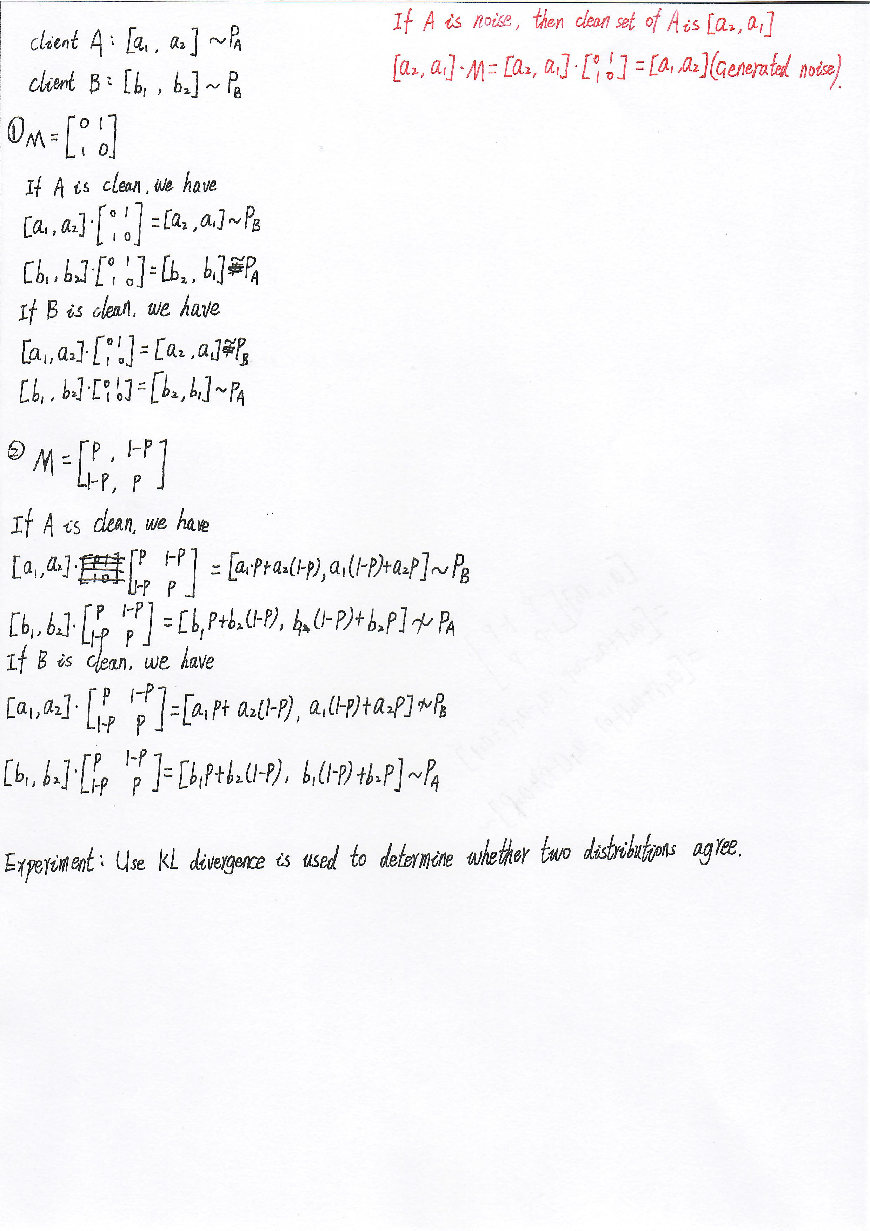
Some Proof

Slide 18
Thank You! Questions are welcome!

