Slide 1

Week Summarry
12332463 Geng Tian
Department of Computer Science and Engineering, Southern University of Science and Technology, Shenzhen, China

Slide 2
Non-IID
1. Dirichlet distribution
2. Label percentage
3. Classes of Label

Slide 3
FedCorr
1. Noise clients cannot be detected when non-IID is severe
2. Add a detection step in front of FedCorr: entropy of non-IID noise data

Slide 4

Entropy of non-IID Noise Data
1. Collect the occurrence probability of each label in each clients’ data.
2. According to the label of probability to compute entropy.

Slide 5
Entropy of non-IID Noise Data
3. Calculate the entropy of each client’s label
4. Calculate the standard deviation of the entropy of all users' labels.
5. If the standard deviation is greater than 0.1, it is considered that non-IID and label noise currently exist.
6. The client whose label entropy is greater than the average is a noisy user

Slide 6
Entropy of non-IID Noise Data
If the standard deviation is greater than 0.1, it is considered that non-IID and label noise currently exist.
IID without label noise | Non-IID without label noise
IID with label noise | Non-IID with label noise

Slide 7
Entropy of non-IID Noise Data
6. The client whose label entropy is greater than the average is a noisy client
[1] Li J, Socher R, Hoi S C H. Dividemix: Learning with noisy labels as semi-supervised learning[J]. arXiv preprint arXiv:2002.07394, 2020.
[2] Yao Y, Gong M, Du Y, et al. Which is better for learning with noisy labels: the semi-supervised method or modeling label noise?[C]//International conference on machine learning. PMLR, 2023: 39660-39673.

Slide 8
Entropy of Different Data
 | Clean | Noisy
Cifar10/MNIST | 0.6 | 1.6
HAM100000 | 1.1 | 1.7
Chest X-ray8 | 1.1 | 1.8

Slide 9
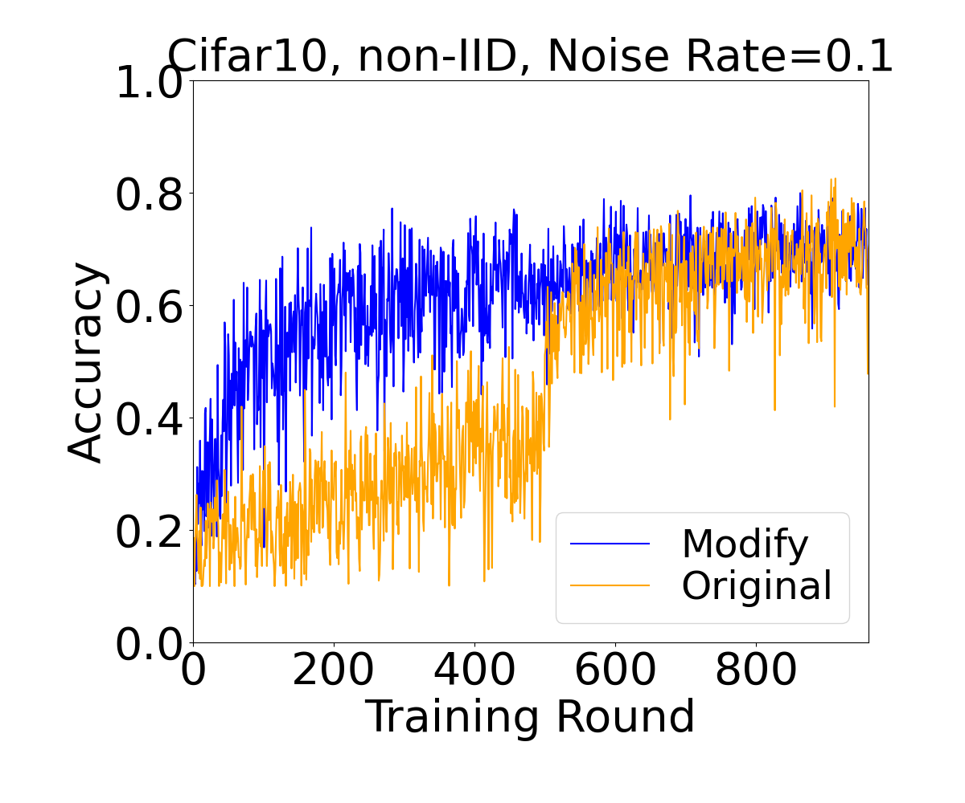
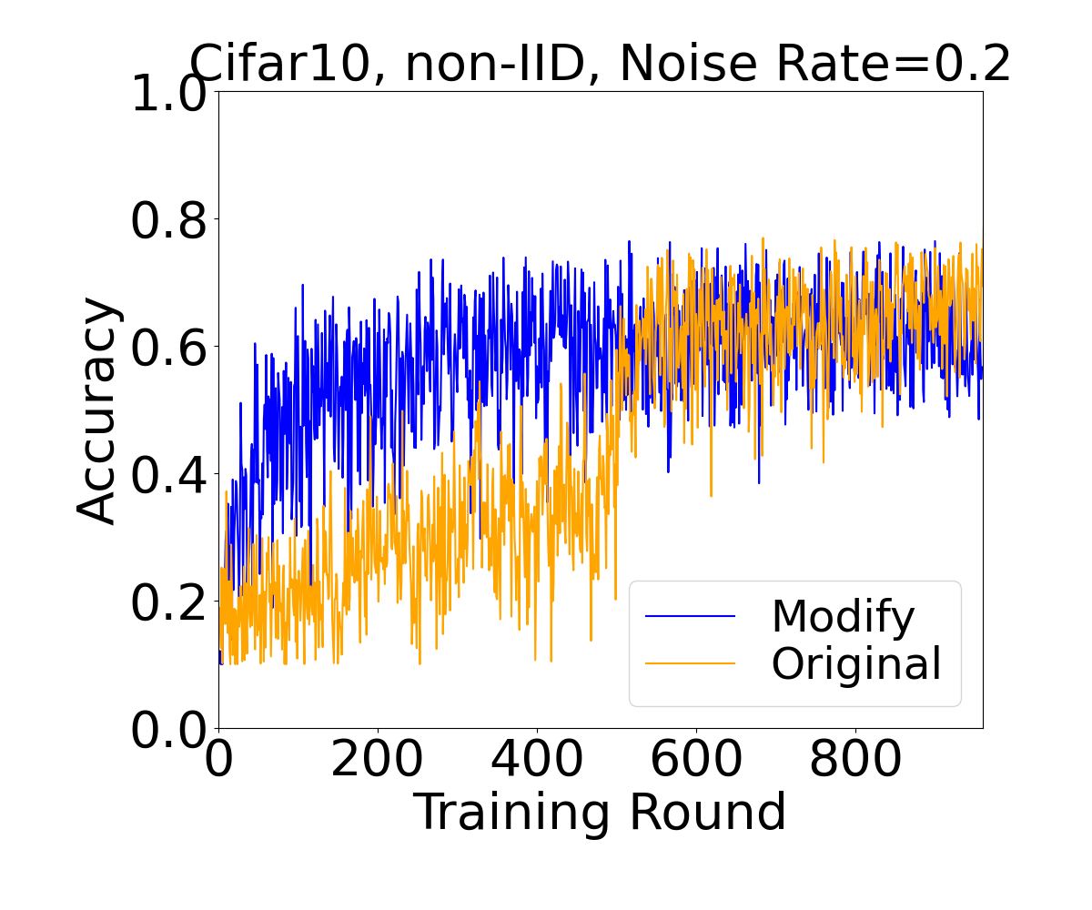
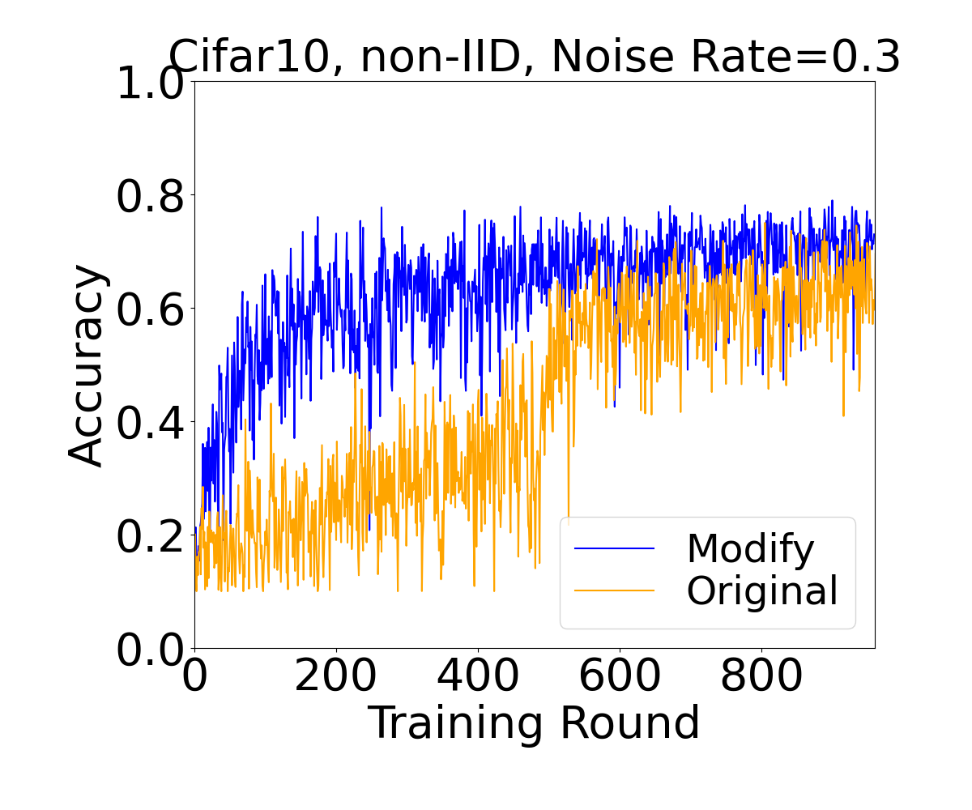
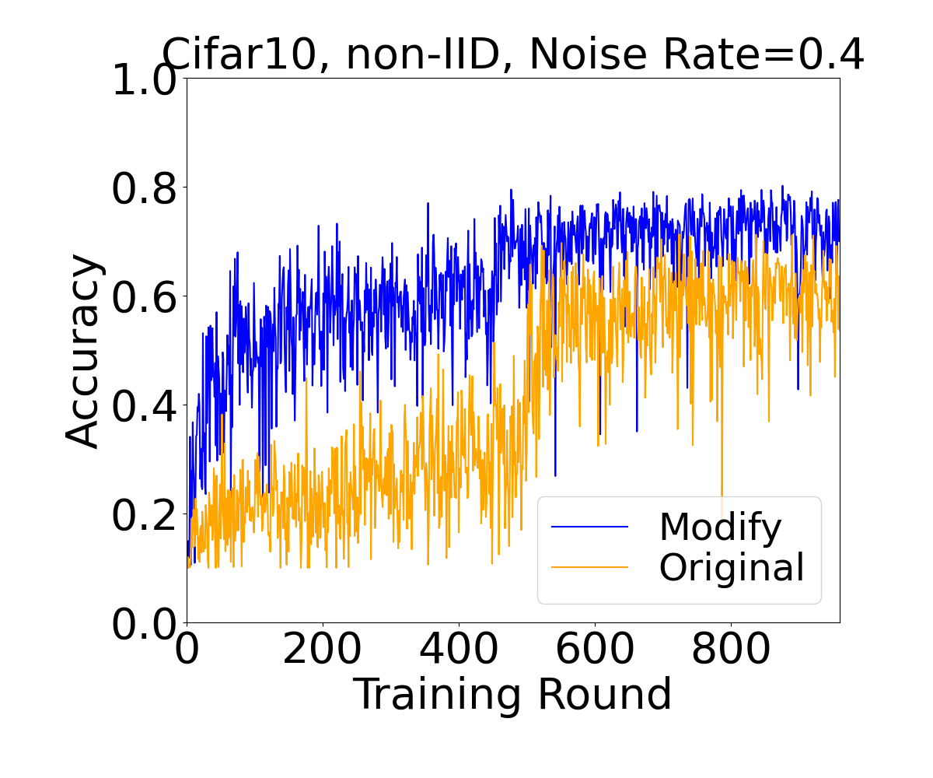
Modified FedCorr

Slide 10
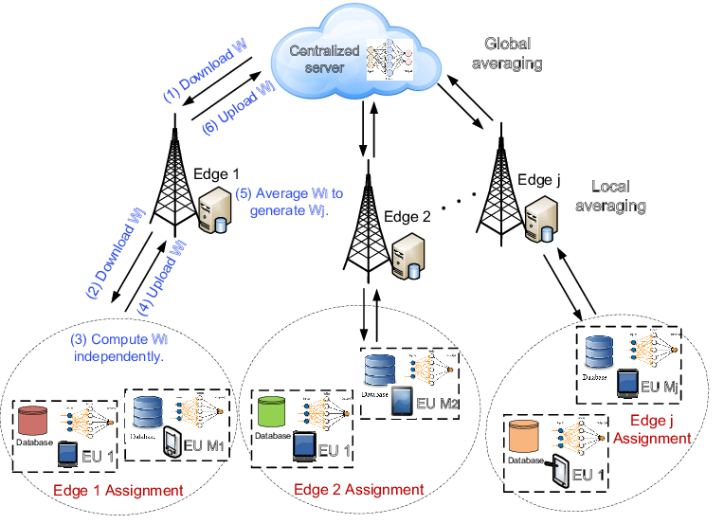
Hierarchical Federated Learning

Slide 11
Thank You! Questions are welcome!

