Slide 1

Week Summarry
12332463 Geng Tian
Department of Computer Science and Engineering, Southern University of Science and Technology, Shenzhen, China

Slide 2
目录
1. SFLCorr+HAM10000
2. How does the number of server models affect SFL
3. Resnet34 on Cifar10
4. Instance dependent label noise
Notes:
我今天会主要从这四个方面阐述我的课题以及我的计划

Slide 3
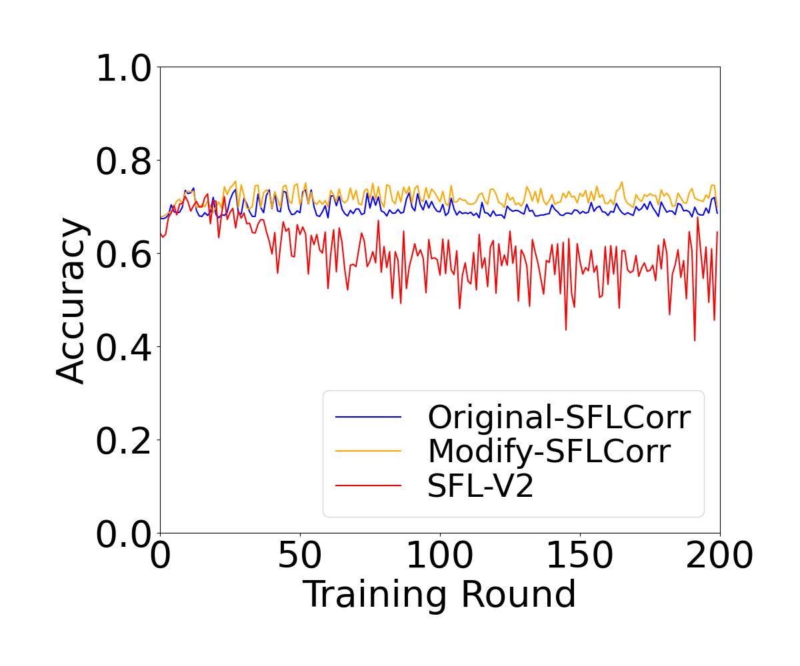
SFLCorr+HAM10000

Slide 4
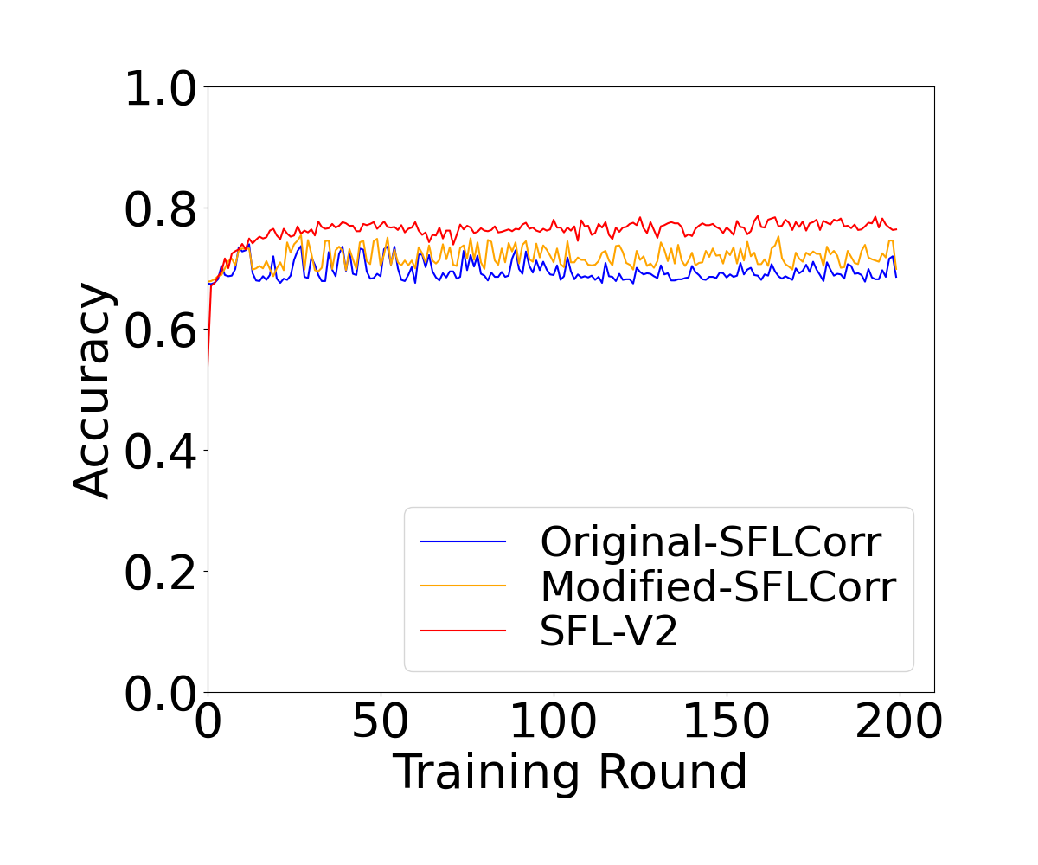
SFLCorr+HAM10000

Slide 5
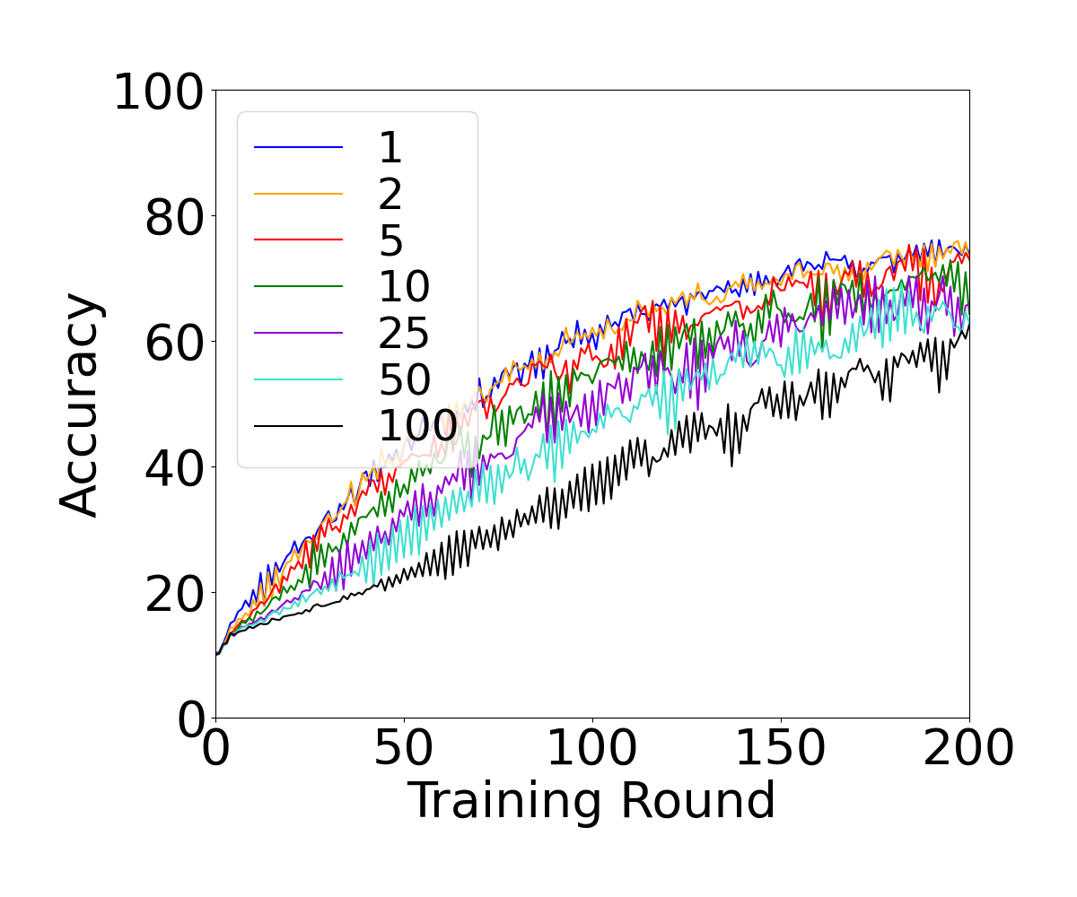
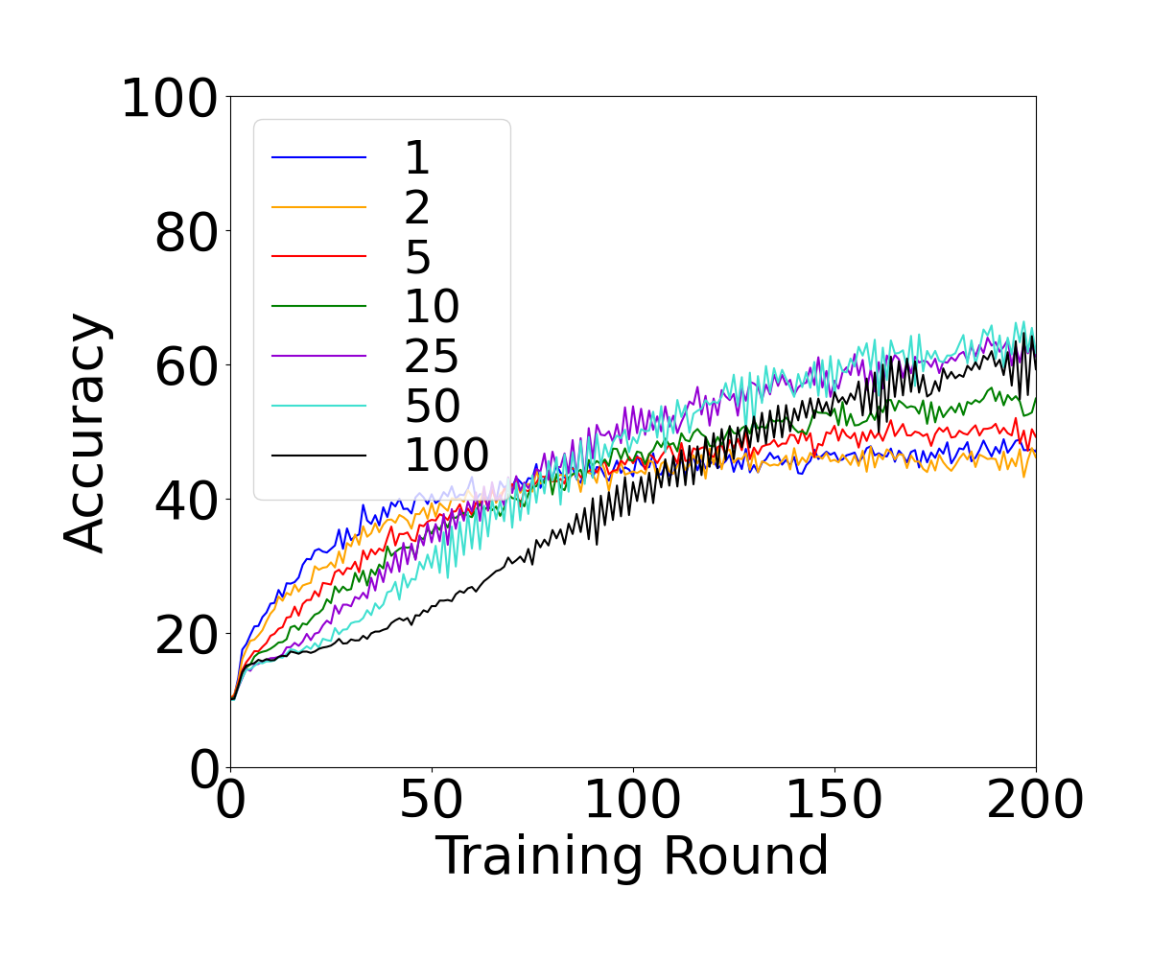
SFL-V1 and SFL-V2
Lc=3
Lc=4

Slide 6
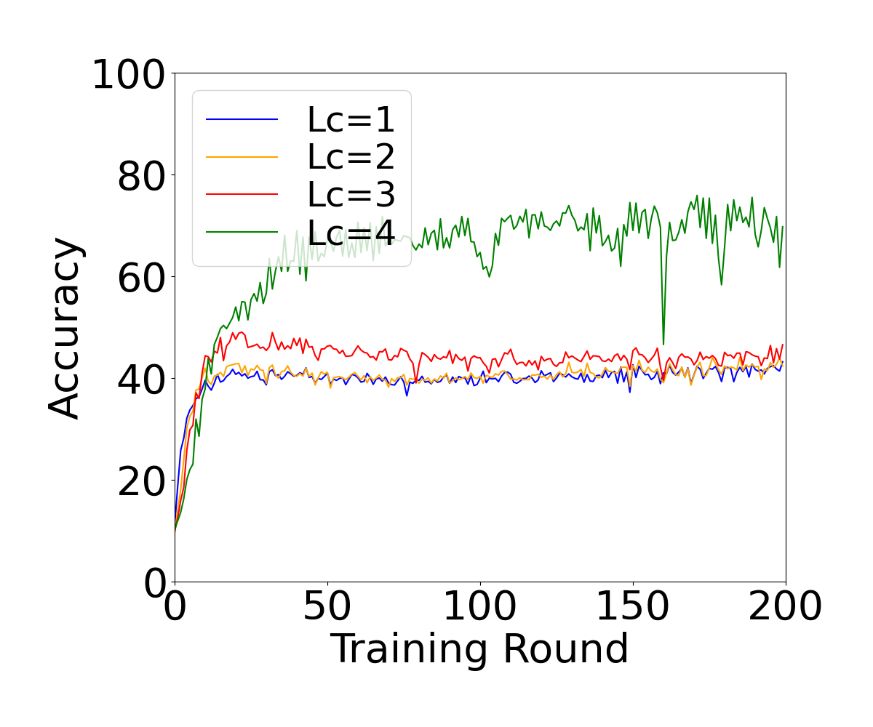
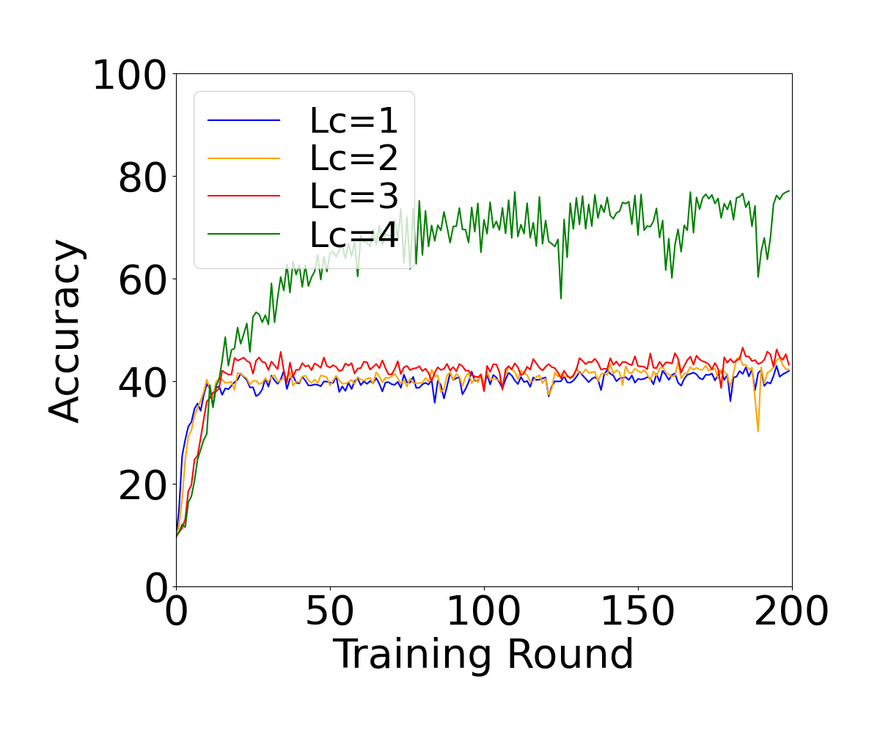
Resnet34 on Cifar10
Resnet18
Resnet34

Slide 7
Instance Dependent
Use Cifar10 dataset
ResNet18
Noise Rate: 12.5%
Alpha of non-IID:0.1
Entropy can be used to identify clients with label noise under extreme non-IID data

Slide 8
Thank You! Questions are welcome!

