Slide 1

Week Summarry
12332463 Geng Tian
Department of Computer Science and Engineering, Southern University of Science and Technology, Shenzhen, China

Slide 2
目录
1. SFL-V1 Cut-layer
2. Result of SFL-V2(ResNet18)
4. Result of SFL-V2(CNN)
3.Proof of Convergence
Notes:
我今天会主要从这四个方面阐述我的课题以及我的计划

Slide 3
SFL-V1 Cut-layer
 | Lc=1 | Lc=2 | Lc=3 | Lc=4 | FL
最佳分层 | 71 | 70 | 69 | 71 | 70
原来的开源代码中使用了错误的准确率计算方式
SFL-V1的准确率不受分层的影响，也证明了SFL-V1与FL等价

Slide 4
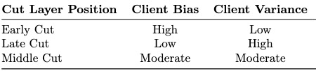
Result of SFL-V2(ResNet18)
 | Lc=1 | Lc=2 | Lc=3 | Lc=4
Client Bias | 19305.5 | 19216.5 | 18850.5 | 17305.5
Client Variance | 18724.3 | 18769.8 | 18640.0 | 15617.3

Slide 5
Result of SFL-V2(CNN)

Slide 6
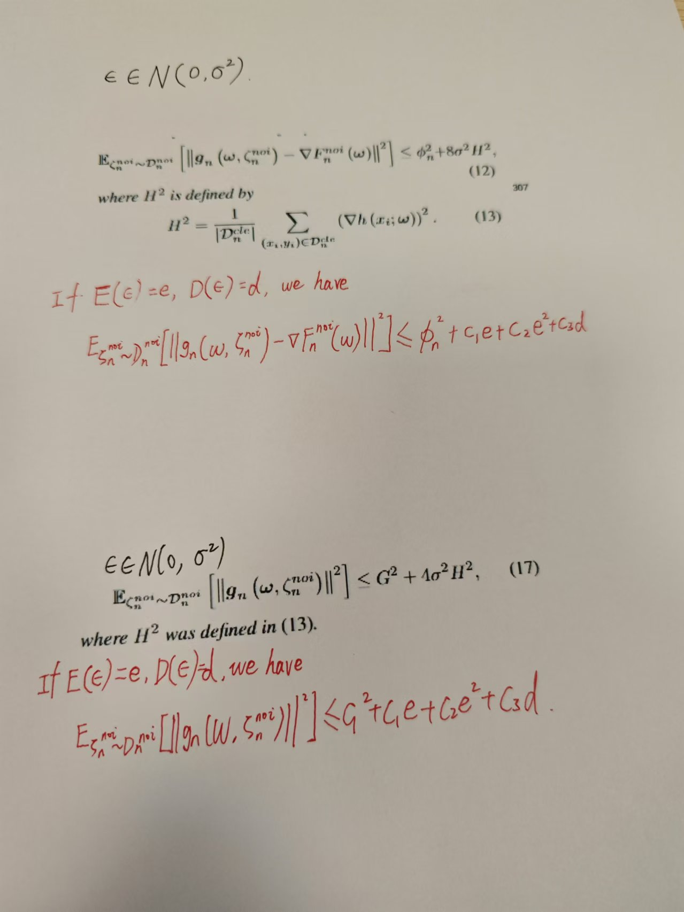
Proof of Convergence

Slide 7
Thank You! Questions are welcome!

