Slide 1

Week Summarry
12332463 Geng Tian
Department of Computer Science and Engineering, Southern University of Science and Technology, Shenzhen, China

Slide 2
目录
1. Result of Cut Layer(ResNet18)
2. Result of Cut Layer(CNN)
Notes:
我今天会主要从这四个方面阐述我的课题以及我的计划

Slide 3
Result of SFL-V2(CNN)

Slide 4
Result of SFL-V2(CNN)
 | Lc1 | Lc2 | Lc3 | Lc4 | Lc5 | Lc6 | Lc7 | Lc8 | Lc9
Bias | 16152 | 16349 | 16408 | 15812 | 15686 | 15974 | 17467 | 18789 | 17984
Variance | 26797 | 27161 | 27058 | 25241 | 25216 | 27484 | 27349 | 38843 | 36558
Between-Client Variance | 0 | 0 | 0 | 0 | 0 | 0 | 0 | 0 | 0
Sequential Update Error | 23098134 | 28914844 | 30353605 | 10869991 | 7828255 | 14627967 | 48247839 | 100944672 | 84780946

Slide 5
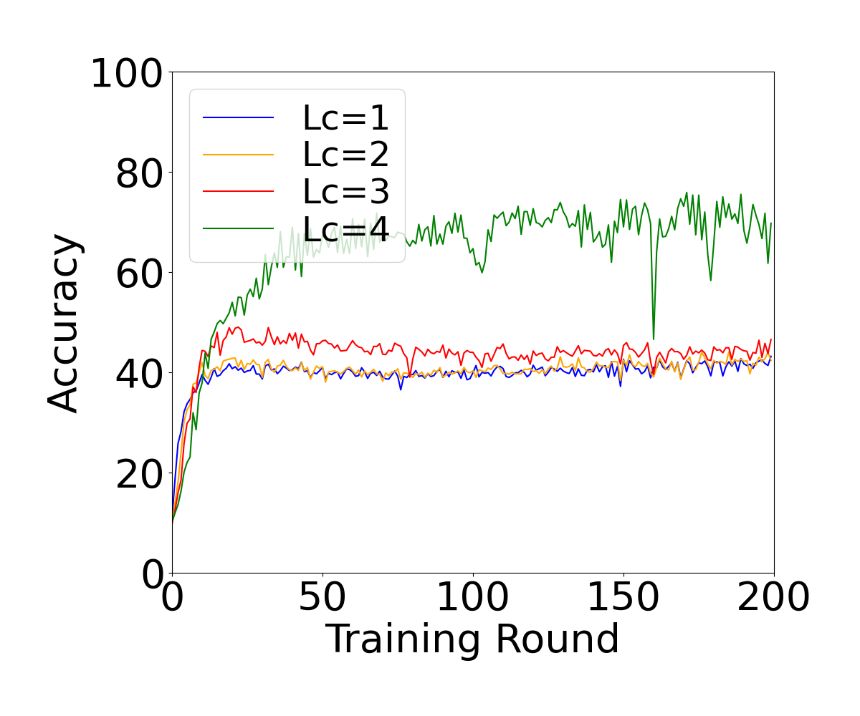
Result of SFL-V2(ResNet18)

Slide 6
Result of SFL-V2(ResNet18)
 | Lc1 | Lc2 | Lc3 | Lc4
Bias | 19305.5 | 19216.5 | 18850.5 | 17305
Variance | 37481 | 37659 | 37150 | 25294
Between-Client Variance | 0 | 0 | 0 | 0
Sequential Update Error | 71882139 | 64731317 | 45293380 | -11885375

Slide 7
Thank You! Questions are welcome!

