Slide 1

Week Summarry
12332463 Geng Tian
Department of Computer Science and Engineering, Southern University of Science and Technology, Shenzhen, China

Slide 2
目录
1. SFL-V1 Cut-layer
2. Result of SFL-V2
3.Calculation Methods
Notes:
我今天会主要从这四个方面阐述我的课题以及我的计划

Slide 3
SFL-V1 Cut-layer
 | Lc=1 | Lc=2 | Lc=3 | Lc=4
最佳分层 | 71 | 70 | 69 | 71
原来的开源代码中使用了错误的准确率计算方式
SFL-V1的准确率不受分层的影响，也证明了SFL-V1与FL等价

Slide 4
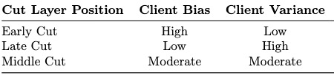
Result of SFL-V2
 | Lc=1 | Lc=2 | Lc=3 | Lc=4
Client Bias | 14474 | 11564 | 7512 | -7155
Client Variance | 86036.5 | 87781.5 | 83391.25 | 17576.5

Slide 5
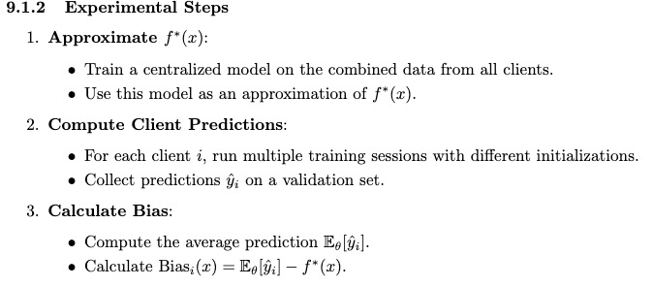
Calculation Methods

Slide 6
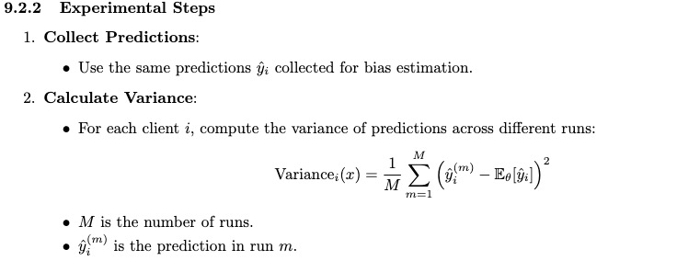
Calculation Methods

Slide 7
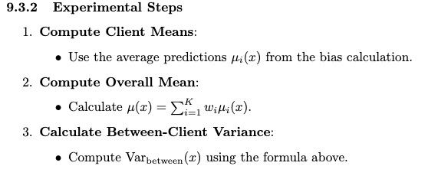
Calculation Methods

Slide 8
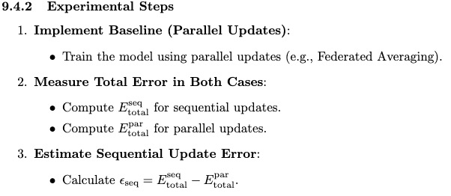
Calculation Methods

Slide 9
Thank You! Questions are welcome!

