Slide 1

Week Summarry
12332463 Geng Tian
Department of Computer Science and Engineering, Southern University of Science and Technology, Shenzhen, China

Slide 2
目录
1. 已经完成的任务
2. 尚未完成的任务
3. 论文的总体框架
Notes:
我今天会主要从这四个方面阐述我的课题以及我的计划

Slide 3
Proof of Convergence
1. MSE
2. Cross-Entropy
3. ...

Slide 4
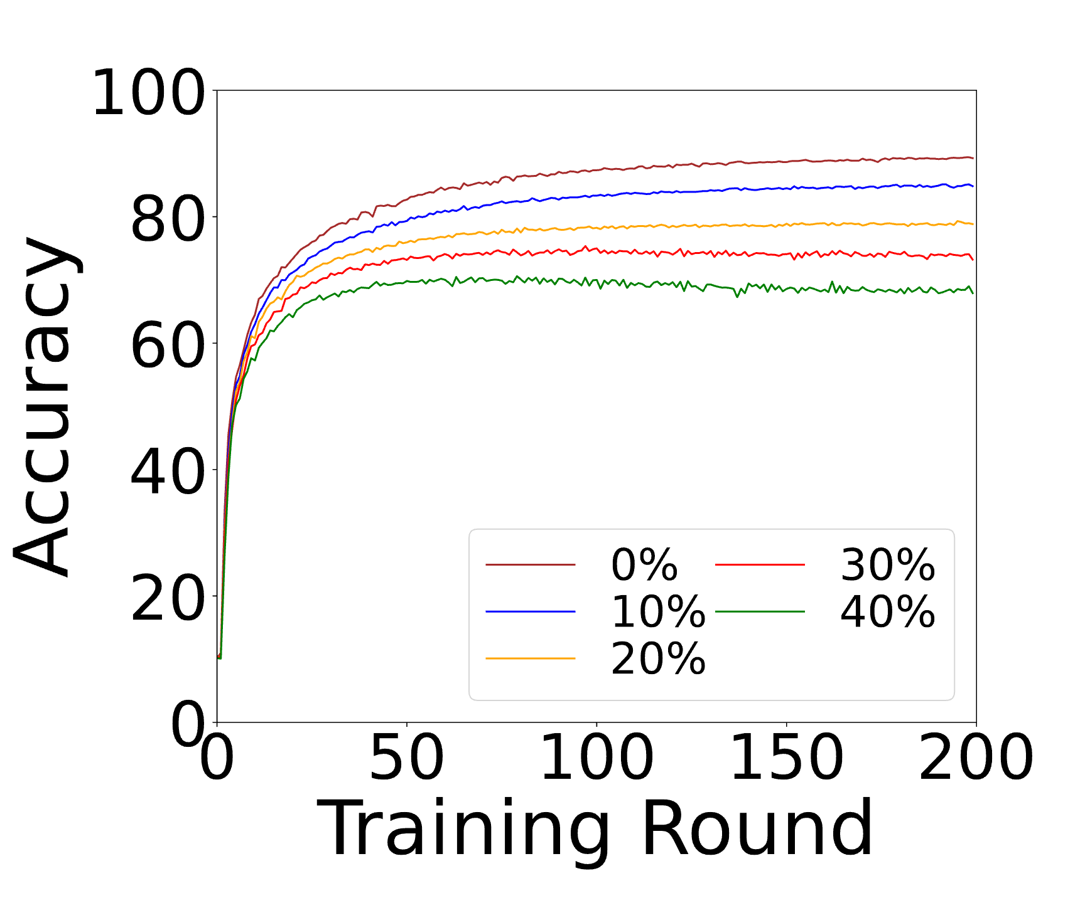
Experiments Relating to Proof
Cross-Entropy

Slide 5
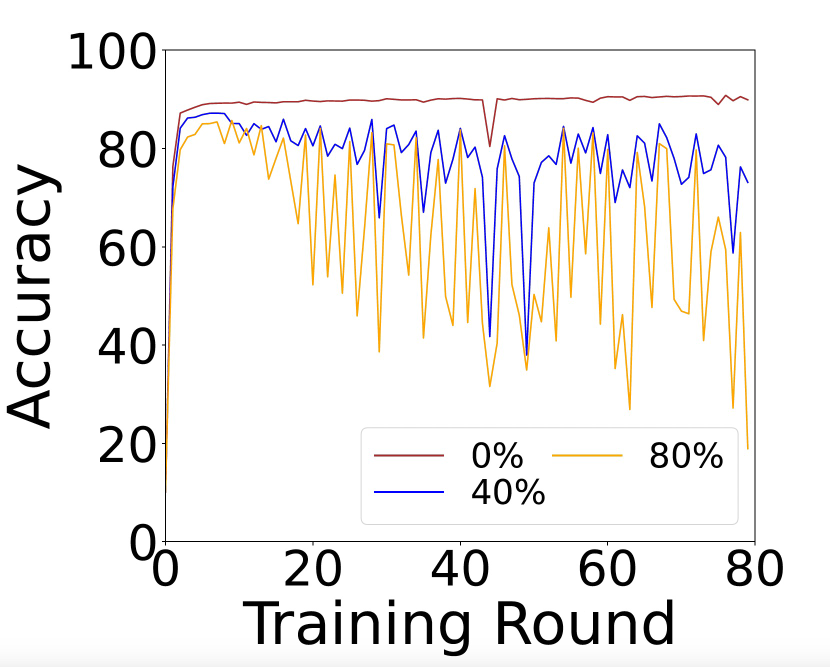
Experiments Relating to Proof
MSE

Slide 6
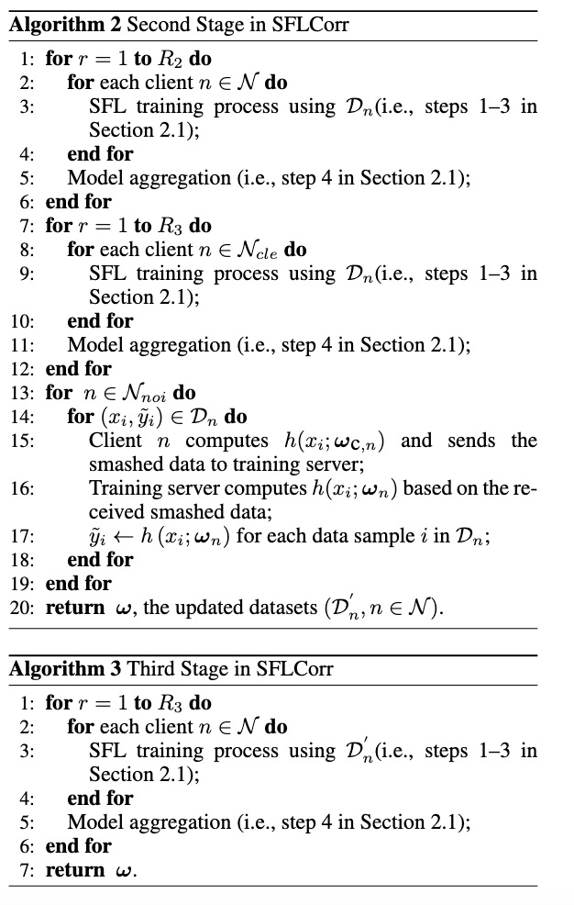
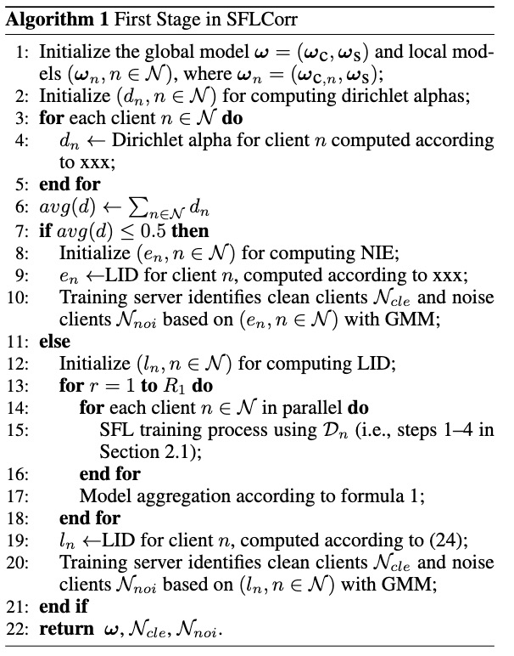
New Version of SFLCorr

Slide 7
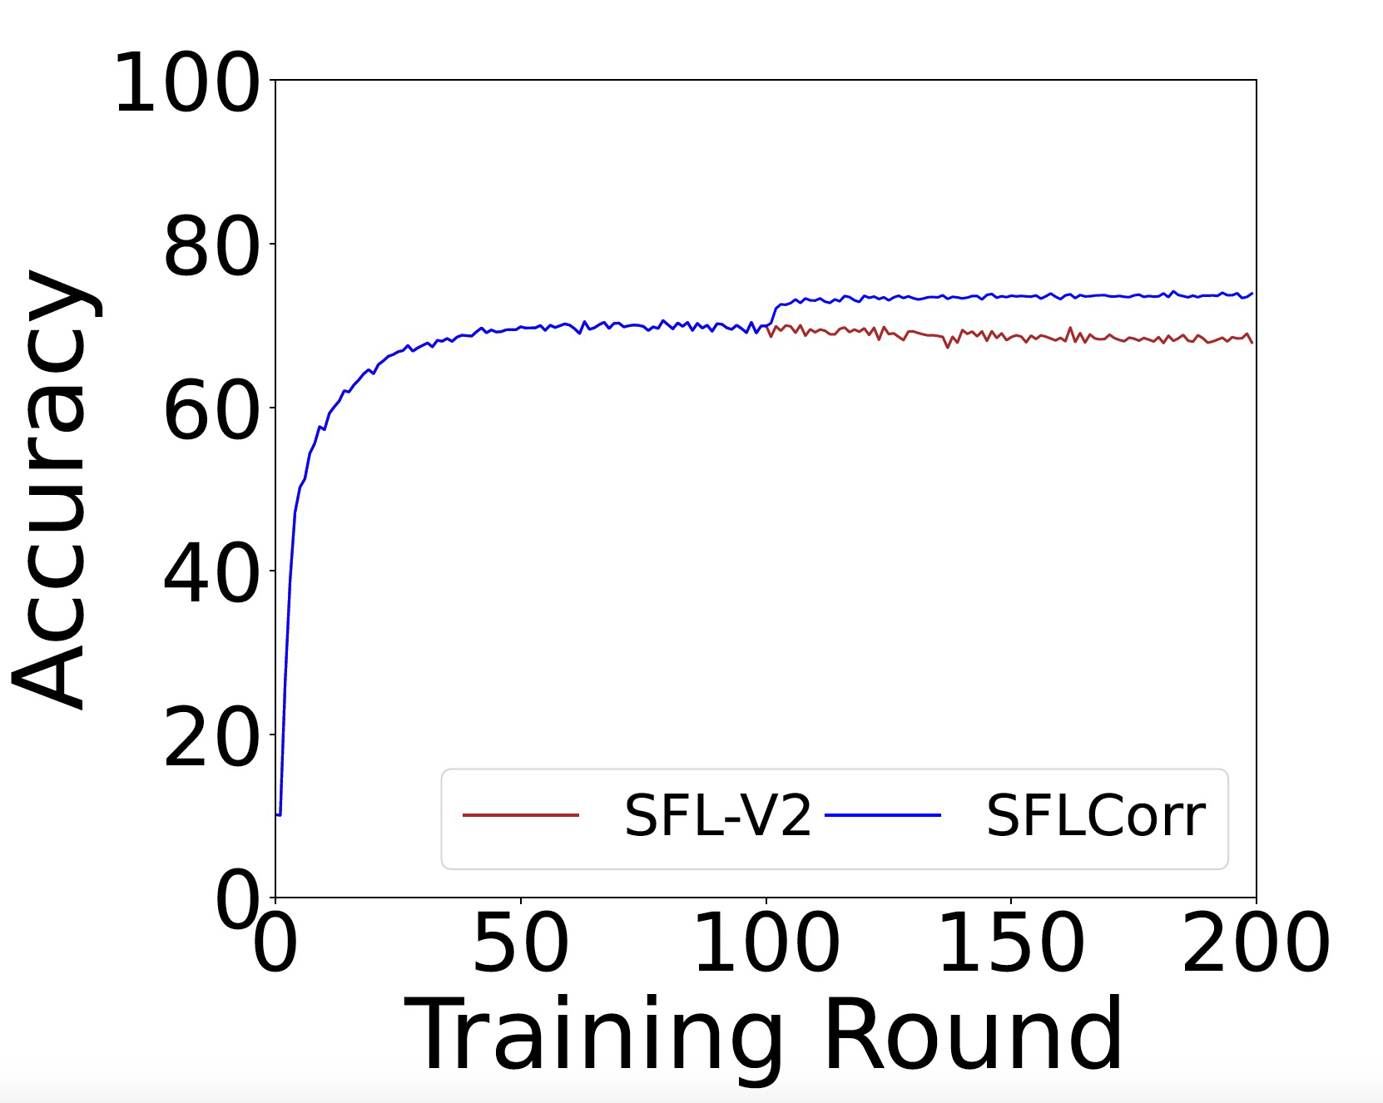
New Version of SFLCorr

Slide 8
Unfinished Business
1. 树莓派上证明SFL优于FL
2. 大规模的实验
3. 与其他论文的对比
4. 论文写作

Slide 9
Thank You! Questions are welcome!

