Slide 1


Summary of the Week

Slide 2
Content
Some questions about the papers
Some results of SplitFed under data noise

Slide 3
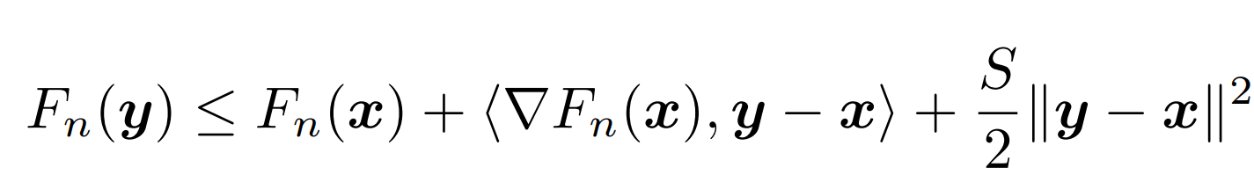
S-smooth
||∇f(x)−∇f(y)||≤L||x−y||

Slide 4
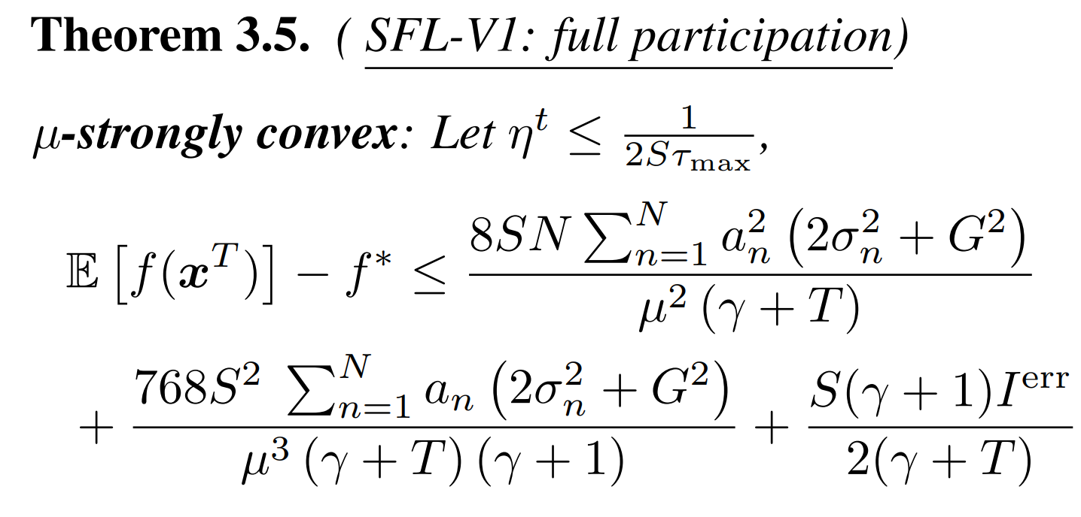
Meaning of proof

Slide 5
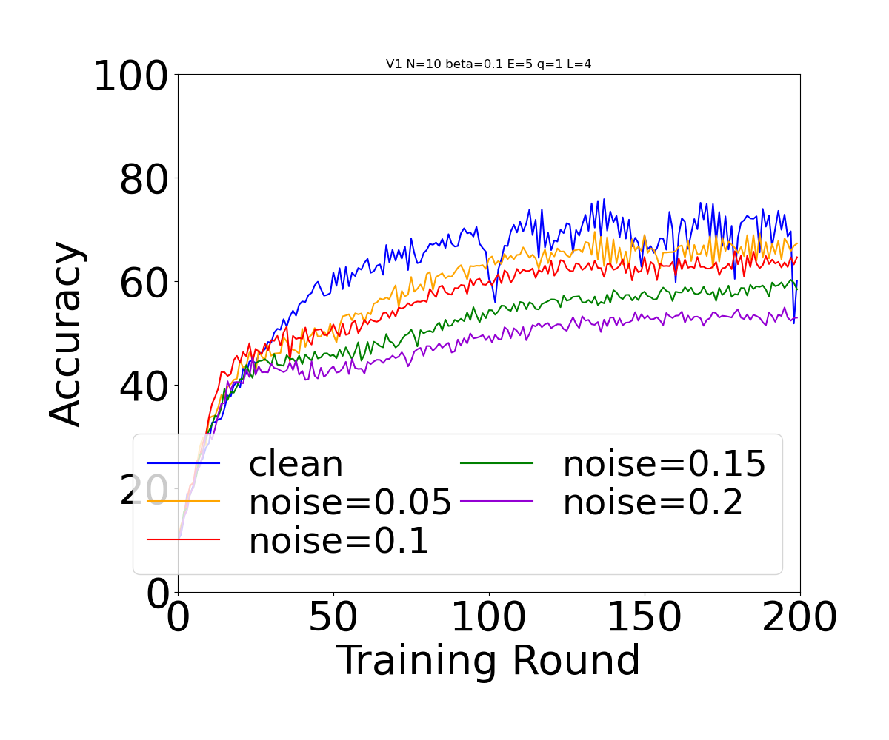
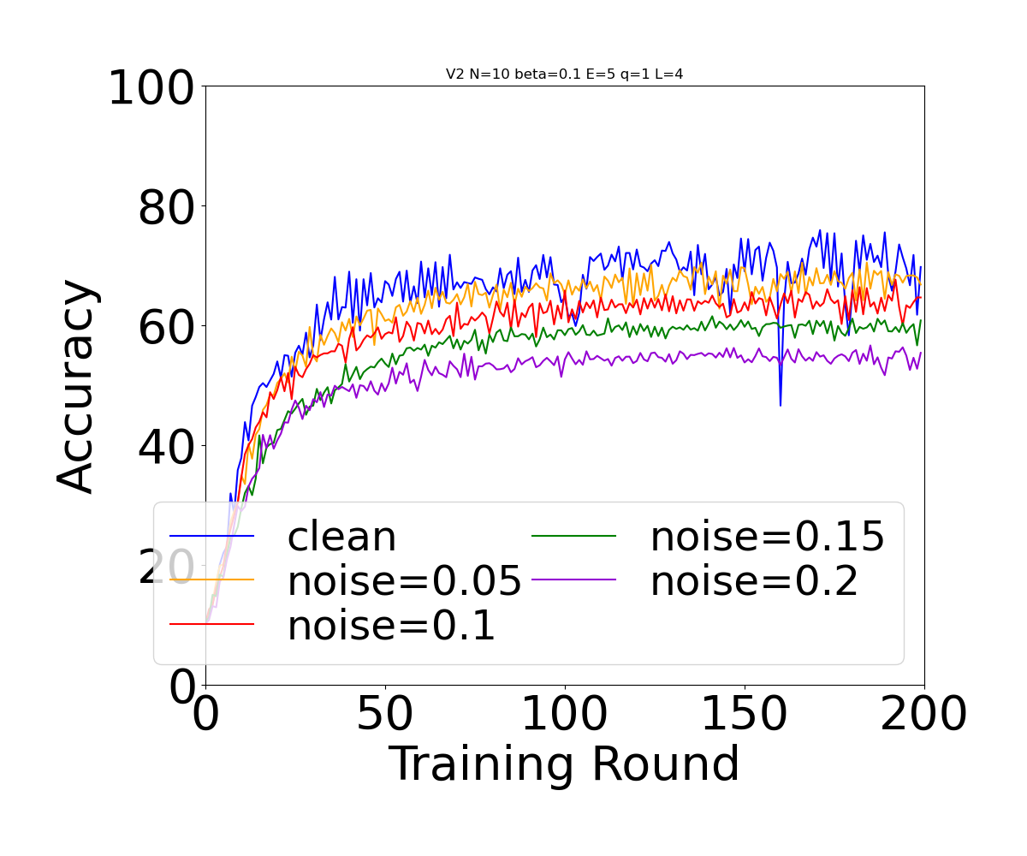
Noise in SplitFed

Slide 6

THANK YOU

