Slide 1



Summery of the Week

Slide 2
Content
Test result
The problem with this idea
Advantages of Minibatch-SFL displayed under this method

Slide 3
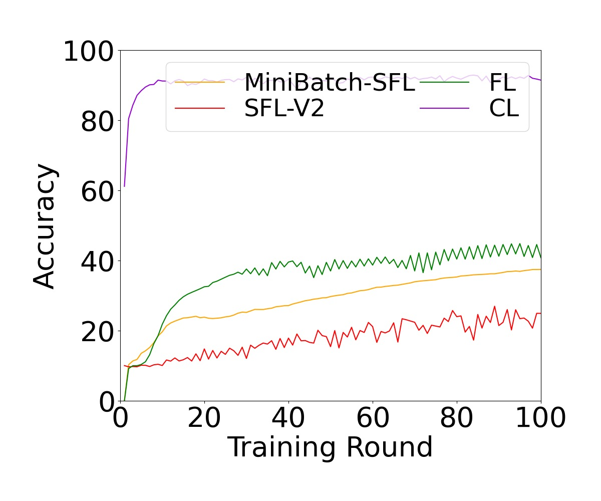
Test result
Non-IID=0.9

Slide 4
The problem with this idea
Minibatch too large training method is not common, easy to be attacked by reviewers
The GPU cannot hold too large minibatch, resulting in low practicality

Slide 5
Advantages of minibatch
The accuracy curve is smoother
Accuracy is higher than SFL

Slide 6
THANK YOU

