Slide 1



Summery of the Week

Slide 2
Content
Code accuracy verification
New model algorithm

Slide 3
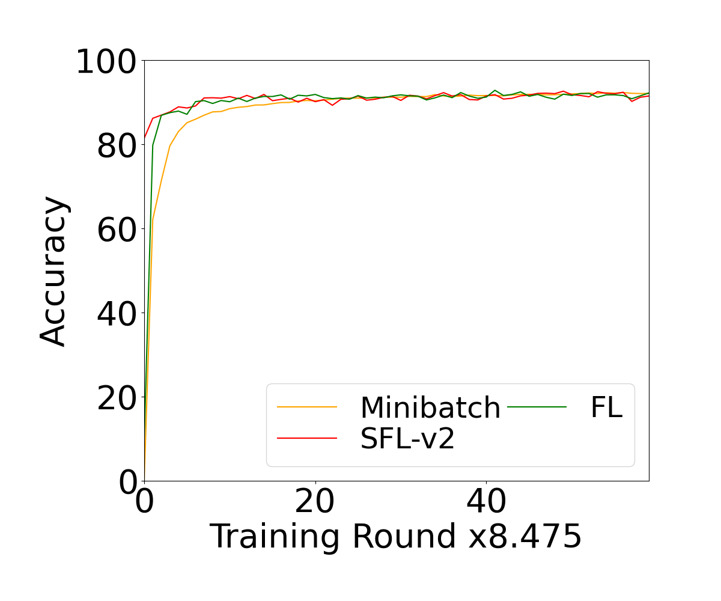
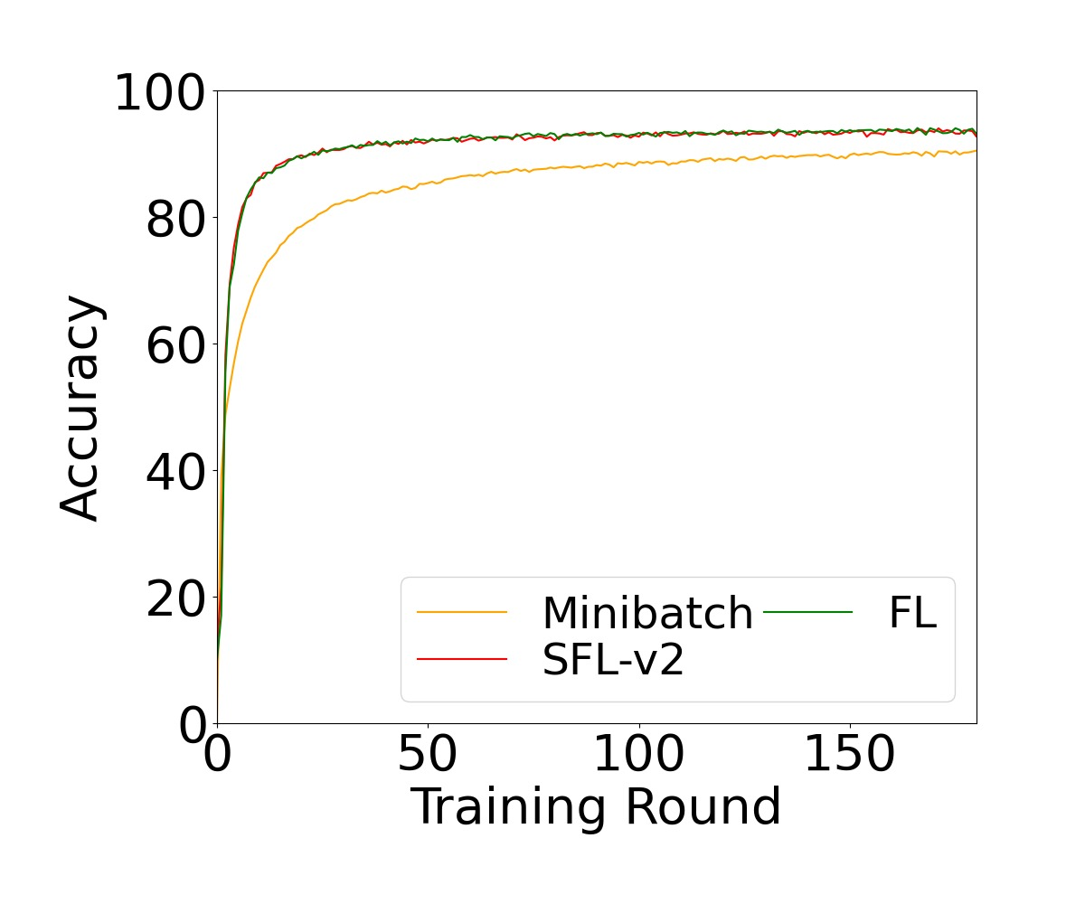
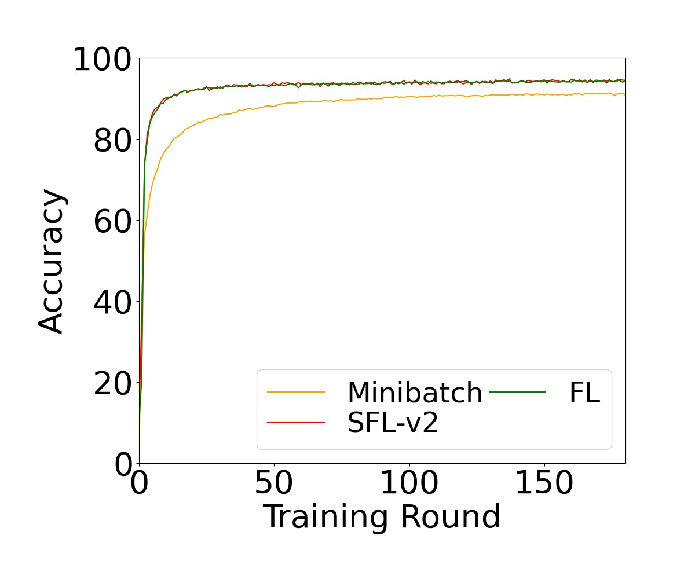
Code accuracy verification

Slide 4
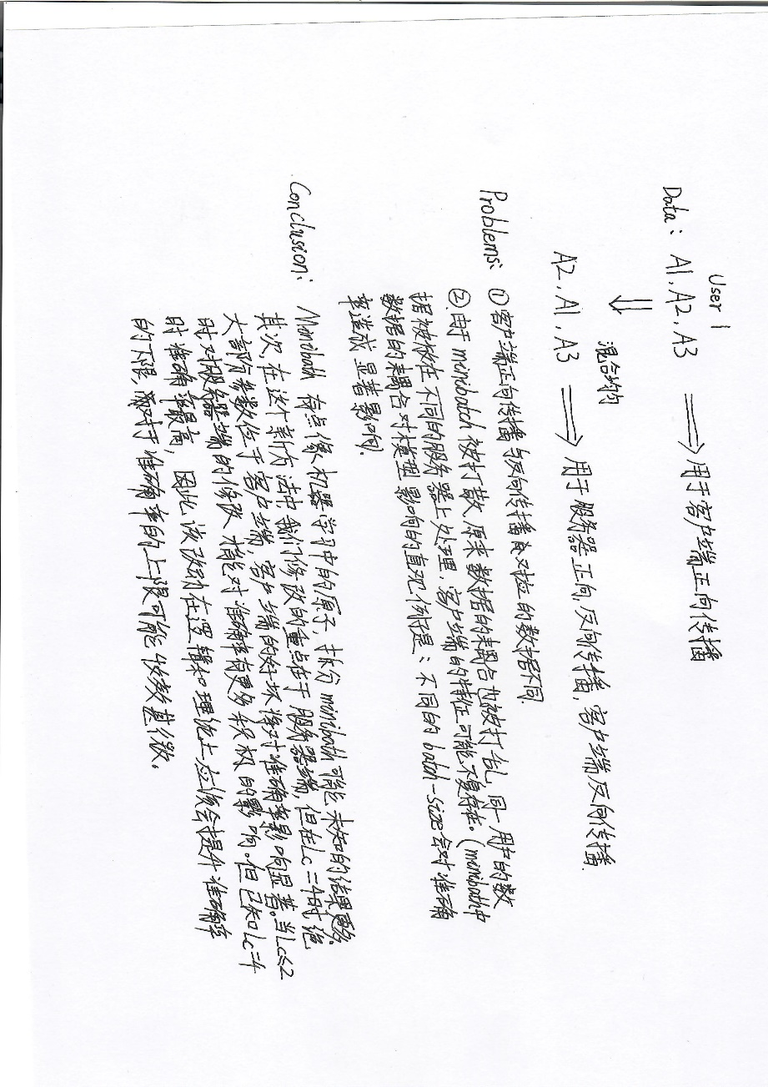
New model algorithm

Slide 5
THANK YOU

