Slide 1

Week Summarry
12332463 Geng Tian
Department of Computer Science and Engineering, Southern University of Science and Technology, Shenzhen, China

Slide 2
SFL-V1 and FL

Slide 3
SFL-V1 and FL
1. The optimizer status differences
2. Numerical precision error
3. Back propagation chain rules are different

Slide 4
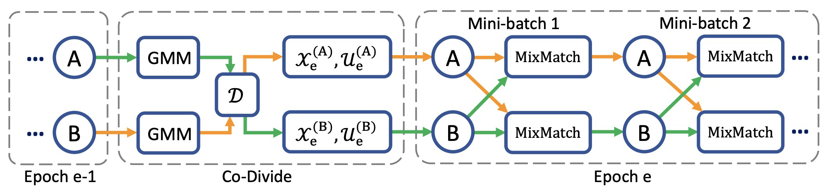
Semi-supervised Learning
Semi-supervised learning is a method of model training using a small amount of labeled data and a large amount of unlabeled data
[1] Li J, Socher R, Hoi S C H. Dividemix: Learning with noisy labels as semi-supervised learning[J]. arXiv preprint arXiv:2002.07394, 2020.
[2] Yao Y, Gong M, Du Y, et al. Which is better for learning with noisy labels: the semi-supervised method or modeling label noise?[C]//International conference on machine learning. PMLR, 2023: 39660-39673.

Slide 5
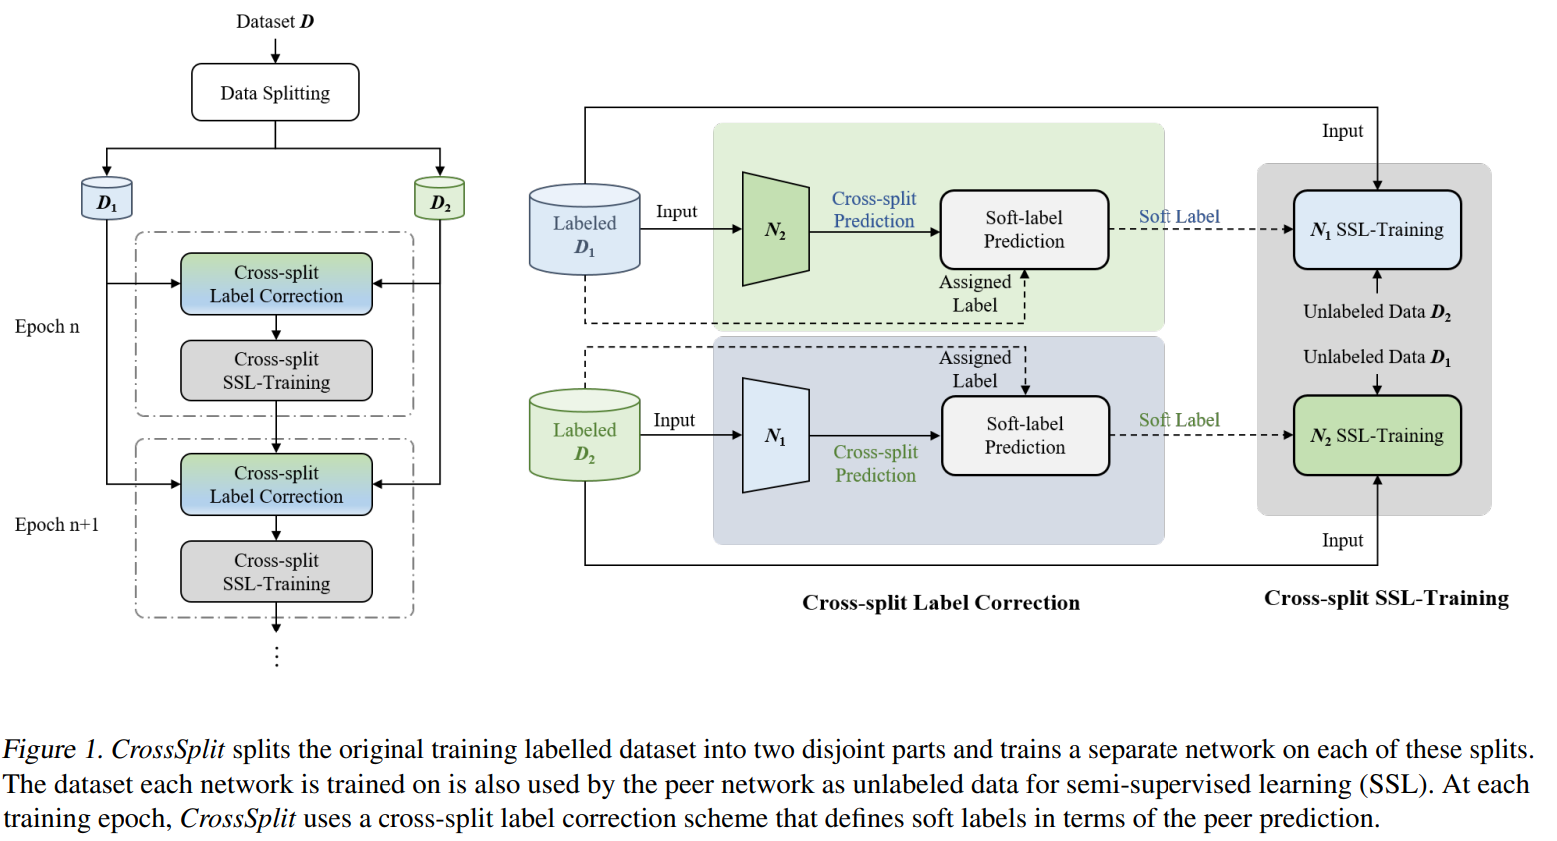
Self-Distillation & Soft Labels
This method reduces the influence of label noise by generating soft labels
[1] Das R, Sanghavi S. Understanding self-distillation in the presence of label noise[C]//International Conference on Machine Learning. PMLR, 2023: 7102-7140.
[2] Kim J, Baratin A, Zhang Y, et al. CrossSplit: mitigating label noise memorization through data splitting[C]//International Conference on Machine Learning. PMLR, 2023: 16377-16392.
[3] Nguyen Q, Valizadegan H, Hauskrecht M. Learning classification models with soft-label information[J]. Journal of the American Medical Informatics Association, 2014, 21(3): 501-508.

Slide 6
Pseudo Labels

Slide 7
Pseudo Labels

Slide 8
Pseudo Labels
1. Assumption: all clients have label noise or only some clients have label noise
2. Difficulty: non - IID data noise may be mistaken for a label
3. Innovation: through prediction confidence to decide whether correcting a label

Slide 9
More ideas
1. How about the idea of this algorithm
2. How to analyze the algorithm mathematically
3. What else should be added

Slide 10
Thank You! Questions are welcome!

