Slide 1

Week Summarry
12332463 Geng Tian
Department of Computer Science and Engineering, Southern University of Science and Technology, Shenzhen, China

Slide 2
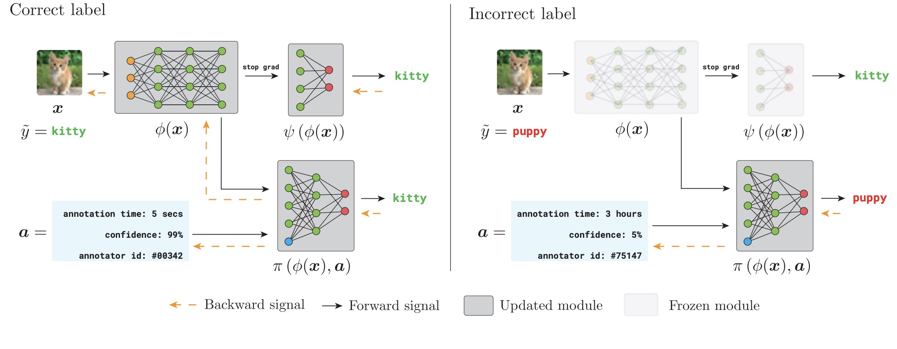
Privileged Information
[1] Das R, Sanghavi S. Understanding self-distillation in the presence of label noise[C]//International Conference on Machine Learning. PMLR, 2023: 7102-7140.
[2] Collier M, Jenatton R, Kokiopoulou E, et al. Transfer and marginalize: Explaining away label noise with privileged information[C]//International Conference on Machine Learning. PMLR, 2022: 4219-4237.

Slide 3
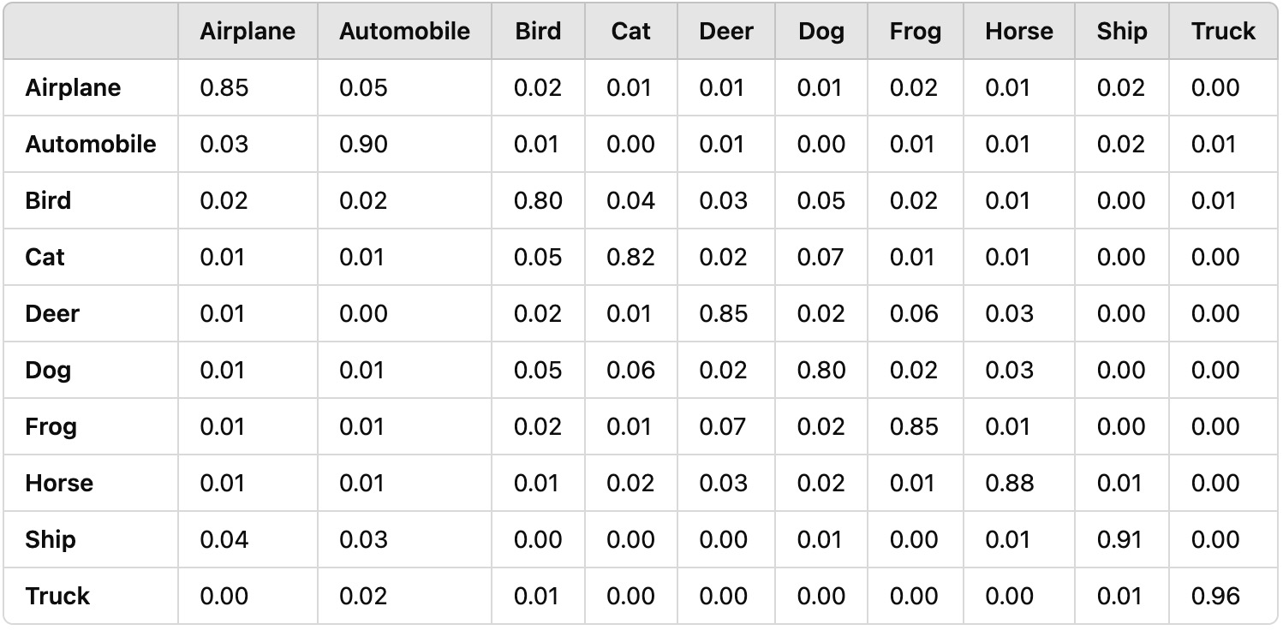
Privileged Information
[1] Liu Y, Cheng H, Zhang K. Identifiability of label noise transition matrix[C]//International Conference on Machine Learning. PMLR, 2023: 21475-21496.
[2] Yao Y, Liu T, Han B, et al. Dual t: Reducing estimation error for transition matrix in label-noise learning[J]. Advances in neural information processing systems, 2020, 33: 7260-7271.
[3] Zhu Z, Wang J, Liu Y. Beyond images: Label noise transition matrix estimation for tasks with lower-quality features[C]//International Conference on Machine Learning. PMLR, 2022: 27633-27653.

Slide 4
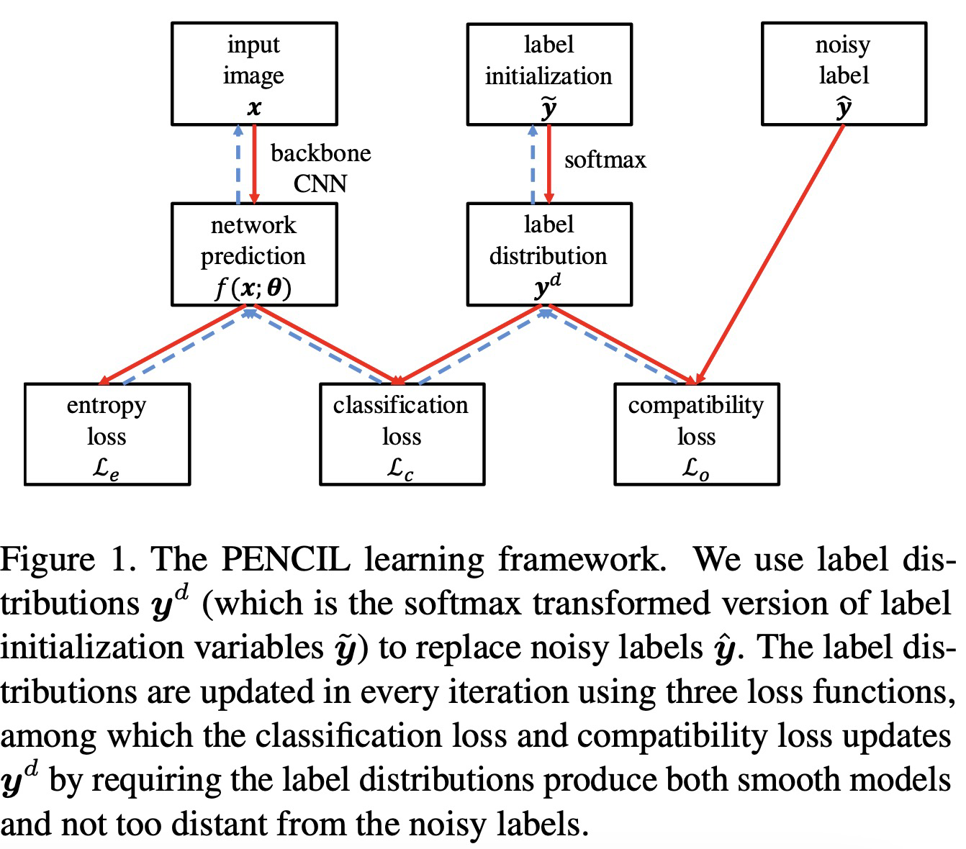
Modeling Label Noise
[1] Yi K, Wu J. Probabilistic end-to-end noise correction for learning with noisy labels[C]//Proceedings of the IEEE/CVF conference on computer vision and pattern recognition. 2019: 7017-7025.
[2] Yao Y, Gong M, Du Y, et al. Which is better for learning with noisy labels: the semi-supervised method or modeling label noise?[C]//International conference on machine learning. PMLR, 2023: 39660-39673.

Slide 5
Modeling Label Noise
1. Identify the sparsity of label noise
2. Introduce sparse over-parameterized items
3. Use implicit algorithm to regularize
4. Separation of noise and data
[1] Liu S, Zhu Z, Qu Q, et al. Robust training under label noise by over-parameterization[C]//International Conference on Machine Learning. PMLR, 2022: 14153-14172.

Slide 6
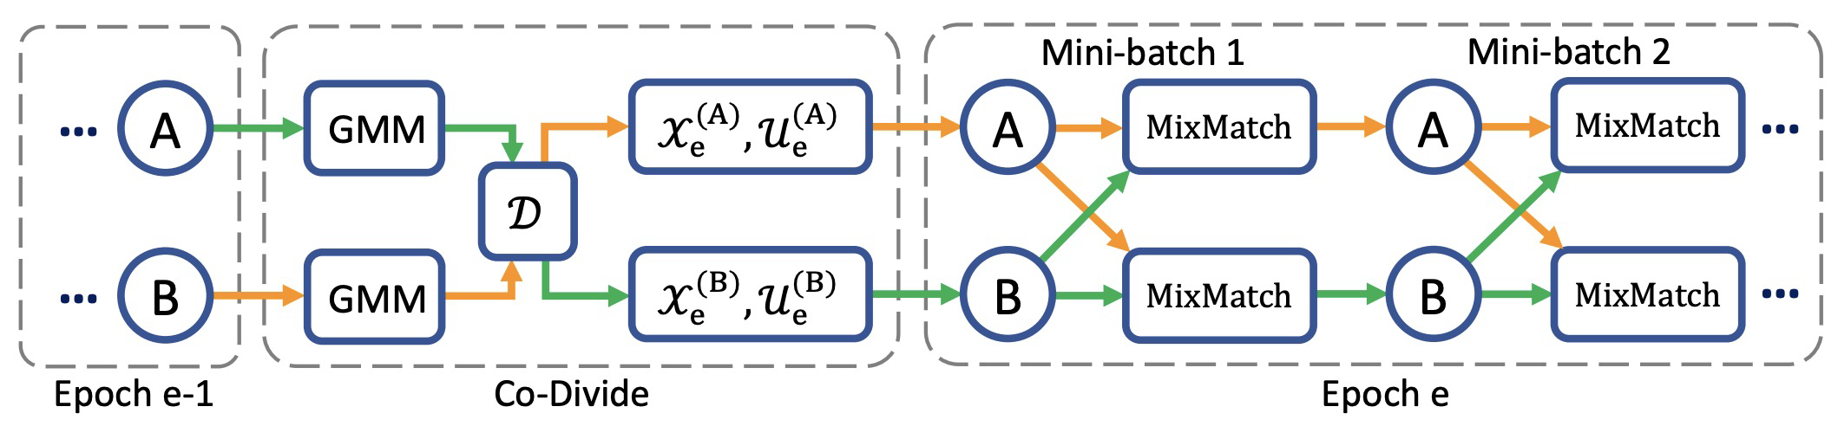
Semi-supervised Learning
Semi-supervised learning is a method of model training using a small amount of labeled data and a large amount of unlabeled data
[1] Li J, Socher R, Hoi S C H. Dividemix: Learning with noisy labels as semi-supervised learning[J]. arXiv preprint arXiv:2002.07394, 2020.
[2] Yao Y, Gong M, Du Y, et al. Which is better for learning with noisy labels: the semi-supervised method or modeling label noise?[C]//International conference on machine learning. PMLR, 2023: 39660-39673.

Slide 7
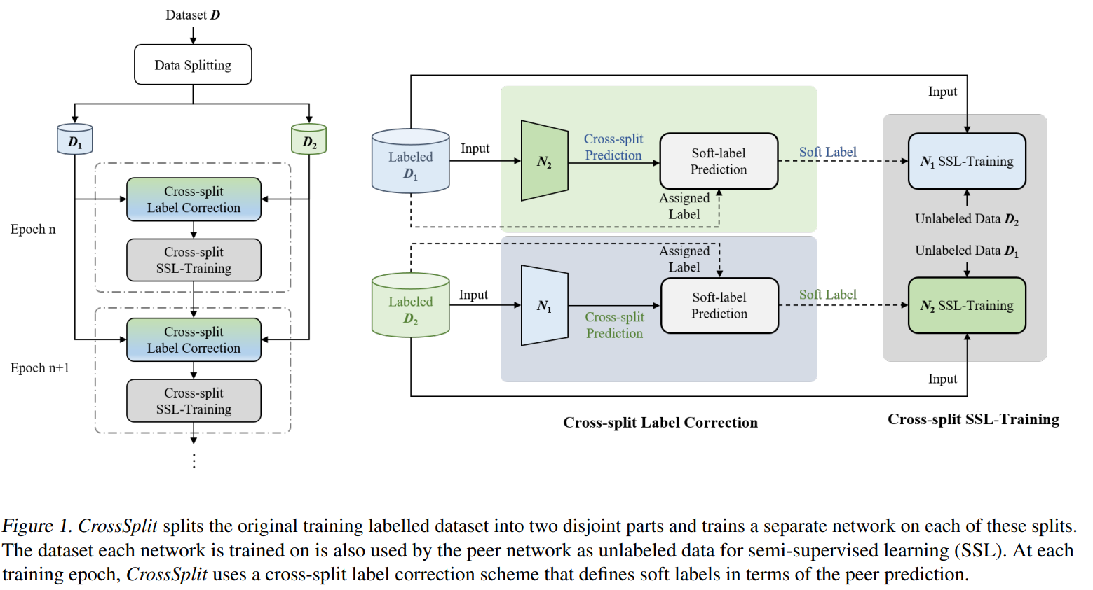
Self-Distillation & Soft Labels
This method reduces the influence of label noise by generating soft labels
[1] Das R, Sanghavi S. Understanding self-distillation in the presence of label noise[C]//International Conference on Machine Learning. PMLR, 2023: 7102-7140.
[2] Kim J, Baratin A, Zhang Y, et al. CrossSplit: mitigating label noise memorization through data splitting[C]//International Conference on Machine Learning. PMLR, 2023: 16377-16392.
[3] Nguyen Q, Valizadegan H, Hauskrecht M. Learning classification models with soft-label information[J]. Journal of the American Medical Informatics Association, 2014, 21(3): 501-508.

Slide 8
Thank You! Questions are welcome!

